Slide 1
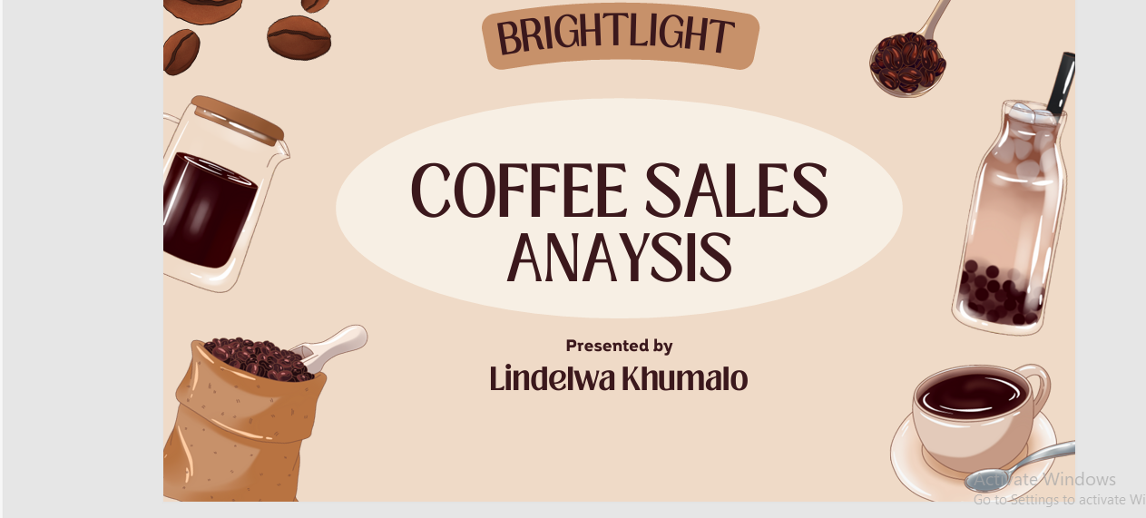

Slide 2
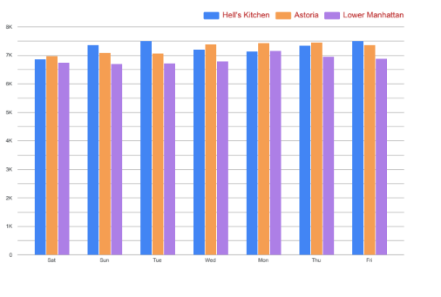
Bar graph

Slide 3
INSIGHTS
According to our research we have concluded that most customers buy coffee during the morning and during the rush hour evening after a long day at work for nice refreshment.
So we have come up different marketing campaigns during slow time slots to increase the sales of our products.
We can come up with campaigns such as buy one and get one FREE. Spin a wheel or pick a lucky number to receive prizes for each purchase item.

Slide 4
Marketing Campaigns During Slow Time Slots.
Bring A Friend Deals
Bring A Friend Tuesday buy any drink and get your friend’s drink FREE from 2-5PM.
Encouraging social dining by offering deals that rewards customers for bringing a guest, this is a great way for our business to increase profit.
Study and Sip student hours
Offering 20% off for students between 2-6PM, but they must show their student id.
Open Mic Espresso
When slow weekday afternoons 3-6PM local musicians play, drawing in their friends and fans offering FREE drinks for performers.
Spin The Wheel
Small wheel at the register
Prizes FREE espresso shot, 15% off.

Slide 5
Stock best selling items
Focussing on core beverage ingredients like espresso beans, milk, and sweeteners. Popular drink componets such as ice, tea, and hot chocolate mix.
Essential disposable items like cups, lids, nakins and stirrers.
Food items keeping sytock of popuklar pastries and baked goods anf for popular seasonal or promotional items.
Stock the ingredienst for those as well, by tracking our sales data, we can identify which items are ,ost popular and esure those are well stocked, while also monitoring trends to stock seasonal specrilas effectively.

Slide 6
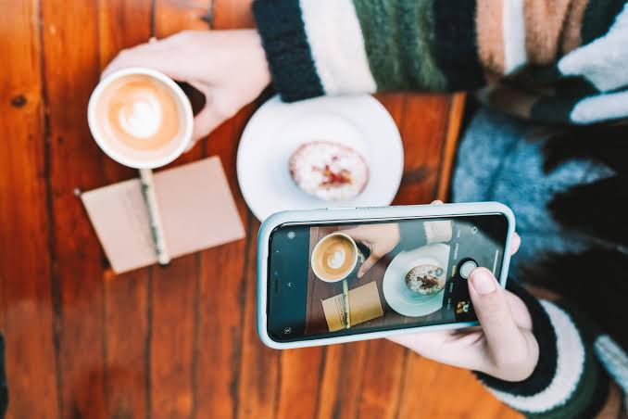
Promting underperforming products
We can do this by offering attractive promotianl deals, bundle them with poplular items, suing creative marketing strategies like visually appealing social media posts, local partherships, host special events, and by training staff yo actively suggest the products to customers.

Slide 7
Results

Slide 8
Conclusion
In conclusion this marketing campaigns were designed to target the slowest time slots and boost overall coffee shop performance.
Bring A Friend Deal: has increase sales by 50% since we had consumers who made use of this promotion.
Study And Sip: has increase sales by 35% which was not much due to our location being far from campus.
Open Mic Espresso: has increase sales by 45%
Spin The Wheel: has increase sales by 40%

