Slide 1

CMPG325 NETWORK
IMPLEMENTATION PROJECT
Iketsetseng Private School | Mahikeng
Project ID: CMPG325-2026-022 • Client ID: CLI-022
Addressing block: 192.168.21.0/24
Presented by: Miss N Khumalo
Student number: 42606152
WIRELESS SECURITY • VLAN SEGMENTATION • TESTING

Slide 2
Client requirements and design response
The design focuses on secure, segmented connectivity and additional-floor coverage.
Client needs
Assigned requirements
• Connect staff, students and administration
• Use 192.168.21.0/24
• Provide local DHCP and DNS services
• Wireless security: WPA2-PSK with AES
• Add coverage to another floor/area
• Minimise unnecessary Internet bandwidth use
Design approach
Router-on-a-stick routing, VLAN separation, a managed switch, local services and three wireless access points address the key requirements.
CMPG325 • Iketsetseng Private School

Slide 3
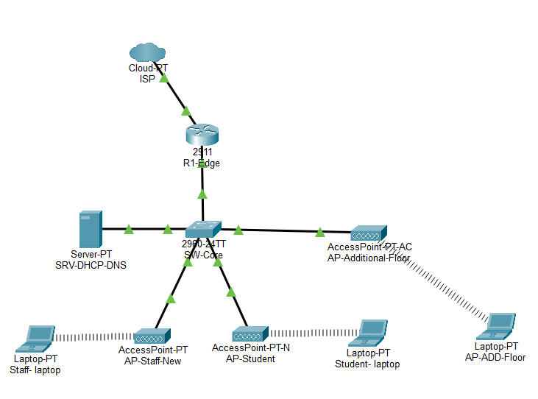
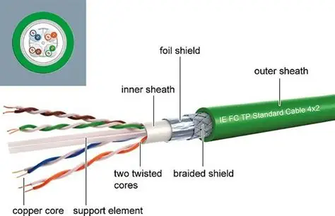
Network topology
1qesx
CMPG325 • Iketsetseng Private School

Slide 4
Network layout and IP addressing
VLANs separate logical groups and make the network easier to manage.
SRV-DHCP-DNS
R1-Edge
Router
SW-Core
Switch
AP-Staff +
AP-Student
AP-Additional-
Floor
Router-on-a-stick: VLAN subinterfaces route between internal networks.
VLAN | Purpose | Network / mask | Default gateway
10 | Staff | 192.168.21.0/26 | 192.168.21.62
20 | Students | 192.168.21.64/26 | 192.168.21.126
30 | Admin / Servers | 192.168.21.128/27 | 192.168.21.158
99 | Management | 192.168.21.192/28 | 192.168.21.193
CMPG325 • Iketsetseng Private School

Slide 5
Wireless security and additional-floor coverage
The additional-floor change request was addressed with a third student access point.
Staff Wi-Fi
Student Wi-Fi
Additional-floor Wi-Fi
SSID: Iketsetseng-Staff
Security: WPA2-PSK
Encryption: AES
SSID: Iketsetseng-Student
Security: WPA2-PSK
Encryption: AES
SSID: Iketsetseng-Student-Floor2
Security: WPA2-PSK
Encryption: AES
Security test
Coverage change
An incorrect Wi-Fi password caused the client to disconnect.
AP-Additional-Floor connects to SW-Core Fa0/4 in VLAN 20.
CMPG325 • Iketsetseng Private School

Slide 6
Core configuration and services
Central services support automatic addressing and local name resolution.
DHCP on R1-Edge
Local DNS server
Pools: STAFF_POOL, STUDENT_POOL and ADMIN_POOL.
Clients receive an IP address, gateway and DNS settings.
SRV-DHCP-DNS: 192.168.21.130/27
Gateway: 192.168.21.158
www.iketsetseng.local → 192.168.21.130
Switch configuration
Bandwidth-conscious design
VLANs 10, 20, 30 and 99. Gi0/1 is the 802.1Q trunk to R1-Edge.
Local services and internal traffic can stay within the school network, avoiding unnecessary Internet dependence.
CMPG325 • Iketsetseng Private School

Slide 7
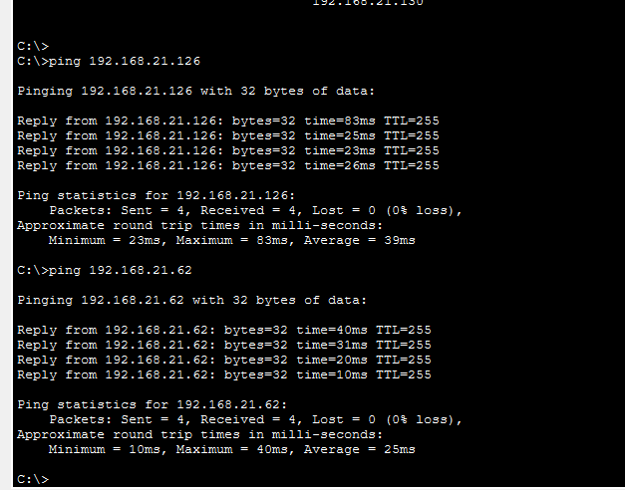
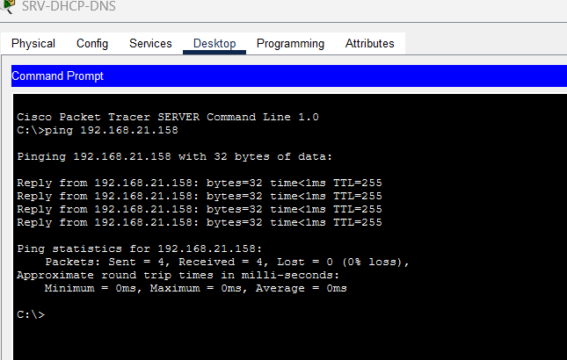
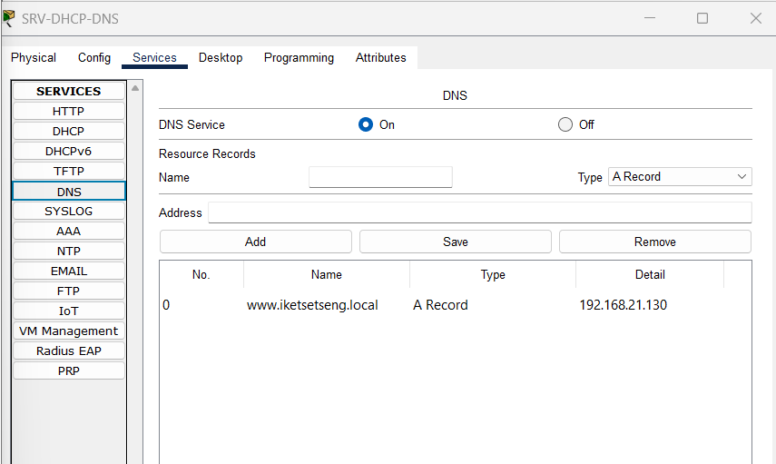
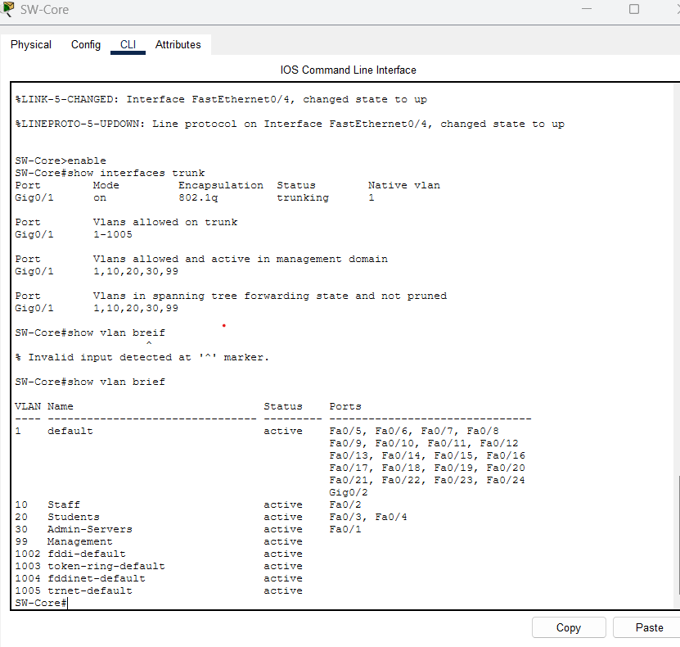
Key test evidence
Screenshots from Packet Tracer confirming connectivity, VLAN trunking and local DNS.
Server to gateway
Server to VLAN gateways
SRV-DHCP-DNS pings 192.168.21.158: 4 sent, 4 received, 0% loss.
Pings to 192.168.21.126 and 192.168.21.62 both reply 4/4 with 0% loss.
VLANs and trunk
Local DNS record
SW-Core Gig0/1 is an 802.1Q trunk carrying VLANs 10, 20, 30 and 99, all active.
DNS service on: www.iketsetseng.local resolves to 192.168.21.130.
CMPG325 • Iketsetseng Private School

Slide 8
Testing and results
Tests were performed in Packet Tracer using client command prompts and device CLI.
Test | Observed result | Status
Staff DHCP | 192.168.21.11 | PASS
Student DHCP | 192.168.21.75 | PASS
Additional-floor DHCP | 192.168.21.77 | PASS
Staff gateway / server | 4/4 replies to .62 and .130 | PASS
Student gateway / server | 4/4 replies to .126 and .130 | PASS
Additional-floor gateway / server | 4/4 replies to .126 and .130 | PASS
Local DNS | www.iketsetseng.local resolved to 192.168.21.130 | PASS
Wrong Wi-Fi password | Client disconnected from secured SSID | PASS
CMPG325 • Iketsetseng Private School

Slide 9
Conclusion
The implementation addresses the main internal networking requirements in the project brief.
What was achieved
Assigned feature
• VLAN-based segmentation
• DHCP address assignment
• Local DNS resolution
• WPA2-PSK/AES on three SSIDs
• Wrong-password rejection tested
• Additional-floor AP added to VLAN 20
Limitation to report accurately
Local services and segmented traffic reduce avoidable Internet use. Public Internet reachability was not proven by the recorded tests.
Thank you
CMPG325 • Iketsetseng Private School

