Slide 1


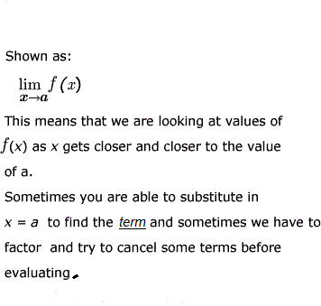
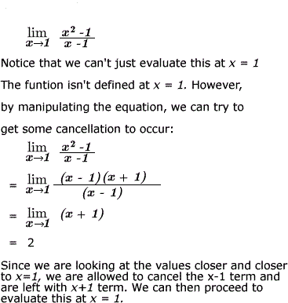

LIMIT
Definition: is used to describe the value that a function or sequence "approaches"
as the input or index approaches some value
EXAMPLE↓↘

