Slide 1

RESPECT

Slide 2
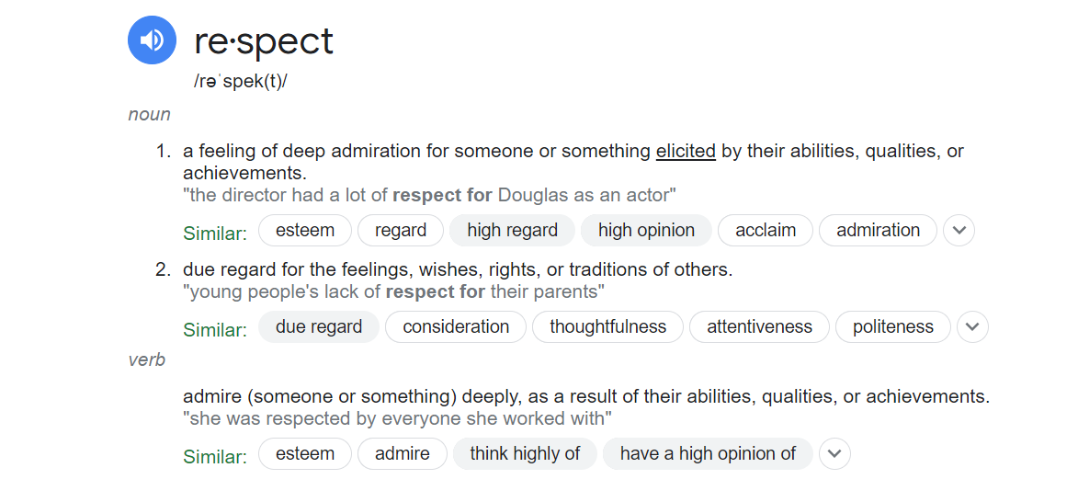
Another Definition: https://www.merriam-webster.com/dictionary/respect
More Examples: https://helpfulprofessor.com/respect-examples/

Slide 3

COMPONENTS OF RESPECT

Slide 4
Definition of Respect:
Start by defining what respect means to you or in the context of your writing.
Explain that respect is a positive feeling or action that acknowledges the value of others.
Types of Respect:
Differentiate between various types of respect, such as self-respect, respect for others, and respect for the environment or cultural traditions.
Importance of Respect:
Highlight why respect is essential in personal relationships, communities, and society at large.
Discuss the role of respect in promoting empathy, cooperation, and conflict resolution.
Respect in Relationships:
Explore how respect is a fundamental element in healthy relationships.
Describe how it can be shown through active listening, valuing opinions, and setting boundaries.
Respect in Cultural and Diversity Contexts:
Discuss the significance of respect in a multicultural and diverse world.
Address how respect can bridge cultural gaps, foster inclusivity, and reduce discrimination.
Respect in the Workplace/ School place:
Explain the role of respect in professional settings and how it can enhance teamwork and productivity.
Provide examples of respectful behavior in the workplace.
Respect for Nature:
Discuss the concept of environmental respect and the importance of preserving natural resources.
Highlight the consequences of disrespecting the environment.
Challenges to Respect:
Identify common challenges to showing respect, such as prejudice, stereotypes, and misunderstandings.
Offer solutions and strategies for overcoming these challenges.
Cultural and Historical Perspectives on Respect:
Explore how different cultures and historical periods have defined and demonstrated respect.
Compare and contrast cultural approaches to respect.
Personal Experiences with Respect:
Share personal anecdotes or stories that illustrate the impact of respect in your life.
Reflect on times when you've experienced or witnessed respect in action.
Teaching and Encouraging Respect:
Discuss ways to teach respect to children and promote it in educational settings.
Consider the role of parents, teachers, and mentors in instilling respect in younger generations.
The Connection Between Respect and Empathy:
Examine the link between empathy and respect, explaining how they complement each other.
Highlight the importance of understanding and sharing the feelings of others in a respectful manner.
Consequences of Disrespect:
Describe the negative outcomes that can result from a lack of respect, including conflicts, social tension, and broken relationships.

Slide 5

WRITING PROMPT: 5 SENTENCES
DEFINE RESPECT.
GIVE 1 EXAMPLE OF RESPECT
WRITE ABOUT AT LEAST (1) OF THE TYPES OF RESPECT
WRITE ABOUT 2 OTHER COMPONENTS OF RESPECT

