Slide 1
DINING SERVICES SYSTEM
LONG KHUONG, LOI MAI

Slide 2
1. METHODOLOGIES USED FOR PROJECT
Interview with current employees at Dining Services
Personal Experience as Student Worker / Student Manager

Slide 3
II. PROBLEM STATEMENT
Dining services is one of the most famous options for a work-study at Luther College. Working for dining services including working for Caf, Marty’s, Nordic Brew, Oneota, or Peace Dining. Each place will have a list of positions and each position will have few students, depending on the demand of works in that position. The Student Management System will keep track of the employees working for Dining Services.
To register for a work-study at Dining services, students will show their first name, last name, ID, email, and class schedule to the Manager and the Manager will enter their information into the Student Management System. First, the system will verify the qualification of the student by checking their information in the Ban List. The Ban List will have the information of the previous Employees who got terminated from the Dining services for some particular reasons.

Slide 4
CONTINUE
If the student is qualified for the work, the Manager will add the student’s information into the system. After that, the system will then check their class schedule and return a list of jobs that will fit into the student’s schedule. The student has the right to choose their working time, but he or she need to pick at least 1 shift at the weekend. After the student successfully picks the shift, the system will save his or her record, then also create three new instances to keep tracking their number of warnings, working schedules, and working time. Every time a student violates a rule, he or she will receive a warning. If that student receives a total of 3 warnings, he or she will be terminated, and that student’s information will go into the Ban List so that he or she can never work for dining services again. Working schedule is the student’s schedule, and working time is the total working time of that student in every 2 weeks.
However, the student can appeal against the warning. If the student has an appropriate reason to violate the rule, the manager can remove their warning or even can remove them from the Ban List.

Slide 5
CONTINUE
When students go to work, there will be a place for them to clock in and clock out. Students will show their ID to the scanner when they clock in or clock out so that the system will calculate their working time and then add to their total working time. There are few rules for students when they clock in and clock out:
Student cannot clock in earlier than 5 minutes
Student cannot late for work
Student cannot clock out sooner than 5 minutes unless they have the permission of the Manager
However, there will be some issues such as students forget their ID or they forget to clock in/ clock out. In this case, students will enter their clock in and clock out time in the computer near the scanner, but they will need the verification of the Manager.
The manager can use the system manually to deal with some specific cases. For example, the students can violate the dress code, they take a long break, etc. In those cases, the manager can manually send the warning to those students.

Slide 6
END OF PROBLEM STATEMENT
For meal swipe case, the manager selects the number of board or dinning dollar, then swipes with the student’s card. The system will subtract that amount of board or dinning dollar in the student’s card. If the student doesn’t have enough board left in his or her card, the system returns an error. After successfully swiping, the system will increase the total number of student in the daily record by the number of boards input by the manager.
For the case of payment, first, the manager selects the pay period then choose the worker. the manager can select all the workers at one or choose the individual worker by searching his or her name in the search bar. After that, the manager presses the make payment button. The system will then prompt a message to confirm. If the manager clicks yes, the payment is made.
When the item is out of stock, the manager will choose the storage tab. Then, he or she will search the item name on the search bar, then inputs the amount he or she wants to refill. After making the confirmation, the system will automatically send an order to the supplier.

Slide 7
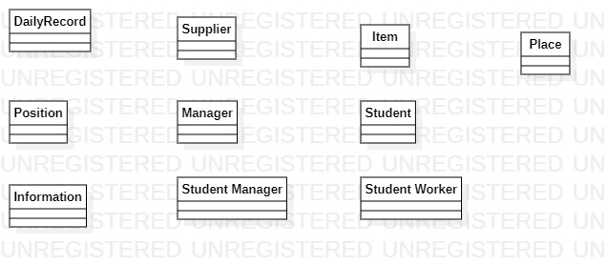
CLASS DIAGRAM: POSSIBLE DOMAIN CLASSES

Slide 8
III. USE CASES
Student Register
Clock in
Clock out
Warnings
Board Swipes
Payment
Item Manipulation

Slide 9
USE CASE: REGISTRATION
User action | System Response
1. The manager type in student information into main screen | 1. System checks the validity of that student in the Ban List. If the student is valid, the system shows the available positions on the screen
2. The student choose his or her suitable position with the manager. The manager then fills in those spots in the screen and saves | 2. System saves the student’s record as well as his or her working schedule in the system

Slide 10
USE CASE: CLOCK-IN
User action | System Response
1. The student shows his or her ID to the Scanner | 1. System opens the student’s profile, saves his or her entry time into the system.

Slide 11
USE CASE: CLOCK OUT
User action | System Response
1. The student shows his or her ID to the Scanner | 1. System opens the student’s profile, check his or her entry time, then add the working time to the total time in the student’s profile

Slide 12
USE CASE: WARNINGS
USER ACTION | SYSTEM RESPONSE
1. The manager writes the worker’s name in the search bar | 1. The system shows the list of students with that name on the screen, as well as possible commands that the manager can do (send warning, delete warning, etc)
2. The manager chooses sends warning and then write the reason | 2. The system will send a warning to the worker’s email. Also, the system will increase the number of warning in the worker class by one. Then, the worker class will return the number of warnings. If the total warning is 3, the system sends another email saying that the worker has been terminated. Then, the system changes the status of that worker to terminated, then moves the information of that worker to the Ban List.

Slide 13
USE CASE: BOARD SWIPE
User action | System Response
1. The manager inputs the amount of money then swipes with student’s id or guess’ debit card | 1. The system subtracts that amount of money from the card. If the current money or meal plan left in the card is less than the input amount, return an error. If successful, add 1 to the Daily Record depends on whether he or she is a student or guess.

Slide 14
USE CASE: PAYMENT
User action | System Response
1. The manager selects the pay period | 1. The system return the list of employees and their salaries.
2. The manager can pay individually or all of the employees at one | 2. The system shows a confirmation prompt
3. The manager selects yes or no | 3. If yes, the system makes the payment, if no, do nothing.

Slide 15
USE CASE: ITEMS MANIPULATION
USER ACTION | SYSTEM RESPONSE
1. The student manager chooses the item he or she wants to refill | 1. The system displays the information of that item on the screen
2. The student manager chooses the amount of item he or she wants to refill | 2. If the input amount is small than the remaining amount in the storage, tells the manager to sign then allows he or she to take the item. If the input amount is bigger, return an error

Slide 16
IV. DOMAIN CLASSES WITH ATTRIBUTES
Position
+Title +MaxNumWorker +CurrentWorker +Place
Information
+FirstName +LastName +LutherID +DOB
Supplier
+CompanyName +Address +PhoneNumber +Product
Place
+Workers +Managers +Positions +Name
Manager
+Information +PlaceInCharge
StudentWorker
+Information +NumOfWarnings +Shift +TotalWorking Time +Status
StudentManager
+Information +NumOfWarnings +Shift +TotalWorkingTime +Employer +Status

Slide 17
CONTINUE
Item
+Name +Supplier +ProductDetail +Amount +LastOrderAmount
Student
+Information +Board +DiningDollar
DailyRecord
+NoOfStudent +NoOfGuest

Slide 18
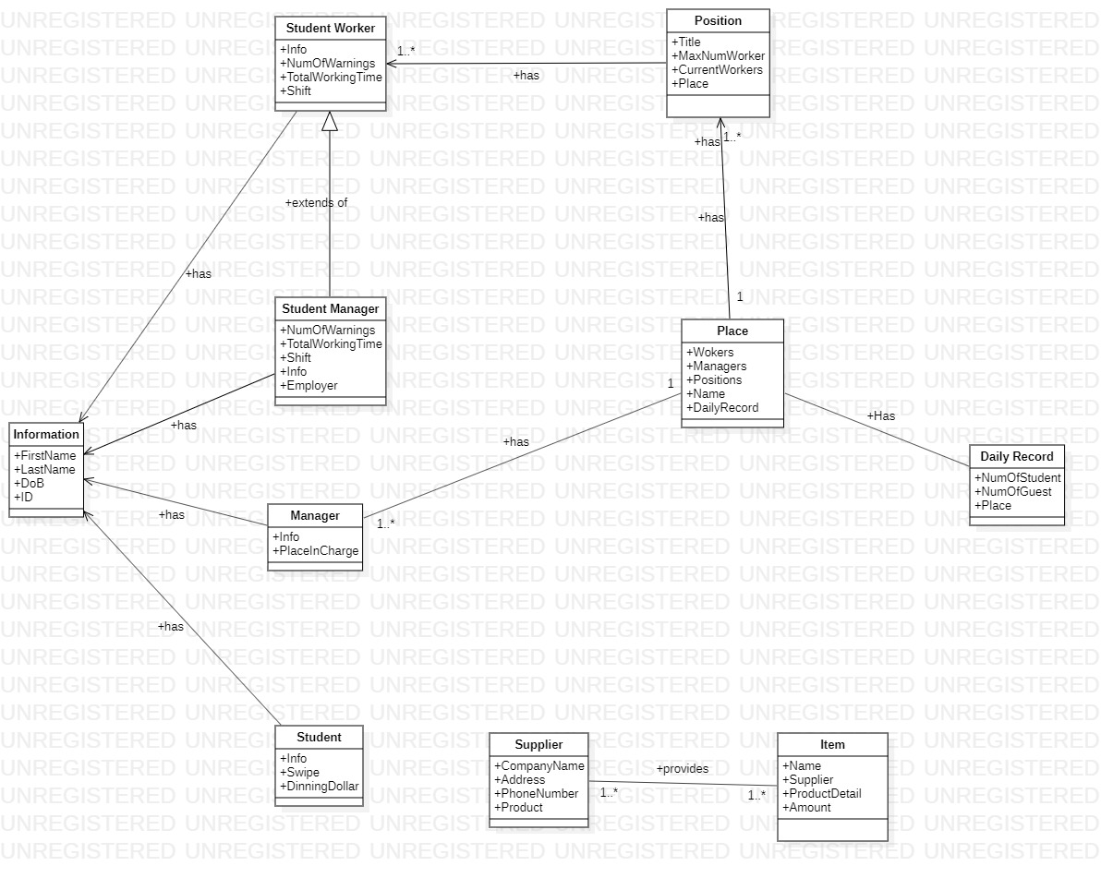
CLASS DIAGRAM V2: WITH RELATIONSHIP

Slide 19
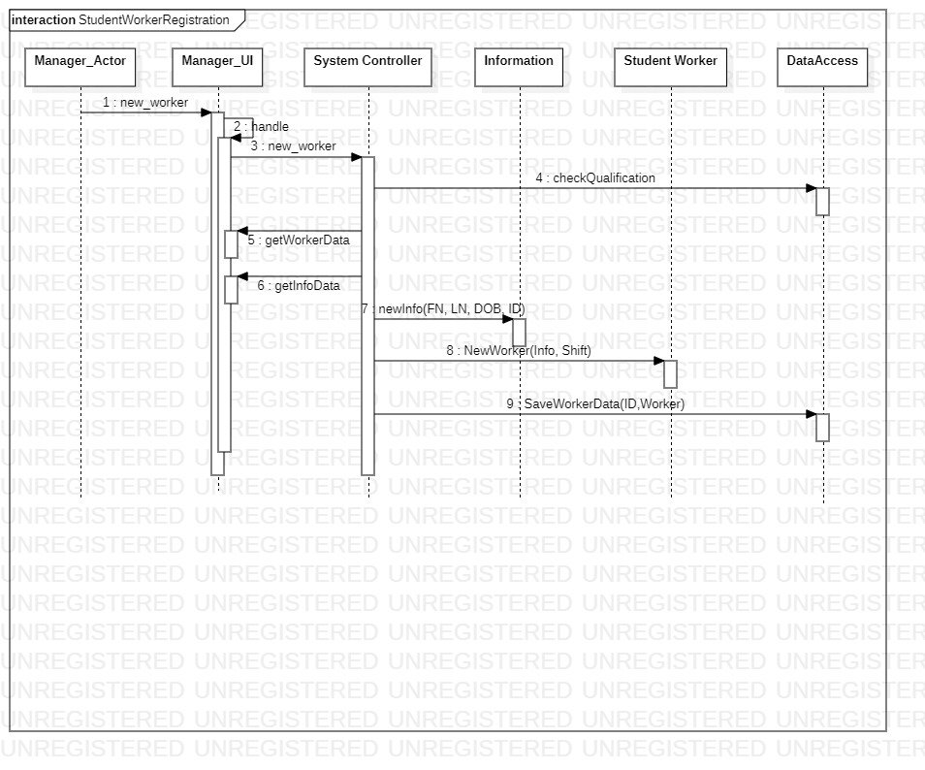
Sequence Diagram: Student Worker Registration

Slide 20
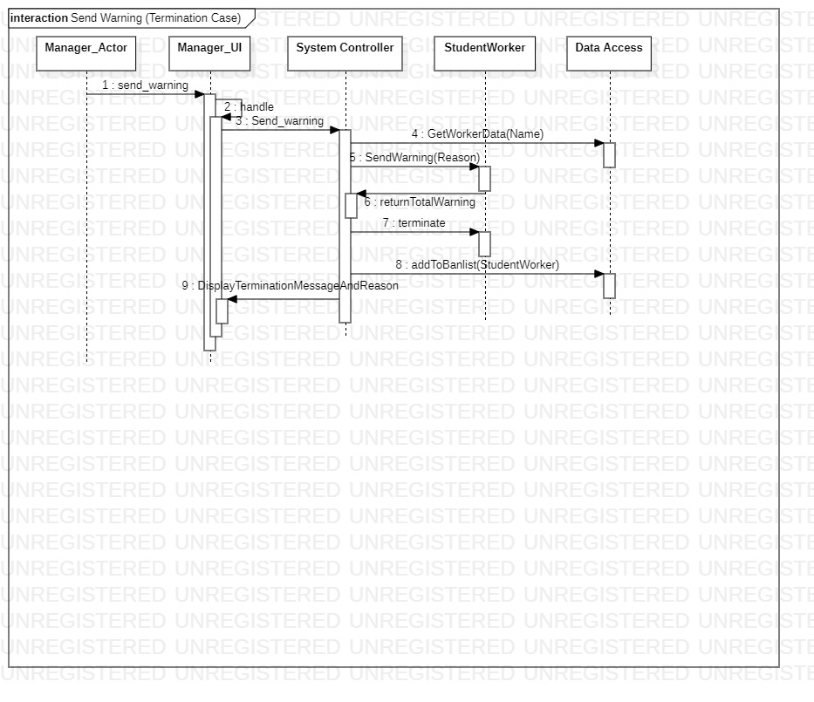
Sequence Diagram: Send Warning

Slide 21
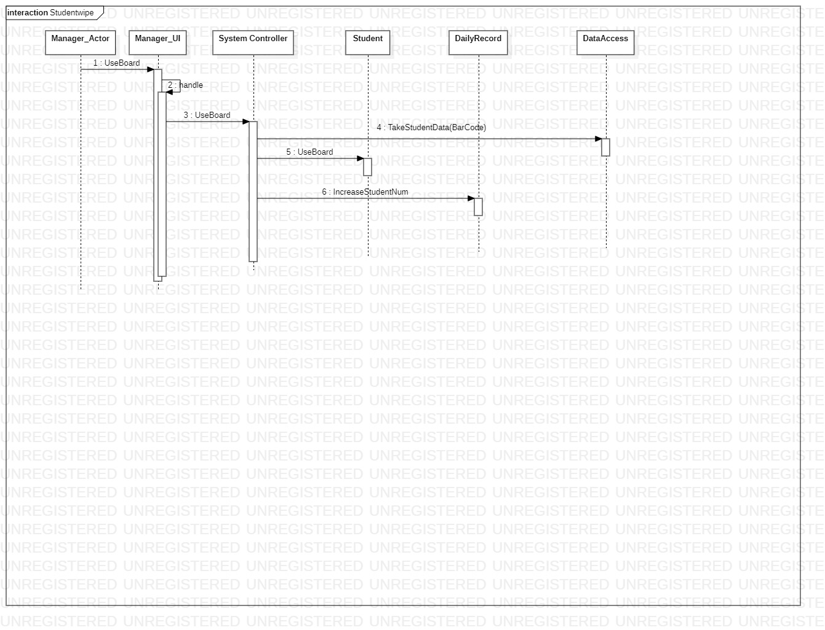
Sequence Diagram: Student Swipe

Slide 22
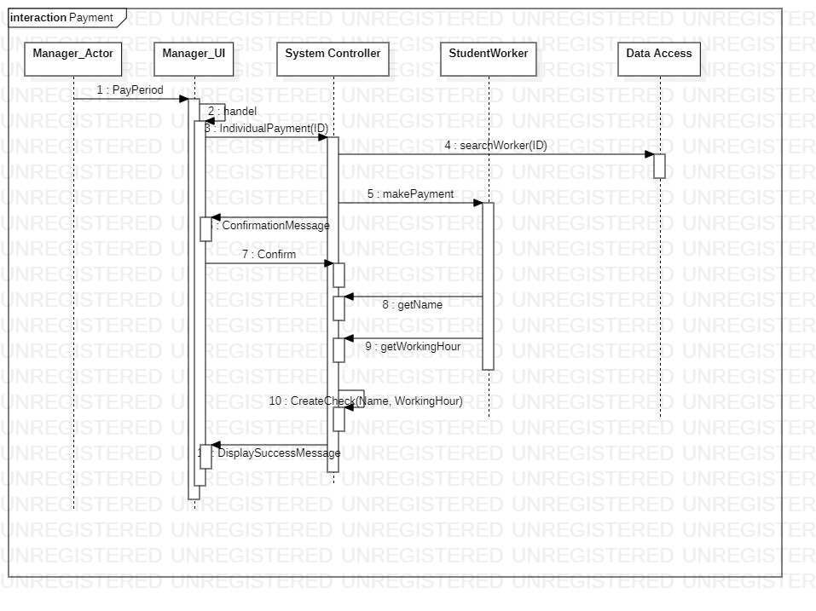
Sequence Diagram: Pay Salary

Slide 23
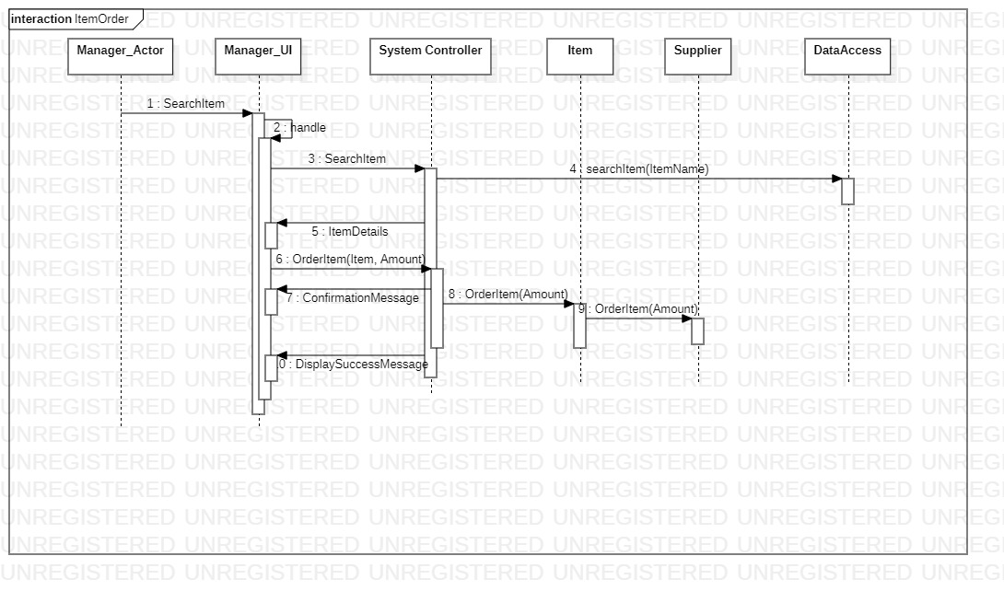
Sequence Diagram: Item Order

Slide 24
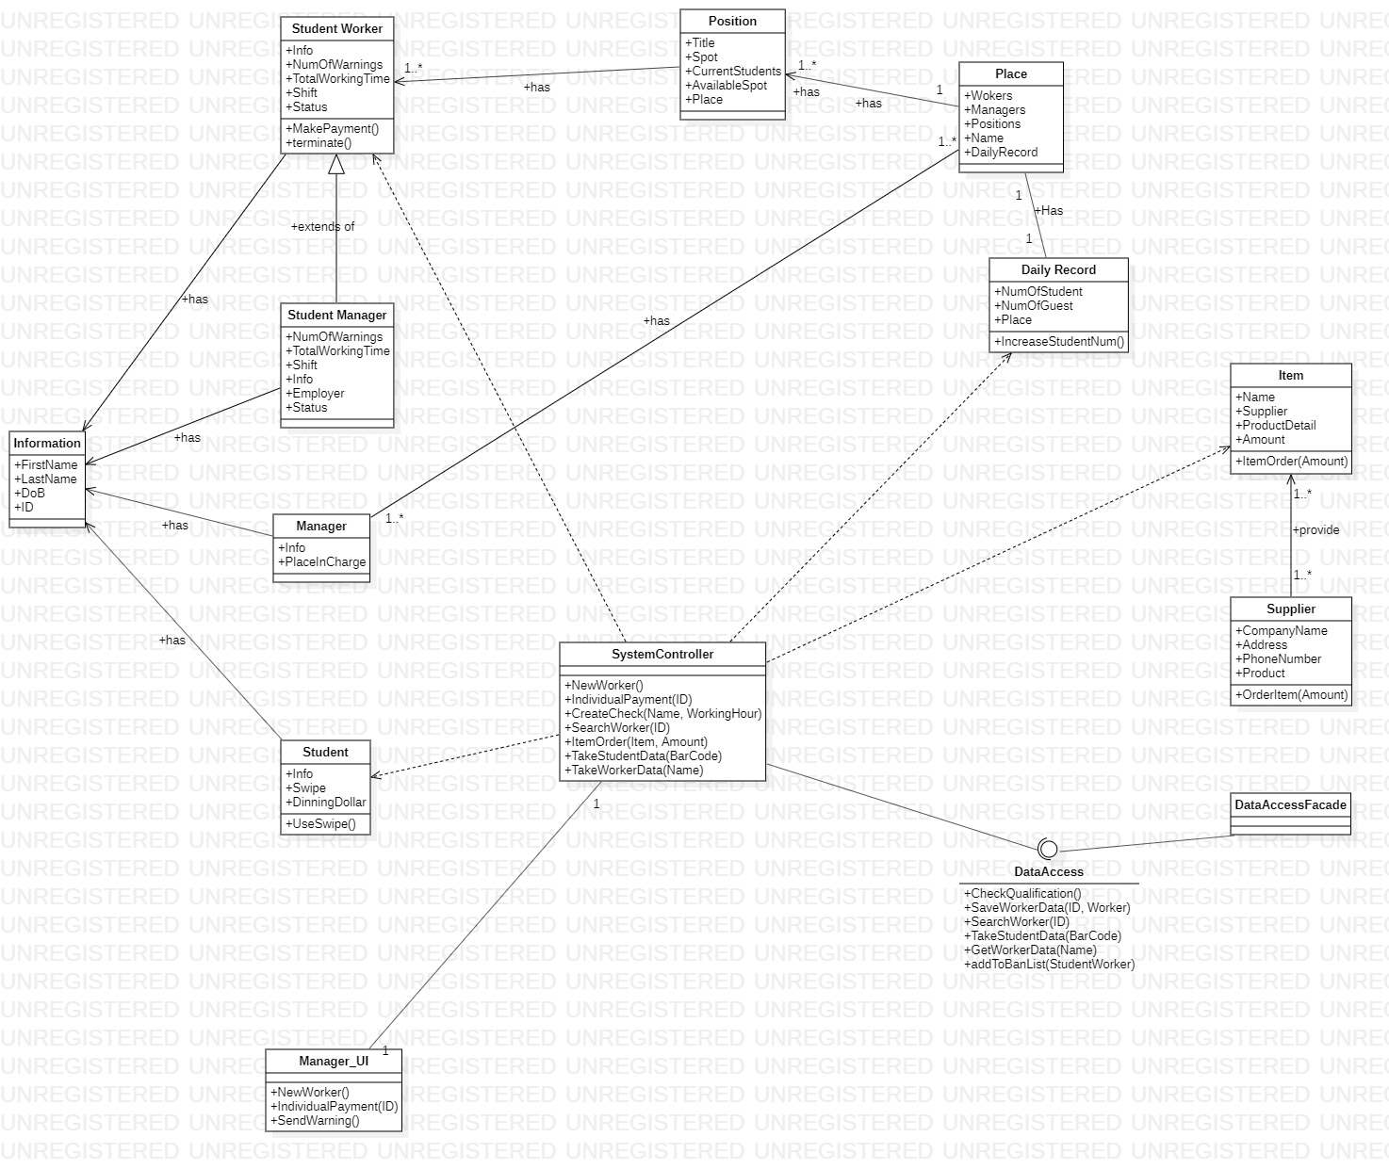
Final Class Diagram

Slide 25
THANK YOU !

