Slide 1


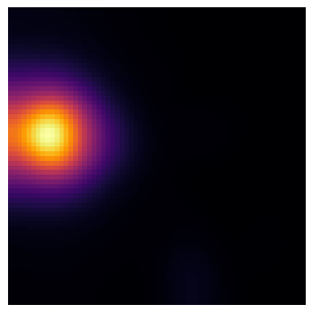


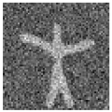

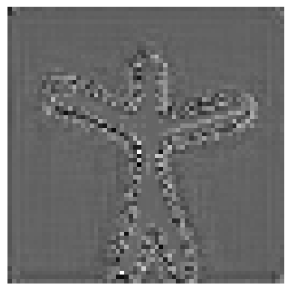
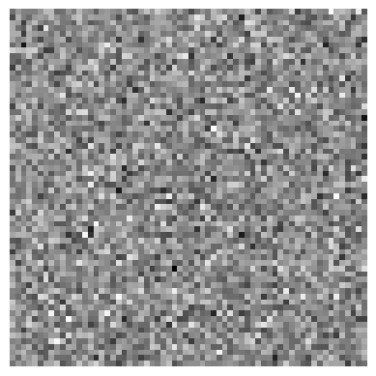
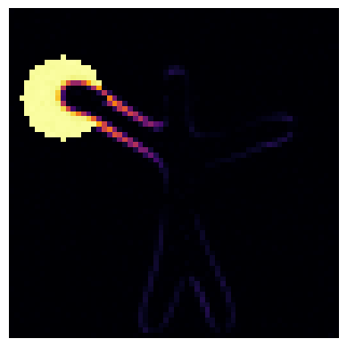

Anomaly Detection (Inference)
Spatial Diffusion Models (SDM)
LAF
segmentation
Trained
Diffusion Model
Potential anomaly
Encoder path (stochastic)
Encoder path (semantic)
Decoder path (reconstruction)
Denoising step (DDIM)

Slide 2


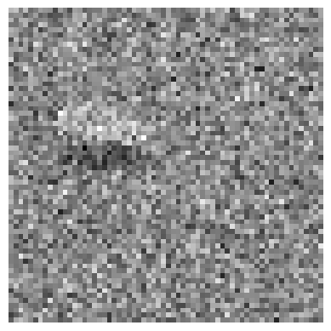

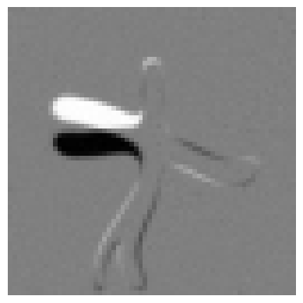
Temporal Diffusion Models (TDM)
Diffusion Forward Process
Down block
Up block
Denoising step (DDIM)

