Slide 1


1
FINAL PRESENTATION
FAIR MACHINE LEARNING FOR ANALYZING INCOME OPPORTUNITIES USING THE 1994 CENSUS DATA
Introduction to DataScience
DATASET:
LECTURER: MR. QUÁCH ĐÌNH HOÀNG
Income Adult
GROUP 5:
23110035 - TRẦN ĐÌNH KHƯƠNG
23110060 - TRẦN HUỲNH XUÂN THANH

Slide 2
Contentlist
1. Introduction & Goal of Study
2. Data Description
3. EDA
4. Feature Engineering
5. Model Building
6. Results
7. Conclusion

Slide 3
Contentlist
1. Introduction & Goal of Study
2. Data Description
3. EDA
4. Feature Engineering
5. Model Building
6. Results
7. Conclusion

Slide 4
Goal of the study
2
Feature Impact: Which factors (education, age, occupation) have the strongest influence on income?
Model Performance: Which preprocessing techniques and models achieve the best performance and stability on imbalanced data?
Bias & Explainability: Does the model exhibit bias with respect to gender or race? How can predictions be explained using SHAP or LIME?
Controlled Analysis: When holding working hours and education constant, how do gender and race affect income?
Motivation: Personal income reflects key economic factors and helps understand social inequality. At the same time, this problem provides a practical setting to apply machine learning techniques and build interpretable and fair predictive models.

Slide 5
Analysis Approach & Evaluation
3
Problem Handling: Check for class imbalance in the dataset
Clean and preprocess the Adult Census dataset
Handle missing values and remove redundant features
Apply feature engineering and feature selection
Train and compare ML models: Logistic Regression, Random Forest, LightGBM, XGBoost
Evaluation Metrics: Use F1-score (balancing precision and recall), AUC-ROC, MCC, and Stratified K-Fold cross-validation to evaluate and compare models
Explainability & Fairness (XAI): Apply techniques such as SHAP and LIME, along with fairness metrics

Slide 6
Contentlist
1. Introduction & Goal of Study
2. Data Description
3. EDA
4. Feature Engineering
5. Model Building
6. Results
7. Conclusion

Slide 7
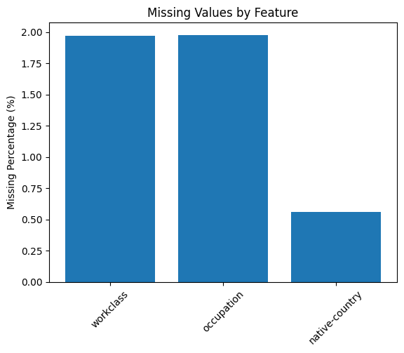
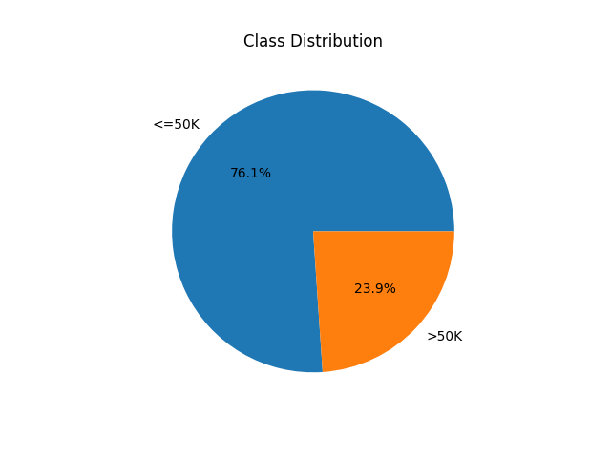
Dataset description
4
Source: Extracted from the 1994 U.S. Census Bureau database by Barry Becker and Ronny Kohavi
Scale: 48,842 independent observations (76% training, 24% testing).
Number of Variables: 15 variables (14 features and 1 target variable).
Data Issues: Approximately 3,620 rows contain missing values (about 7% of the dataset)

Slide 8
Features Description
5
Numerical Features:
age, education-num, hours-per-week (personal characteristics and work intensity)
capital-gain, capital-loss (Investment-related activities)
fnlwgt (Census sampling weight)
Categorical Features:
workclass, education, marital-status, occupation, relationship, race, native-country (Reflect social and socio-economic characteristics), sex (gender)

Slide 9

Input và Output of Problem
6
Input/Feature X: 14 categorical và numberic variable
Machine Learning Model
(Logistic, RF, XGBoost,...)
Input Features
- age
- education-num
- workclass
...
Income Prediction
>50K / <=50K
Output/Target Y: Binary variable "income"
Y=1: Income >50.000 USD
Y=0: Income <=50.000 USD
Moreover, outputs also answer these goal questions
Model metrics.
Fairness Metrics (Disparate Impact), SHAP Waterfall Plot
SHAP Summary Plot, Feature Importance (Bar chart)...

Slide 10
Limitations of dataset
7
Outdated data (1994): Income patterns may no longer reflect current conditions
Binary classification: Oversimplifies the problem and loses information about income levels
Missing important features: Lacks variables such as soft skills, location, assets, and social connections
Imbalance and missing data: Requires handling (e.g., SMOTE, class weighting, imputation)
Risk of historical bias: The model may learn and amplify existing social biases

Slide 11
Contentlist
1. Introduction & Goal of Study
2. Data Description
3. EDA
4. Feature Engineering
5. Model Building
6. Results
7. Conclusion

Slide 12
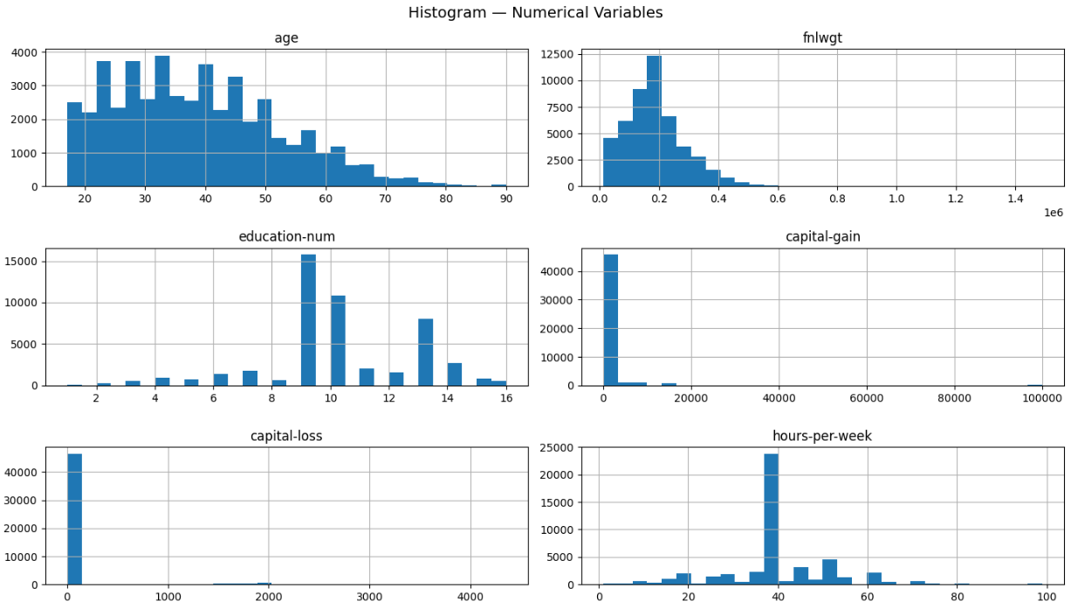
EDA
8

Slide 13
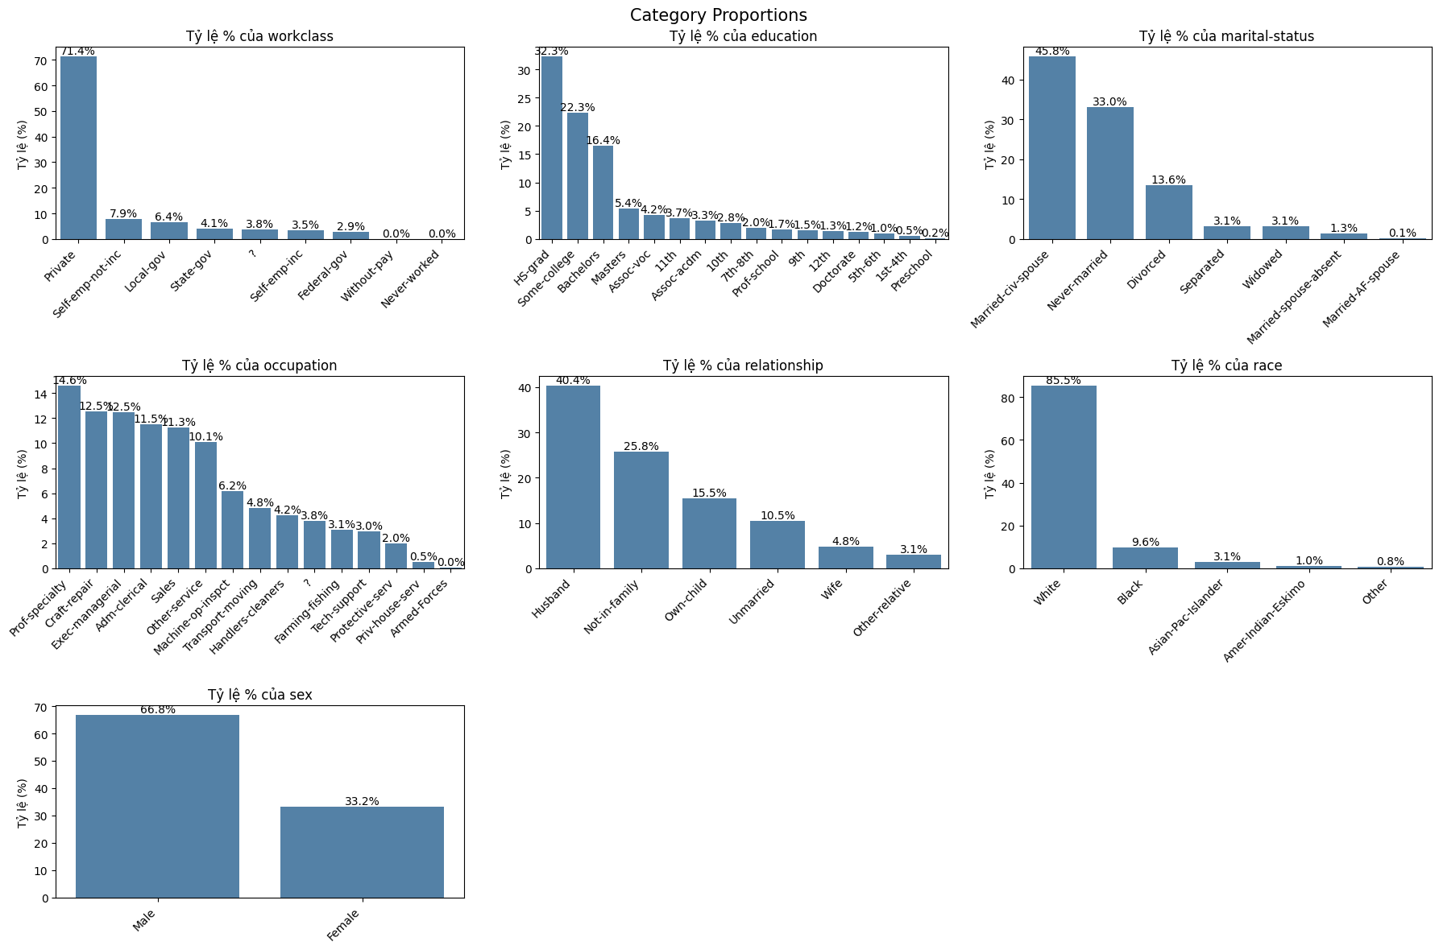
9

Slide 14
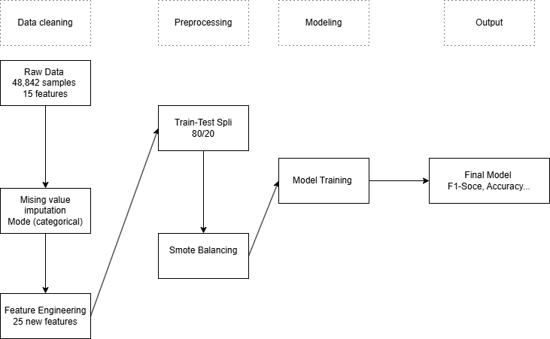
Processing Pipeline
10

Slide 15
Contentlist
1. Introduction & Goal of Study
2. Data Description
3. EDA
4. Feature Engineering
5. Model Building
6. Results
7. Conclusion

Slide 16
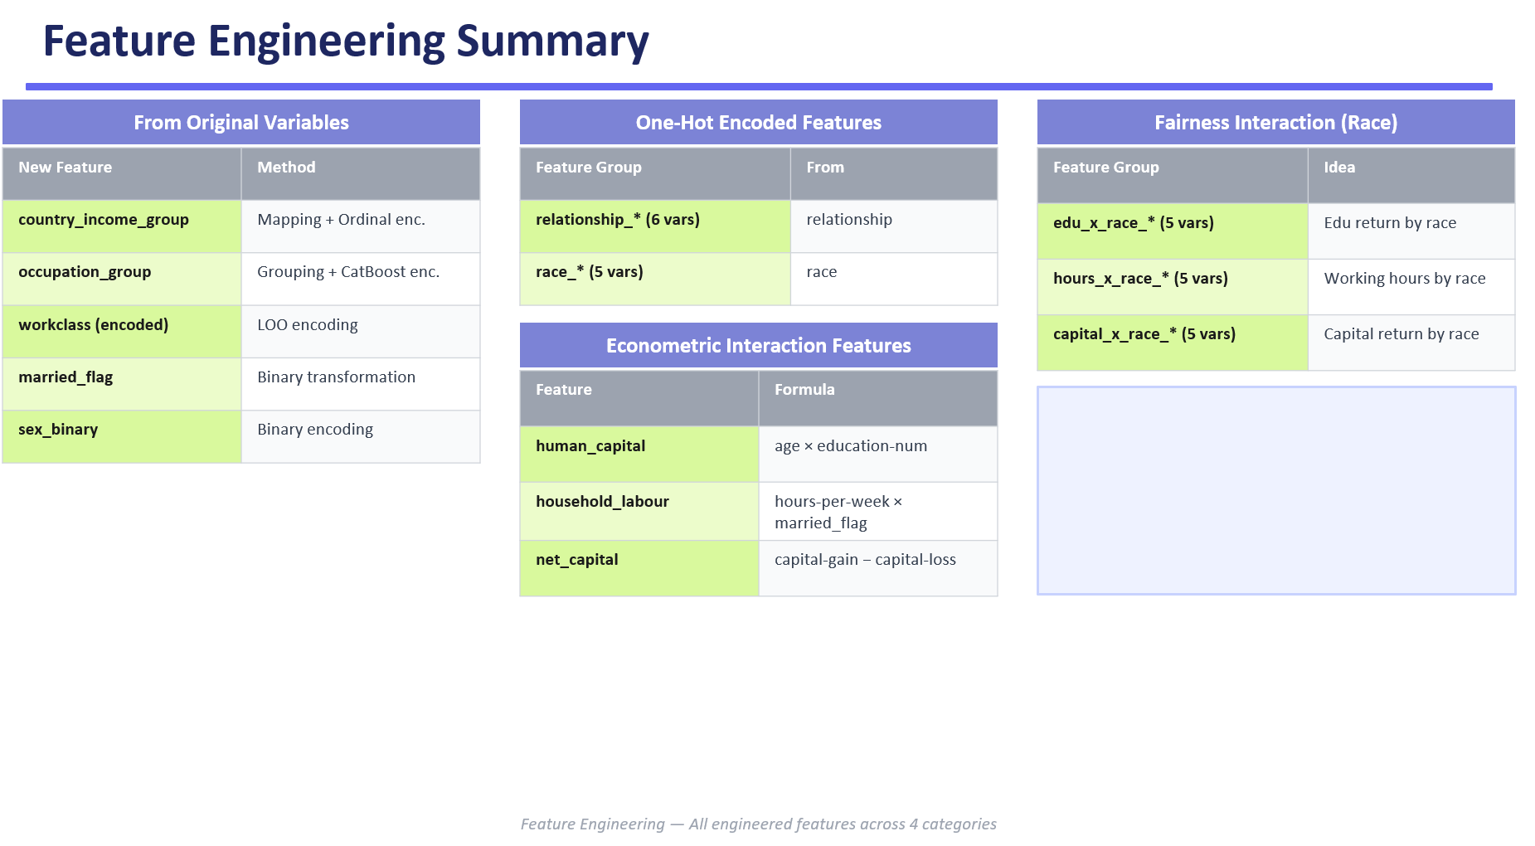
11
Create interaction features between race and key socio-economic variables (education, hours, capital) to analyze fairness.
Form three feature groups: edu_x_race_*, hours_x_race_*, and capital_x_race_*.

Slide 17
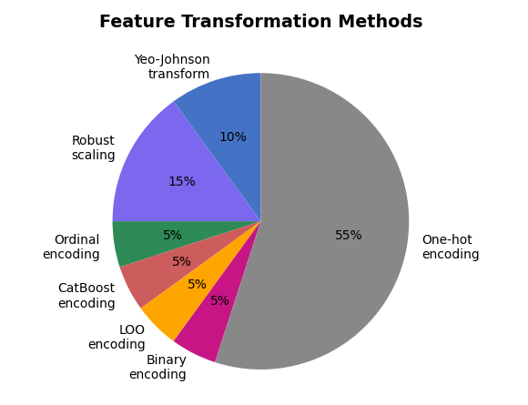
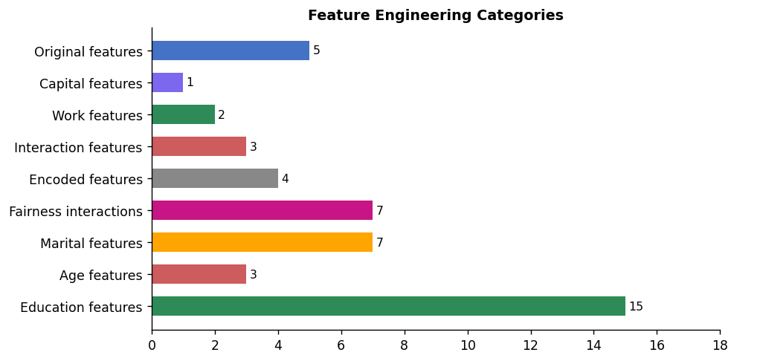
Feature Engineering
12
►Feature engineering primarily increases the number of features through interaction terms and fairness-related transformations, rather than simple encoding alone.
►A variety of encoding and scaling techniques are applied, but most new features are generated from one-hot encoding and interaction features.

Slide 18
Contentlist
1. Introduction & Goal of Study
2. Data Description
3. EDA
4. Feature Engineering
5. Model Building
6. Results
7. Conclusion

Slide 19
Machine Learning Models Used
13
To address this binary classification problem, the following models are applied:
Logistic Regression
Random Forest Classification
LightGBM
XGBoost Classification
The models are selected to balance interpretability and predictive performance. Logistic Regression serves as a baseline, while Random Forest, XGBoost, and LightGBM capture non-linear relationships.
This combination ensures accurate prediction and reliable feature importance analysis.

Slide 20
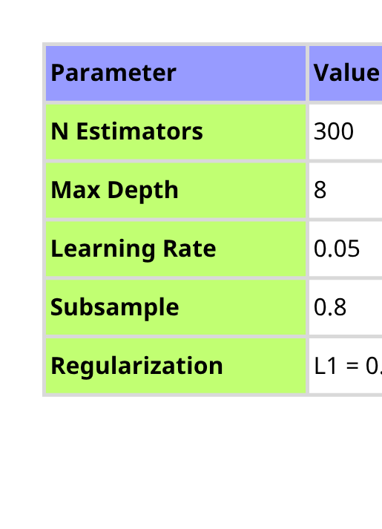
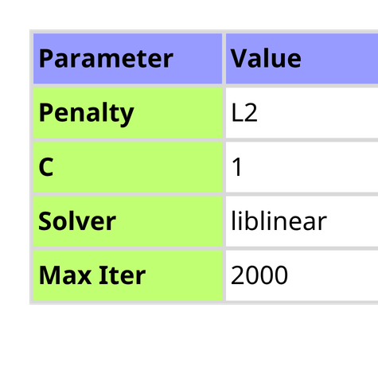
Logistic Regression & Random Forest config
14
Logistic Regression
Random Forest
► Model parameters are selected based on configurations reported in prior research to ensure academic rigor and comparability
►These configurations have been validated on similar tasks and are therefore expected to provide stable performance with the proposed data exploration and preprocessing approaches

Slide 21
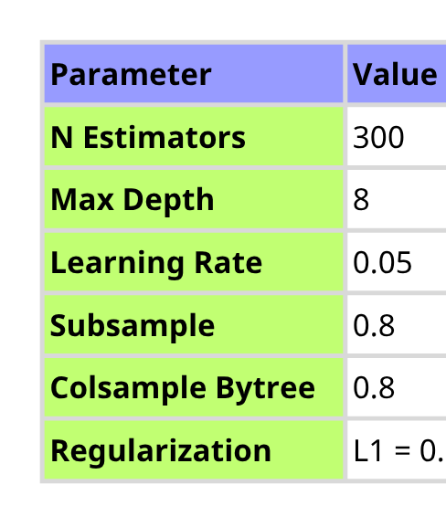
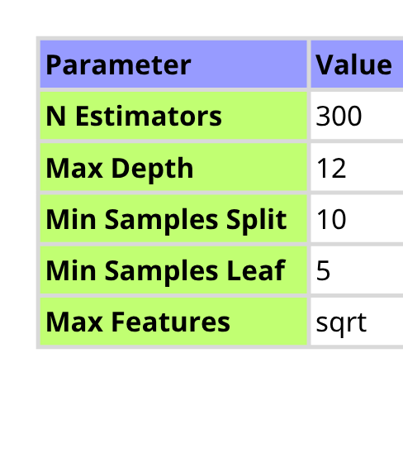
XGBoost & LightGBM config
15
XGBoost
LightGBM

Slide 22
Contentlist
1. Introduction & Goal of Study
2. Data Description
3. EDA
4. Feature Engineering
5. Model Building
6. Results
7. Conclusion

Slide 23
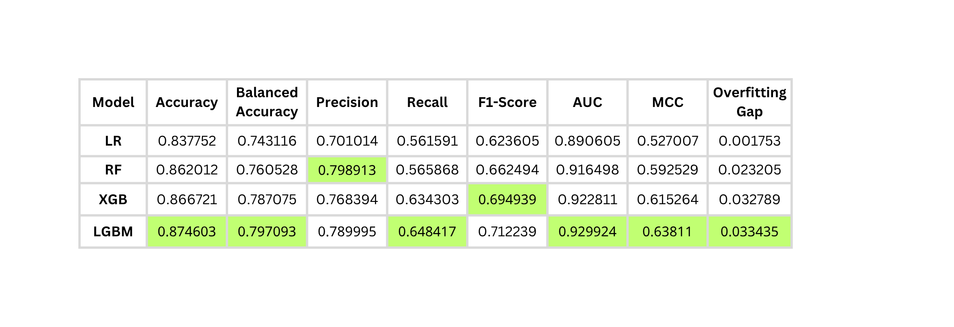
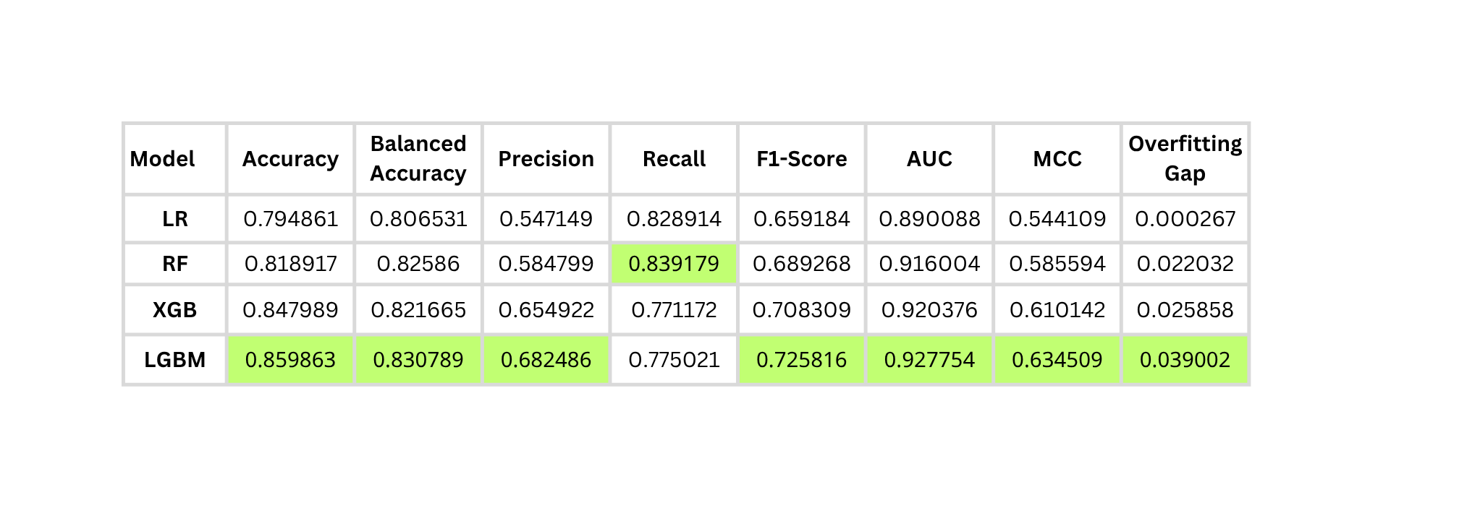
Metrics
16
Result after not handling imbalance
Result after applying smote

Slide 24
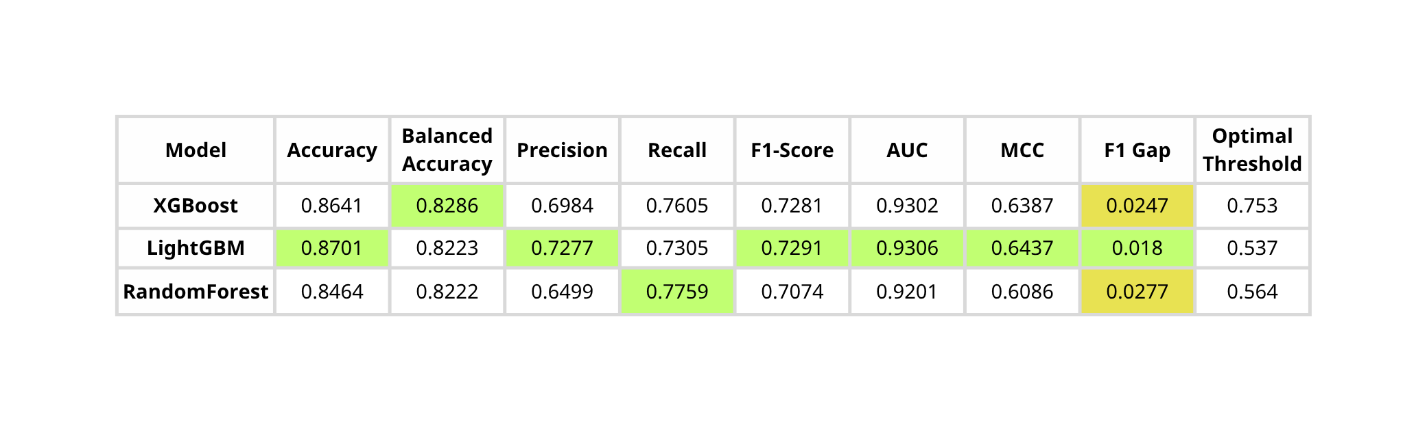
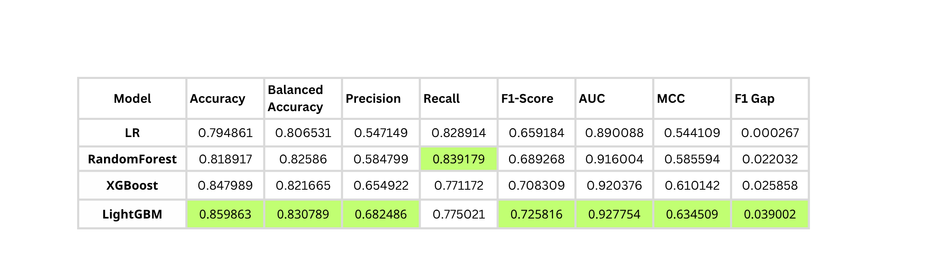
Metrics
17
DOI: 10.17148/IJARCCE.2025.14801 using optimal threshold
Result after applying smote

Slide 25
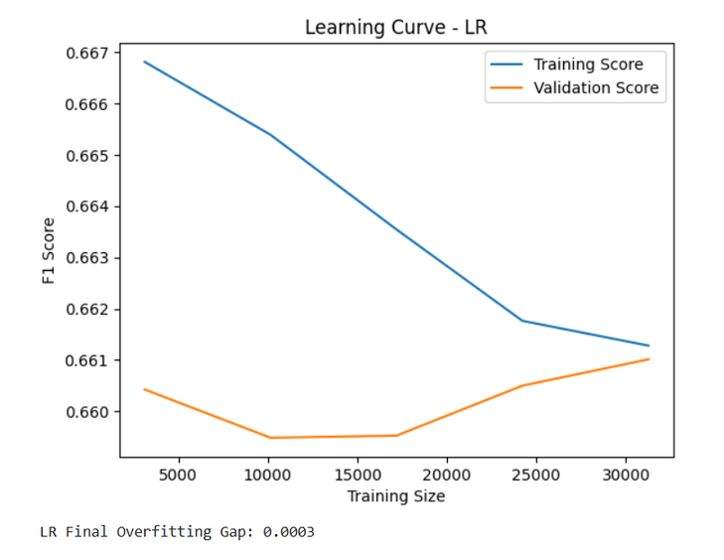
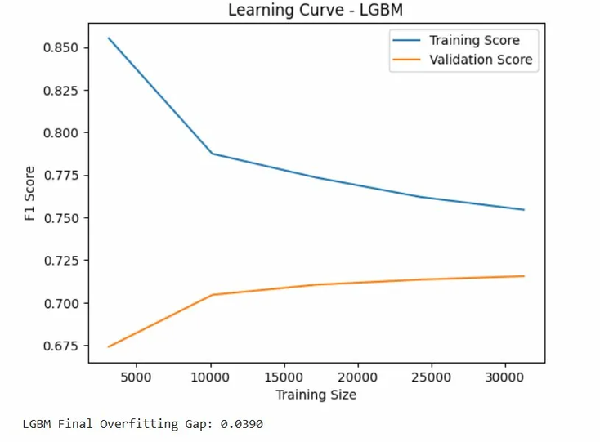
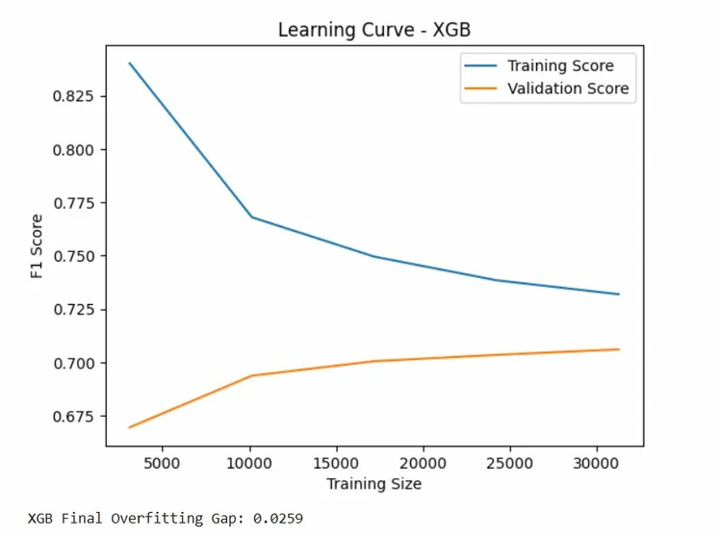
Analysis Learning Curves — SMOTE
18

Slide 26
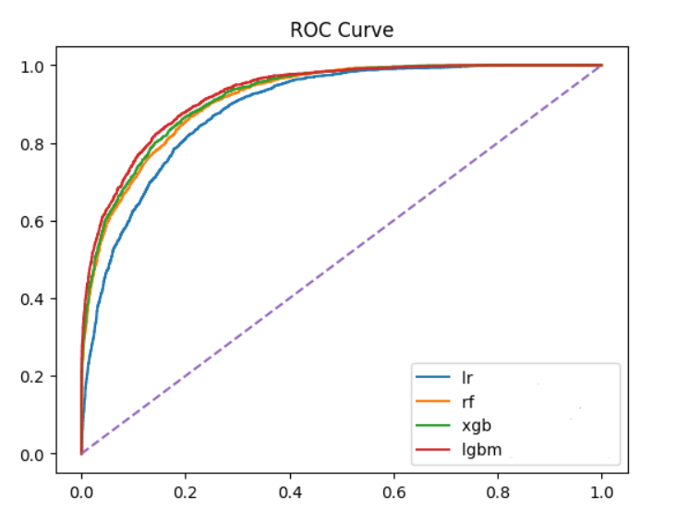
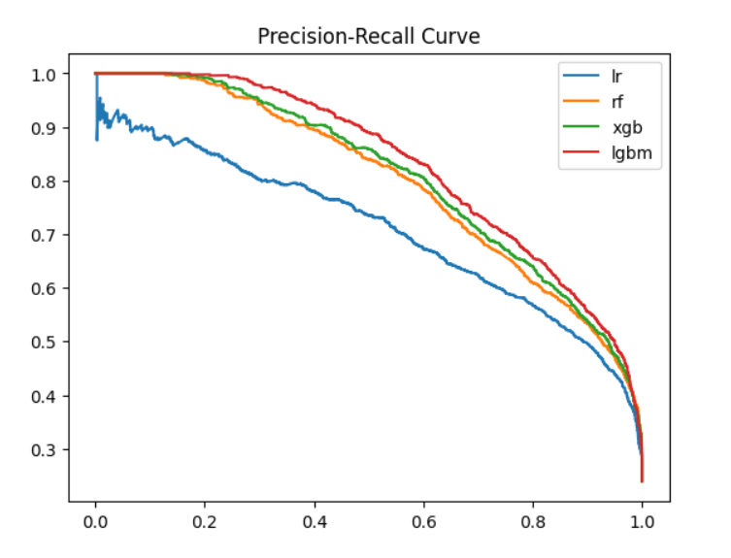
ROC & Precision-Recall Curve
19
►LightGBM creates very sharp decision boundaries, which helps minimize the overlap between the two income groups, as reflected by the low number of false positives
►With the highest PR curve, LightGBM demonstrates that when it predicts an individual to have an income greater than 50k, the prediction is the most reliable, with the highest likelihood of being correct.

Slide 27
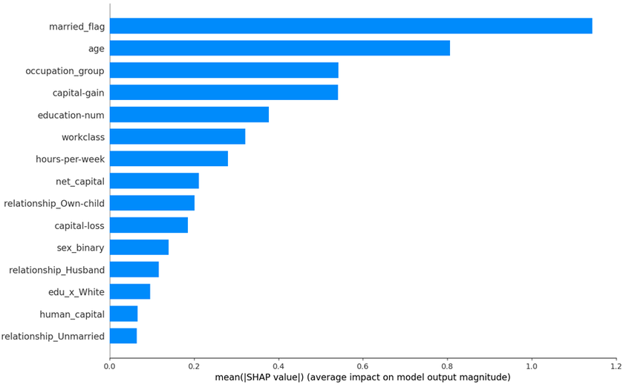
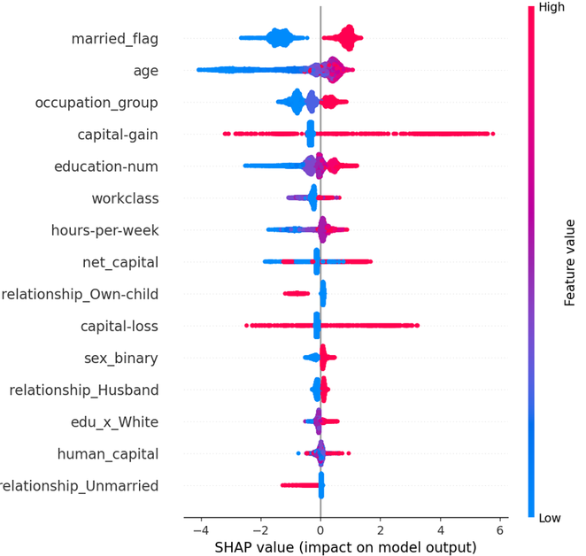
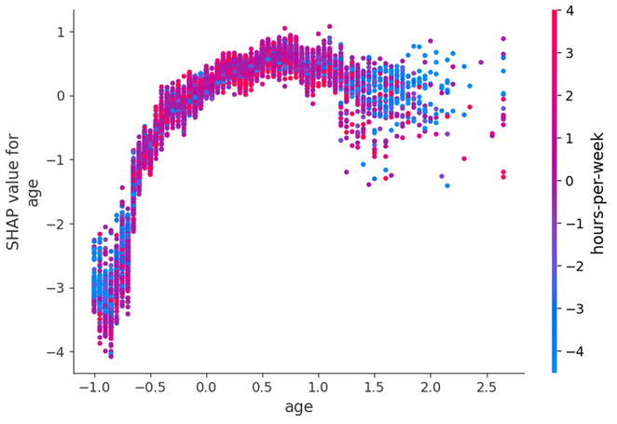
SHAP Analysis
20
FEATURE IMPACT RANKING: MARRIED_FLAG HAS THE STRONGEST INFLUENCE (~1.14), FOLLOWED BY AGE (~0.80), WHILE EDUCATION-NUM IS MUCH WEAKER (~0.38). AGE OUTWEIGHS BOTH OCCUPATION AND EDUCATION.
NON-LINEAR EFFECTS & INTERACTIONS: AGE SHOWS AN INVERTED-U PATTERN (YOUNG: SHAP ≈ -4, PEAKS AT MIDDLE AGE, THEN DECLINES); MARRIED_FLAG CONSISTENTLY BOOSTS PREDICTIONS; STRONG INTERACTION WITH HOURS-PER-WEEK.
CORE INSIGHT: THE MODEL DOES NOT LEARN TRUE “ABILITY” BUT LARGELY REFLECTS REAL-WORLD INCOME DISTRIBUTION, WITH AGE AND MARITAL STATUS AS THE DOMINANT FACTORS.

Slide 28
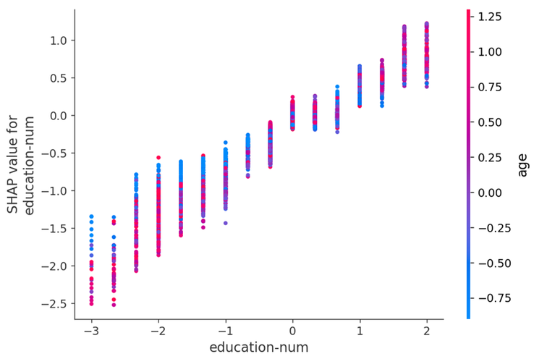
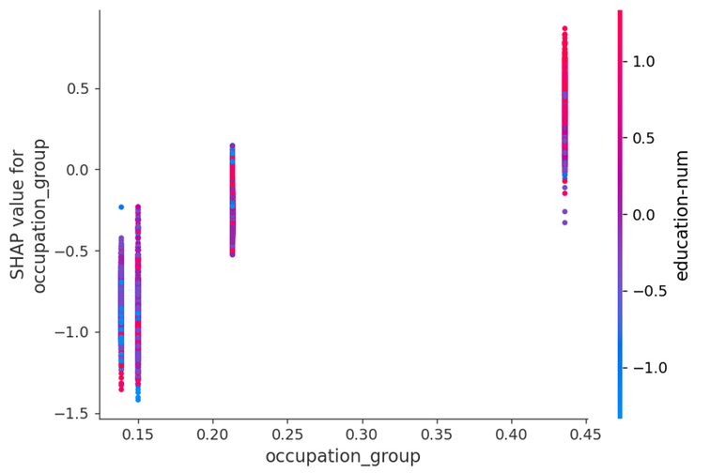
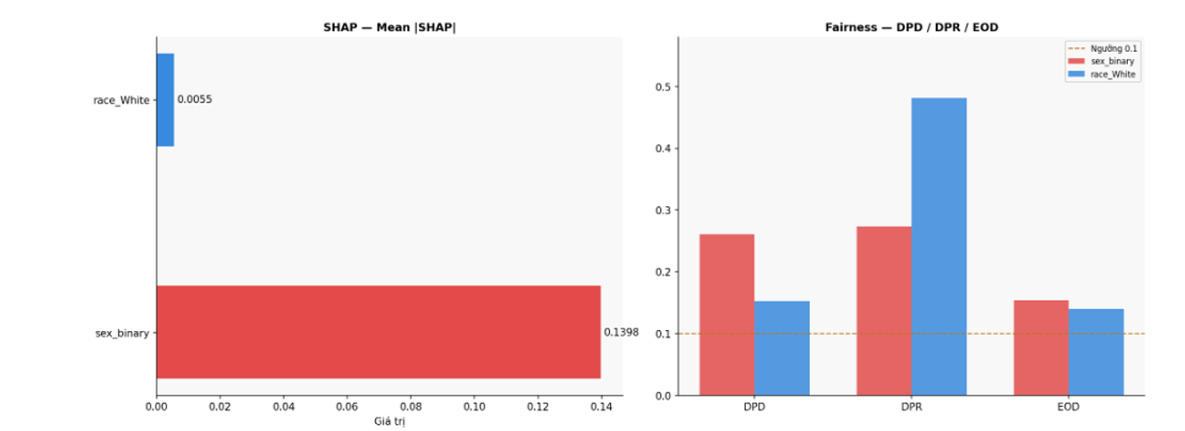
Fairness Explaination
21
Fairness analysis shows strong bias across gender and race (high DPD, DPR ~0.27, EOD above threshold).
However, SHAP indicates sensitive features have low direct impact → the model learns bias through proxy variables (e.g., married_flag, occupation_group, relationship).
The model not only reflects historical inequality but reinforces it—bias is embedded in the data structure, not just sensitive features.

Slide 29
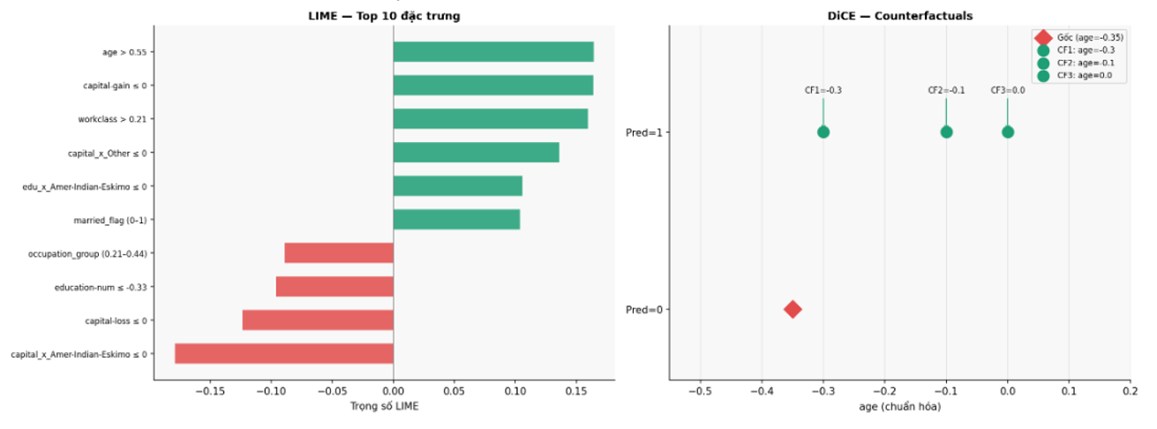
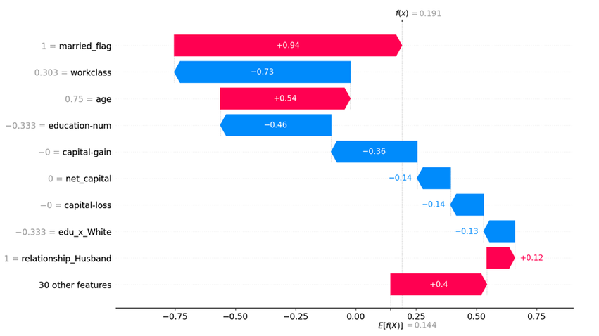
LIME Analysis
22
LIME shows a trade-off between positive and negative factors: married_flag (+0.94) and age (+0.54) push predictions up, while workclass (-0.73), education-num (-0.46), and capital-gain (-0.36) pull them down.
This indicates the model prioritizes age and social structure over education.
DiCE reveals that a small increase in age (from -0.35 to ~ -0.30) can flip the outcome → a sharp decision threshold.

Slide 30
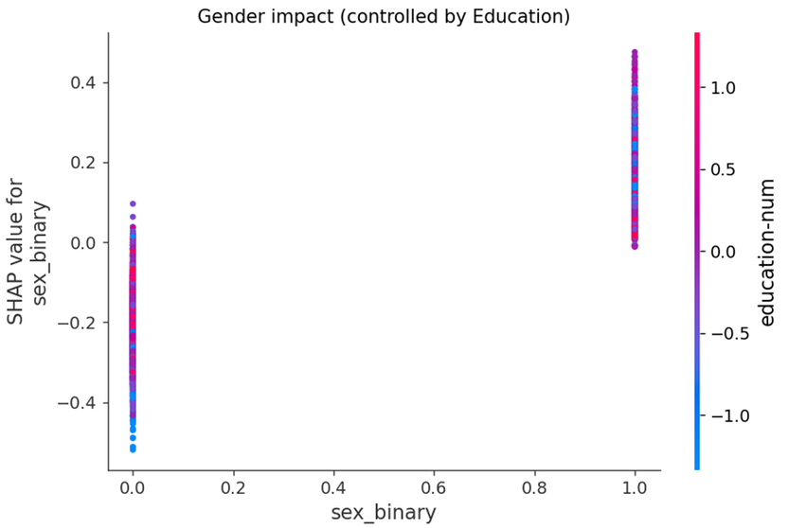
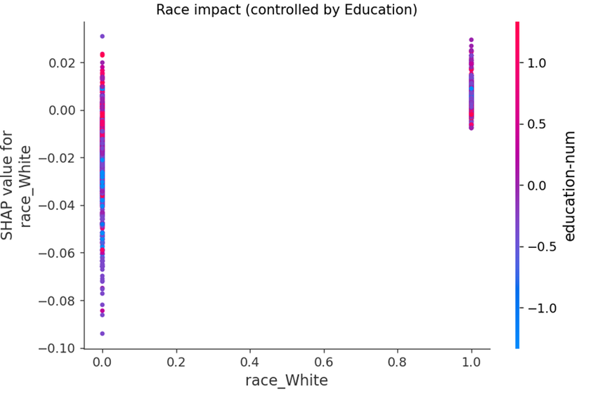
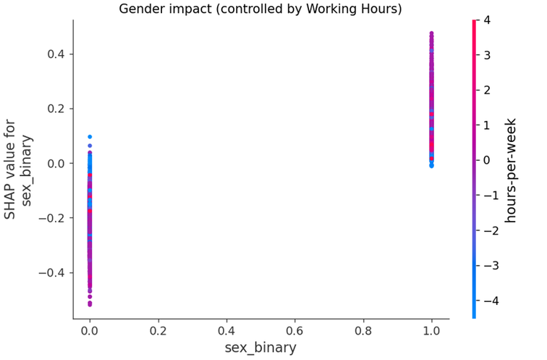
Fairness Explaination
23
EVEN AFTER CONTROLLING FOR EDUCATION AND WORKING HOURS, BIAS STILL PERSISTS:
+ Gender: same education/hours → one group gets negative SHAP, the other positive
+ RACE: SAME EDUCATION → WHITE GROUP STILL HAS HIGHER SHAP

Slide 31
Contentlist
1. Introduction & Goal of Study
2. Data Description
3. EDA
4. Feature Engineering
5. Model Building
6. Results
7. Conclusion

Slide 32
Conclusion
24
The analysis shows that the model does not purely learn individual capability, but mainly captures the social structure of income distribution. Factors like age, marital status, and occupation have stronger influence than education.
Among key variables, age is the most important driver, with clear nonlinear effects, while education has significantly weaker impact.
In terms of modeling, feature engineering + SMOTE + LightGBM provides the best performance and stability, while remaining interpretable via SHAP and LIME.
Fairness analysis reveals clear bias in gender and race, even though sensitive features have low direct importance. This is due to proxy variables (e.g., occupation, marital status) indirectly encoding these attributes.
Even after controlling for education and working hours, disparities persist, indicating that inequality is embedded in the data structure, not individual ability.

