Slide 1


Slide 2
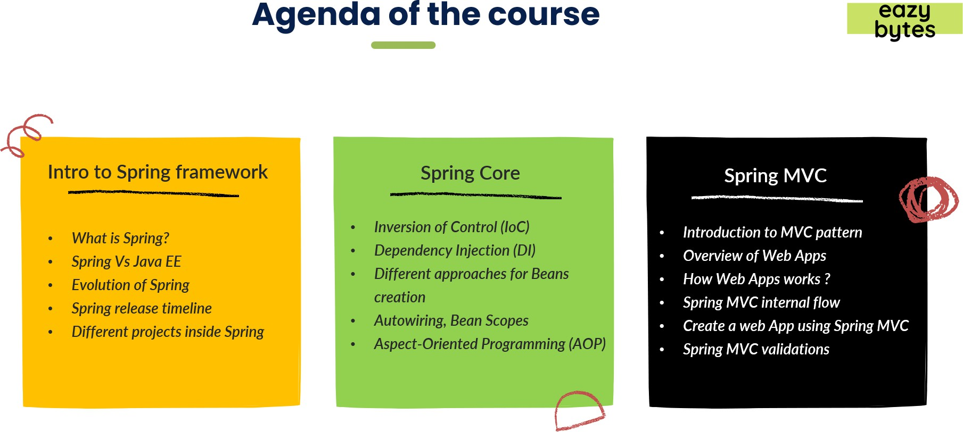

Slide 3

Only two pages were converted.
Please Sign Up to convert the full document.
www.freepdfconvert.com/membership

