Slide 1
How did the Department of Defense move to Kubernetes and Istio?
Mr. Nicolas Chaillan
Chief Software Officer, U.S. Air Force
Co-Lead, DoD Enterprise DevSecOps Initiative
V2.5 – UNCLASSFIED

Slide 2
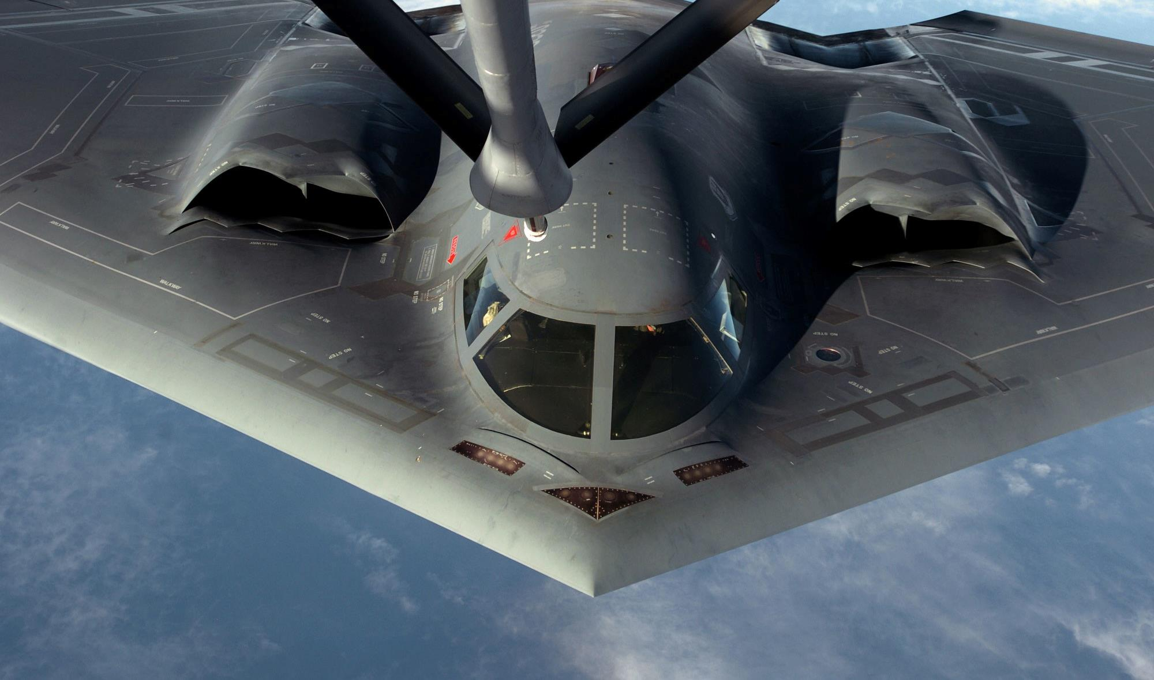
Must Adapt to Challenges
Must Rapidly Adapt To Challenges

Slide 3
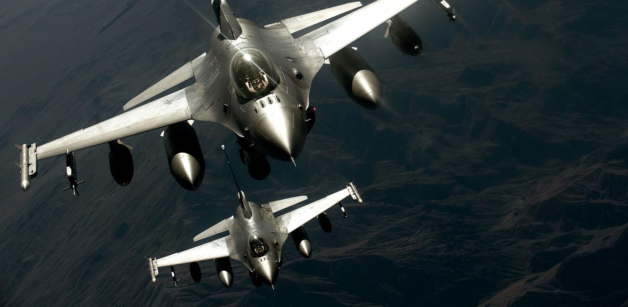
Must Adapt to Challenges
Work as a Team!
Must Adapt To Challenges

Slide 4
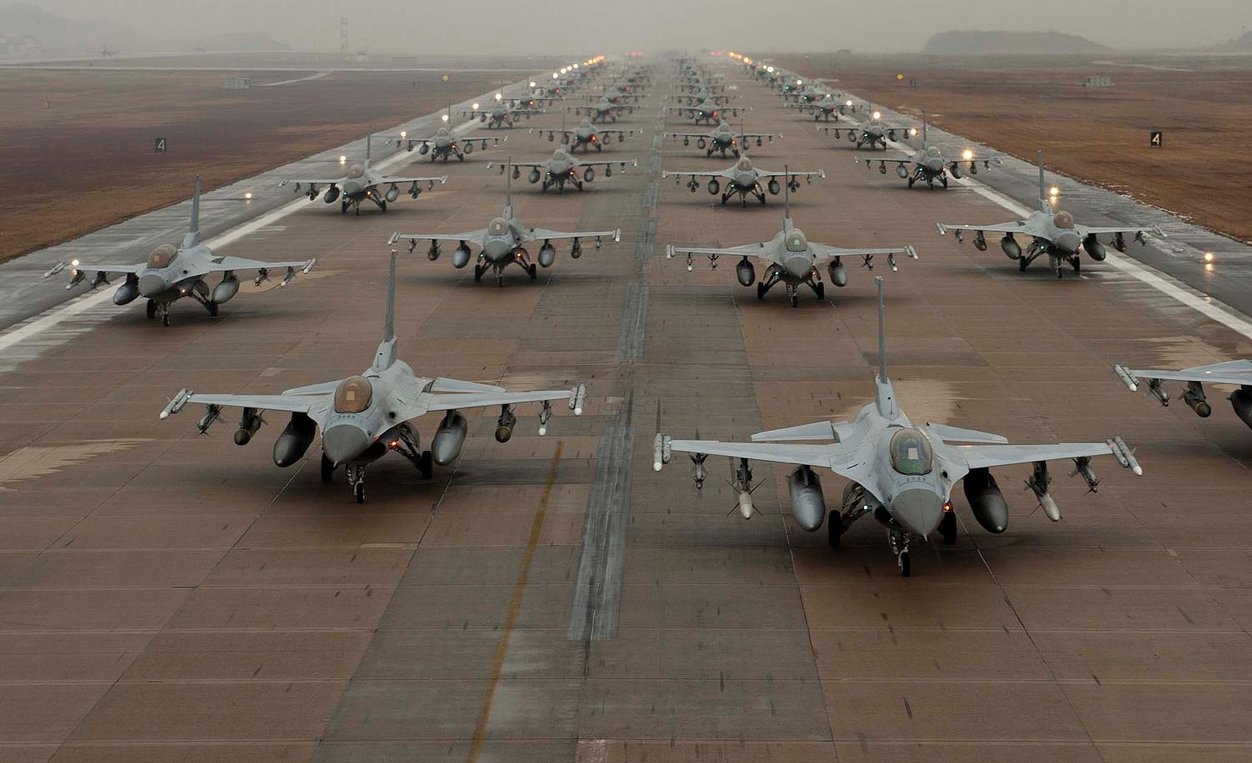
Must Adapt to Challenges
Work as a Team!
A Large Team!
Must Adapt To Challenges

Slide 5

Must Adapt to Challenges
Work as a Team!
With Various Technologies
A Large Team!
Must Adapt To Challenges

Slide 6
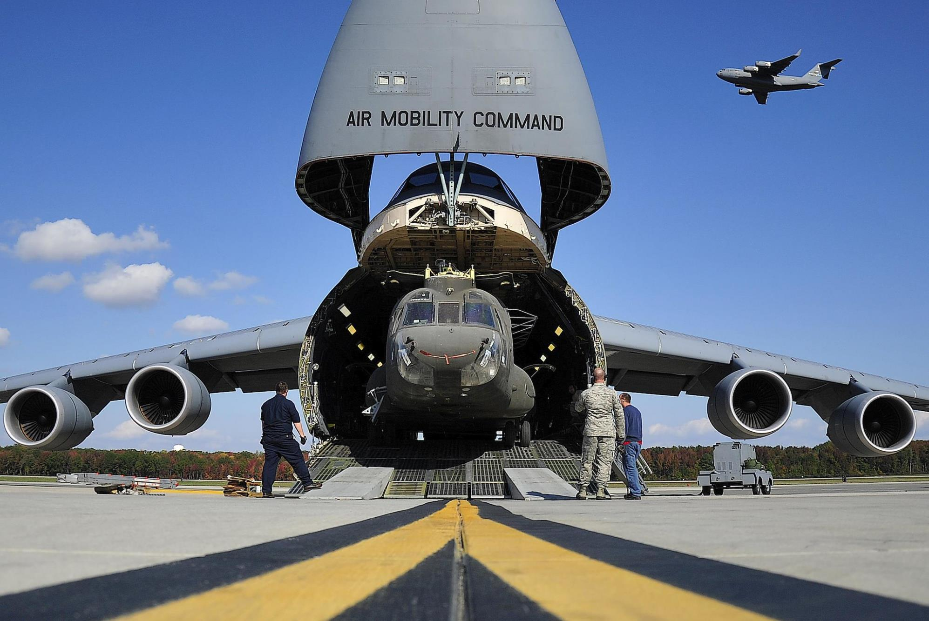
Must Adapt to Challenges
With Various Technologies
Work as a Team!
A Large Team!
Must Adapt To Challenges
Bring It With Us!

Slide 7

Must Adapt to Challenges
With Various Technologies
Work as a Team!
Even To Space!
A Large Team!
Must Adapt To Challenges
Bring It With Us!

Slide 8

Must Adapt to Challenges
With Various Technologies
Work as a Team!
To Space!
A Large Team!
Must Adapt To Challenges
With a Few Sensors!
Bring It With Us!

Slide 9
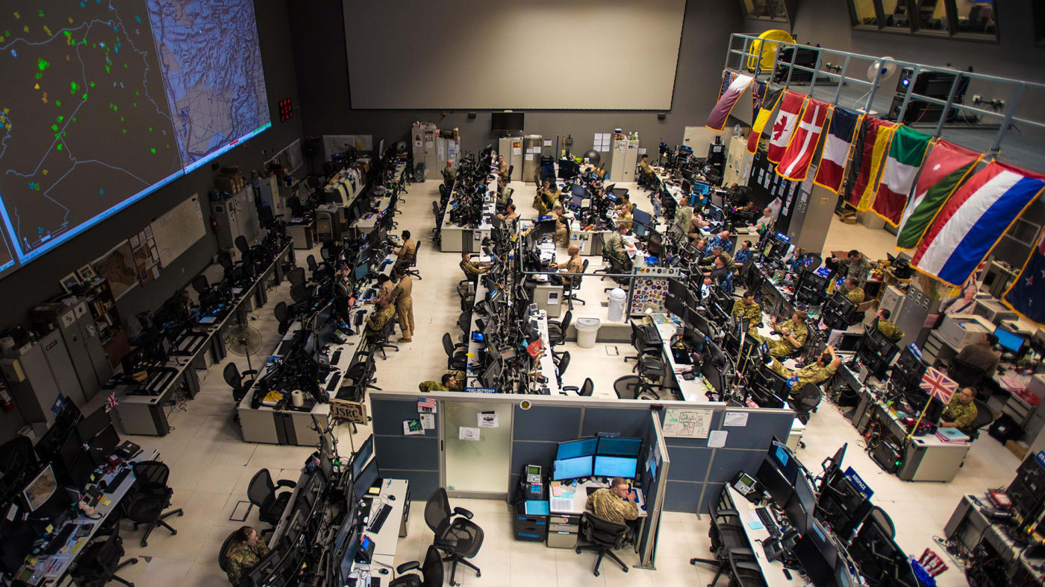
Must Adapt to Challenges
With Their Help!
With Various Technologies
Work as a Team!
To Space!
A Large Team!
Must Adapt To Challenges
With a Few Sensors!
Bring It With Us!

Slide 10
What is the DoD Enterprise DevSecOps Initiative?
Joint Program with OUSD(A&S), DoD CIO, U.S. Air Force, DISA and the Military Services.
Bringing Enterprise IT Capabilities with Cloud One and Platform One – Cloud and DevSecOps as Managed Services capabilities, on-boarding and support! Brings timeliness, modularity and enables reuse.
Technology:
Avoid vendor lock-in at the Infrastructure and Platform Layer by leveraging FOSS with Kubernetes and OCI containers (reusable lego blocks),
Created Iron Bank, the DoD Centralized Artifacts Repository (DCAR) of hardened and centrally accredited containers: selecting, certifying, and securing best of breed development tools and software capabilities (over 170+ containers) - https://repo1.dsop.io/dsop/ and https://ironbank.dsop.io
Baked-in Zero Trust Security with our Sidecar Container Security Stack (SCSS) leveraging behavior detection, zero trust down to the container/function level.
Leveraging a Scalable Microservices Architecture with Service Mesh (Istio), baked-in security
Leveraging KNative to avoid lock-in to Cloud provider Serverless stacks and Kubeflow for AI/ML/Deep Learning
Standardizing metrics and define acceptable thresholds for DoD-wide continuous Authority to Operate
Massive Scale Training with Self Learning Capabilities (train over 100K people within a year) and bring state of the art DevSecOps curriculum
Creating new Agile contracting language to enable and incentivize the use of DevSecOps: https://www.dau.edu/cop/it/DAU%20Sponsored%20Documents/Contracting%20Considerations%20for%20Agile%20Solutions%20v1.0.pdf

Slide 11
CSO Website – Continuously Updated!
Want to find information about the DevSecOps initiative and the CSO?
Our latest documents/videos: https://software.af.mil/dsop/documents/
Our latest training videos/content at: https://software.af.mil/training/
Platform One Services: https://software.af.mil/dsop/services/
More information about :
Platform One On Boarding: https://software.af.mil/team/platformone/
Cloud One: https://software.af.mil/team/cloud-one/
Repo One: https://repo1.dsop.io
Iron Bank: https://ironbank.dsop.io
Registry One: https://registry1.dsop.io
DevStar: https://software.af.mil/dsop/dsop-devstar/
Our Events/News: https://software.af.mil/events/

Slide 12
Why Kubernetes / Containers?
One of the most critical aspect of the DevSecOps initiative is to ensure we avoid any vendor lock-in so the DoD mandated:
Open Container Initiative (OCI) containers (no lock-in to containers/container runtimes/builders)
Cloud Native Computing Foundation (CNCF) Kubernetes compliant cluster for container orchestration, no lock-in to orchestration options/networking/storage APIs.
SaaS vs COTS/FOSS containers:
SaaS requires FedRAMP certification and will limit you to unclassified environments (IL2 for FedRAMP moderate) which doesn’t satisfy most needs for DoD programs. Often takes up to 1 year.
COTS/FOSS as containers: can be sold as a managed service deployed in DoD cloud environments (including classified clouds) on Kubernetes and can be accredited at multiple classification levels, within weeks, by following the container hardening guide and vendor on-boarding process!
Get your container(s) onboarded on Iron Bank for DoD wide reciprocity? https://repo1.dsop.io/dsop/dccscr/tree/master/contributor-onboarding
Containers are immutable and will allow the DoD to centrally accredit and harden containers (FOSS, COTS, GOTS) (think of a true gold disk concept but that actually scale and works).
Continuous Monitoring is a critical piece of our Continuous ATO model and the Sidecar Container Security Stack (SCSS) brings those capabilities with Behavior, Zero Trust and CVE scanning.
Kubernetes will provide:
Resiliency: Self-healing so containers that crash can automatically be restarted,
Baked-in security: thanks to automatic injection of our Sidecar Container Security Stack (SCSS) to any K8S cluster with Zero Trust,
Adaptability: containers are “Lego” blocks and can be swapped with no downtime thanks to load balancing and modern routing (A/B testing, canary release etc.),
Automation: thanks to our Infrastructure as Code (IaC) and GitOps model,
Auto-scaling: if load requires more of the same container, K8S will automatically scale based on compute/memory needs,
Abstraction layer: ensure we don’t get locked-in to Cloud APIs or to a specific platform as K8S is managed by CNCF and dozens of products are compliant with its requirements.

Slide 13
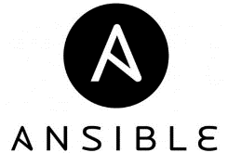



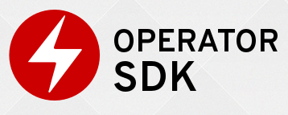








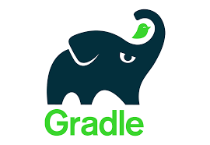






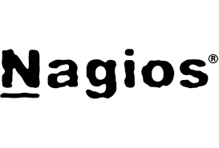



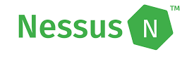

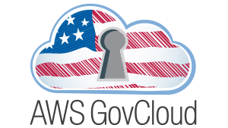







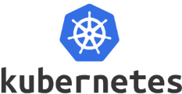





PLAN
&
DEVELOP
DoD Enterprise DevSecOps
Technology Stack
(Exemplar)
DEPLOY
&
OPERATE
BUILD
“Continuous Integration &
Continuous Delivery”
Orchestration
MONITOR
TEST
SECURE
SCALE
STORE ARTIFACTS
Container and Container Management

Slide 14


Understanding the DevSecOps Layers
Continuous Monitoring
Leverages the Sidecar Container Security Stack
Development Teams can build software/microservices leveraging hardened containers
YOU
Application
Layer
Brings baked-in security and
Microservices architecture enablement
Platform
One
Service Mesh
Layer
Fully containerized, leverages DoD approved containers from Iron Bank
Development Team selects tools from 172 approved containers or custom containers
Continuous Integration / Continuous Delivery
(CI/CD) Layer
CNCF compliant Kubernetes (K8S)
Includes Site Reliability Engineers (SREs) etc.
Development Team selects between approved K8S stacks
Platform
Layer
Environment Agnostic
Cloud One Preferred for unclassified (IL2, IL4, IL5)
Or SC2S/C2S/FENCES
Or on-premise/embedded systems/classified environments
Cloud One
Infrastructure
Layer

Slide 15
























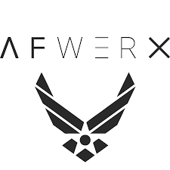
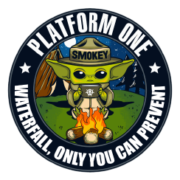





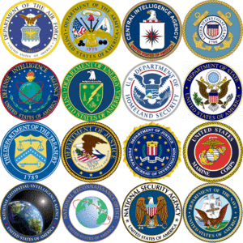



Software Ecosystem Multiple Innovation Hubs – One Platform
Software Factories
43 PMOs & PEOs Across Services
Science & Technology
Ventures & Non-Traditional Start-ups
Defense Industrial Base
AF Ventures
DoD-wide Enterprise Services
Other Agencies

Slide 16










Software Ecosystem Multiple Innovation Hubs, One Platform
N2X Pathfinder
Colorado Springs, CO
Thunder CAMP
Oklahoma City, OK
Platform One
Colorado Springs, CO
Space CAMP
Colorado Springs, CO
NORAD
Rogue Blue
Omaha, NE
76th SWEG
JAIC
Army Cyber
AEGIS
F-35
ABMS
Space Force
STRATCOM
Kessel Run
Boston, MA
AOC
F-35
ABMS
SoniKube
Hill AFB, UT
Ski CAMP
Hill AFB, UT
F-16
Conjure
Scott AFB, IL
GBSD
375th
Kobayashi Maru
Los Angeles, CA
Blue Sky
Warner Robins, GA
SMC
402nd SWEG
Corsair Ranch
Tuscon, AZ
LevelUP
San Antonio, TX
BESPIN
Montgomery, AL
TRON
Oahu, HI
Unified Platform
PEO BES
PACOM

Slide 17
Platform One Services
Full details at: https://software.af.mil/dsop/services/
Repo One – DoD Centralized Container Source Code Repository (DCCSCR)
Container source code, Infrastructure as Code, K8S distributions, etc.
Repo One is the central repository for the source code to create hardened and evaluated containers for the Department of Defense. It also includes various source code open-source products and infrastructure as code used to harden Kubernetes distributions.
Repo One is currently operated at https://repo1.dsop.io/dsop/.
Iron Bank – DoD Centralized Artifacts Repository (DCAR)
200+ containers available, 250 containers by end of 2020.
Iron Bank is the DoD repository of digitally signed, binary container images that have been hardened according to the Container Hardening Guide coming from Iron Bank. Containers accredited in Iron Bank have DoD-wide reciprocity across classifications.
Iron Bank is currently operated at https://ironbank.dsop.io/.

Slide 18
Platform One Services (continued)
DevSecOps Platform (DSOP) The DSOP is a collection of approved, hardened Cloud Native Computer Foundation (CNCF)-compliant Kubernetes distributions, infrastructure as code playbooks, and hardened containers that implement a DevSecOps platform compliant with the DoD Enterprise DevSecOps Reference Design, and its source code is hosted on Repo One.
Infrastructure as Code (IaC) Repositories:
Platform One IaC: https://repo1.dsop.io/platform-one
D2IQ: https://repo1.dsop.io/platform-one/distros/d2iq
Rancher Federal: https://repo1.dsop.io/platform-one/distros/rancher-federal
OpenShift 4.x: https://repo1.dsop.io/platform-one/distros/red-hat
Kubernetes CNCF-compliant currently supported are: OpenShift 4.x, Kubernetes upstream, D2IQ Konvoy and Rancher Federal RKE. Kubernetes CNCF-compliant to be supported soon: VMWare Tanzu and Oracle Kubernetes.
Platform One will be supporting the following environments:
Amazon Web Services (AWS) IL-2, IL-5, S, S-SAP (when available), TS/SCI, and TS-SAP (FENCES), AWS Outpost
Azure IL-2, IL-5, S (when available), S-SAP (when available), Azure Stack
On-premise / Edge - VMWare vSphere
The DSOP includes the various mandated containers of the Reference Design including Elasticsearch, Fluentd, and Kibana (EFK), Sidecar Container Security Stack (SCSS), etc.

Slide 19
Platform One Services (continued)
Party Bus – ABMS All Domain Common Environment: Platform One Shared Enterprise Environments (Multi-Tenant) (for Development, Test and Production)
These are environments that benefit from the Platform One Continuous ATO, hosted on Cloud One, SC2S and C2S managed by the Platform One team as multi-tenant environments. Perfect for smaller/medium sized teams. They provide Continuous Integration/Continuous Delivery (CI/CD) and various development tools/capabilities.
Big Bang: Platform One Dedicated DevSecOps Environments
Build, deliver and operate custom Infrastructure as Code and Configuration as Code with the deployment of dedicated environments at various classification levels with CI/CD pipelines and c-ATO. Perfect for large teams/programs that need a dedicated enclave (cost per DevSecOps environment).
Build and deliver new hardened containers as needed for program specific software (pay per use/container).

Slide 20
Platform One Services (continued)
Cloud Native Access Point (CNAP)
The Cloud Native Access Point is available on Cloud One to provide access to Development, Testing, Staging and Production enclaves at IL-2, IL-4 and IL-5 that using Platform One DevSecOps environments by using an internet-facing Cloud-native Zero trust environment.
The CNAP enables access to VDI options and allows thick endpoints (incl. mobile), including BYOD, government owned and contractor owned devices to connect at various impact level while enforcing device state/security.
Brings Single Sign On with various DoD PKI options and IL2 MFA options.
CNAP diagram: https://software.af.mil/wp-content/uploads/2020/04/CNAP-Data-Flow-Diagram-v5.3-NC.pptx

Slide 21
Platform One Services (continued)
Platform One Training/On-Boarding Options
Check out the CSO DevSecOps / DAU training at https://software.af.mil/training/
Virtual Platform One Learning Hub that provides self service on-boarding [June 2020 Launch]
1-day training Session: Introduction to DevSecOps. Overview and understanding of the vision and activities. [June 2020 Virtual Launch]
A 3 day Platform One Platform Workshop. Hands on code and User-Centered Design (UCD) to create your first Platform One DevSecOps pipelines and deploy a “push button” DoD DevSecOps software factory. [Currently Available]
A 6-week full on-boarding, that concludes with own CI/CD pipeline and Minimum Viable Product (MVP) ready for production [Currently Available]
A 2-month full on-boarding, that concludes with your platform team being able to support your own DevSecOps applications for development and production [July 2020 Virtual Launch]
Customized training options (both at our locations or on your premises) (pay per use).

Slide 22
DevSecOps Basic Ordering Agreements (BOAs) – Contract Vehicles
BOA 1: Cloud Services
Services to develop and deploy accredited, integrated and tested code at multiple classification levels and hybrid cloud architectures
Awarded 1 Nov 2019, 27 companies on-boarded
BOA 2: DevSecOps Pipeline and Platform Integration and Licensing Services
DevSecOps pipeline and platform integration and licensing service to support a wide collection of software and programming tools supporting the CI/CD of software products
Awarded 1 Nov 2019, 9 companies on-boarded
BOA 3: Software DevSecOps Services
Technical services of full-stack DevSecOps engineers, infrastructure engineers, and other key personnel
Awarded 15 Jan 2020, 19 companies on-boarded

Slide 23
Key “DevSecOps” Ingredients
Abstracted: to avoid drifts, be agnostic to environment (Cloud/on-premise/classified/disconnected…) and prevent lock-ins with Cloud or Platform layers, we leverage CNCF compliant Kubernetes and OCI compliant containers - open source stacks with U.S eyes on code and continuous scanning,
GitOps / Infrastructure as Code (IaC): no drift, everything is code (including configuration, networking etc.) Instantiate entire stack automatically,
Continuous Integration/Continuous Delivery pipeline (CI/CD): fully containerized and using Infrastructure as Code (IaC),
Hardened Containers: hardened “Lego blocks” to bring options to development teams (one size fits all lead to shadow IT)
Software Testing: mandated high test coverage,
Baked-in Security: mandated static/dynamic code analysis, container security, bill of material (supply chain risk) etc.
Continuous Monitoring:
Centralized logging and telemetry,
Automated alerting,
Zero trust, leveraging Service Mesh as Sidecar (part of SCSS), down to the container level,
Behavior detection (automated prevention),
CVE scanning,
Chaos engineering: Dynamically kills/restarts container with moving target defense.

Slide 24
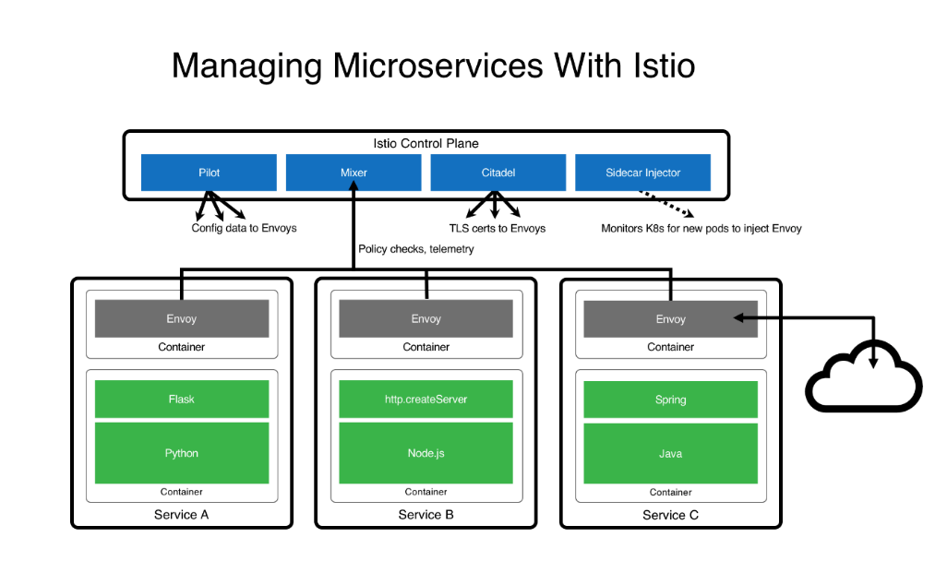
Microservices Architecture (ISTIO)
Turnkey Service Mesh (ISTIO) architecture
ISTIO side car proxy, baked-in security, with visibility across containers, by default, without any developer interaction or code change
Benefits:
API Management, service discovery, authentication…
Dynamic request routing for A/B testing, gradual rollouts, canary releases, resilience, observability, retries, circuit breakers and fault injection
Layer 7 Load balancing
Zero Trust model: East/West Traffic Whitelisting, ACL, RBAC…
TLS encryption by default, Key management, signing…

Slide 25
“Infrastructure as Code” Benefits
The “Infrastructure as Code” concept is a critical DevSecOps ingredient to ensure that production environments do not drift from development/testing environments. No human should make changes in production environments. Changes should only be made in source code and redeployed by the CI/CD pipeline.
No drift between environments, whether classified/disconnected/Cloud/on-premise,
Immutable,
Replicable,
Automated,
No human in production environments: reduces attack surface (disable SSH etc.), insider threat and configuration drifts,
Everything is code: including playbooks, networking, tests, configuration etc.

Slide 26
What is GitOps?
Based on Infrastructure as Code concepts, makes Git the single source of truth of the desired state of your Infrastructure, Platform and Applications.
Benefits:
Everything is code: infrastructure, networking, configuration, sealed secrets etc.
Auditability & Compliance
Consistent deployments and rollback (no drifts between environment)
Configuration Management enforcement
Disaster Recovery
Baked-in security: Kubernetes clusters pulls from Git. CI/CD won’t have access to production clusters. Removing human from production environments
Declarative manifests and playbooks
Options:
Argo CD, Flux as FOSS. Projects are merging into a single FOSS and be part of CNCF.

Slide 27
What is a Continuous ATO?
A Continuous ATO is very different from a traditional ATO or a Fast-Track/Accelerated ATO:
Platforms have to be compliant with the DoD Enterprise DevSecOps Ref Design to ensure DoD-wide reciprocity, including the use of the Sidecar Container Security Stack (SCSS). Platform controls are mapped to NIST-800-53.
We accredit the Platform’s PROCESS (Continuous Integration/Continuous Delivery (Software Factory)) with mandated change management, testing and security gates. The software coming out of the factory and that is RUNNING IN PRODUCTION on the Platform (Kubernetes with SCSS) also benefits from the cATO.
We accredit TEAMS using the Platform so they can produce quality software and be trained to move to DevSecOps
A key principle of DevSecOps is the baked-in security with:
Zero Trust
Automation
Removal of environment drifts
Behavior Detection
Continuous Monitoring
Pen-testing

Slide 28

Thank You!
Nicolas Chaillan
Chief Software Officer, U.S. Air Force
af.cso@us.af.mil

Slide 29
Backup Slides

Slide 30
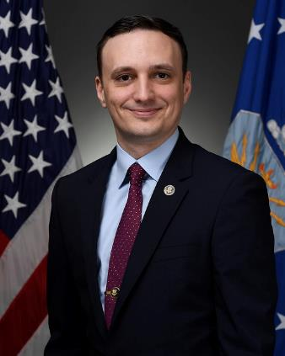
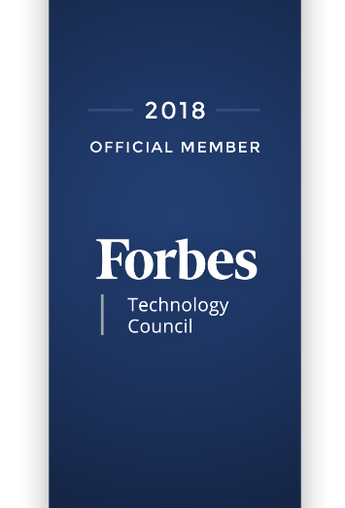
Nicolas M. Chaillan
Nicolas M. Chaillan is the Chief Software Officer at the U.S. Air Force and the Co-Lead for the DoD Enterprise DevSecOps Initiative.
He is the former Special Advisor for Cloud Security and DevSecOps at OSD, A&S.
He was the Special Advisor for Cybersecurity at the Department of Homeland Security and the Chief Architect for Cyber.gov, the new robust, innovative and holistic .Gov cyber security architecture for all .gov agencies.
Chaillan is a technology entrepreneur, software developer, cyber expert and inventor. He is recognized as one of France’s youngest entrepreneurs after founding his first company at 15 years of age.
With 19 years of international tech, entrepreneurial and management experience, Chaillan is the founder of more than 12 companies, including AFTER-MOUSE.COM, Prevent-Breach, anyGuest.com, and more.
Over the last eight years alone, he has created and sold over 180 innovative software products to 40 Fortune 500 companies.
Chaillan is recognized as a pioneer of the computer language PHP.
Chief Software Officer

Slide 31
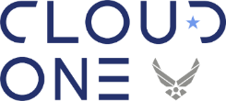
Cloud One
Air Force Cloud Office with turnkey access to AWS GovCloud and Azure Government at IL2, 4 and 5. IL6 available by December 2019.
Simple “Pay per use” model with ability to instantiate your own Development and Production VPCs at various Impact Levels within days with full compliance/security and a baked-in ATO.
Enterprise Solution: we provide the guardrails to the cloud in a standard manner so you can focus on your mission
Fully Automated: All environmental stand-up is managed by Infrastructure as Code, drastically speeding up deployment, reducing manual work, and human error
Centralized Identities and Single-Sign-On (SSO): one login across the Cloud stack
Internet facing Cloud based VPN to connect to IL5 enclaves with a Cloud Native Access Point (not using IAP/CAP).
DevSecOps Focused: secure, mission driven deployments are built into the framework to ensure self-service and seamless deployments. Leverages Zero Trust model.
Proactive Scaling and System Monitoring: Mission Owners can see all operational metrics and provide rules and alerts to manage each mission their way
Accreditation Inheritance has been identified in the AF-Cloud One eMASS accounts (AWS & Azure) to include inheritance from the CSP, USAF, DoD and CSSP. All that’s left for the mission is the controls that are unique to them.

Slide 32
DCCSCR/DCAR (DoD Container Repository)
Containers are centrally accredited by the DSOP team in the DoD repository:
DoD Centralized Containers Source Code Repository (DCCSCR): https://dccscr.dsop.io/dsop
DCCSCR Infrastructure as Code (IaC): https://dccscr.dsop.io/levelup-automation/aws-infrastructure
Allows DoD programs to reuse DevSecOps stack and CI/CD pipelines to ensure pre-hardened deployments.
DoD Centralized Artifacts Repository (DCAR) (Container binaries): https://dcar.dsop.io
Containers are signed and continuously monitored.
Community can contribute code merge requests, reviewed by the DSOP team.
Vendors/DoD Programs can contribute containers that have enterprise benefits to DCCSCR/DCAR and DSOP team will accredit them and maintain them.

Slide 33
Key “Continuous Security” Ingredients
Kubernetes hardening.
Automated injection of Sidecar Container Security Stack (SCSS) into all containers/pods running without manual action.
RBAC/SSO/SELinux enabled
Compliant with CIS Kubernetes Benchmark, mapped to NIST 800-53
Nodes, master, etcd are hardened.
Automated backups of cluster and persistent storage!
Sidecar Container Security Stack (SCSS):
Automated centralized logging and telemetry with Elasticsearch, Fluentd, Kibana (EFK),
Service Mesh (Istio):
Baked-in zero trust model down to the container level!
Strong identities automatically generated using certificates.
mTLS tunnel injected across all container communication
Whitelist enforcement, Layer 7 load balancer etc
Container security: Continuous Scanning, Alerting, CVE scanning, Behavior detection both in development and production (Build, Registry, Runtime) with Twistlock (looking into StackRox and Sysdig)
Container security and insider threat (custom policies detecting unapproved changes to Dockerfiles) with Anchore
Automated STIG compliance with OpenSCAP.

Slide 34
DevSecOps Stack implements Zero Trust!
Identities:
strong NPE identities are automatically managed by Istio (Service Mesh) for each container to enable zero trust down to the container level.
Non-NPE identities are using strong identities with DoD PKI
Devices:
Developer endpoints are using VDI options or approved endpoints images
Applications:
Apps are containerized and behind the Service Mesh which enforces Zero trust with strong identities per pod/container and .
Infrastructure:
Kubernetes is centrally hardened and continuously monitored with centralized logs and telemetry.
SCSS monitors container signatures and container state
SCSS brings Behavior detection and CVE continuous scanning
Network:
mTLS tunnels are automatically injected across all containers/pods by SCSS.
Data:
Data is always encrypted in transit and leverages FIPS encryption at rest.

Slide 35
Value for DoD Programs
Enables any DoD Program across DoD Services deploy a DoD hardened Software Factory, on their existing or new environments (including classified, disconnected and Clouds), within days instead of a year. Tremendous cost and time savings.
Multiple DevSecOps pipelines are available with various options (no one-size-fits-all)
Enables rapid prototyping (in days and not months or years) for any Business, C4ISR and Weapons system. Deployment in PRODUCTION!
Enables learning and continuous feedback from actual end-users (warfighters).
Enables bug and security fixes in minutes instead of weeks/months.
Enables automated testing and security.
Enables continuous Authorization to Operate (c-ATO) process. Authorize ONCE, use MANY times!
Brings a holistic and baked-in cybersecurity stack, gaining complete visibility of all assets, software security state and infrastructure as code.

Slide 36
DoD Enterprise DevSecOps
Architecture

Slide 37
DoD Enterprise DevSecOps Architecture*
Centralized DoD Enterprise DevSecOps Artifacts Repository
Continuously
Hardens Docker Public Images and Assesses Open Source Libraries
Program
Source code repository
pulls
Bare-metal, GovCloud, AWS Secret, Azure Secret,
mil Cloud, C2S, Jedi…***
Application / Microservices
built by DoD Programs.
Artifacts Repository**
pulls
DoD Enterprise DevSecOps Platform**
pulls
Microservices Architecture (ISTIO)
Sidecar Container Security Stack
DoD OCIO/DISA
Centralized
Logs/Telemetry****
DevSecOps
CI/CD pipeline**
Elasticsearch
pulls
Fluentd Real-time pushes
pulls
Kubernetes
Per DoD Service for Service-wide Visibility
Logs/Telemetry****
*each DoD Program can have its own instantiation of the DoD Enterprise DevSecOps Platform on any Cloud.
** can be installed with single command and deployed on any Cloud.
*** could be deployed inside an enclave or on-premises
**** gives complete visibilities of assets, security/vulnerability state etc. can be integrated to existing cybersecurity shared services.
Optional Abstraction Layer with
Red Hat OpenShift or PKS or CNCF compliant Kubernetes Product

Slide 38
Training Options
Our latest training videos from DAU available at: https://software.af.mil/training/
Check out our curated YouTube videos on Kafka, Kubernetes, Service Mesh, Microservices, Cloud etc. at https://software.af.mil/training/
NEW: Federal employees/Military personnel (limited number of seats, free of charge): reach out to us at usaf.cso@mail.mil if you want to pilot the access to the O’Reilly Online Learning Platform (all O’Reilly content + virtualized K8S env)!
Platform One Training/On-Boarding Options:
1-day training Session: introduction to DevSecOps. Overview and understanding of the vision and activities
A 3-day introduction to LevelUP DevSecOps tech stack. Hands on code and User-Centered Design (UCD) to deploy your first demo app to production
A several week full on-boarding, that concludes with an MVP ready for production
A several month full on-boarding, that concludes with your platform team being able to support your own DevSecOps applications for development and production
Customized training options (both at our locations or on your premises)
Follow the CNCF channel: https://www.youtube.com/channel/UCvqbFHwN-nwalWPjPUKpvTA

Slide 39
DevSecOps Platform Stack
(continuously evolving)

Slide 40
DevSecOps Product Stack (1)
Source Repository GitHub Government GitLab Container Management technologies: Kubernetes Openshift VMWare Tanzu PKS OKD Rancher (K8S only) D2IQ (K8S only) Docker EE (K8S only) Container Packagers: Helm Kubernetes Operators | API Gateways Kong Azure API AWS API Axway 3Scale Apigee ISTIO (service mesh) Artifacts Artifactory Nexus Maven Archiva S3 bucket | Programming Languages C/C++ C#/.NET .NET Core Java PHP Python Groovy Ruby R Rust Scala Perl Go Node.JS Swift | Databases SQL Server MySQL PostgreSQL MongoDB SQLite Redis Elasticsearch Oracle etcd Hadoop/HDInsight Cloudera Oracle Big Data Solr Neo4J Memcached Cassandra MariaDB CouchDB InfluxDB (time)

Slide 41
DevSecOps Product Stack (2)
Message bus/Streams Kafka Flink Nats RabbitMQ ActiveMQ Proxy Oauth2 proxy nginx ldap auth proxy openldap HA Proxy Envoy Visualization Tableau Kibana | Logs Logstash Splunk Forwarder Fluentd Syslogd Filebeat rsyslog Webservers Apache2 Nginx IIS Lighttpd Tomcat | Docker base images OS: Alpine Busybox Ubuntu Centos Debian Fedora Universal Base Image Serverless (FaaS) Knative AI/ML/Deep Learning Kubeflow

Slide 42
DevSecOps Product Stack (3)
Build MSBuild CMake Maven Gradle Apache Ant Tests suite Cucumber J-Unit Selenium TestingWhiz Watir Sahi Zephyr Vagrant AppVerify nosetests SoapUI LeanFT | Test coverage JaCoCo Emma Cobertura codecov CI/CD Orchestration Jenkins (open source) CloudBees Jenkins GitLab Jenkins plugins Dozens (Need to verify security). Configuration Management / Delivery Puppet Chef Ansible Saltstack | Security Tenable / Nessus Agents Fortify Twistlock Aqua SonarQBE Qualys StackRox Aporeto Snort OWASP ZAP Contrast Security OpenVAS Metasploit ThreadFix pylint JFrog Xray OpenSCAP (can check against DISA STIG) OpenControl for compliance documentation | Security (2) Snyk Code Climate AJAX Spider Tanaguru (508 compliance) InSpec OWASP Dependency-Check Burp HBSS Anchore Checkmarx SD Elements Clair Docker Bench Security Notary Sysdig Layered Insight BlackDuck Nexus IQ/Lifecycle/Firewall RunSafe

Slide 43
DevSecOps Product Stack (4)
Monitoring Sensu EFK (Elasticsearch, Fluentd, Kibana) Splunk Nagios New Relic Sentry Promotheus Grafana Kiali | Collaboration Rocket.Chat Matter.Most PagerDuty Plan Jira Confluence Rally Redmine Pivotal Tracker Secrets Kubernetes Secrets Vault Credentials (Jenkins) CryptoMove SSO Keycloak | Documentation Javadoc RDoc Sphinx Doxygen Cucumber phpDocumentator Pydoc Performance Apache AB Jmeter LoadRunner

Slide 44
Self-Learning (1)
Recommended Videos (Part 1)
Watch our playlists, available at different expertise levels and continuously augmented!
Kafka / KSQL (message bus, pub/sub, event driven):
Beginners: https://www.youtube.com/playlist?list=PLSIv_F9TtLlzz0zt03Ludtid7icrXBesg
Intermediate: https://www.youtube.com/playlist?list=PLSIv_F9TtLlxxXX0oCzt7laO6mD61UIQw
Advanced: N/A
Kubernetes
Beginners: https://www.youtube.com/playlist?list=PLSIv_F9TtLlydFzQzkYYDdQK7k5cEKubQ
Intermediate: https://www.youtube.com/playlist?list=PLSIv_F9TtLlx8dSFH_jFLK40Tt7KUXTN_
Advanced: https://www.youtube.com/playlist?list=PLSIv_F9TtLlytdAJiVqbHucWOvn5LrTNW

Slide 45
Self-Learning (2)
Recommended Videos (Part 2)
Watch our playlists, available at different expertise levels and continuously augmented!
Service Mesh
Beginners: https://www.youtube.com/playlist?list=PLSIv_F9TtLlxtC4rDIMQ8QiG5UBCjz7VH
Intermediate: https://www.youtube.com/playlist?list=PLSIv_F9TtLlwWK_Y_Cas8Nyw-DsdbH6vl
Advanced: https://www.youtube.com/playlist?list=PLSIv_F9TtLlx8VW2MFONMRwS_-2rSJwdn
Microservices
Beginners: https://www.youtube.com/playlist?list=PLSIv_F9TtLlz_U2_RaONTGYLkz0lh-A_L
Intermediate: https://www.youtube.com/playlist?list=PLSIv_F9TtLlxqjuAXxoRMjvspaEE8L2cB
Advanced: https://www.youtube.com/playlist?list=PLSIv_F9TtLlw4CF4F4t3gVV3j0512CMsu

Slide 46
Self-Learning (3)
Recommended Books
A Seat at the Table – by Mark Schwartz (former CIO of USCIS, leader in Agile)
This book is highly recommended for ALL leadership as it is not technical but focused on the challenges around business, procurement and how leadership can enable DevOps across the organization and remove impediments.
The Phoenix Project – by the founders of DevOps
The DevOps Handbook – by Gene Kim, Patrick Debois.
For those who drive to work like me (for hours), please note that these books are available as Audiobooks.

Slide 47
Legacy to DevSecOps => Strangler Pattern
Martin Fowler describes the Strangler Application:
One of the natural wonders of this area are the huge strangler vines. They seed in the upper branches of a fig tree and gradually work their way down the tree until they root in the soil. Over many years they grow into fantastic and beautiful shapes, meanwhile strangling and killing the tree that was their host.
To get there, the following steps were followed:
First, add a proxy, which sits between the legacy application and the user. Initially, this proxy doesn’t do anything but pass all traffic, unmodified, to the application.
Then, add new service (with its own database(s) and other supporting infrastructure) and link it to the proxy. Implement the first new page in this service. Then allow the proxy to serve traffic to that page (see below).
Add more pages, more functionality and potentially more services. Open up the proxy to the new pages and services. Repeat until all required functionality is handled by the new stack.
The monolith no longer serves traffic and can be switched off.
Learn more: https://www.ibm.com/developerworks/cloud/library/cl-strangler-application-pattern-microservices-apps-trs/index.html and https://www.michielrook.nl/2016/11/strangler-pattern-practice/

