Slide 1
Containers
A quick deep dive

Slide 2
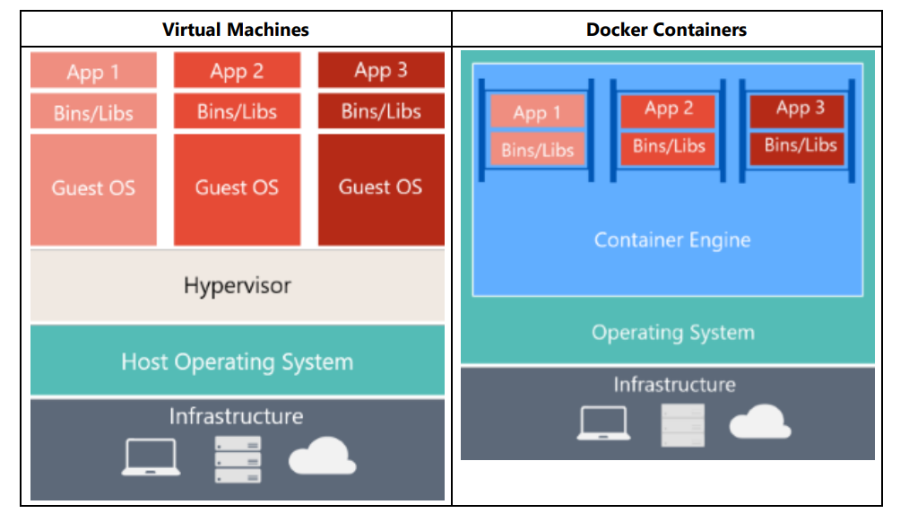
Containers vs Virtual Machine

Slide 3
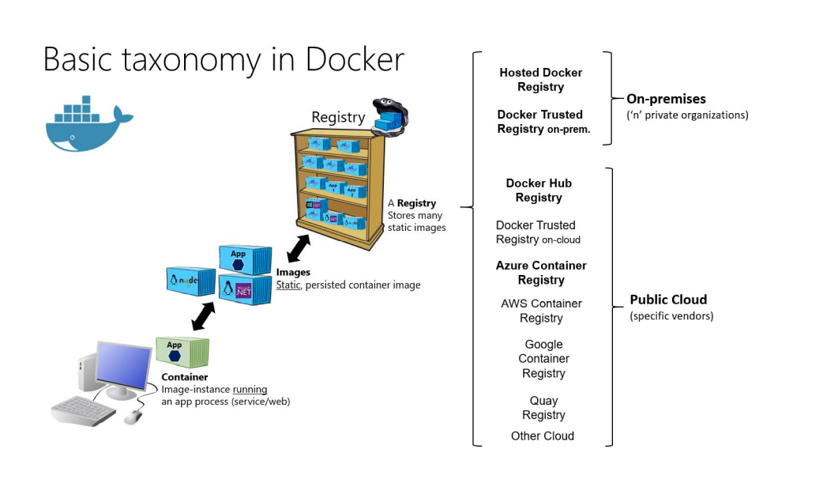

Slide 4
Docker
Containers and Image
Image Generation
Dockerfile
Compose
Docker Alternatives
Running your first Container

Slide 5
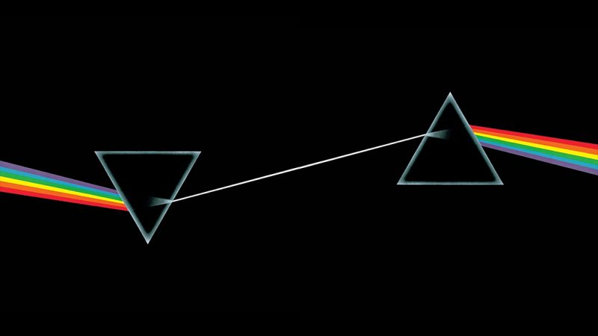
.NET and Containers
Dark Side of the Moon
PostgreSQL
Redis
Zookeeper
And lot more
Build & Run
Build Locally
Multi Stage Builds
Linux
Git
Multi Stage Builds

Slide 6
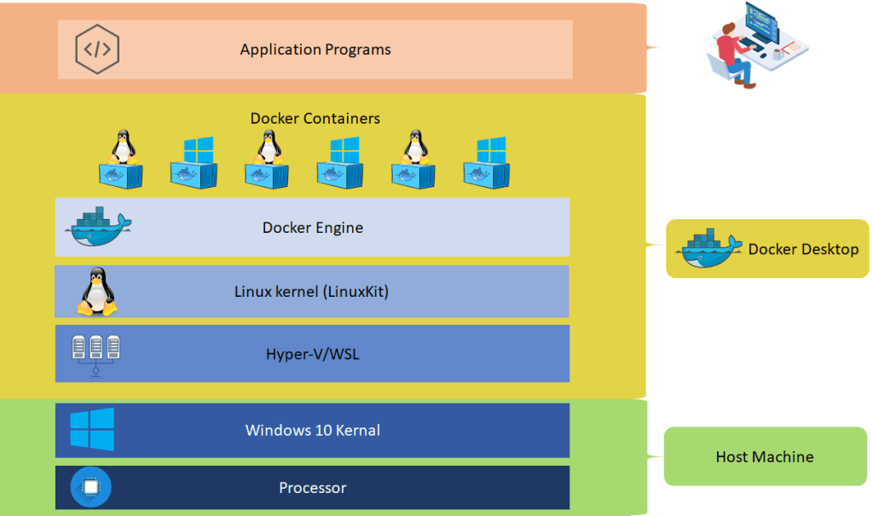
Docker “Desktop” (Windows and Mac)

