Slide 1
PAKISTAN'S COMPLETE ENTERPRISE ERP SUITE
Nexora Business Management Platform
All-in-one centralized web ERP engineered for Pakistani business environments: FBR Sales Tax Invoicing, Multi-Godown Logistics, EOBI Payroll, and Executive P&L Analytics.
✓ FBR Digital POS & Tax Compliance ✓ Karachi • Lahore • Islamabad Multi-Godown ✓ Automated EOBI / PESSI Payroll
Live Interactive Demo: https://kmbnexora.vercel.app • Confidential Client Presentation

Slide 2
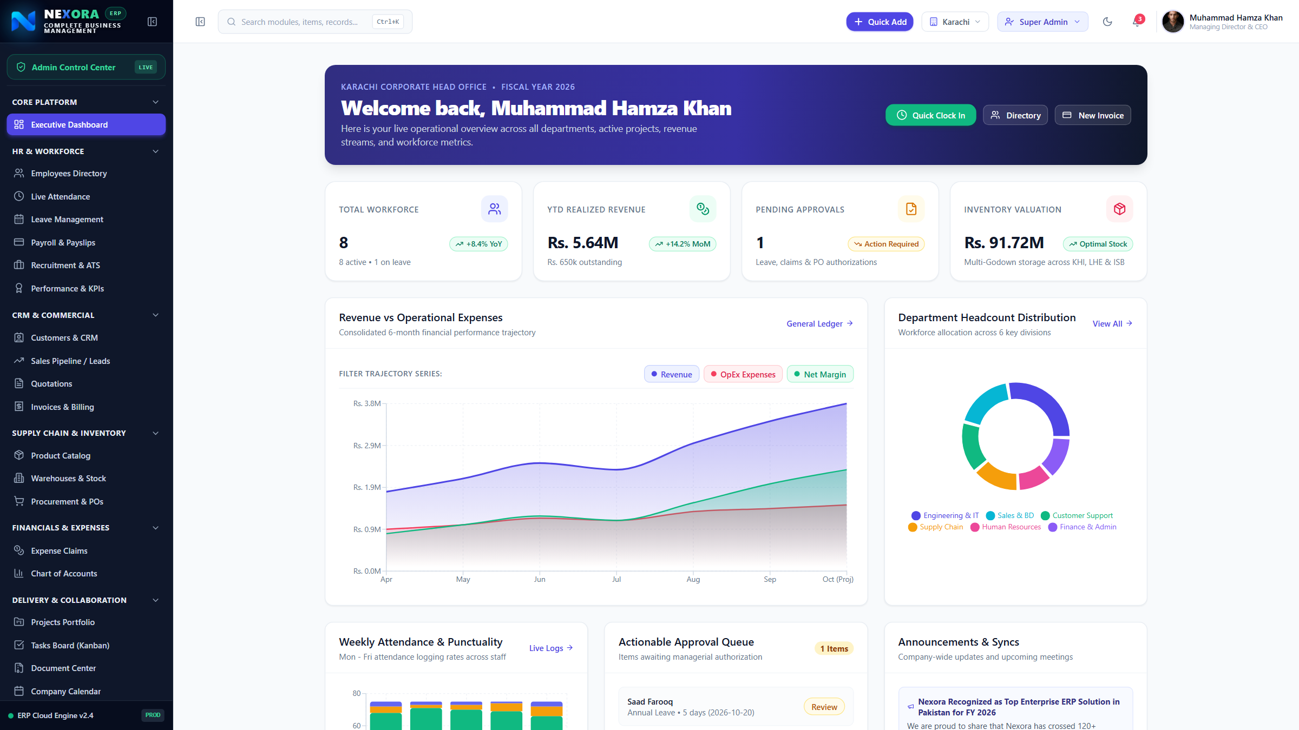
EXECUTIVE OVERVIEW
Unified Executive Command Center
Real-time visibility over enterprise cash flow, YTD revenue, pending approvals, and department budgets.
• Birds-Eye Financial Visibility
Realized revenue, monthly operational expenses, and net profit tracked in PKR (Rs.) with live baseline toggles.
• Pending Approvals Radar
Instant notification of invoices, purchase orders, and expense claims awaiting executive signoff.
• Multi-Metric KPI Cards
Directly clickable cards allowing directors to dive straight into workforce, stock valuation, or invoices.
• Department Distribution
Dynamic visual breakdown of staff and expense allocation across Administration, Accounts, and Logistics.

Slide 3
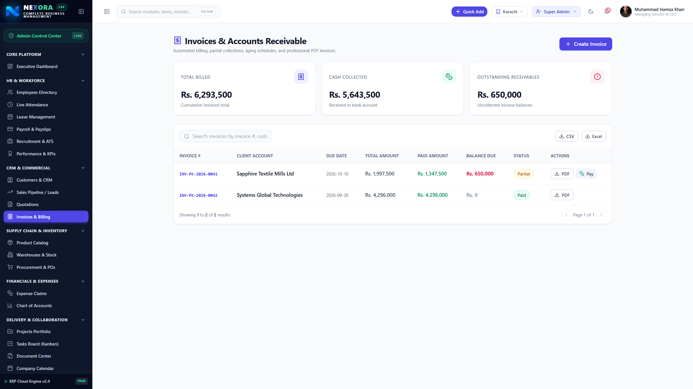
FINANCE & COMPLIANCE
FBR-Compliant Digital Invoicing & Tax Ledger
Automated cryptographic QR codes, provincial sales tax calculations, and instant audit trails.
• FBR Digital POS Integration
Compliant invoice formatting with automated tax calculation (GST, Provincial SST) ready for Iris reporting.
• Verifiable QR Codes
Each invoice features a unique cryptographic QR code for authentic digital verification by customers and authorities.
• Accounts Receivable Tracking
Real-time visibility over Paid, Partially Paid, and Overdue customer invoices with automated reminders.
• 1-Click PDF Export & Letterhead
Generate professional tax invoices on corporate letterhead ready for email and WhatsApp dispatch.

Slide 4
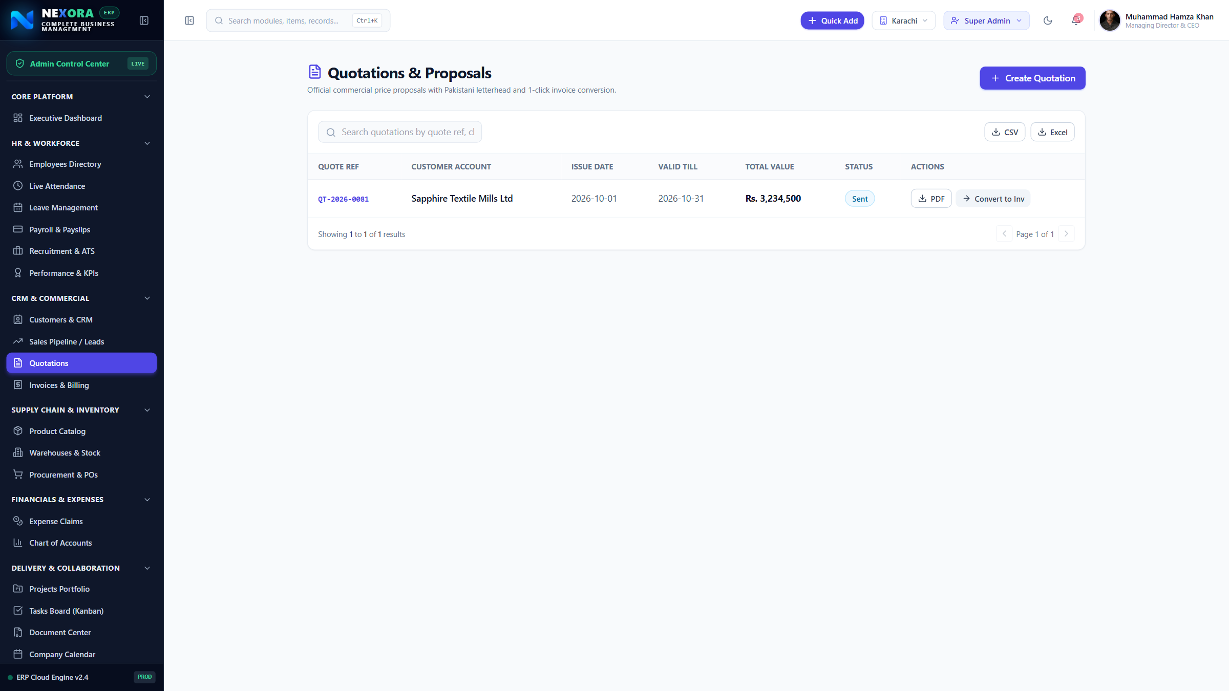
COMMERCIAL & SALES
Professional Quotations & Proposal Generator
Rapid multi-item quote builder with automated tax, discounts, terms, and letterhead.
• Multi-Item Quote Builder
Add unlimited line items with quantity, unit prices in PKR, and itemized discount percentages.
• Automated Tax Computation
Dynamic sales tax calculations ensuring 100% pricing accuracy before proposals reach clients.
• Corporate Letterhead
Pre-formatted with Nexora branding, company contact, NTN, bank details, and customized terms & conditions.
• Instant Quotation-to-Invoice
Convert approved quotations into live sales orders and invoices with a single click, saving hours of manual data entry.

Slide 5
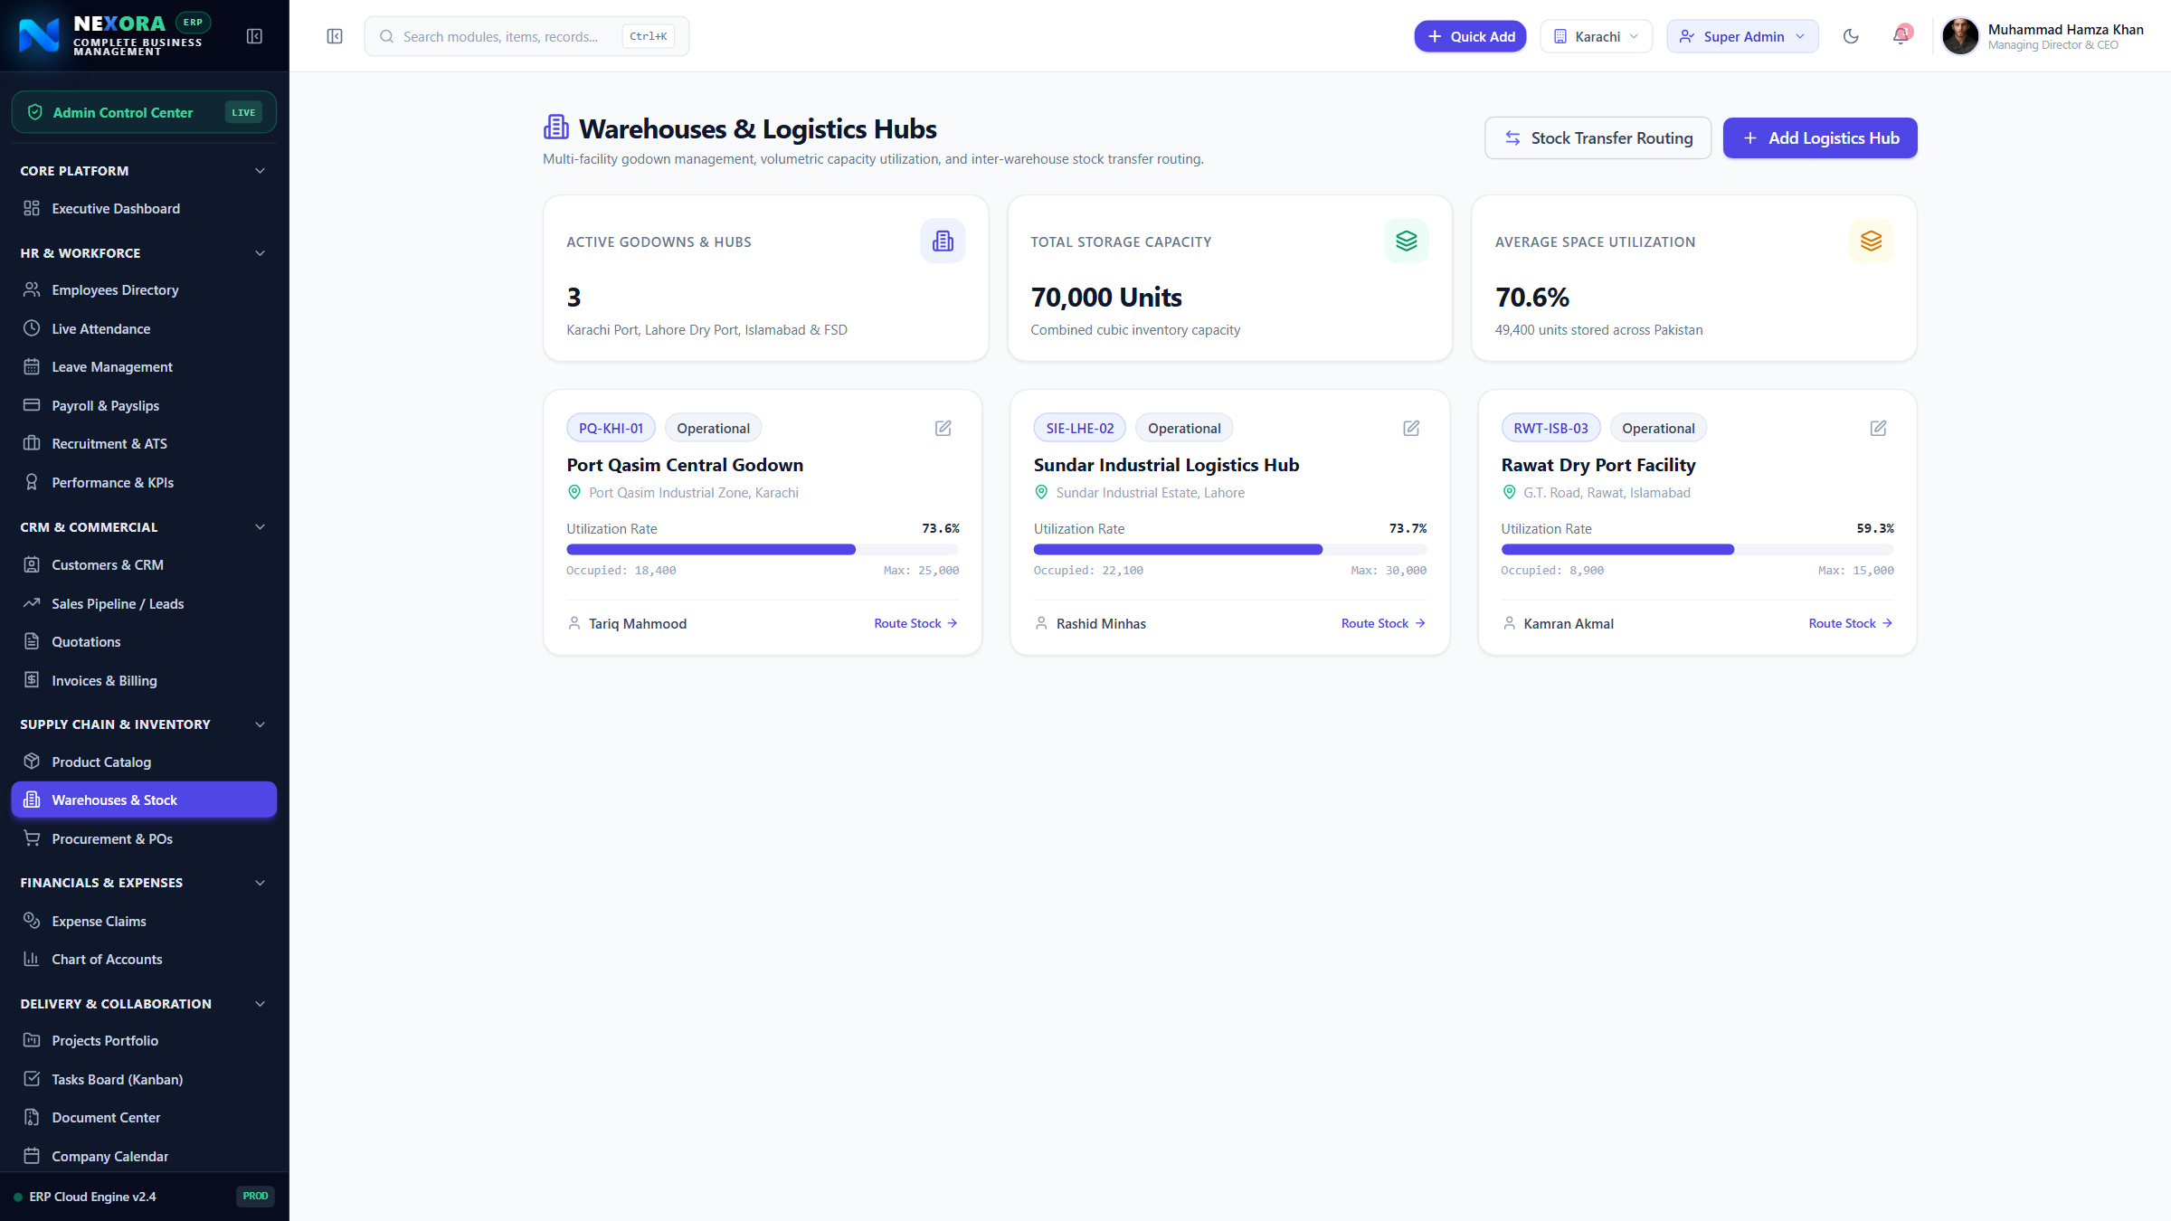
SUPPLY CHAIN
Multi-Godown Storage & Logistics Hubs
Centralized inventory control across Karachi, Lahore, Faisalabad, and Islamabad facilities.
• Facility Utilization Tracking
Monitor capacity utilization percentages for Port Qasim, Lahore Multan Rd, and Islamabad depots.
• Inter-Warehouse Stock Routing
Execute internal stock transfer requests with digital dispatch notes and receiving acknowledgements.
• Real-Time Valuation in PKR
Live total inventory valuation tracked by individual warehouse location to eliminate dead stock.
• Facility Manager Governance
Assign dedicated warehouse supervisors and godown managers with isolated access control.

Slide 6
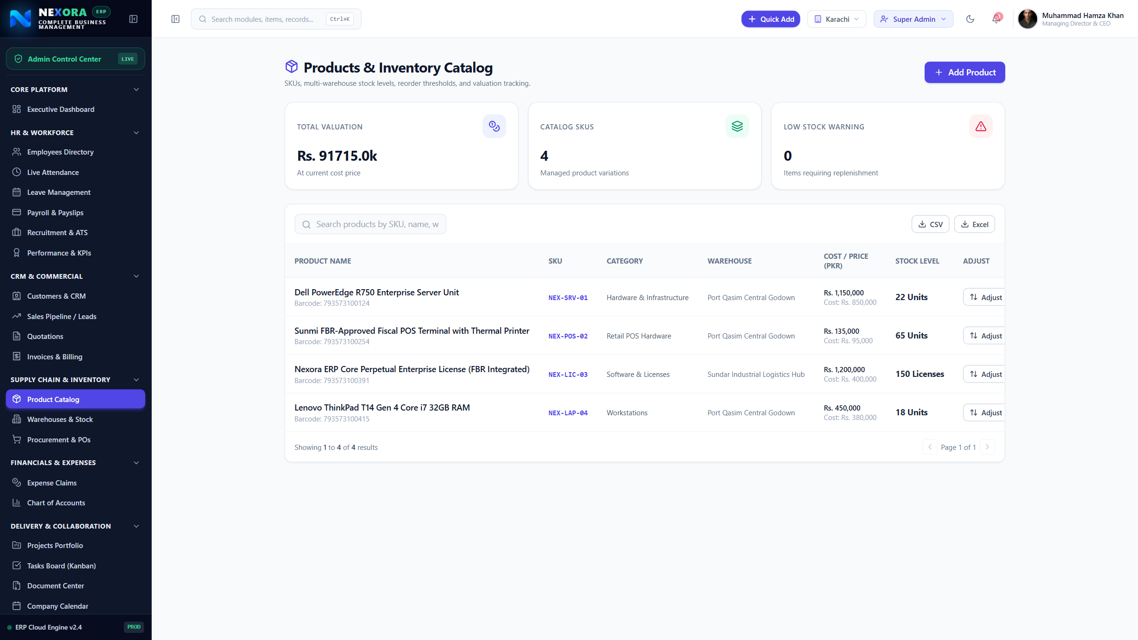
INVENTORY CONTROL
Products Catalog, SKUs & Reorder Alerts
Comprehensive SKU management, cost vs selling prices, low-stock alerts, and category tagging.
• Automated Reorder Alerts
Instant alerts when item quantities drop below safety thresholds, preventing costly stockouts.
• Multi-Price Management
Track unit purchase costs vs wholesale and retail selling prices with gross margin percentages.
• Categorization & Filtering
Quickly filter by IT hardware, machinery, raw materials, or consumables with instant barcode / SKU lookup.
• Bulk Import & Export
Effortlessly import thousands of items from legacy Excel spreadsheets within minutes.

Slide 7
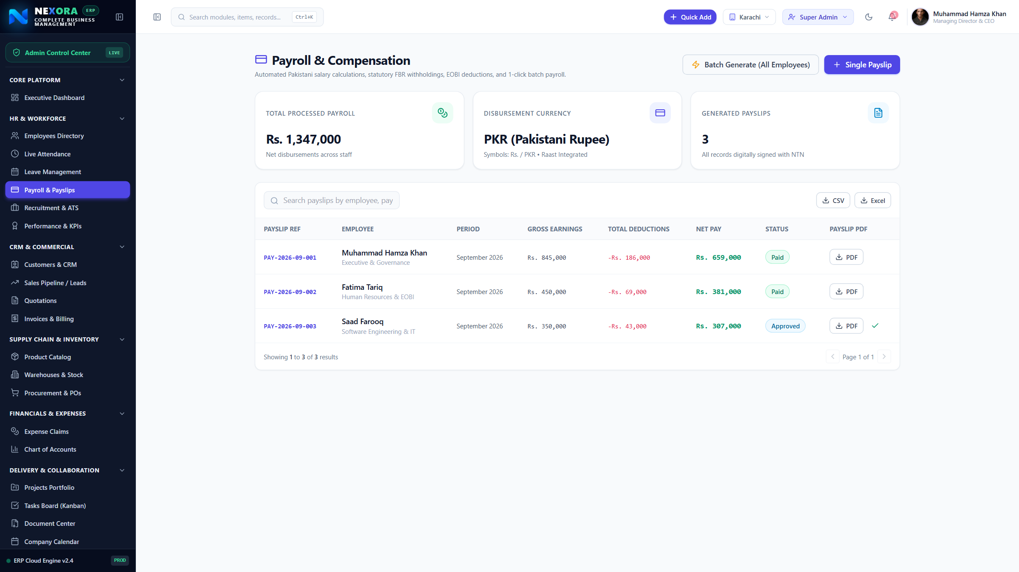
HUMAN CAPITAL
Localized Payroll, EOBI & Direct Salary Credits
Automated monthly payroll runs with income tax deductions, social security, and 1Link banking.
• Pakistan Tax & EOBI Deductions
Automated calculations for EOBI employee/employer contributions, PESSI/SESSI, and FBR income tax slabs.
• 1-Click Bulk Payroll Generation
Generate entire company payroll runs across all departments simultaneously with individual adjustments.
• 1Link & Raast Direct Bank Transfer
Export standardized bank salary clearing sheets for Habib Bank (HBL), Meezan, MCB, and UBL.
• Printable Employee Payslips
Secure digital payslips detailing basic pay, house rent, medical allowance, overtime, and net payout.

Slide 8
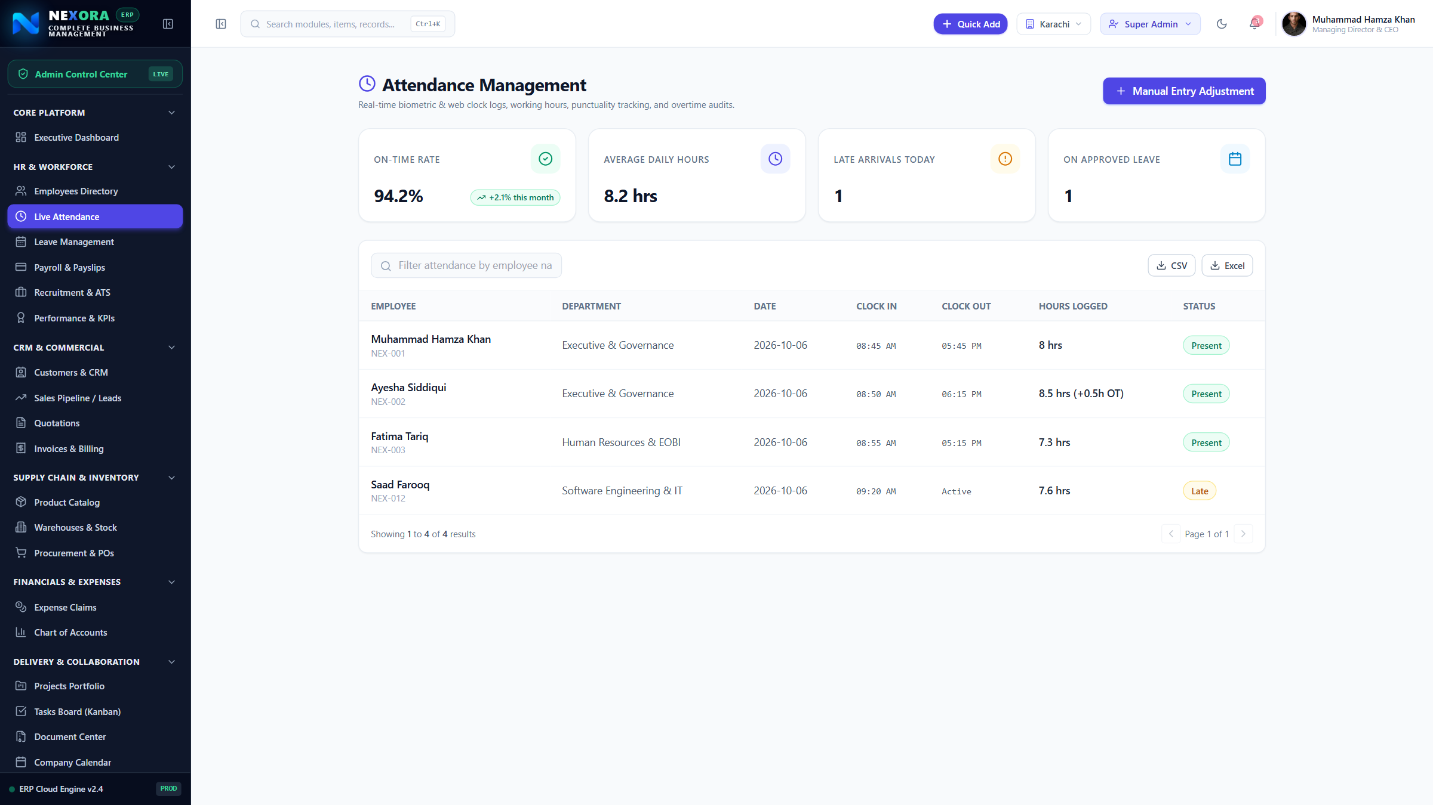
WORKFORCE MONITORING
Live Attendance & Shift Management
Real-time biometric radar tracking present, late arrivals, half-days, and leave balances.
• Real-Time Workforce Radar
Live attendance status counters showing present headcount, late arrivals, on-duty, and absentees.
• Multi-Shift Configurations
Support for morning, evening, and rotating factory / office shifts with customizable grace periods.
• Overtime & Deduction Rules
Seamless sync between daily attendance logs and the monthly payroll engine to calculate late deductions.
• Biometric & Mobile Check-In
Ready for hardware biometric machine integration and mobile field-staff check-in.

Slide 9
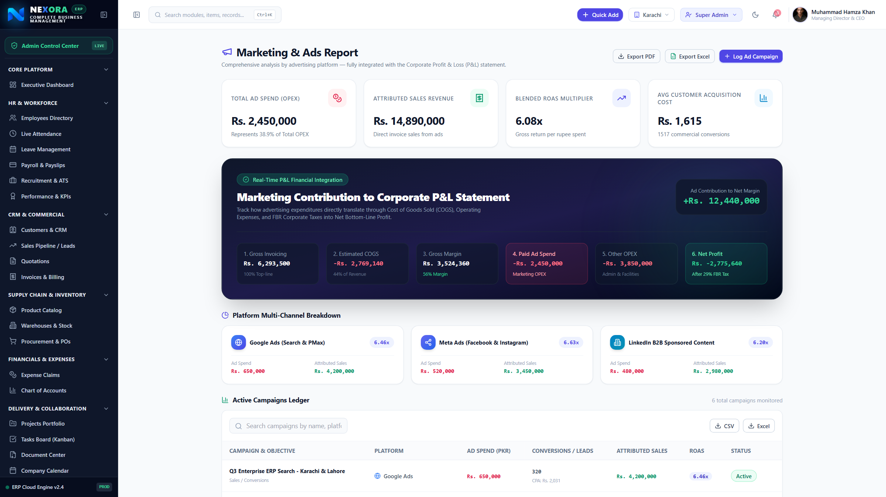
COMMERCIAL INTELLIGENCE
Marketing & Ads Performance Integrated with P&L
Comprehensive analysis across Meta, Google, and TikTok integrated directly with financials.
• Cross-Platform Attribution
Track ad spend, impressions, clicks, customer acquisition cost (CAC), and ROAS across Meta, Google Ads & TikTok.
• Direct P&L Statement Integration
Marketing ad spend automatically reflects as operational expense in financial reports and EBITDA calculations.
• Realized vs Ad-Generated Revenue
Compare actual cash collections in bank against digital campaign conversions to gauge genuine profitability.
• Channel Efficiency Benchmarking
Identify which marketing platforms deliver the highest ROI for your products and services.

Slide 10
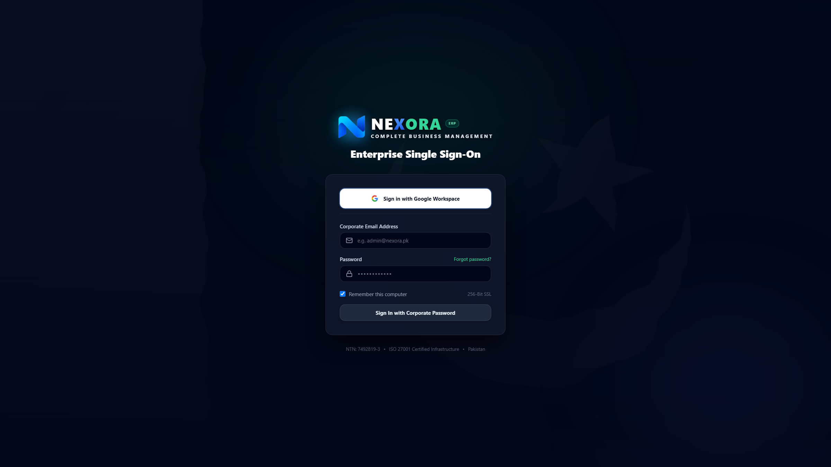
ENTERPRISE SECURITY
Granular Access Control & Google Single Sign-On
Role-based permission architecture protecting your commercial and financial data.
• Google Workspace SSO
Secure 1-click single sign-on via corporate Google accounts with enterprise OAuth verification.
• Role-Based Access Control (RBAC)
Pre-configured roles (Super Admin, HR, Finance, Inventory, Sales, Department Manager) with View/Create/Edit/Approve rights.
• Complete Audit Trail
Every login, document export, price edit, and approval is recorded with user identity, timestamp, and IP tracking.
• Data Sovereignty & Backups
Automated cloud backups with strict SSL encryption adhering to State Bank of Pakistan data regulations.

Slide 11
DEPLOYMENT PLAN
Fast-Track Implementation & Commercial Next Steps
Structured 3-phase rollout ensuring zero disruption to your daily business operations.
PHASE 1 (Week 1)
System Setup & Data Onboarding
✓ Company profile & branch setup
✓ Chart of accounts configuration
✓ Import inventory & pricing from Excel
✓ Import employee records & salaries
PHASE 2 (Week 2)
Departmental Staff Training
✓ Executive & Director dashboard training
✓ Invoicing & accounts staff walkthrough
✓ Warehouse storekeeper training
✓ HR & payroll execution run
PHASE 3 (Week 3)
Live Go-Live & Dedicated Support
✓ Parallel run with existing records
✓ Final data verification & audit signoff
✓ Full enterprise cutover to Nexora
✓ Dedicated WhatsApp support hotline

