Slide 1
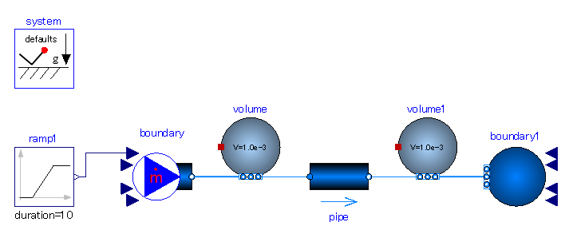

Slide 2
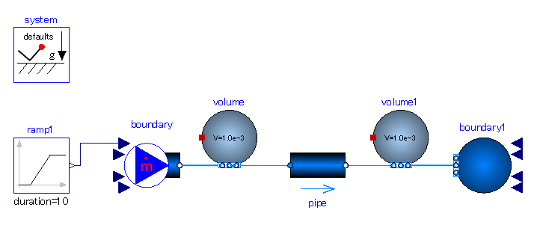
Volumes
-. In order to see the temperature and enthalpy change across the pipe.
Pipe= Flow resistance.
-. Fluid pressure drops through it.
Input (boundary cond.):
-. mass flow rate with ramp in time. Increase it gradually.
-. Inlet temperature with fixed value.
Output of interest:
-. Inlet pressure.
Input (boundary cond.):
-. Outlet pressure with fixed value.
Output of interest:
-. Outlet temperature.

Slide 3
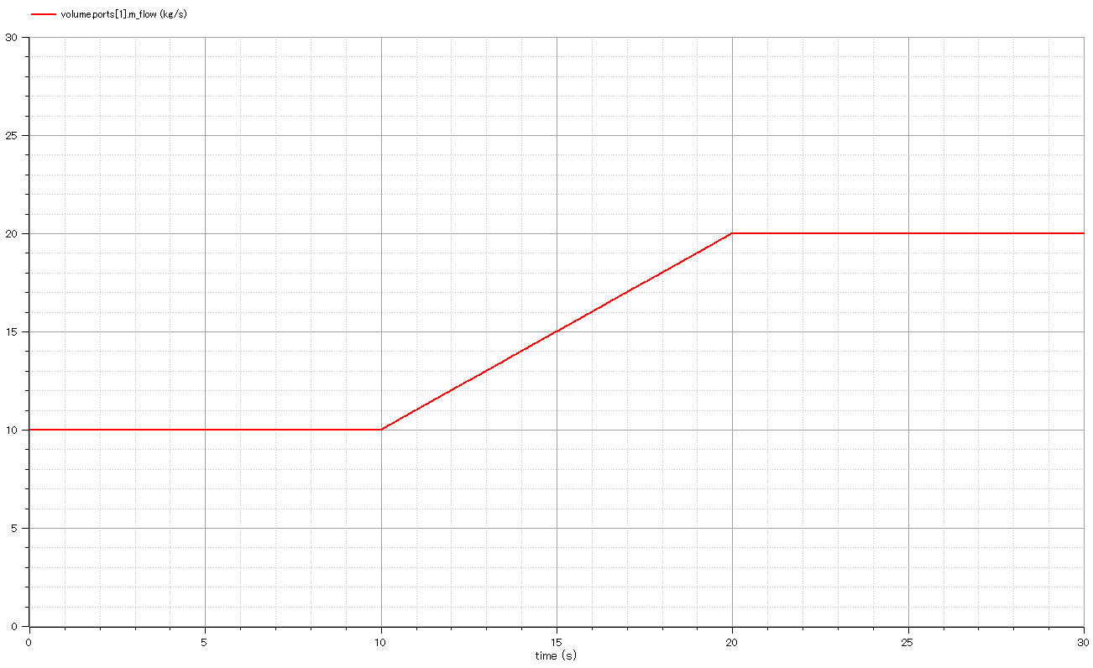
Input:
mass flow rate flowing through pipe.

Slide 4
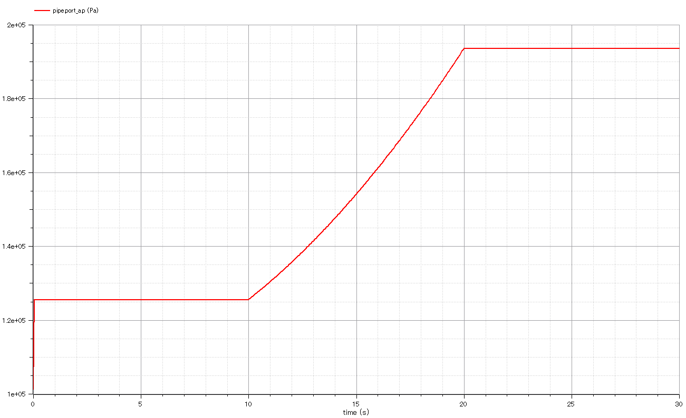
Output:
Fluid pressure of pipe inlet.
It increases as mass flow rate increases.

Slide 5
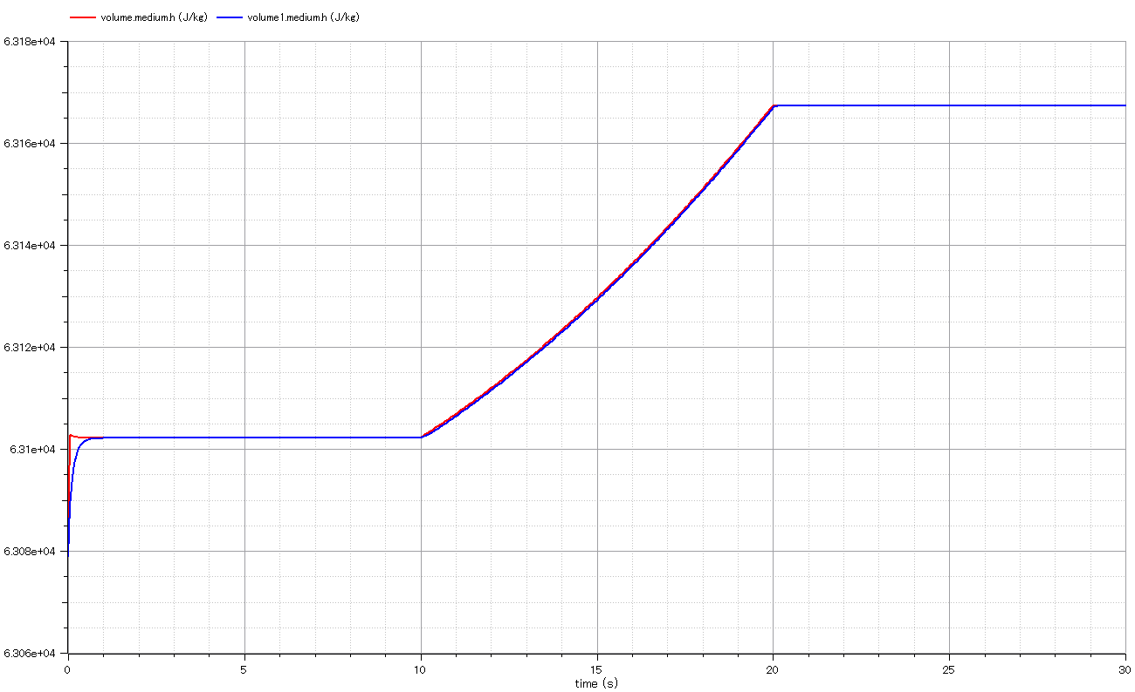
Output:
Specific enthalpy at inlet.
Output:
Specific enthalpy at outlet.
It is same value as inlet owe to enthalpy conservation.
The “delay” occurs due to volume effect (storage of mass and energy).

Slide 6
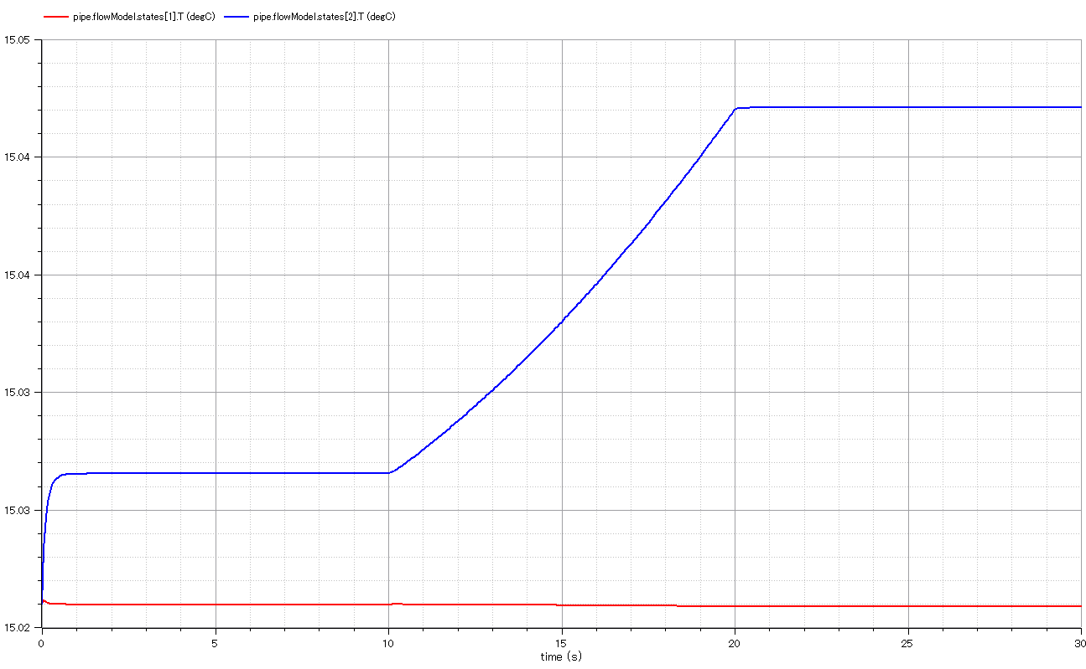
Output:
-. Temperature at outlet.
-. It is slightly greater than that of inlet. The energy lost as pressure drop is converted to temperature. Notice flow enthalpy conserves because the energy lost does not go anywhere.
-. Temperature rise occurs only in incompressible fluid (liquid)
-. The temperature difference increases as pressure drop increases.
Output:
Temperature at inlet.

Slide 7
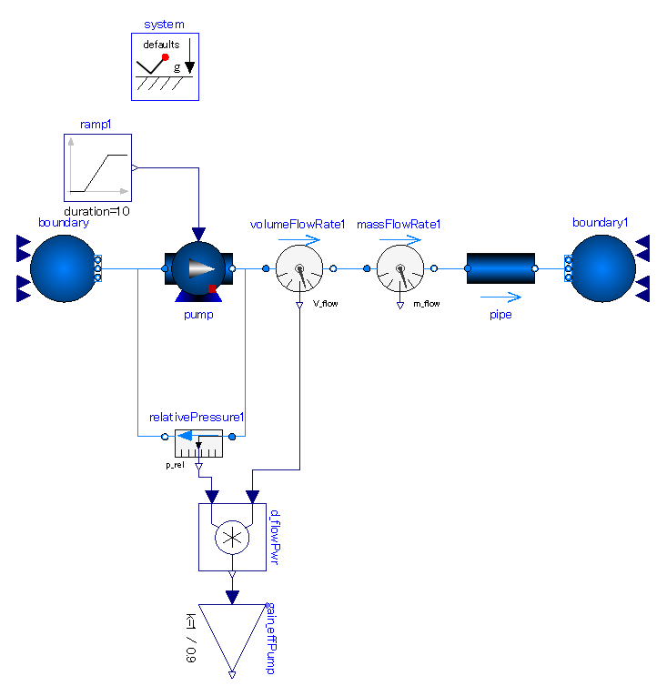
pumpingSystem_ex01

Slide 8
Centrifugal pump
-. Constant efficiency.
-. Mechanical interface is rotational speed signal.
Pipe= Flow resistance.
-. Fluid pressure drops through it.
Measure fluid power of pump.
Figure out mechanical power supplied to pump.
= (fluid power) / eff.

Slide 9
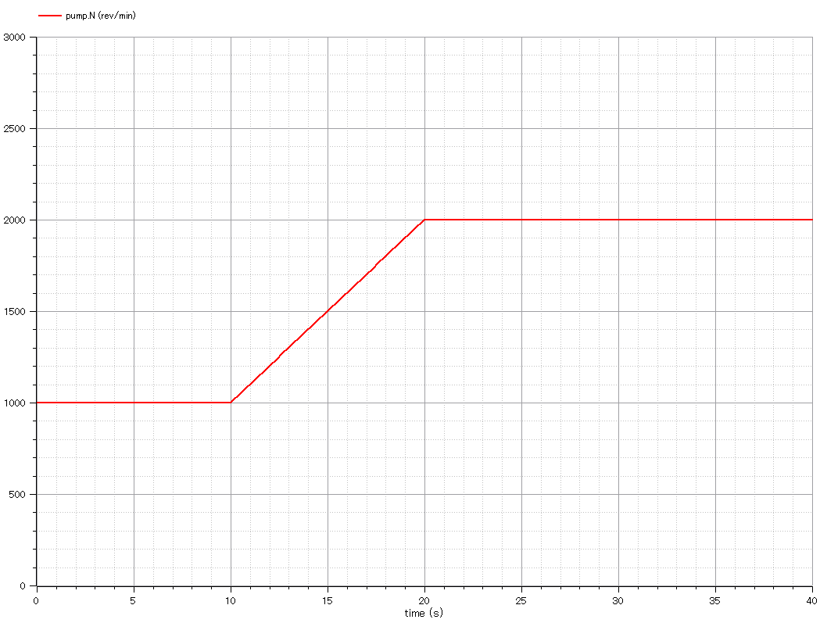
Input:
mechanical rotary speed of pump.

Slide 10
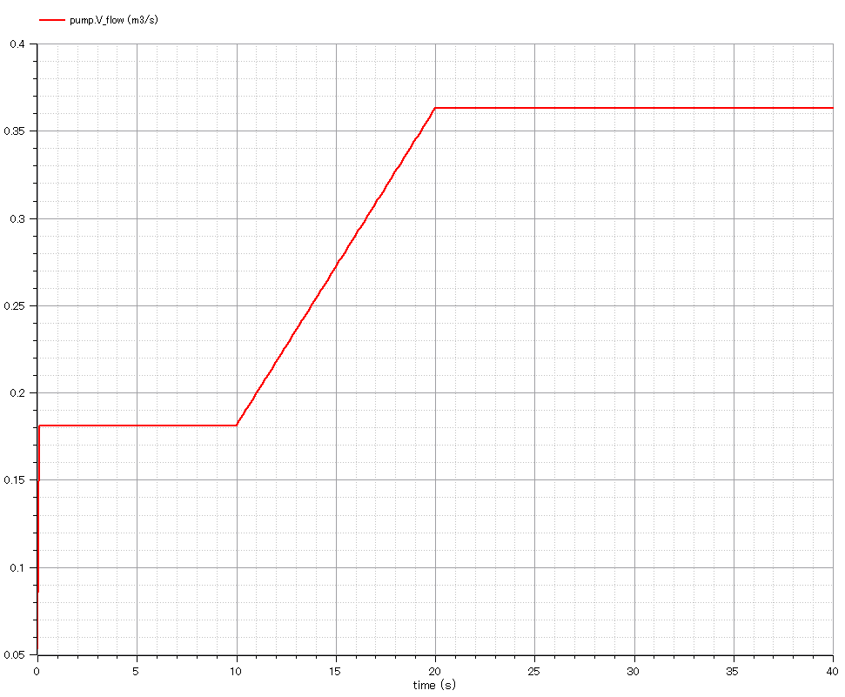
Output:
Volumetric flow rate through pump.

Slide 11
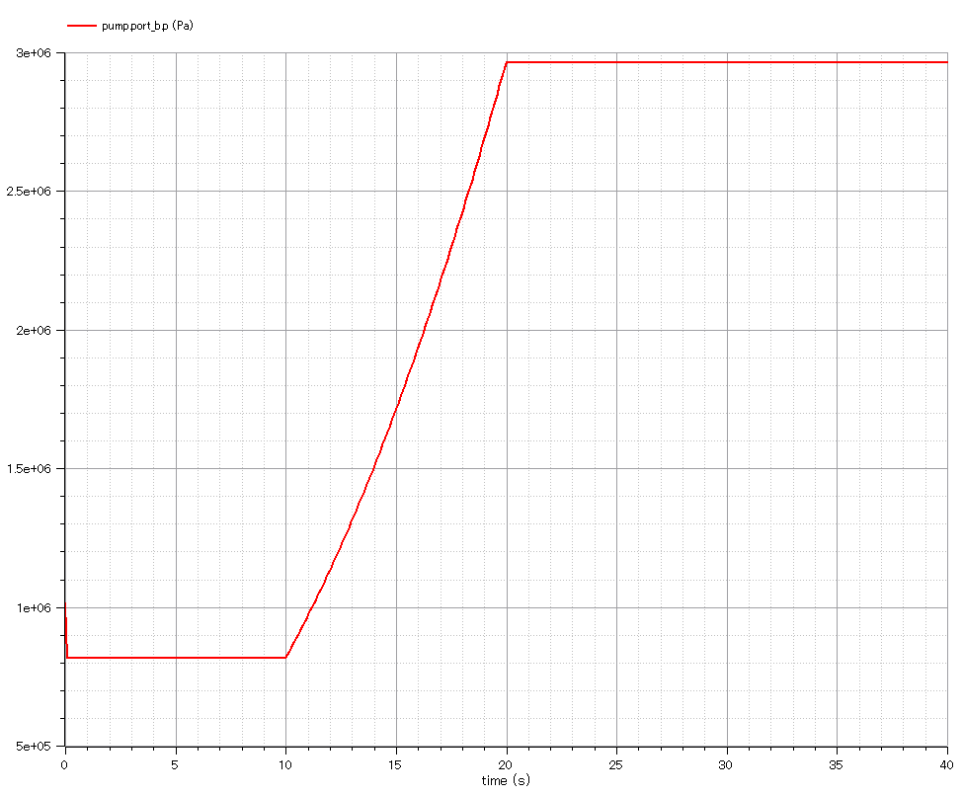
Output:
pump discharge pressure.

Slide 12
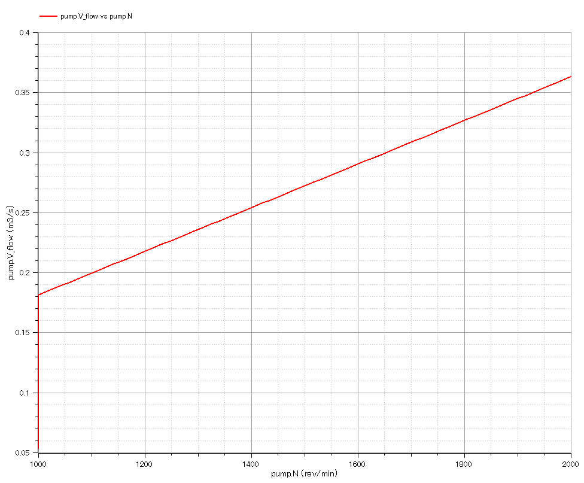
Output:
Pump’s volumetric flow rate vs. mechanical rotation speed.

Slide 13
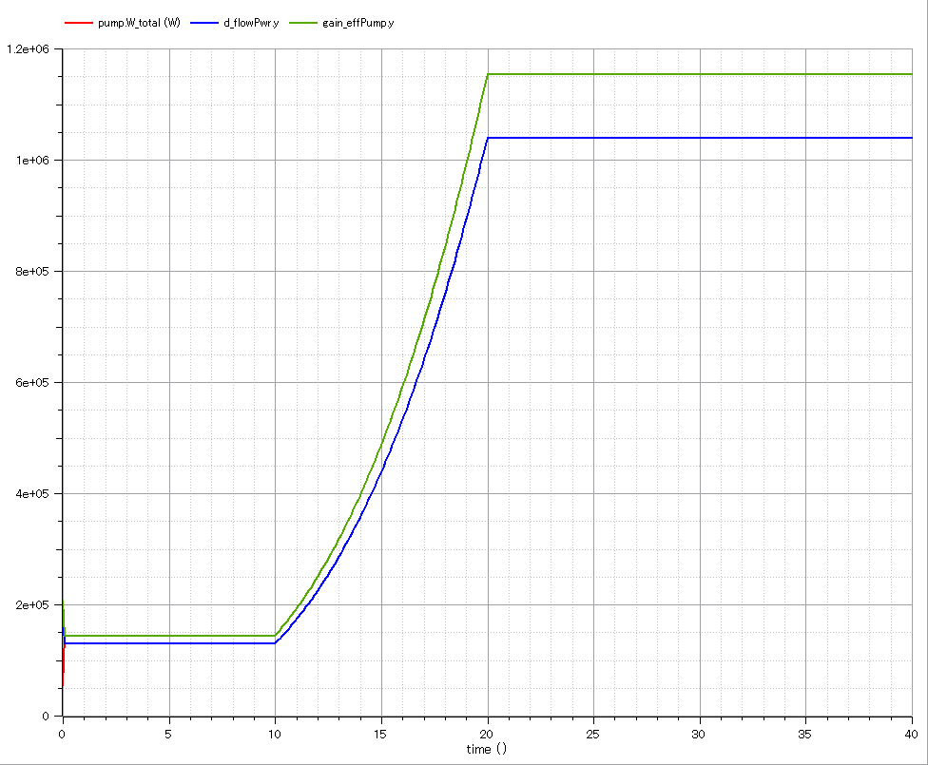
Output:
-. Mechanical power consumed by pump.
-. (pump.V_flow)*dP / pump.eta
-. 2 variables are equal.
Output:
-. (pump.V_flow)*dP
-. Increase in “flow power”

Slide 14
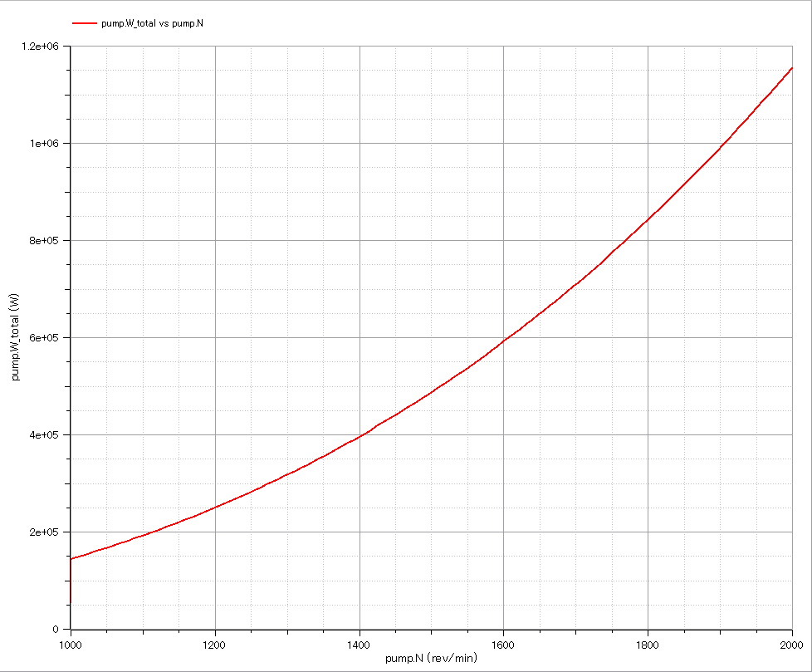
Output:
mechanical power consumption of pump vs. mechanical rotation speed.

Slide 15
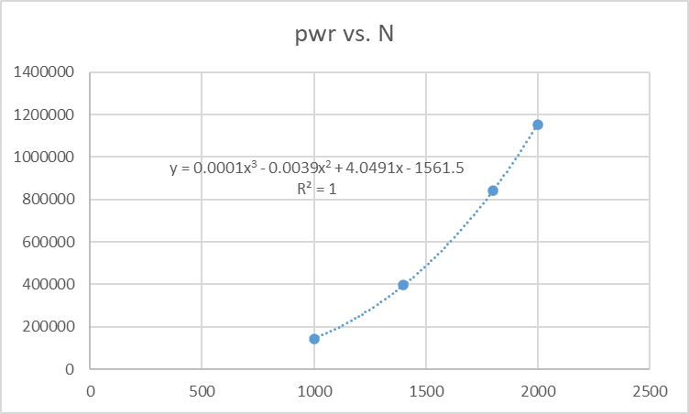

Slide 16
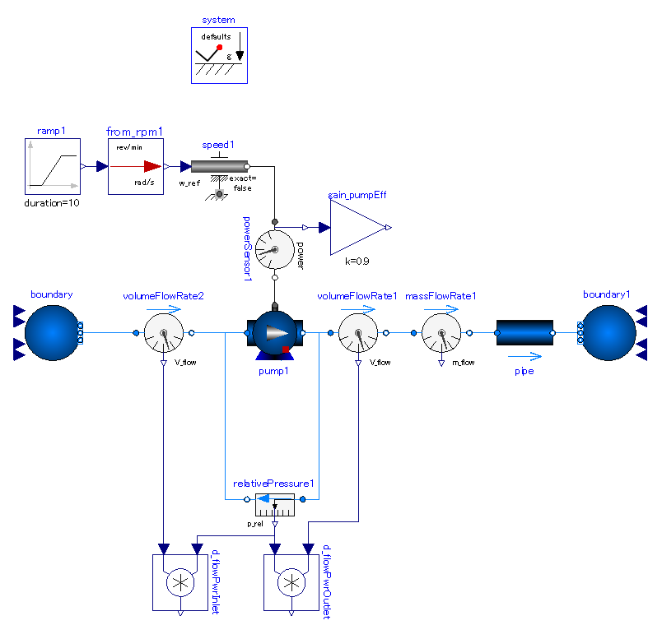
pumpingSystem_ex02

Slide 18
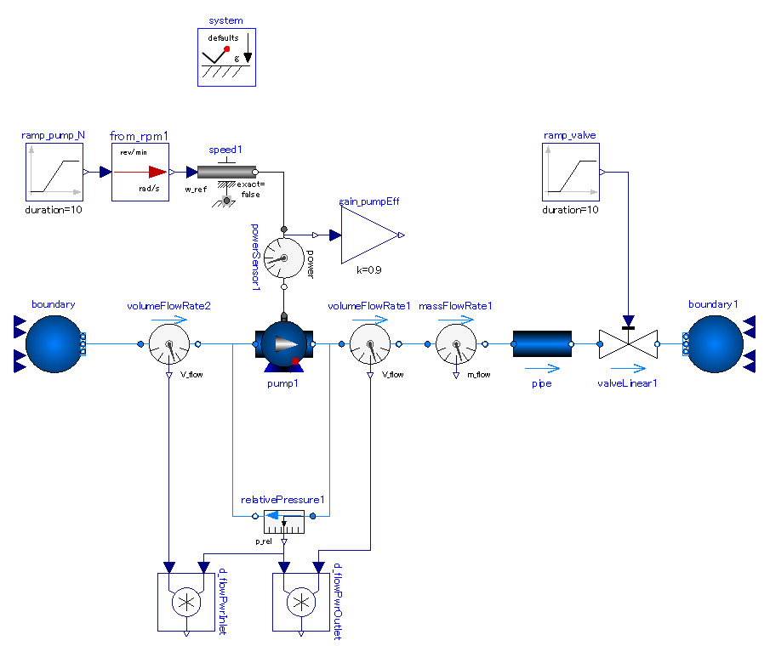
pumpingSystem_ex03

Slide 20
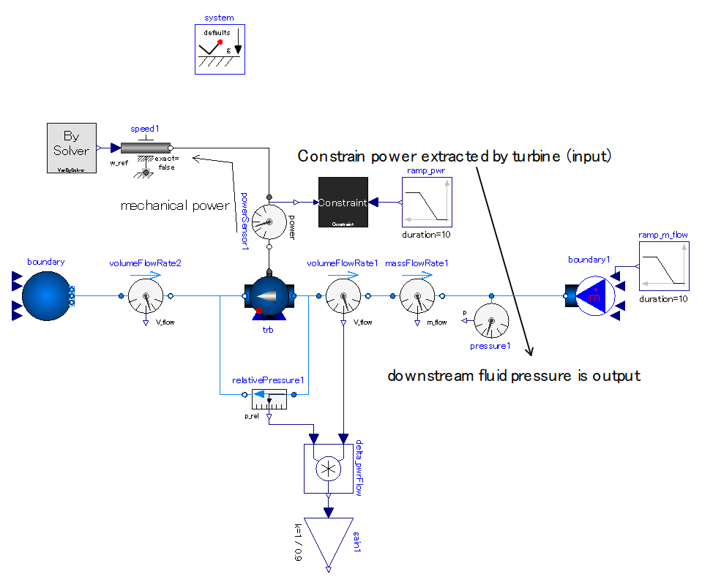
PumpAsTurbine_ex01

Slide 22
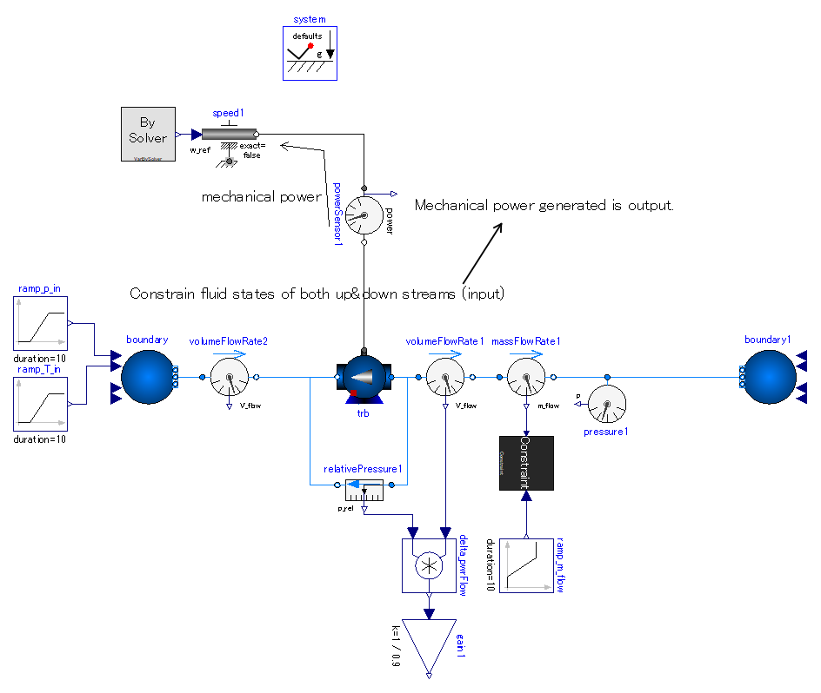
PumpAsTurbine_ex02

