Slide 1
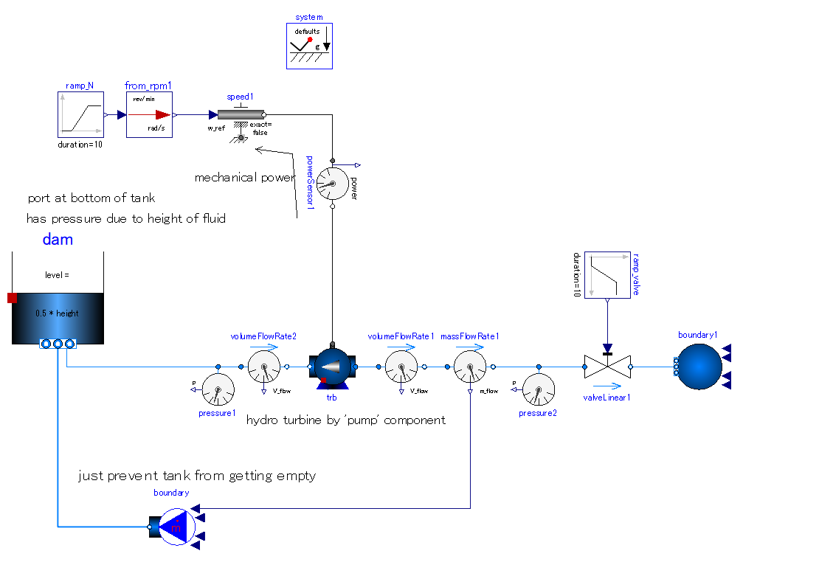

Slide 2
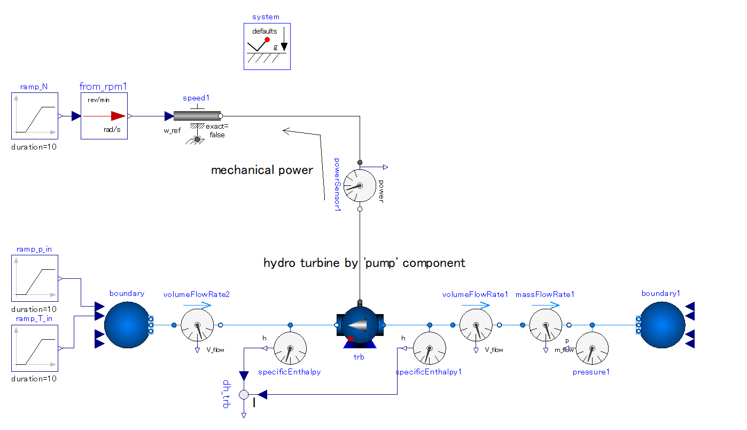
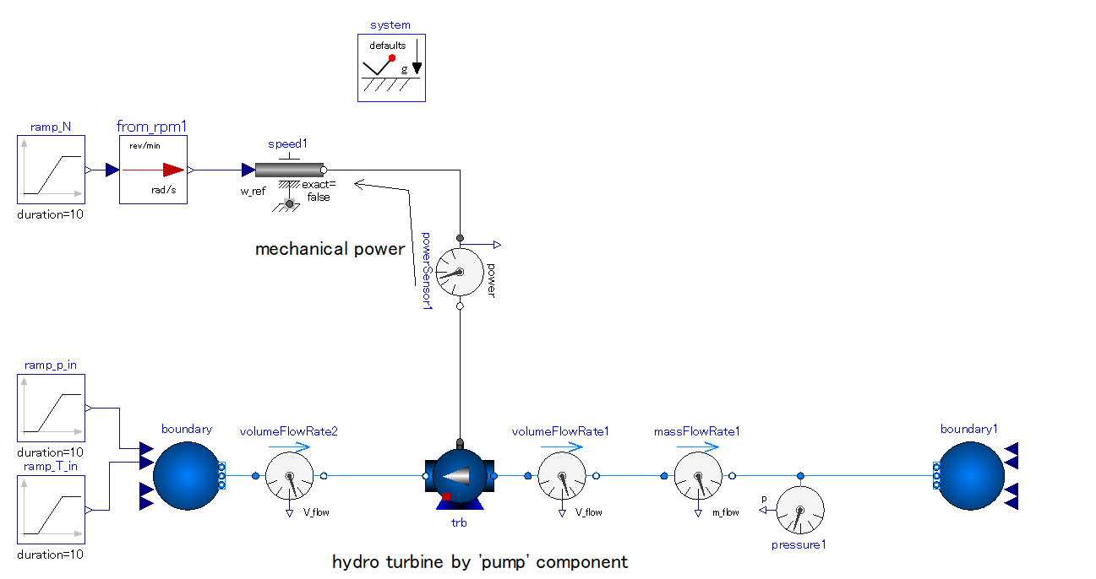

Slide 3
Constrain the rotational speed of shaft. -> torque is variable as a result of turbine extracted power.
Centrifugal pump integrated into system as turbine.
-. Constant efficiency.
-. Opposite connection to pump; Outlet port – upstream side, Inlet port – downstream side.
-. Mechanical work is extracted via flange.

Slide 4
ポンプ：体積流量、揚程の特性の与え方
-. 定格回転数における、揚程 vs. 体積流量の特性カーブを与える必要が有る。
-. MSLには２次カーブと多項式カーブを与えるfunctionが用意されている。
揚程 [m]
redeclare function flowCharacteristic = Modelica.Fluid.Machines.BaseClasses.PumpCharacteristics.quadraticFlow(V_flow_nominal = {0, 0.25, 0.5}, head_nominal = {100, 60, 0})
体積流量 [m^3/s]
揚程、体積流量の特性テーブルの両方に負の値を与えることで、「ポンプ」が「ハイドロタービン」となる。
ハイドロタービン：体積流量、揚程の特性の与え方
揚程
[m]
体積流量
[m^3/s]
redeclare function flowCharacteristic = Modelica.Fluid.Machines.BaseClasses.PumpCharacteristics. quadraticFlow(V_flow_nominal = {0, -0.25, -0.50}, head_nominal = {-100, -70, 0})

Slide 5
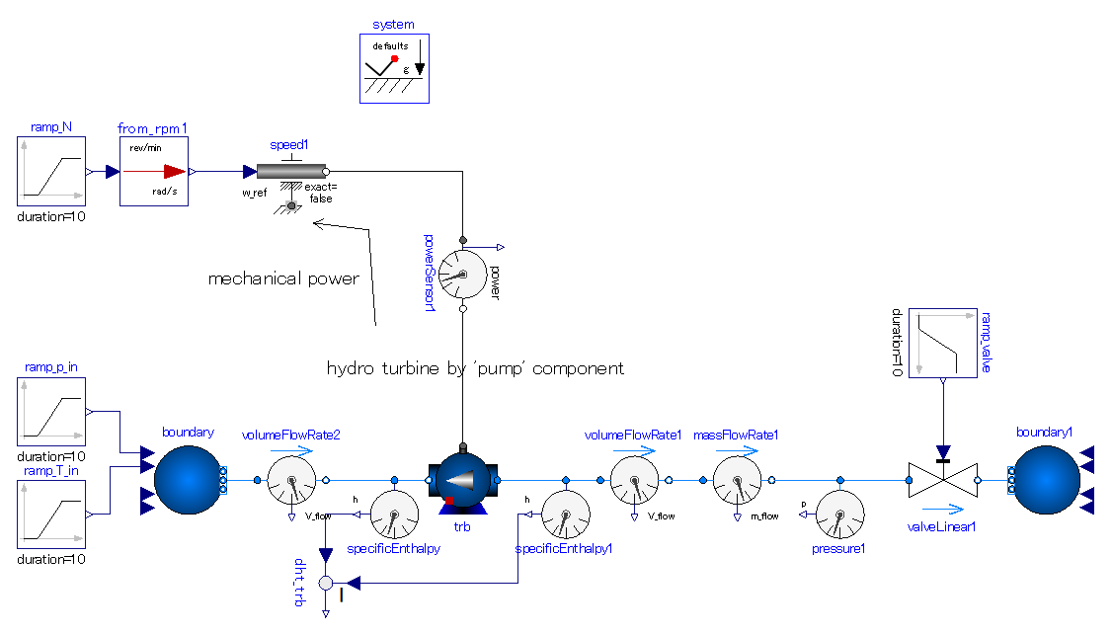

Slide 6
Constrain the rotational speed of shaft. -> torque is variable as a result of turbine extracted power.
Centrifugal pump integrated into system as turbine.
-. Constant efficiency.
-. Opposite connection to pump; Outlet port – upstream side, Inlet port – downstream side.
-. Mechanical work is extracted via flange.

Slide 8
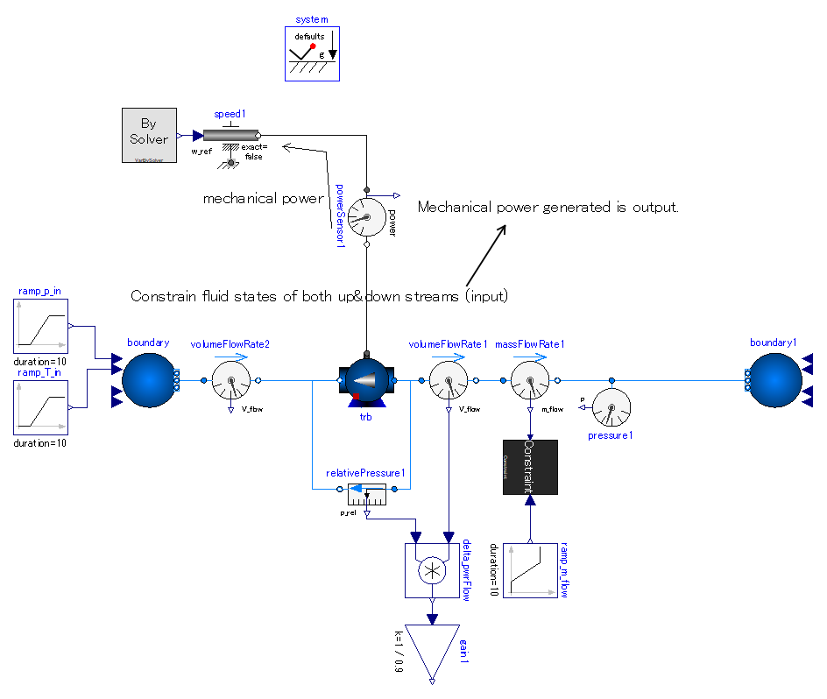
PumpAsTurbine_ex02

Slide 10
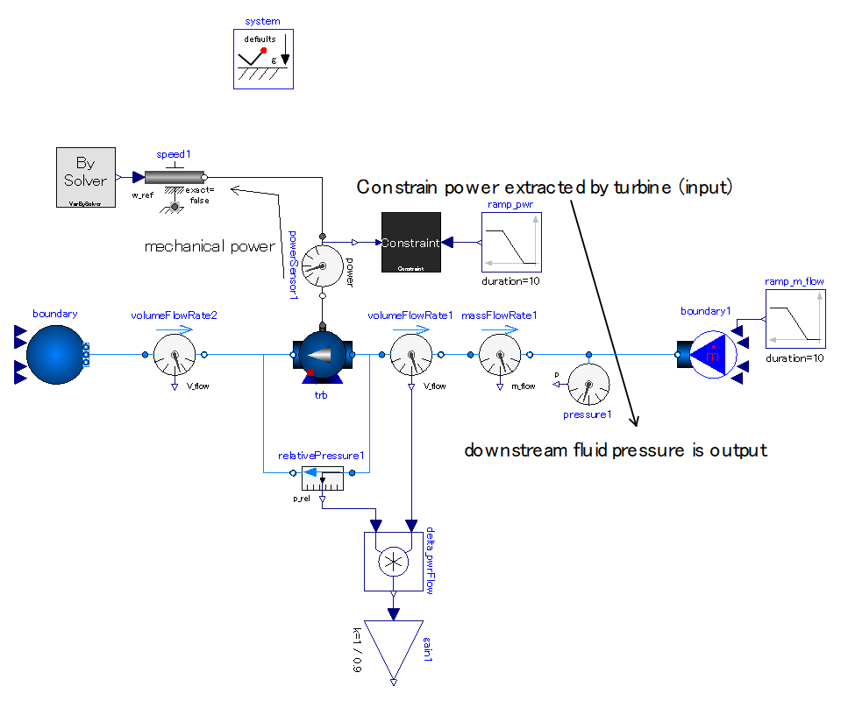
PumpAsTurbine_ex01

