Slide 1
Hi
你好

Slide 2
Python
它很强大，所以不简单

Slide 3
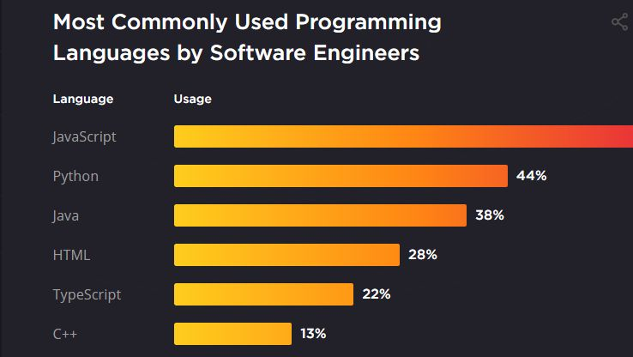

Slide 4
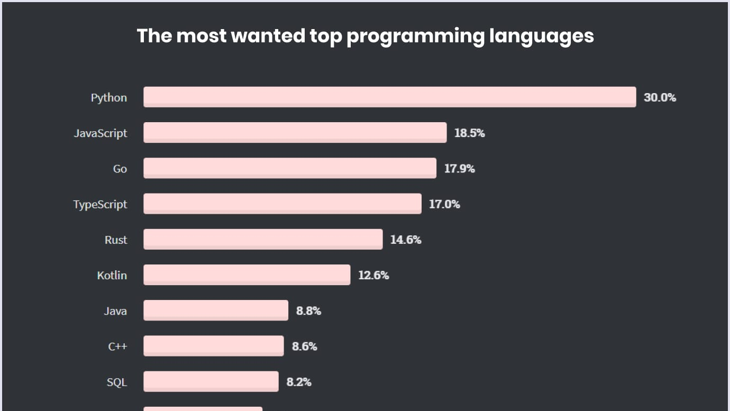

Slide 5
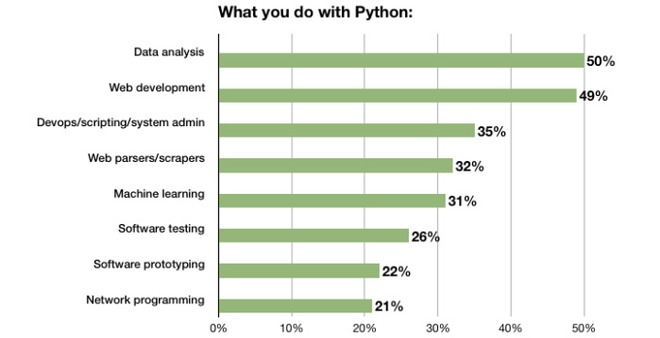

Slide 6






Python
拥有非常多种类的library

Slide 7
Data Science
真的了解吗？

Slide 8
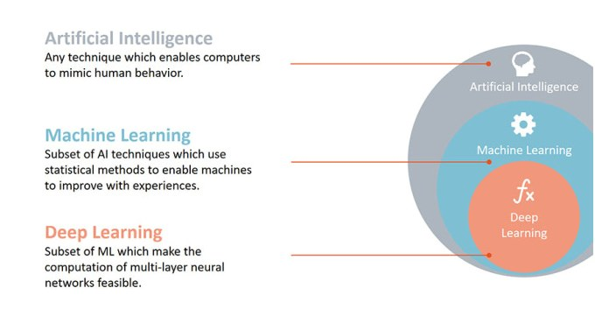

Slide 9
Software & Programming Languages
Anaconda - https://www.anaconda.com/products/individual
Jupyter Notebook
Spyder
R-Studio
Python & R
https://www.python.org/
https://cran.r-project.org/bin/windows/base/

Slide 10
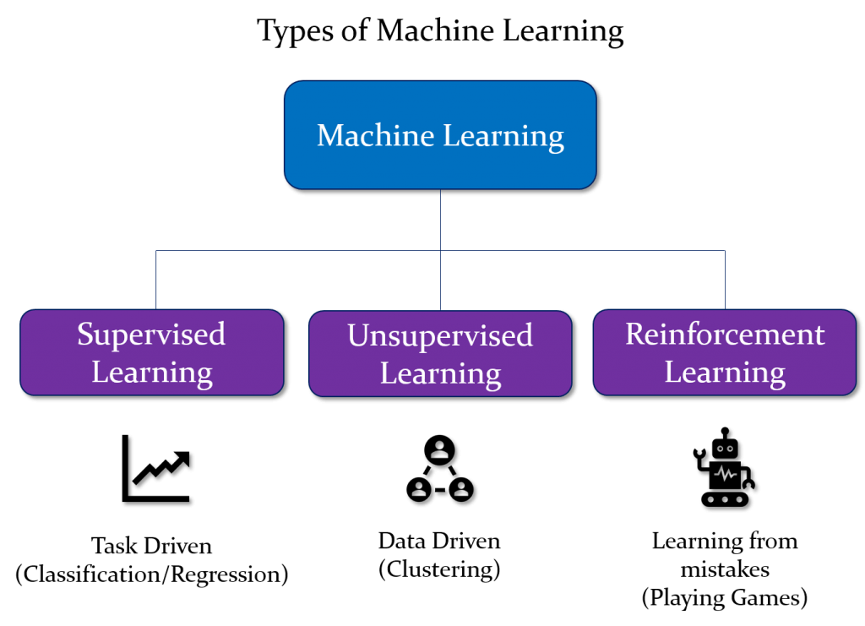

Slide 11
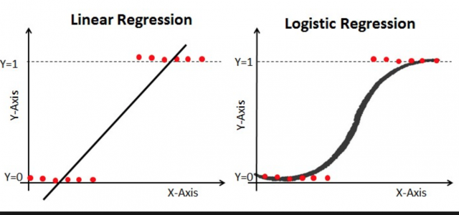
Supervised Learning
Classification
https://www.kaggle.com/rafetcan/titanic-ann-prediction
Regression
https://www.kaggle.com/bhanupalagati/advanced-house-price-prediction-using-xgboost

Slide 12
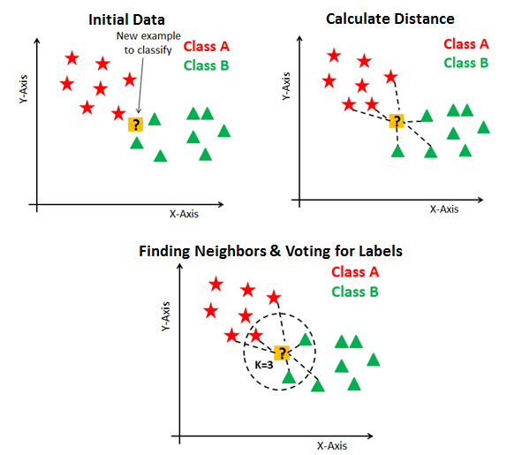
Unsupervised Learning
Clustering
https://www.kaggle.com/kushal1996/customer-segmentation-k-means-analysis

Slide 13
Web Development
Websites

Slide 14
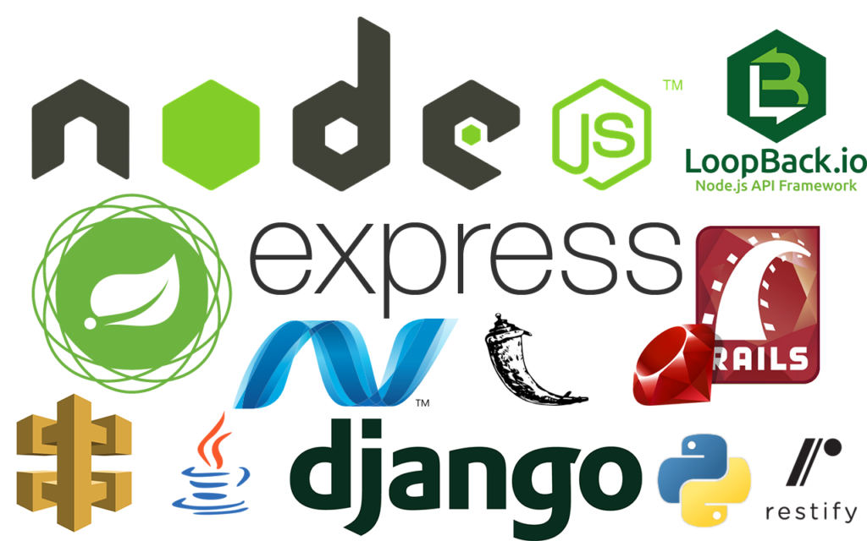

Web
Frontend
Backend

Slide 15
Framework
Flask
Django
Full-stack web framework that follows the batteries-included approach.
Developers already have access to the most common features that makes development faster.
Django comes with a ready-to-use admin framework that can be customized.
Light-weight framework with minimalistic features.
Developers can explore and keep control of the core of the application.
Flask doesn’t have any such feature to handle administration tasks.

Slide 16
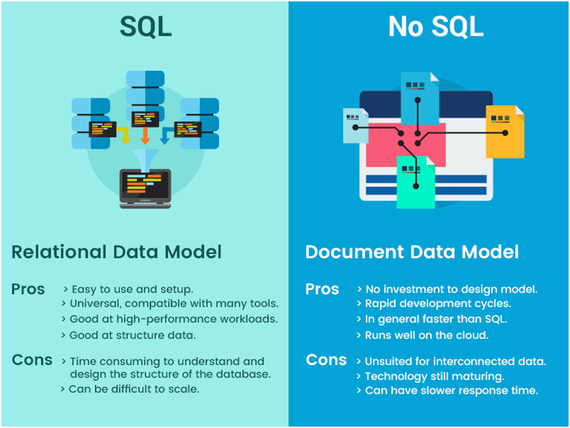
Databases

Slide 17






Database
SQL

Slide 18
SQL
SELECT
WHERE
JOIN
GROUP BY
ORDER BY
COUNT, AVG, SUM
https://www.w3schools.com/sql/default.asp

Slide 19
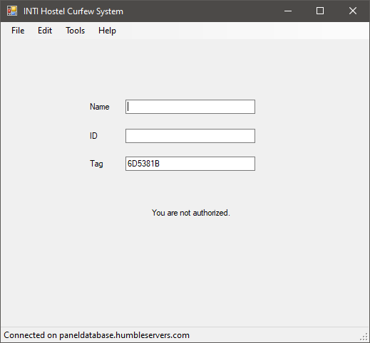
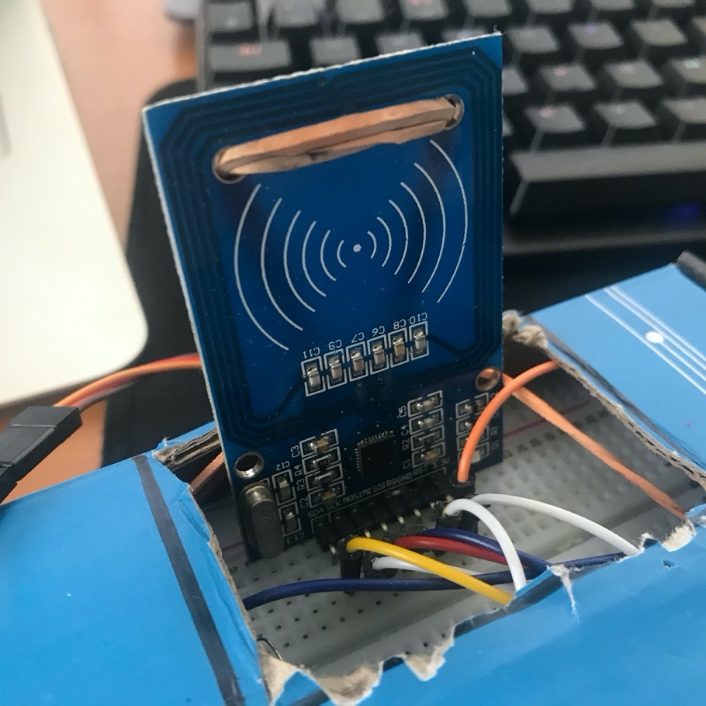
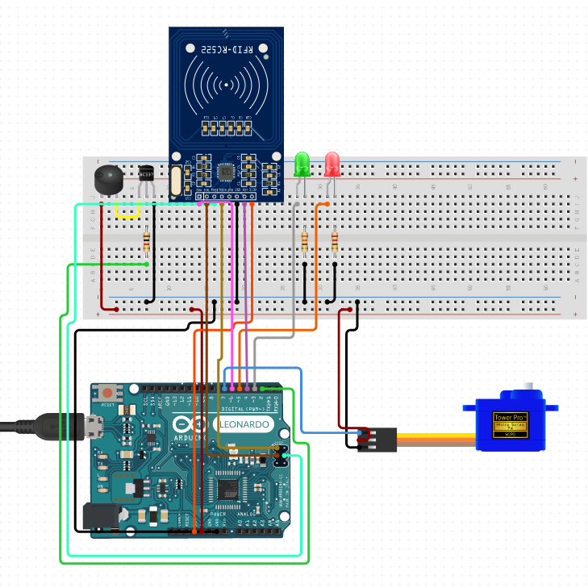
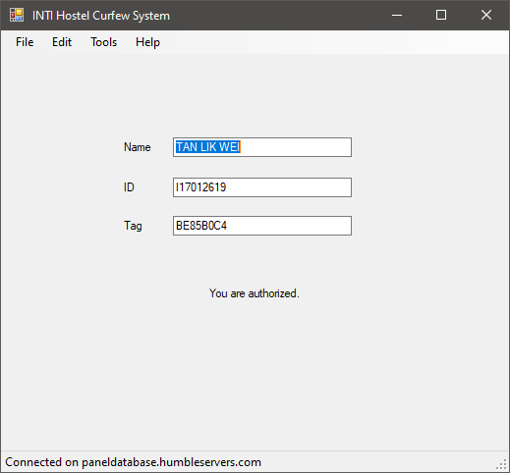
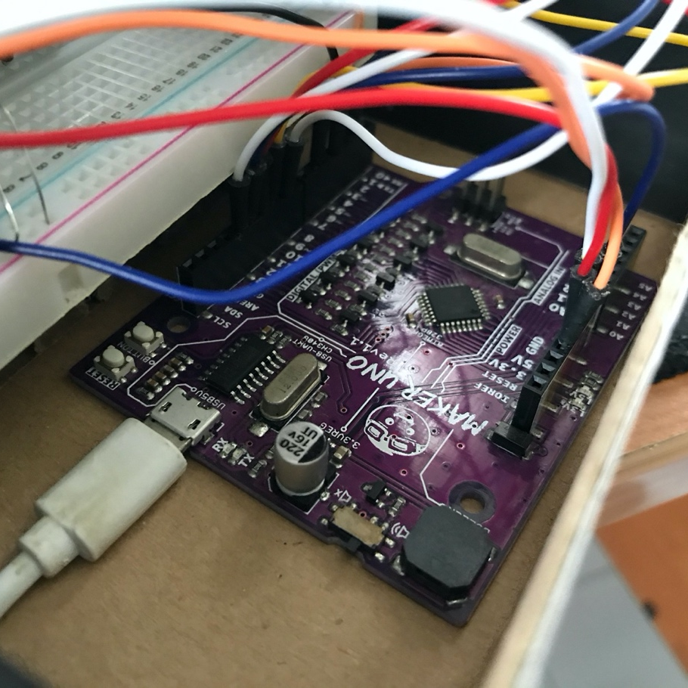
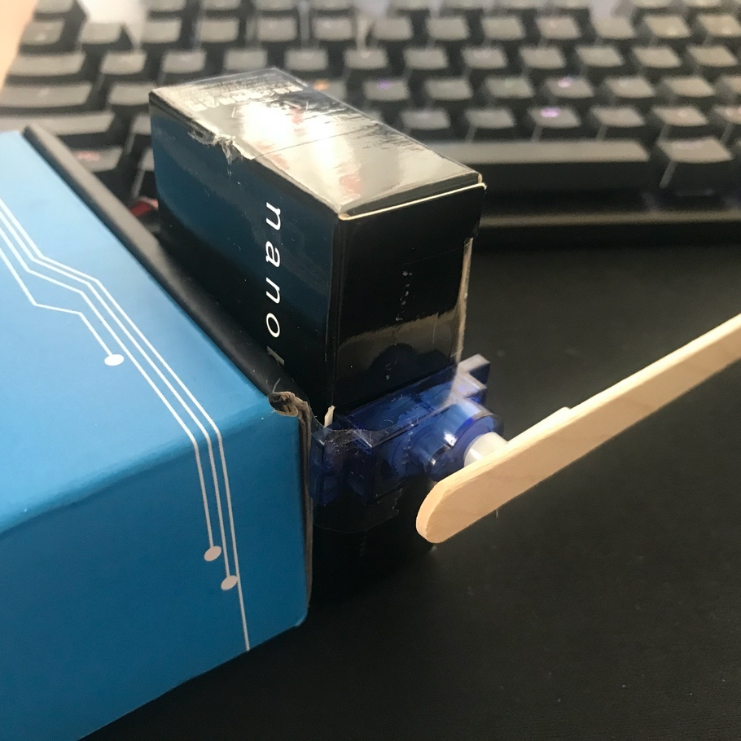
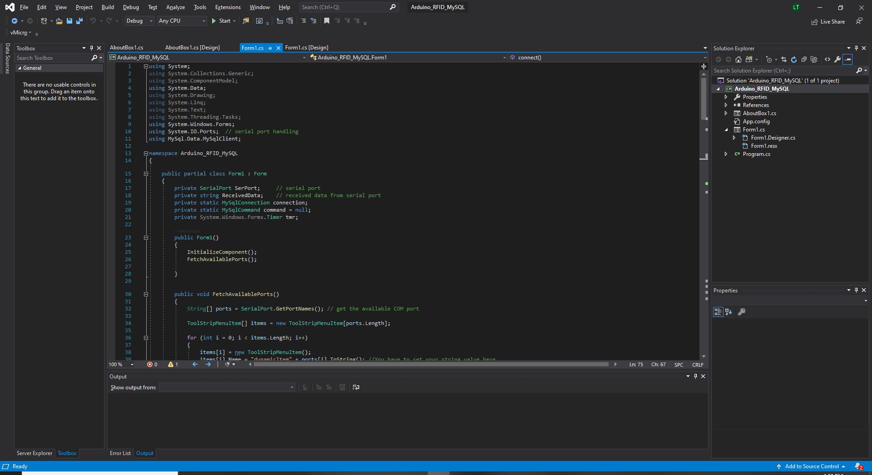
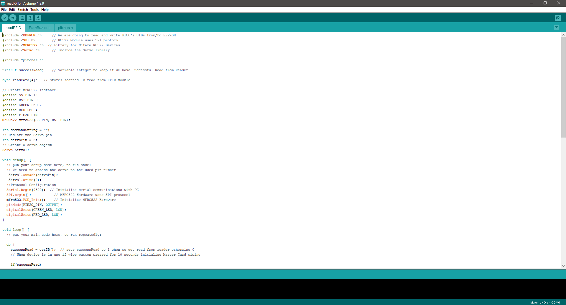
HOSTEL CURFEW AUTOAMTION SYSTEM
Students could use their ID card to gain access into hostel
The system is connected to the student database system
Github Project Link: https://github.com/likweitan/Hostel-Curfew-Automation-System Youtube Link: https://www.youtube.com/watch?v=StGXbfp1XxM&ab_channel=LikWeiTan

Slide 20
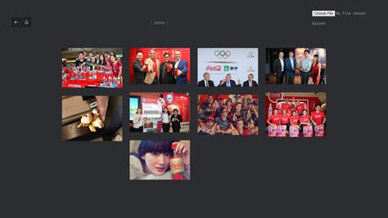
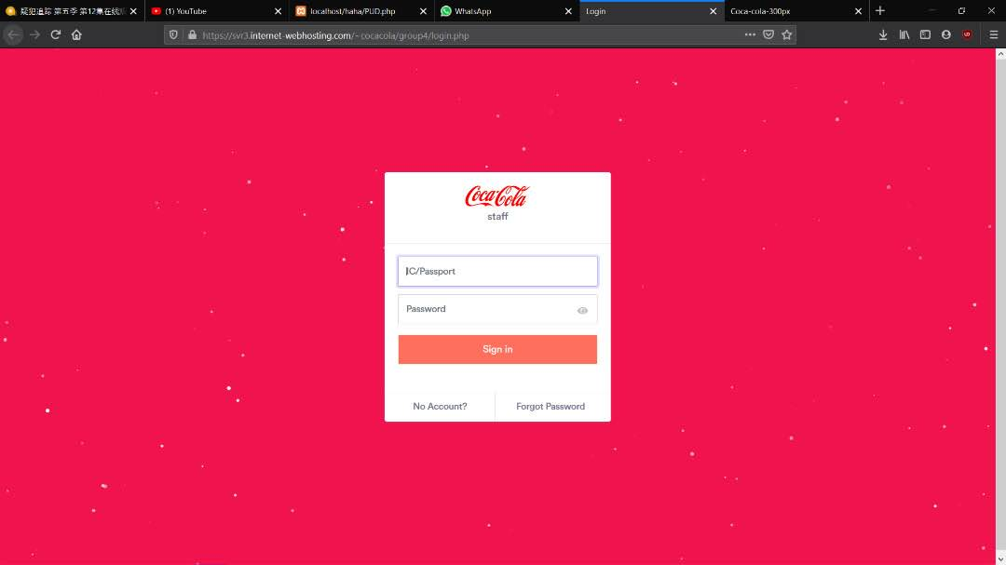
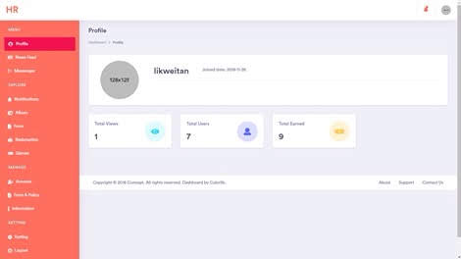
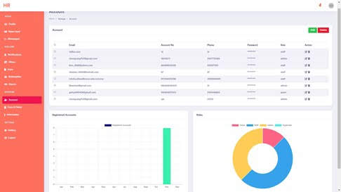
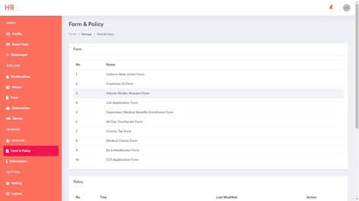
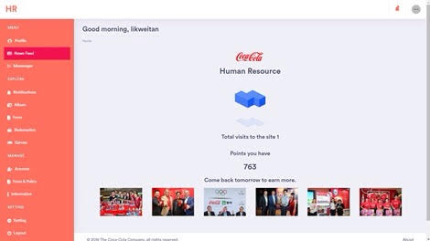
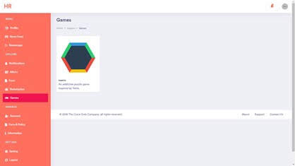
HR AUTOMATION WEB BASED SYSTEM
Built many features for the human resource automation forms website
Rewards system
Form's automation
Gamification
Virtual staff ID card
Analytical dashboard system
…
Github Project Link: https://github.com/likweitan/COCA-COLA-Malaysia-Human-Resource-Automation-Project

Slide 21
References
https://www.kaggle.com/ - Data Science
https://www.w3schools.com/ - HTML, CSS, Python, SQL, …
https://www.codecademy.com/ - HTML , CSS, Python, SQL, …
https://www.freecodecamp.org/learn - ALL

Slide 22
Thank You
谢谢

