Slide 1



Developing Intelligent Voicebots: Leveraging Gemini AI and Streamlit for Enhanced User Interactions

Slide 2





Introduction to Voicebots
In today's digital landscape, voicebots have emerged as a vital tool for enhancing user interactions. This presentation explores how Gemini AI and Streamlit can be leveraged to develop intelligent voicebots that improve engagement and efﬁciency.

Slide 3




Understanding Voicebots
Voicebots are AI-driven systems that utilize natural language processing to interact with users. They can handle various tasks, from answering queries to executing commands, providing a seamless experience that mimics human conversation.

Slide 4


What is Gemini AI?
Gemini AI is a powerful tool designed to enhance voicebot capabilities through advanced machine learning and natural language understanding. It allows for more accurate responses, improving the overall user experience signiﬁcantly.

Slide 5


Introduction to Streamlit
Streamlit is an open-source framework that enables developers to create interactive web applications easily. It is particularly useful for building user interfaces for voicebots, providing a simple way to visualize and manage data.

Slide 6



Integrating Gemini AI with Streamlit
Combining Gemini AI with Streamlit allows developers to build intuitive voicebot applications. This integration facilitates real- time data processing and enhances user interaction through a friendly interface and responsive design.

Slide 7
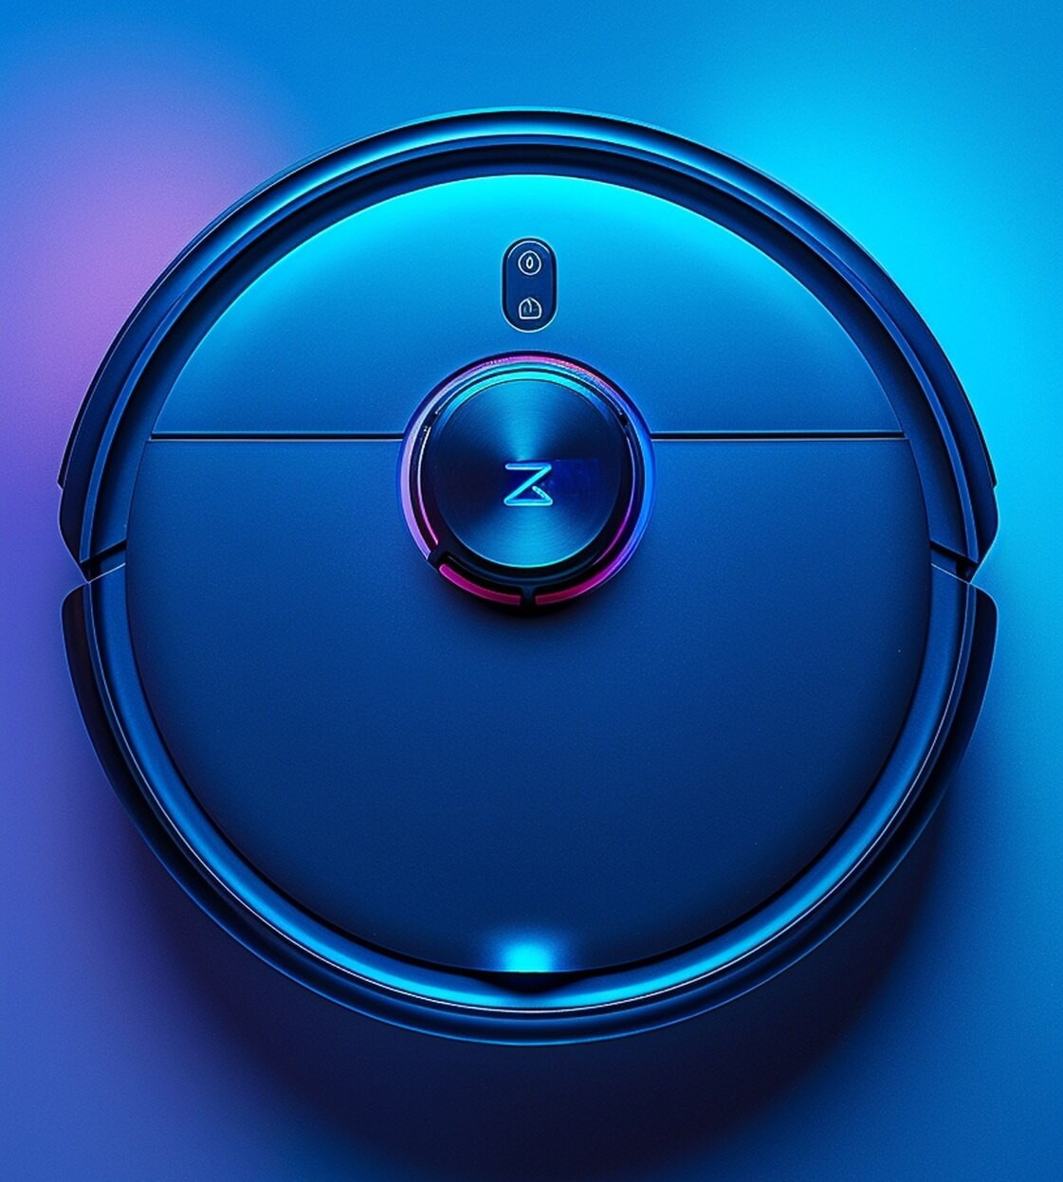
Key Features of Intelligent Voicebots
Intelligent voicebots exhibit several key features, including contextual understanding, personalization, and multi-language support. These attributes contribute to a more engaging and effective user experience, making interactions more natural.

Slide 8


USE CASES FOR VOICEBOTS
Voicebots can be utilized across various industries, such as customer service, healthcare, and e-commerce. They streamline operations, reduce costs, and enhance customer satisfaction by providing instant support and information.

Slide 9
Challenges in Voicebot Development
Despite their advantages, developing voicebots comes with challenges, including understanding accents, handling ambiguous queries, and ensuring data privacy. Addressing these issues is crucial for creating reliable and trustworthy voicebot applications.

Slide 10
CONCLUSION AND FUTURE TRENDS
In conclusion, leveraging Gemini AI and Streamlit can signiﬁcantly enhance the development of intelligent voicebots. As technology evolves, we can expect more sophisticated interactions and broader applications in various sectors.

Slide 11

Thanks!

