Slide 1
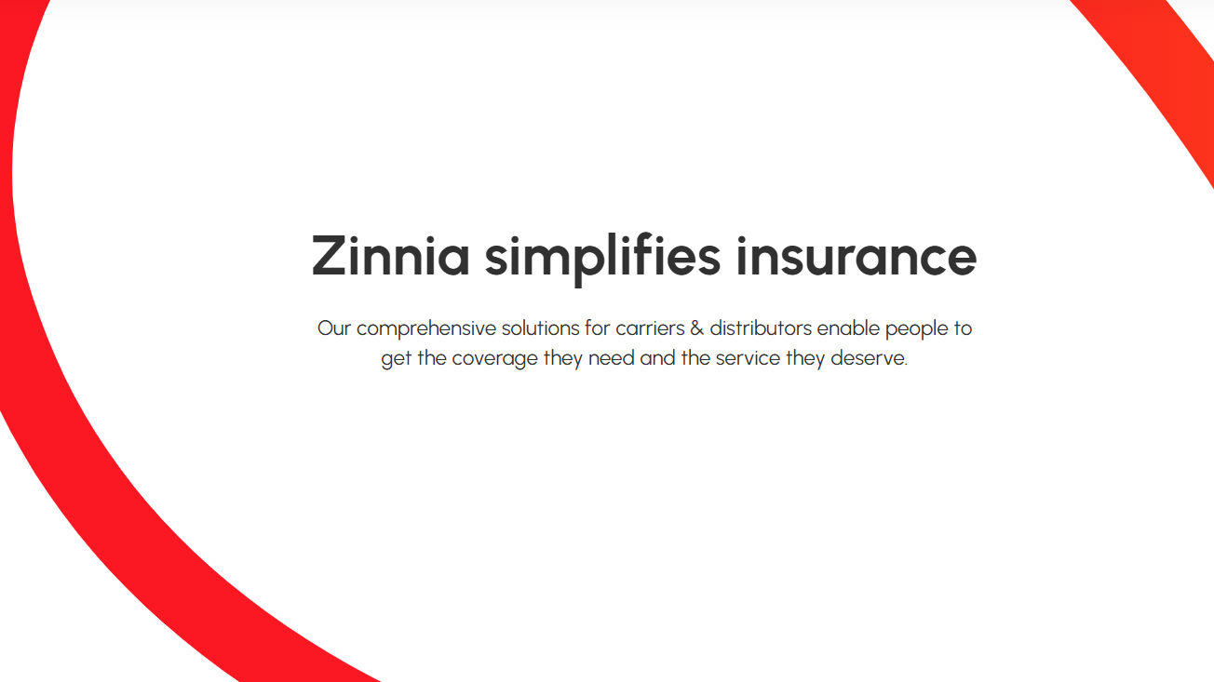
Maximizing Insurance Sales Efficiency: Data-Driven Analysis of Revenue Generation and Channel Optimization
Presented by – Khushwant Arya
Contact – khusa71@gmail.com (+91-8764429258)

Slide 2


Insurance Funnel Optimization
General Overview of business
Key Metrics
Total Marketing Expenditure: $2.75M
Total Generated Revenue: $1.72M
Marketing Efficiency: 63%
Final Cost Per Acquisition (CPA): $3,504
Overall Conversion Rate: 7.84%
Revenue Earned per Conversion: $2,197
Insights
$20M+ Revenue Gap Only $1.72M realized vs $21.97M potential
Early Drop-off Problem 28% lost at first contact stage
8x Cost Increase CPA jumps from $275 to $3.5K
Low Completion Rate Only 8% convert fully (784/10K)
Phone Stage Critical of 47% drop at phone connection
Step Name | Users | Conversion Rate | Drop Off Rate | CPA ($) | Potential Revenue ($M) | Actual Revenue ($M) | Efficiency
Started Navigator | 10,000 | 100% | 0% | $275 | $21.97M | $0.00M | 800%
Collect Contact Info | 7,220 | 72% | 28% | $380 | $15.86M | $0.00M | 577%
Viewed Quotes | 5,245 | 73% | 27% | $524 | $11.52M | $0.00M | 419%
Application Submit | 2,855 | 54% | 46% | $962 | $6.27M | $0.00M | 228%
Phone Connect | 1,525 | 53% | 47% | $1,801 | $3.35M | $0.00M | 122%
Sign And Exam | 784 | 51% | 49% | $3,504 | $1.72M | $1.72M | 63%
Efficiency = Revenue/Marketing Cost
Total Customer Signed Insurance Contract
Assumption: It is assumed that revenue is recognized when the customer signs the insurance contract, and the revenue-to-expenditure ratio is calculated at the final step

Slide 3


Insurance Funnel Optimization
Revenue Gap Realization
Key Metrics
Total Marketing Expenditure: $2.75M
Total Generated Revenue: $1.72M
Marketing Efficiency: 63%
Final Cost Per Acquisition (CPA): $3,504
Overall Conversion Rate: 7.84%
Revenue Earned per Conversion: $2,197
Insights
$20M+ Revenue Gap Only $1.72M realized vs $21.97M potential
Early Drop-off Problem 28% lost at first contact stage
8x Cost Increase CPA jumps from $275 to $3.5K
Low Completion Rate Only 8% convert fully (784/10K)
Phone Stage Critical of 47% drop at phone connection
Bridge $20M revenue gap through optimized pricing tiers, streamlined quote-to-application process, and proactive customer support interventions at key drop-off points
Step Name | Users | Conversion Rate | Drop Off Rate | CPA ($) | Potential Revenue ($M) | Actual Revenue ($M) | Efficiency
Started Navigator | 10,000 | 100% | 0% | $275 | $21.97M | $0.00M | 800%
Collect Contact Info | 7,220 | 72% | 28% | $380 | $15.86M | $0.00M | 577%
Viewed Quotes | 5,245 | 73% | 27% | $524 | $11.52M | $0.00M | 419%
Application Submit | 2,855 | 54% | 46% | $962 | $6.27M | $0.00M | 228%
Phone Connect | 1,525 | 53% | 47% | $1,801 | $3.35M | $0.00M | 122%
Sign And Exam | 784 | 51% | 49% | $3,504 | $1.72M | $1.72M | 63%
Assumption: It is assumed that revenue is recognized when the customer signs the insurance contract, and the revenue-to-expenditure ratio is calculated at the final step

Slide 4

Insurance Funnel Optimization
Optimizing Marketing Cost & CPA
Key Metrics
Total Marketing Expenditure: $2.75M
Total Generated Revenue: $1.72M
Marketing Efficiency: 63%
Final Cost Per Acquisition (CPA): $3,504
Overall Conversion Rate: 7.84%
Revenue Earned per Conversion: $2,197
Insights
$20M+ Revenue Gap Only $1.72M realized vs $21.97M potential
Early Drop-off Problem 28% lost at first contact stage
8x Cost Increase CPA jumps from $275 to $3.5K
Low Completion Rate Only 8% convert fully (784/10K)
Phone Stage Critical of 47% drop at phone connection
Step Name | Users | Conversion Rate | Drop Off Rate | CPA ($) | Potential Revenue ($M) | Actual Revenue ($M) | Efficiency
Started Navigator | 10,000 | 100% | 0% | $275 | $21.97M | $0.00M | 800%
Collect Contact Info | 7,220 | 72% | 28% | $380 | $15.86M | $0.00M | 577%
Viewed Quotes | 5,245 | 73% | 27% | $524 | $11.52M | $0.00M | 419%
Application Submit | 2,855 | 54% | 46% | $962 | $6.27M | $0.00M | 228%
Phone Connect | 1,525 | 53% | 47% | $1,801 | $3.35M | $0.00M | 122%
Sign And Exam | 784 | 51% | 49% | $3,504 | $1.72M | $1.72M | 63%
Target high-intent prospects through predictive lead scoring to reduce the CPA
Assumption: It is assumed that revenue is recognized when the customer signs the insurance contract, and the revenue-to-expenditure ratio is calculated at the final step

Slide 5


Features and Segment Analysis
Key Drivers for Customer Conversion
Model identified key conversion drivers with 37% importance weight on income and 35% on premium variables
Feature | Targeting Converted (Significance) | Targeting Efficiency (Significance)
Age | Significance | Significance
Income | Significance | Significance
Premium | Significance | Significance
Marketing Channels | Significance | Significance
Num Conditions | Significance | Significance
Assumption: It is assumed that revenue is recognized when the customer signs the insurance contract, and the revenue-to-expenditure ratio is calculated at the final step

Slide 6
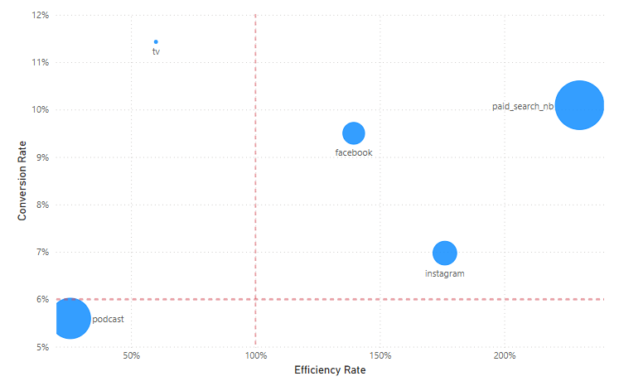
Features and Segment Analysis
Key Segment Contributor to Conversion and Efficiency
Insights
Paid Search dominates: 10% conversion, 230% efficiency, $218/user revenue at $95 cost (Facebook has 9.5% conversion rate with 139% efficiency)
Income + Premium = 72% of conversion drivers; other factors < 5% each
High income ($171K+) leads segments: 13% conversion with $322/user revenue
Single health condition = highest conversion (15%) with positive efficiency (108%)
Channel costs vary slightly ($85-95) but revenue spread is significant ($149-218)
Segment Type | Segment Value | Conversion Rate | Efficiency | Revenue/User | Cost/User | Users
Marketing Channels | Paid Search nb | 10% | 230% | $ 218.77 | $ 95.00 | 3,002
Marketing Channels | Instagram | 7% | 176% | $ 149.70 | $ 85.00 | 1,520
Income Group | 171050-297935 | 13% | 116% | $ 322.99 | $ 279.08 | 2,500
Num Conditions | 1 | 15% | 108% | $ 274.53 | $ 253.62 | 1,039
Num Conditions | 2 | 11% | 81% | $ 224.23 | $ 277.83 | 2,802
Age Group | 35-41 | 8% | 70% | $ 190.48 | $ 274.04 | 2,626
Premium Group | 315-1451 | 11% | 69% | $ 184.80 | $ 269.75 | 2,500
Age Group | 29-34 | 8% | 61% | $ 171.47 | $ 279.97 | 2,467
Premium Group | 1966-3267 | 6% | 61% | $ 169.49 | $ 277.21 | 2,500
Income Group | 138684-171049 | 7% | 59% | $ 158.42 | $ 267.49 | 2,500
Intent-based targeting drives Paid Search success: 10% conversion rate & $218/user revenue vs. Instagram's 7% & $149, proving active searchers convert better than passive audiences at similar costs
Assumption: It is assumed that revenue is recognized when the customer signs the insurance contract, and the revenue-to-expenditure ratio is calculated at the final step

Slide 7

Features and Segment Analysis
Key Segment Contributor to Conversion and Efficiency
Insights
Income + Premium = 72% of conversion drivers; other factors < 5% each
Paid Search dominates: 10% conversion, 230% efficiency, $218/user revenue at $95 cost
High income ($171K+) leads segments: 13% conversion with $322/user revenue
Single health condition = highest conversion (15%) with positive efficiency (108%)
Channel costs vary slightly ($85-95) but revenue spread is significant ($149-218)
Instagram
Segment Type | Segment Value | Conversion Rate | Efficiency | Revenue/User | Cost/User | Users
Marketing Channels | Paid Search nb | 10% | 230% | $ 218.77 | $ 95.00 | 3,002
Marketing Channels | Instagram | 7% | 176% | $ 149.70 | $ 85.00 | 1,520
Income Group | 171050-297935 | 13% | 116% | $ 322.99 | $ 279.08 | 2,500
Num Conditions | 1 | 15% | 108% | $ 274.53 | $ 253.62 | 1,039
Num Conditions | 2 | 11% | 81% | $ 224.23 | $ 277.83 | 2,802
Age Group | 35-41 | 8% | 70% | $ 190.48 | $ 274.04 | 2,626
Premium Group | 315-1451 | 11% | 69% | $ 184.80 | $ 269.75 | 2,500
Age Group | 29-34 | 8% | 61% | $ 171.47 | $ 279.97 | 2,467
Premium Group | 1966-3267 | 6% | 61% | $ 169.49 | $ 277.21 | 2,500
Income Group | 138684-171049 | 7% | 59% | $ 158.42 | $ 267.49 | 2,500
Instagram show high efficiency despite lower conversion rates, suggesting potential for optimization and growth
Assumption: It is assumed that revenue is recognized when the customer signs the insurance contract, and the revenue-to-expenditure ratio is calculated at the final step

Slide 8
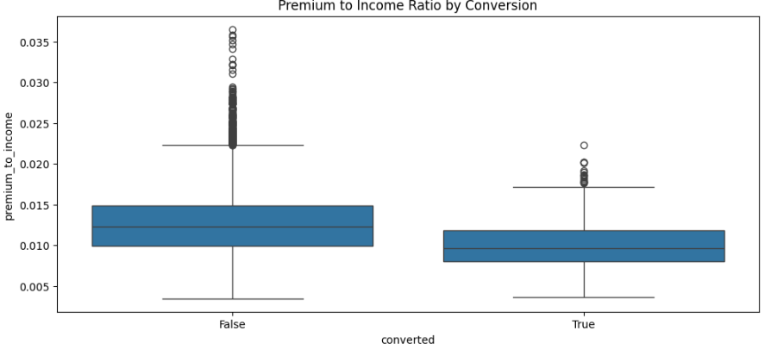
Features and Segment Analysis
Key Segment Contributor to Conversion and Efficiency
Insights
Income + Premium = 72% of conversion drivers; other factors < 5% each
Paid Search dominates: 10% conversion, 230% efficiency, $218/user revenue at $95 cost
High income ($171K+) leads segments: 13% conversion with $322/user revenue
Single health condition = highest conversion (15%) with positive efficiency (108%)
Channel costs vary slightly ($85-95) but revenue spread is significant ($149-218)
Lower premium-to-income ratio (≤1%) correlates with higher conversion rates
Segment Type | Segment Value | Conversion Rate | Efficiency | Revenue/User | Cost/User | Users
Marketing Channels | Paid Search nb | 10% | 230% | $ 218.77 | $ 95.00 | 3,002
Marketing Channels | Instagram | 7% | 176% | $ 149.70 | $ 85.00 | 1,520
Income Group | 171050-297935 | 13% | 116% | $ 322.99 | $ 279.08 | 2,500
Num Conditions | 1 | 15% | 108% | $ 274.53 | $ 253.62 | 1,039
Num Conditions | 2 | 11% | 81% | $ 224.23 | $ 277.83 | 2,802
Age Group | 35-41 | 8% | 70% | $ 190.48 | $ 274.04 | 2,626
Premium Group | 315-1451 | 11% | 69% | $ 184.80 | $ 269.75 | 2,500
Age Group | 29-34 | 8% | 61% | $ 171.47 | $ 279.97 | 2,467
Premium Group | 1966-3267 | 6% | 61% | $ 169.49 | $ 277.21 | 2,500
Income Group | 138684-171049 | 7% | 59% | $ 158.42 | $ 267.49 | 2,500
Assumption: It is assumed that revenue is recognized when the customer signs the insurance contract, and the revenue-to-expenditure ratio is calculated at the final step

Slide 9
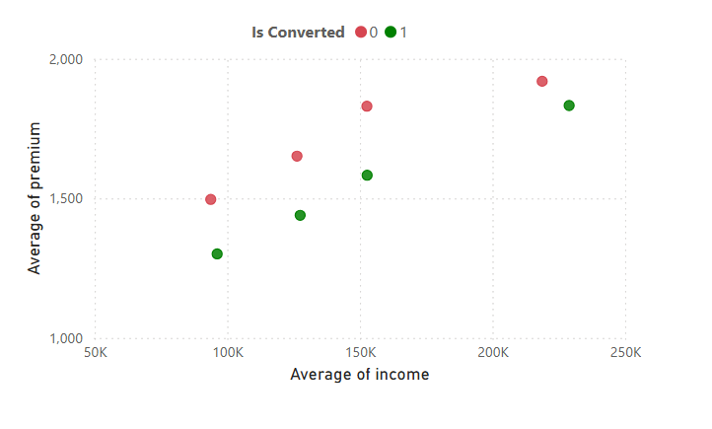

Features and Segment Analysis
Key Segment Contributor to Conversion and Efficiency
Insights
Income + Premium = 72% of conversion drivers; other factors < 5% each
Paid Search dominates: 10% conversion, 230% efficiency, $218/user revenue at $95 cost
High income ($171K+) leads segments: 13% conversion with $322/user revenue
Single health condition = highest conversion (15%) with positive efficiency (108%)
Channel costs vary slightly ($85-95) but revenue spread is significant ($149-218)
Unaffected by premium
Downwards Discount
3. High Income Group conversions largely unaffected when premiums are discounted relative to income
1. Conversions can improve when premiums are moderately discounted relative to income level
Segment Type | Segment Value | Conversion Rate | Efficiency | Revenue/User | Cost/User | Users
Marketing Channels | Paid Search nb | 10% | 230% | $ 218.77 | $ 95.00 | 3,002
Marketing Channels | Instagram | 7% | 176% | $ 149.70 | $ 85.00 | 1,520
Income Group | 171050-297935 | 13% | 116% | $ 322.99 | $ 279.08 | 2,500
Num Conditions | 1 | 15% | 108% | $ 274.53 | $ 253.62 | 1,039
Num Conditions | 2 | 11% | 81% | $ 224.23 | $ 277.83 | 2,802
Age Group | 35-41 | 8% | 70% | $ 190.48 | $ 274.04 | 2,626
Premium Group | 315-1451 | 11% | 69% | $ 184.80 | $ 269.75 | 2,500
Age Group | 29-34 | 8% | 61% | $ 171.47 | $ 279.97 | 2,467
Premium Group | 1966-3267 | 6% | 61% | $ 169.49 | $ 277.21 | 2,500
Income Group | 138684-171049 | 7% | 59% | $ 158.42 | $ 267.49 | 2,500
2. Conversions can improve when premiums are moderately discounted relative to income level
Assumption: It is assumed that revenue is recognized when the customer signs the insurance contract, and the revenue-to-expenditure ratio is calculated at the final step

Slide 10
Features and Segment Analysis
Key Segment Contributor to Conversion and Efficiency
Insights
Income + Premium = 72% of conversion drivers; other factors < 5% each
Paid Search dominates: 10% conversion, 230% efficiency, $218/user revenue at $95 cost
High income ($171K+) leads segments: 13% conversion with $322/user revenue
Single health condition = highest conversion (15%) with positive efficiency (108%)
Channel costs vary slightly ($85-95) but revenue spread is significant ($149-218)
1. How number of health Conditions have higher conversion rate with higher efficiency (108%)
Segment Type | Segment Value | Conversion Rate | Efficiency | Revenue/User | Cost/User | Users
Marketing Channels | Paid Search nb | 10% | 230% | $ 218.77 | $ 95.00 | 3,002
Marketing Channels | Instagram | 7% | 176% | $ 149.70 | $ 85.00 | 1,520
Income Group | 171050-297935 | 13% | 116% | $ 322.99 | $ 279.08 | 2,500
Num Conditions | 1 | 15% | 108% | $ 274.53 | $ 253.62 | 1,039
Num Conditions | 2 | 11% | 81% | $ 224.23 | $ 277.83 | 2,802
Age Group | 35-41 | 8% | 70% | $ 190.48 | $ 274.04 | 2,626
Premium Group | 315-1451 | 11% | 69% | $ 184.80 | $ 269.75 | 2,500
Age Group | 29-34 | 8% | 61% | $ 171.47 | $ 279.97 | 2,467
Premium Group | 1966-3267 | 6% | 61% | $ 169.49 | $ 277.21 | 2,500
Income Group | 138684-171049 | 7% | 59% | $ 158.42 | $ 267.49 | 2,500
2. Young professional age group (29-34) have similar conversion rate to 35-41 Age group but lower efficiency
Assumption: It is assumed that revenue is recognized when the customer signs the insurance contract, and the revenue-to-expenditure ratio is calculated at the final step

Slide 11
Hypotheses and Recommendations
Data-Driven Insights & Product Recommendations
Channel Efficiency Hypothesis
Hypothesis: Paid Search outperforms (230% efficiency) due to high intent and better targeting vs. Instagram's passive audience
Recommendation: Scale paid search budget; optimize keywords for high-income segments; create intent-specific landing pages
Income-Based Conversion Hypothesis
Hypothesis: Higher income ($171K+) converts better (13%) due to better affordability and lower premium-to-income ratio
Recommendation: Develop income-tiered pricing strategy; customize premium presentation by income bracket; prioritize high-income targeting
Health Condition Impact Hypothesis
Hypothesis: Single condition users (15% conversion) perform best due to simpler underwriting and manageable premiums
Recommendation: Streamline application flow for single condition cases; develop fast-track processing for simple cases
Premium Sensitivity Pattern
Hypothesis: Lower premium group's higher conversion (11% vs 6%) indicates strong price elasticity
Recommendation: Test flexible payment options; introduce tiered coverage options; develop entry-level products
Age Group Optimization
Hypothesis: Low efficiency in age groups (61-70%) suggests misaligned product-market fit
Recommendation: Develop age-specific value propositions; adjust marketing messaging by age segment
Assumption: It is assumed that revenue is recognized when the customer signs the insurance contract, and the revenue-to-expenditure ratio is calculated at the final step

Slide 12
Hypotheses and Recommendations
Data-Driven Insights & Marketing Recommendations
Channel Optimization
Scale Paid Search (230% efficiency)
Increase budget from $285K → $1M
Focus on high-income keywords
Create intent-specific landing pages
Expected: +15% CTR
Boost Instagram (176% efficiency)
Increase budget from $129K → $766K
Deploy lookalike audiences from high-value customers
Focus on Stories & educational content
Expected: +20% conversion
Audience Targeting Priority
High-Value Segment
Income: $171K+ (13% conversion)
Single condition users (15% conversion)
Age: 35-41
Expected CPA: $2,800
Channel-Specific Messaging
Paid Search: "15-minute approval for professionals“
Instagram: Lifestyle & ease of process
Facebook: Family security & educational content
Testing Framework
A/B Tests Priority:
Benefit vs. Problem focused headlines
Professional vs. Family imagery
CTA variations
Channel-specific landing pages
Expected Impact (90 Days)
CPA reduction: -25%
Conversion rate: +30%
Overall efficiency: +40%
Assumption: It is assumed that revenue is recognized when the customer signs the insurance contract, and the revenue-to-expenditure ratio is calculated at the final step

Slide 13
User Insight
Expansion Opportunities for Deeper User Insights
Additional User Attributes to Collect
Financial Behaviors
Credit score ranges
Existing insurance products
Investment portfolio size
Payment method preferences
Financial advisor relationships
Life Stage Indicators
Marital status
Number of dependents
Homeownership status
Career industry/role
Life events (marriage, new child, home purchase)
Behavioral Data Points
Digital Footprint
Time spent on quote pages
Number of quote modifications
Device preferences
Peak engagement times
Cart abandonment patterns
Content Interaction
Most viewed FAQs
Educational content engagement
Calculator usage patterns
Chat support interactions
Email open/click patterns
Analysis Expansion Ideas
Predictive Modeling
Propensity to convert models
Lifetime value prediction
Churn risk assessment
Premium sensitivity analysis
Cross-sell opportunity scoring
Advanced Segmentation
Behavioral clusters
Value-based segments
Journey-based cohorts
Risk profile groupings
Channel affinity segments
Assumption: It is assumed that revenue is recognized when the customer signs the insurance contract, and the revenue-to-expenditure ratio is calculated at the final step

Slide 14
Approach
Problem-Solving Approach Framework
Initial Data Analysis
Analyzed conversion funnel metrics
Identified major drop-off points
Examined cost & revenue per user
Segmented performance by channels
Mapped key performance indicators
Key Issue Identification
High CPA escalation ($275 → $3.5K)
Significant revenue gap ($1.72M vs $21.97M potential)
Channel efficiency variations (230% vs 59%)
Income-based conversion disparities (13% vs 7%)
Drop-off patterns (28% early-stage loss)
Hypothesis Development
Premium-to-income ratio impacts conversion
Channel intent drives efficiency differences
Health conditions affect completion rates
Income levels correlate with conversion success
Price sensitivity varies by segment
Solution Framework
Data-backed recommendations
Channel-specific strategies
Segment-based targeting
Clear success metrics
Risk mitigation plans
Assumption: It is assumed that revenue is recognized when the customer signs the insurance contract, and the revenue-to-expenditure ratio is calculated at the final step

Slide 15
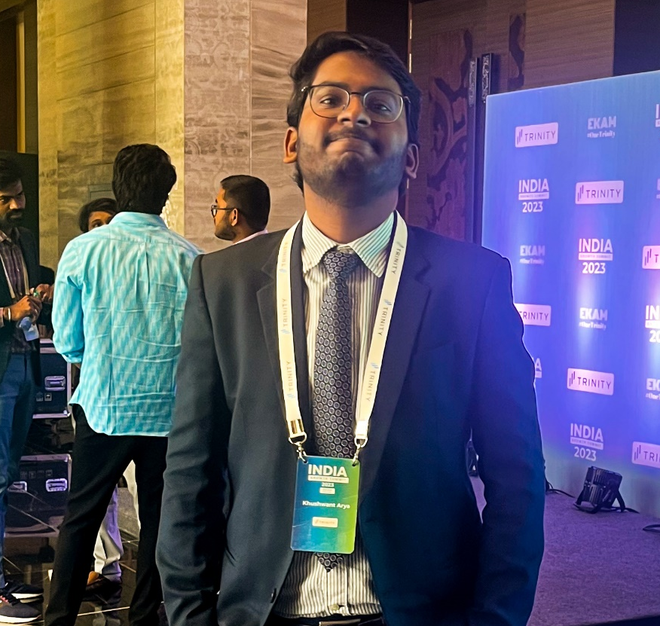
About Me
Open For Questions and Discussion
Khushwant Arya
Email – khusa71@gmail.com
Phone - +91-8764429258
Senior Business Analyst with over 4 years of healthcare consulting experience, specializing in project management, stakeholder engagement, and high-performance analytics. ​
Areas of Expertise
SQL, Python, Excel, Figma
Power BI, Tableau
Basic Machine learning
Cloud Services & Database management
🙏
Thank You

