Slide 1
Gut Guardian
Gamifying Gut Health Through a Detective Mystery
Final Project Presentation | Gamification in Mobile Health
TEAM : Asliddin Ergashev Stefan Ober Khawar Khan
OTTO – Friedrich Universitat BAMBERG Gamified Systems 2026

Slide 2
Agenda
Project Overview
Problem & Motivation
Key Features
Gamification Elements
App Screens & Demo
Technical Implementation
Conclusion & Q&A

Slide 3
01
Project Overview

Slide 4
What is Gut Guardian?
Your 14-Day Health Detective
A mobile health app that gamifies gut health tracking over a 14-day investigation period.
Users log meals and symptoms daily to discover patterns and identify food sensitivities.
The experience is framed as a detective mystery — users solve their own health case.
Platform: React Native with Expo (cross-platform iOS & Android).
Goal: make daily health tracking engaging, structured, and rewarding.

Slide 5
Problem & Motivation
Many people experience bloating, fatigue, and headaches after meals but cannot identify triggers.
Traditional food diaries are tedious and users stop logging within days.
Health apps often feel clinical — there is no story, reward, or sense of progress.
Gut Guardian addresses this by combining health tracking with gamification and narrative.
Users stay motivated through missions, XP, badges, and a clear 14-day goal.

Slide 6
02
Key Features

Slide 7
Key Features
Detective / Mystery Theme — users are detectives solving their gut health mystery
14-Day Investigation — structured tracking period with daily missions
Meal & Symptom Logging — easy interface for recording meals and how users feel
Evidence Board — visual dashboard showing food–symptom connections
XP & Level System — gamification through points and progression
Progress Calendar — visual 14-day calendar with color-coded completed days
Case File — personal health insights and discovered patterns
Interactive Guide Character — animated detective guide that helps throughout
Reward System — unlockable badges and achievements

Slide 8
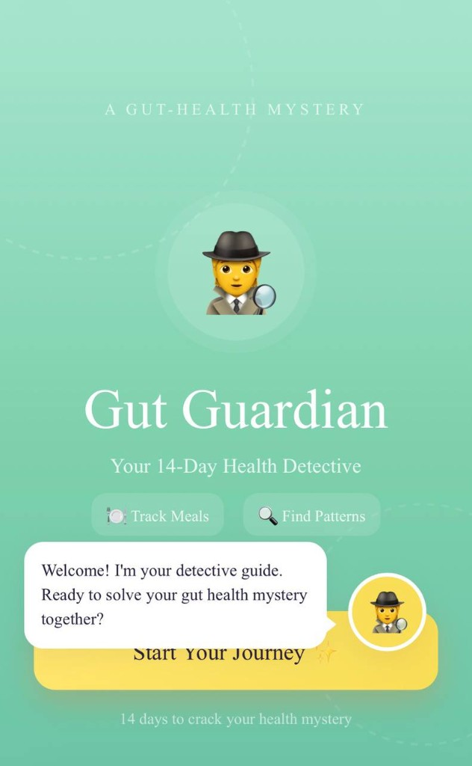
Splash Screen & Welcome
• Detective-themed welcome screen
• Tagline: Your 14-Day Health Detective
• Guide character introduces the mystery
• Track Meals & Find Patterns
• Start Your Journey call-to-action

Slide 9
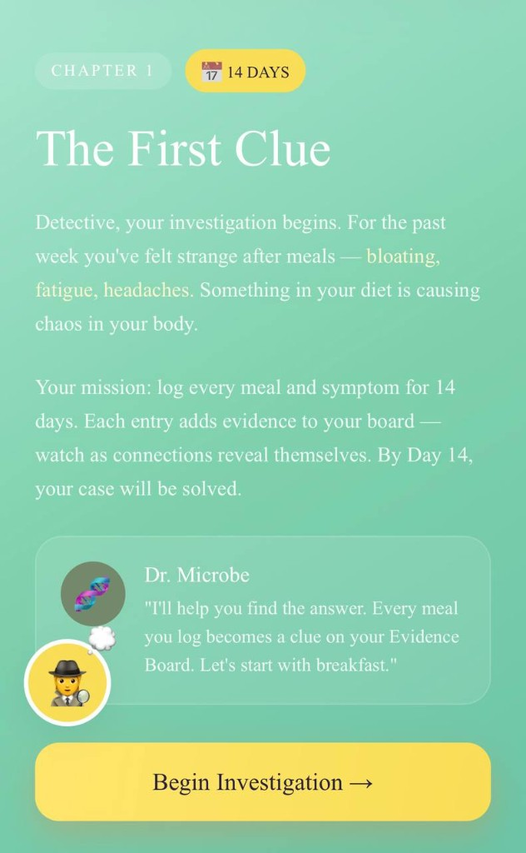
Chapter 1 — The First Clue
• Narrative onboarding with storytelling
• 14-day investigation introduced
• Dr. Microbe guides the user
• Each meal logged becomes a clue
• Day 14 reveals the solved case

Slide 10
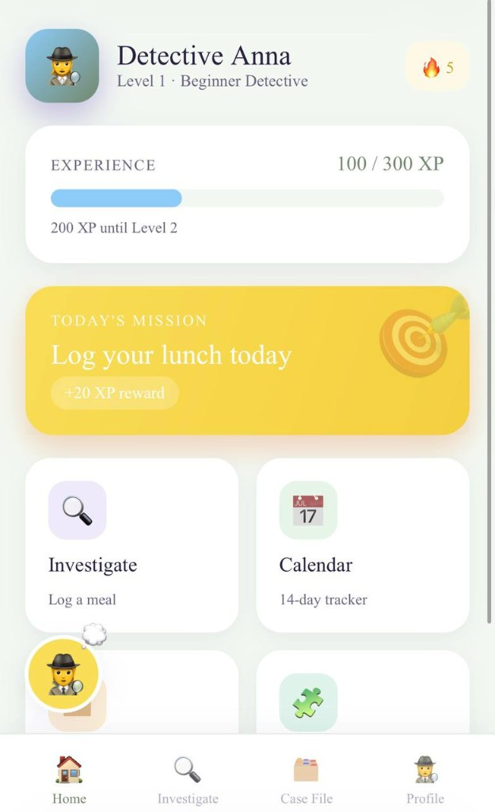
Home Screen & Daily Missions
• Detective profile: name, level, rank
• XP progress bar (100 / 300 XP)
• Today's Mission: Log your lunch (+20 XP)
• Quick access: Investigate, Calendar, Case File
• Streak counter rewards daily consistency

Slide 11
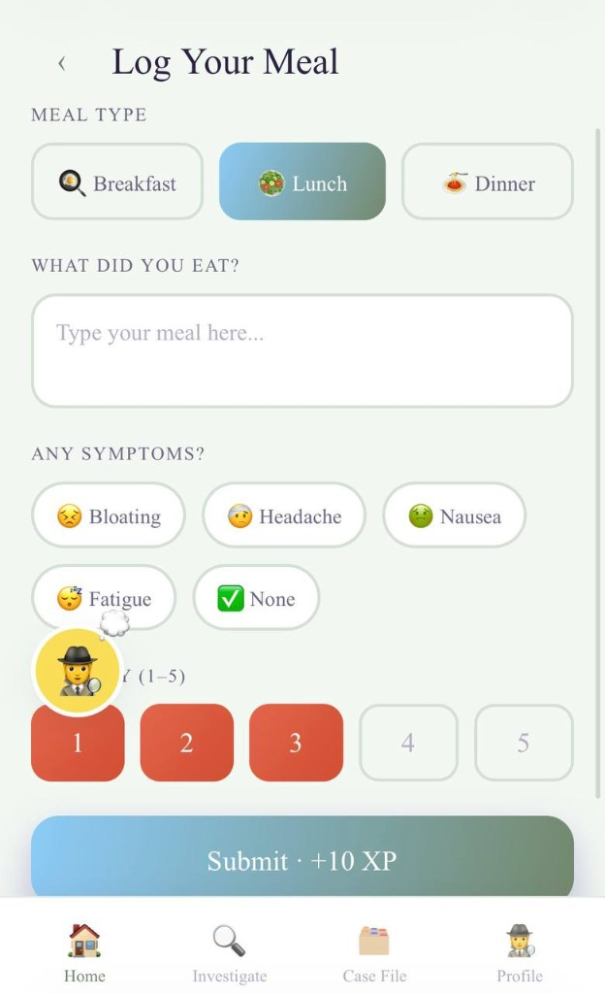
Meal & Symptom Logging
• Select meal type: Breakfast, Lunch, Dinner
• Free-text input for what you ate
• One-tap symptom buttons with emojis
• Severity scale from 1 to 5
• Submit earns +10 XP instantly

Slide 12
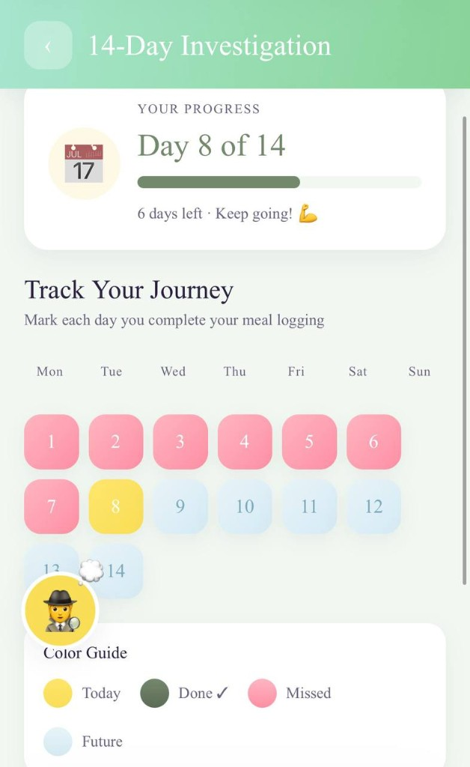
14-Day Progress Calendar
• Day 8 of 14 with progress bar
• Color-coded day tiles:
• Green = Done | Yellow = Today
• Pink = Missed | Blue = Future
• Encouragement: Keep going!

Slide 13
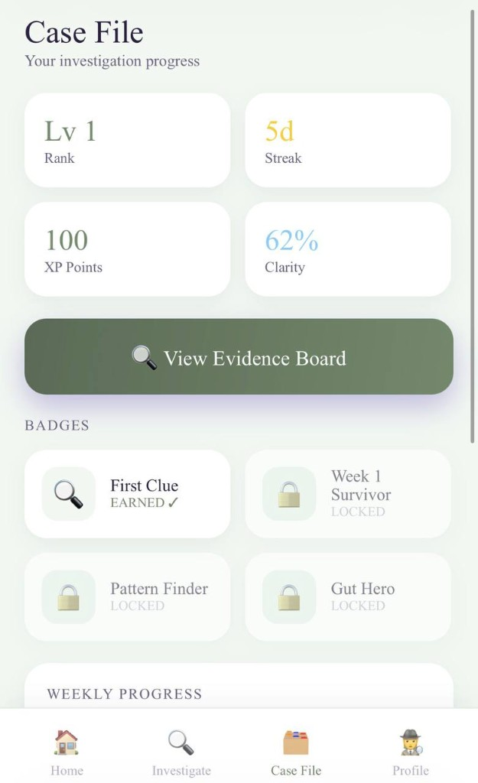
Case File Dashboard
• Rank, Streak, XP, and Clarity stats
• View Evidence Board button
• Badge grid: earned vs locked
• Weekly progress tracker
• Recent clues highlight patterns

Slide 14
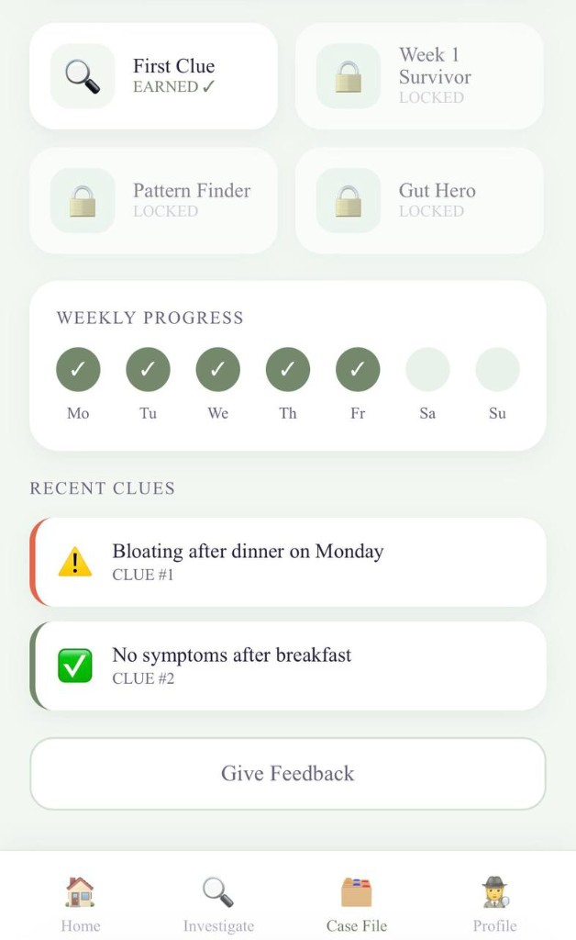
Badges & Recent Clues
• First Clue badge earned
• Week 1 Survivor, Pattern Finder, Gut Hero locked
• Weekly progress with daily checkmarks
• Clue cards show symptom patterns
• Give Feedback option included

Slide 15
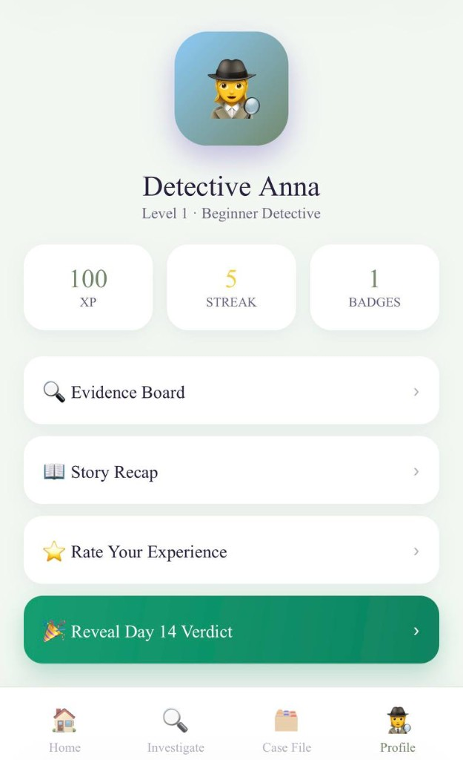
Profile & Day 14 Verdict
• Detective avatar and rank display
• XP, Streak, and Badges summary
• Evidence Board and Story Recap links
• Reveal Day 14 Verdict — final payoff
• Identifies food sensitivities and patterns

Slide 16
03
Gamification Elements

Slide 17
Gamification Elements
Core Mechanics
User Experience Impact
• Detective narrative and storytelling
• XP points for completing daily logs
• Level progression system
• Visual progress tracking (color-coded calendar)
• Achievement badges
• Mission-based structure (Today's Mission)
• Animated feedback and rewards
• Guide character for onboarding and tips
• Turns boring logging into an investigation
• Daily missions give clear goals each day
• XP and levels show visible progress
• Streaks encourage consistent daily use
• Badges create aspirational milestones
• Calendar gives instant visual feedback
• Day 14 Verdict provides story closure
• Guide character reduces onboarding friction

Slide 18
04
Technical Implementation

Slide 19
Technical Implementation
Platform: React Native with Figma prototype
Cross-platform: single codebase for iOS and Android
Navigation: tab bar (Home, Investigate, Case File, Profile)
Stack screens: Log Meal, Calendar, Evidence Board, Verdict
Local data storage for meal logs, symptoms, XP, and badges
Gamification engine: XP calculator, level thresholds, badge unlocks
Component-based architecture for screens and reusable UI
Modular design ready for future backend and AI integration

Slide 20
Conclusion
Gut Guardian transforms gut health tracking into an engaging 14-day detective mystery.
Gamification — XP, levels, badges, missions, and streaks — drives daily engagement.
The narrative framework makes health data feel meaningful, not clinical.
Built with React Native and Expo for rapid cross-platform development.
Every meal is a clue. Every day is progress. Day 14 reveals the truth.

Slide 21
Thank You
Questions & Discussion
Gut Guardian — Your 14-Day Health Detective React Native App | Expo | Gamification Design

