Slide 1
Batch Performance Analysis
TEAM BOTSNBOTS

Slide 2
Problem Statement
Predicting Batch performance
Batch performance is related to the machine’s state which is being captured by 54 sensors

Slide 3
Problem Description
Data is being recorded from various condition monitoring sensors in a manufacturing plant.
There are hundreds of such sensors which may be impacting the quality of final product which is getting manufactured, Hence we can model this problem as a multivariate regression problem.
Important point to note about real-life datasets is that they have various shifts since they are being recorded over the period of time and environment changes with time and further that is going to be the main focus of this challenge.
Here will be covariance shift, prior probability shift, domain shift etc. present in train-test data, so proper method to overcome that has to be implemented.

Slide 4
OUR APPROACH
01
02
03
DATA WRANGLING
DATA EXPLORATION
ML MODEL IMPLEMENTATION
Cleaning the raw data and making it useful for further analysis.
Gaining insights from the data to find correlated features.
Trying different ML models & selecting the best performing model.

Slide 5
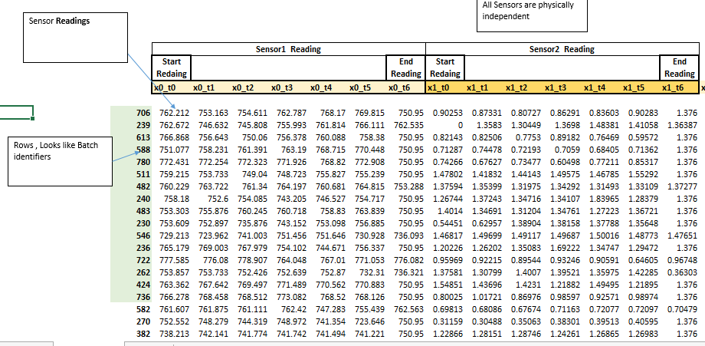
Input Parameters : Sensors wise Readings

Slide 6
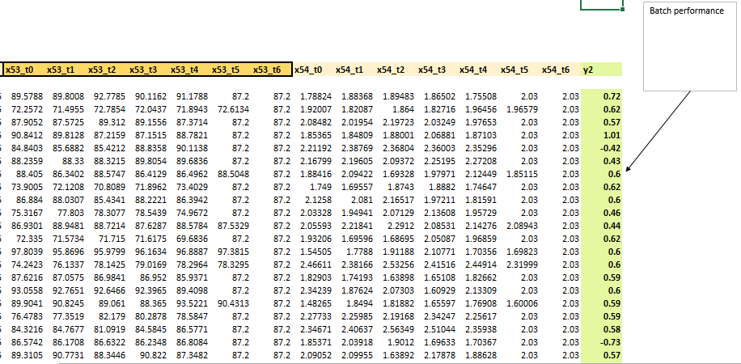
Output Parameter - Performance

Slide 7
Problem Type : Multivariate Regression
Compute batch performance of test data by developing model based on train data
Given Inputs:
794 batches wise data records is available.
Each record has sensor wise readings at 7 time intervals. So total 7 readings for each sensor
There are 55 sensors (X0, X1, X2, X3…… X54), 55 input parameters
So we have total 55 *7 input data points
Output:
Batch wise performance data (Y2)

Slide 8
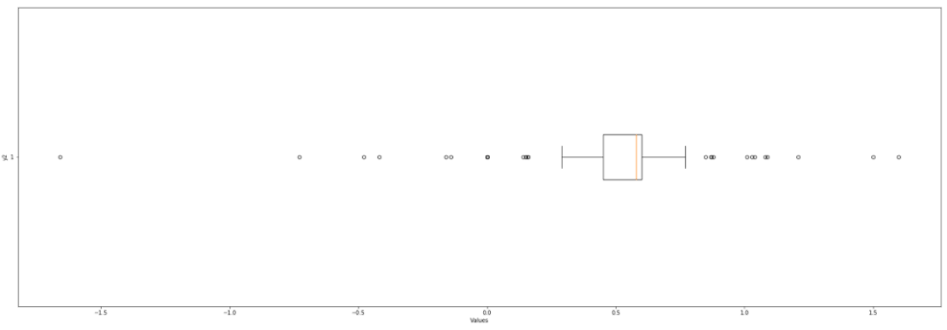
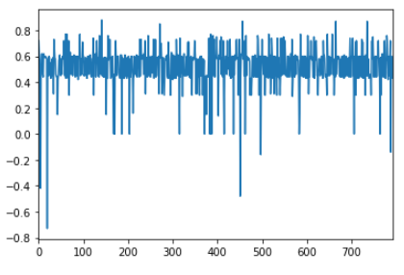
Visualisation
OUTLIERS IN y2
Column y2

Slide 9
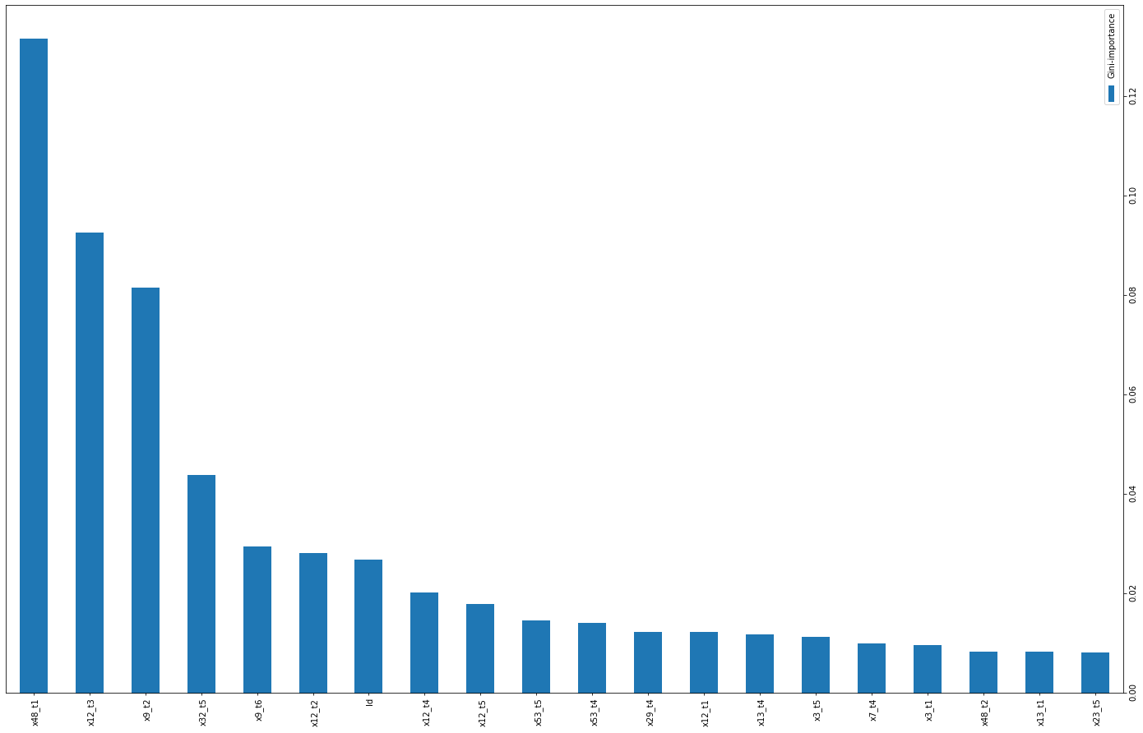
Visualisation
Important dependencies
for target variable y2

Slide 10
Pipeline
We observe that there are columns in the dataset with just 1 unique value
We can drop these columns as they will not do any help to our model to differentiate between two different labels while on the other hand, it can even negatively affect our model by creating a bias in the data
There are more number of columns in the test data with 1 unique value than in the train data
Columns which coincide for both datasets: x2_t0, x2_t1, x18_t0, x18_t1, x18_t2, x18_t3, x18_t4, x18_t5, x18_t6, x25_t0, x25_t1, x37_t6, x38_t5, x38_t6, x42_t6
Dropping these 15 columns from both train data and test data

Slide 11
Pipeline
Summarizing the data cleaning:
Dropping rows that have values of y2 > 1 and y2 < -1
Dropping that have only 1 unique value as that doesn't contribute to the model
Comparing columns from the test data(that have only 1 unique value) in the train data columns that have 2 values.
Dropping the column if the 2nd value has just <=3 occurrences throughout
Model Evaluation:
We tried a number of Different ML models such as Linear Regression, Decision Tree Regressor, Ridge Regression, Lasso Regression, Random Forest Regression, ElasticNet Regression, XGBoost Regression.
Random Forest Regression gave the highest R2 Score on the train dataset. Hence, will be used to predict on the test dataset.

Slide 12
Model Evaluation
-11912…
-3.372
0.094
0.275
Linear Regression
Ridge
Regression
XGBoost
Random Forest

Slide 13
Our Team
MANPREET KAUR KHUSBU VERMA AMIT DESAI
BHAVISHYA GARG

Slide 14
Thanks
Do you have any questions?

