Slide 1
Use of NETWORK ATTACHED SERVER
-KHUSHBU GUPTA
27.11.2015

Slide 2
SERVER OVERVIEW
2TB storage capacity
1 TB active ,1TB for mirroring
Used to prevent the data loss of extremely important files
10 GB allocated for each user

Slide 3
SERVER OVERVIEW..(contd.)
Static IP available so created space for all Area Coordinators
From Local(Within Acted Office)
-https://192.168.0.2:8123
From Internet(Home or Cafe)
-https://110.34.28.65:8088

Slide 4
SERVER OVERVIEW..(contd.)
Created users for each employee
Easily Accessible Using the smart phones
Desktop Application called QSync
Android Application called Qfile by Qnap
Application free available at Google Play Store

Slide 5
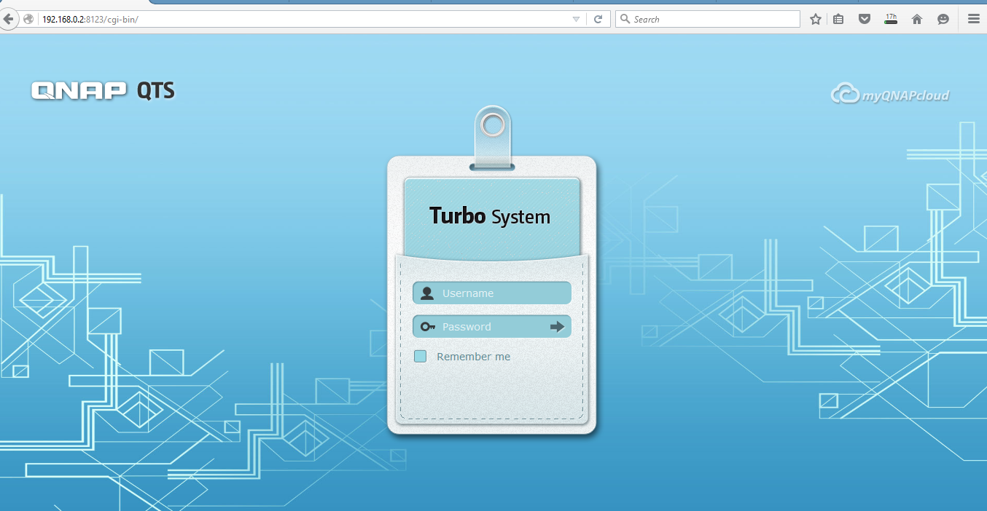
Login Page

Slide 6
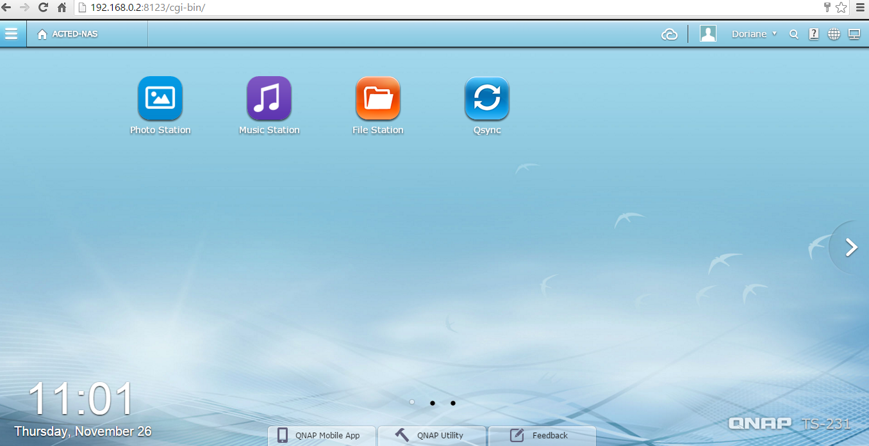
After you Login…

Slide 7
Inside Your Account
When you click the File Station, you can find the folders that you have the access.
Each user has its own “home” folder to store personal work files
The shared folder permission is according to the department involved.
The shared folder contains the folders inside it according to the bases, you could share the documents accordingly.

Slide 8
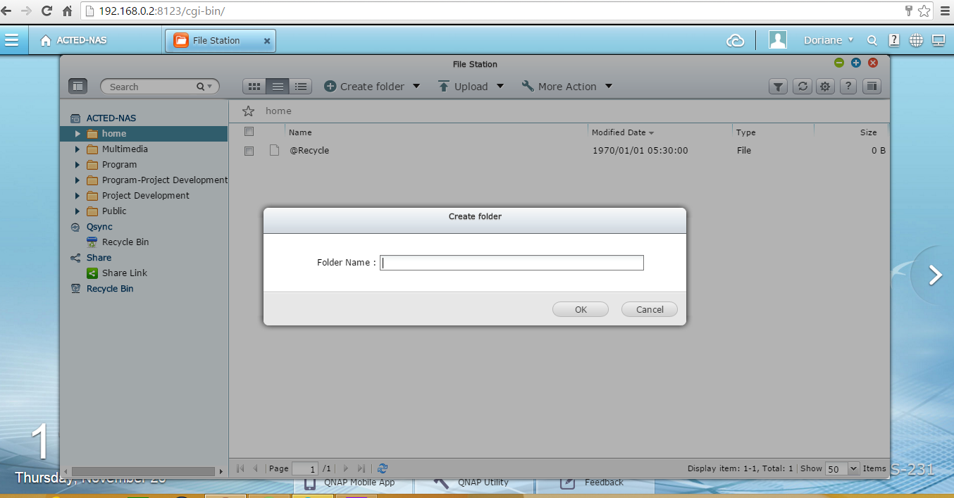
Create Folder

Slide 9
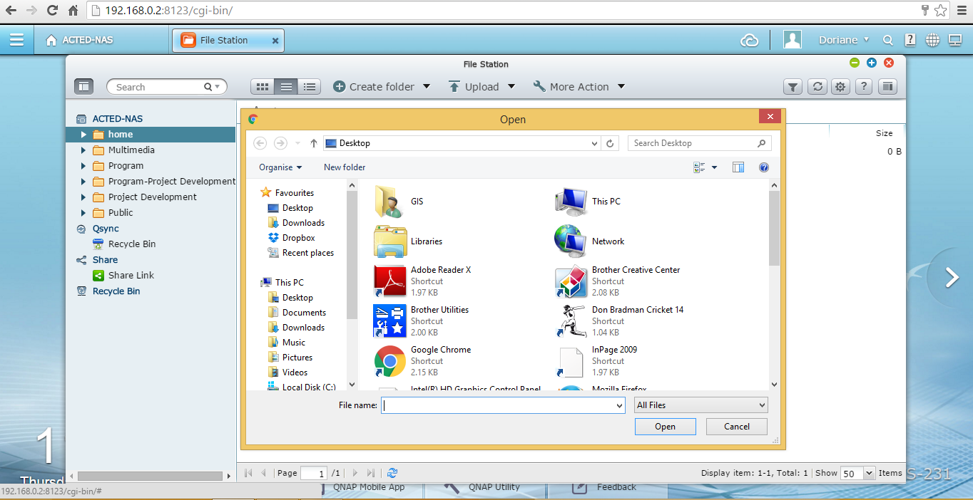
File Upload

Slide 10
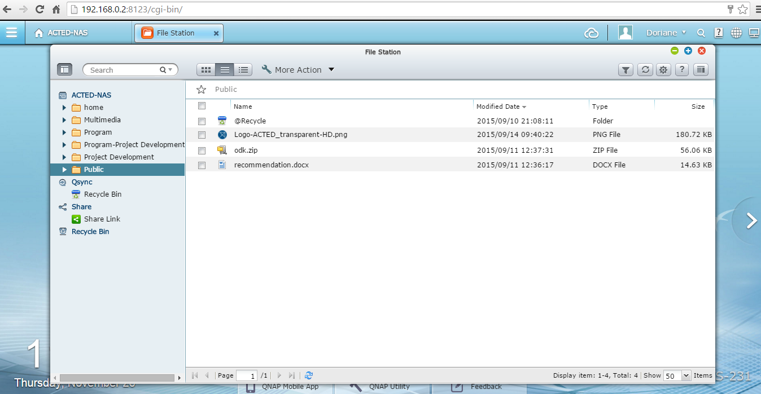
Folder With Read Only Access

Slide 11
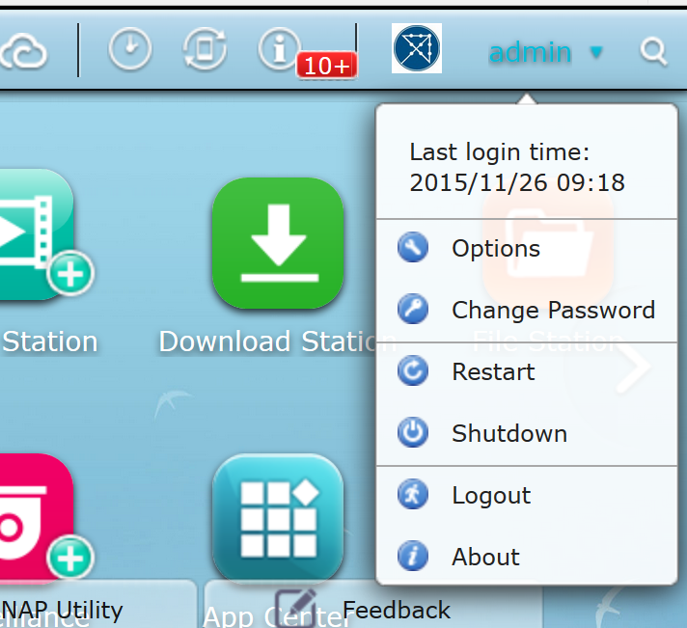
Change Password

Slide 12
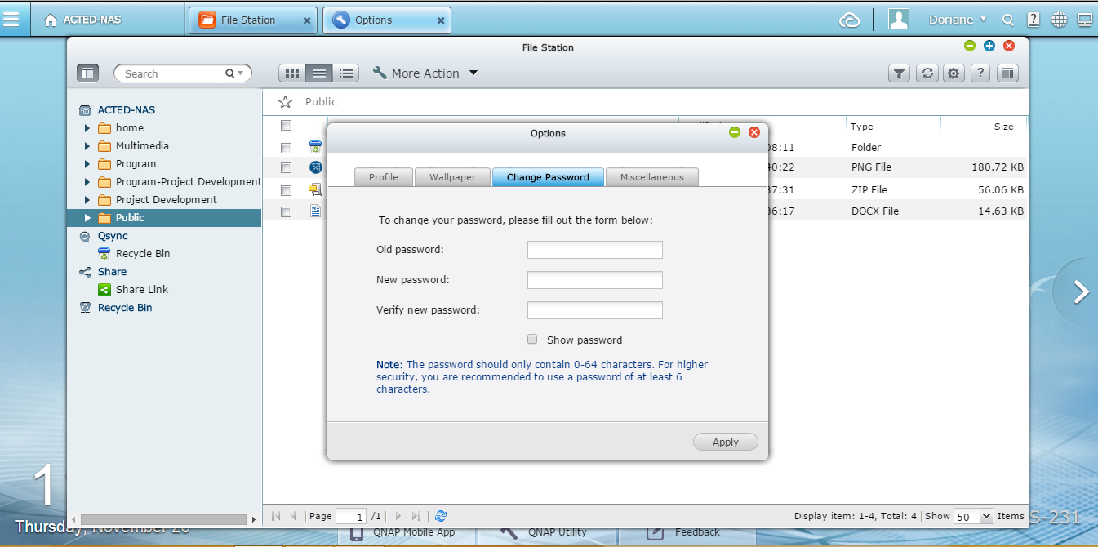
Change Password…contd

Slide 13
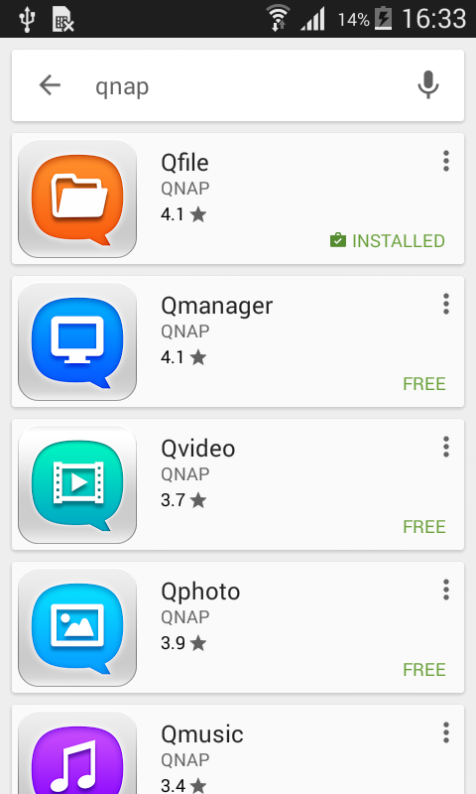
Qnap at Play store

Slide 14
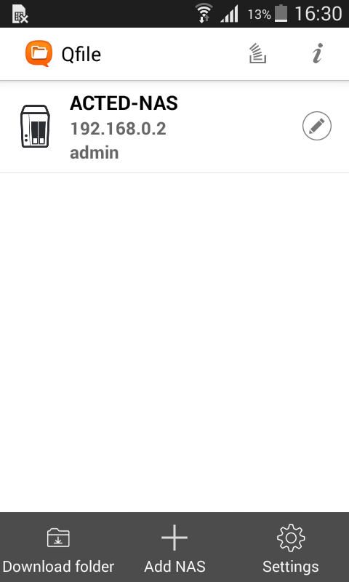
….continued

Slide 15
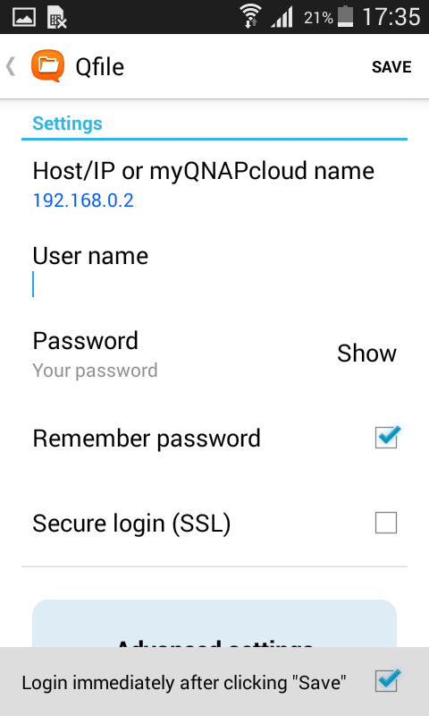
….continued

Slide 16
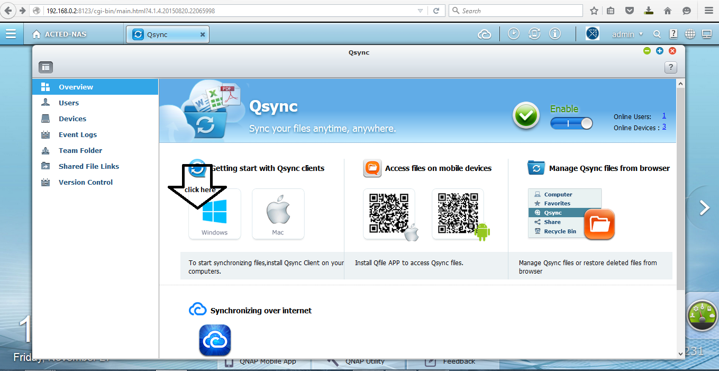
QSync

Slide 17
Qsync …(contd..)
Qsync to synchronize all your folders automatically
When you click on the windows icon, shown in the earlier page it will ask you to download a software.
The software is also available inside the public folder called “QNAPQsync_Windows.exe”.
Download and Install It.
After Installing the software, a folder called Qsync is created and a notification appears at the bottom of the task bar.
A desktop icon of Qsync is made, when you click it you would find a window shown in the next page.
Can create a work folder directly there so that everything gets synchronized automatically
Drop box like functionality
Drag and Drop your documents in this folder and it gets uploaded inside NAS

Slide 18
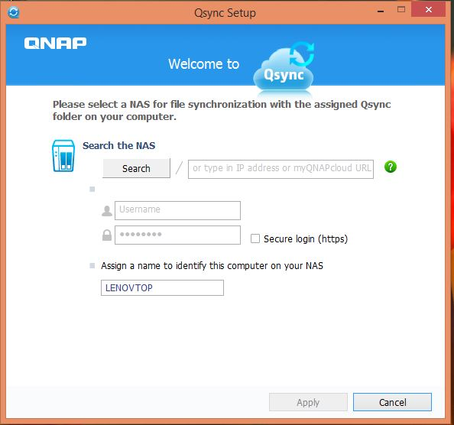

Slide 19
Qsync …(contd..)
Drop box like functionality
Drag and Drop your documents in this folder and it gets uploaded inside NAS
You can create a work folder here so that everything that is inside this work folder gets synchronized automatically and your files get updated automatically.
To find these updated files through the browser, go to the File Station->Qsync
You can find your updated files here. The snapshot is in the next page.

Slide 20
