Slide 1
Assignment API Development
Name: Khush Bhutra
College: Nit Kururkshetra
Branch : Computer Engineering

Slide 2
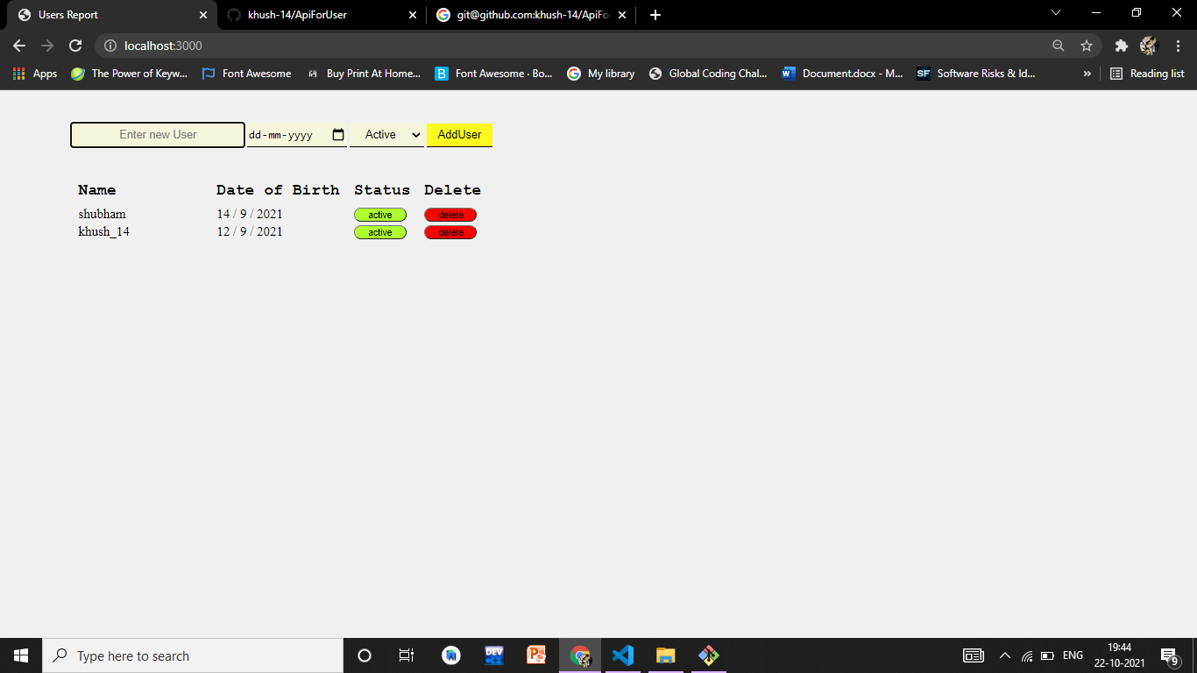
User Page

Slide 3
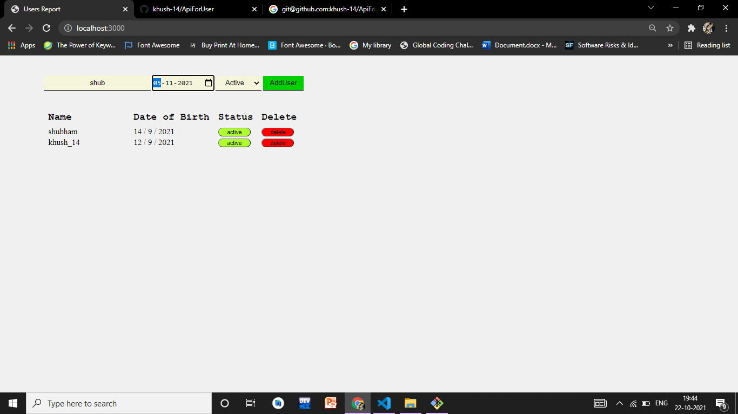
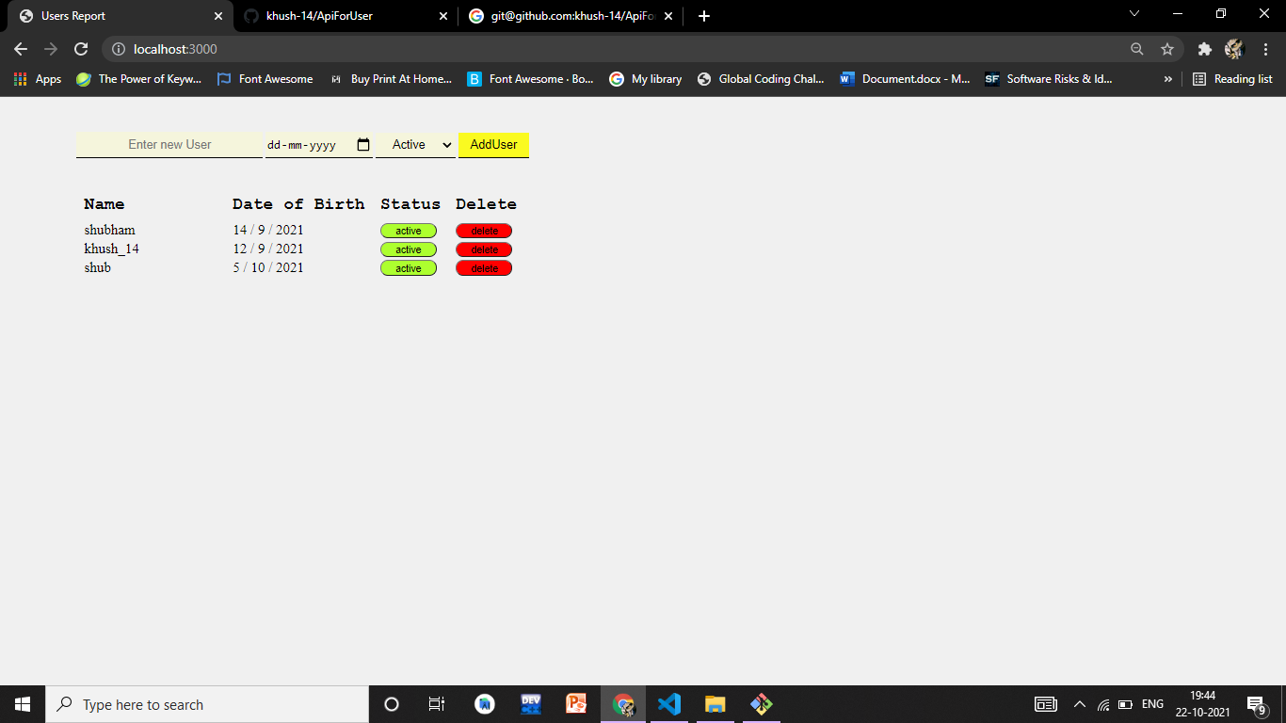
Enter New User

Slide 4

Update Status

Slide 5


Delete User

