Slide 1


Ontario Rental Market Data Analysis Using Machine Learning MODELLING and deployment
Edmonton
.

Slide 2

Problem Statement
"Developing an accurate housing price prediction model tailored for Canadian small communities through regression and classification techniques. The project focuses on implementing cross-validation and hyperparameter tuning to optimize model performance. The resulting application provides real-time price estimates and actionable insights, empowering community members to make informed decisions and address local housing needs effectively."
2

Slide 3
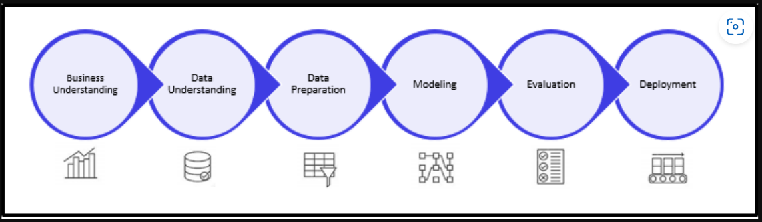

Steps Involved:
3

Slide 4
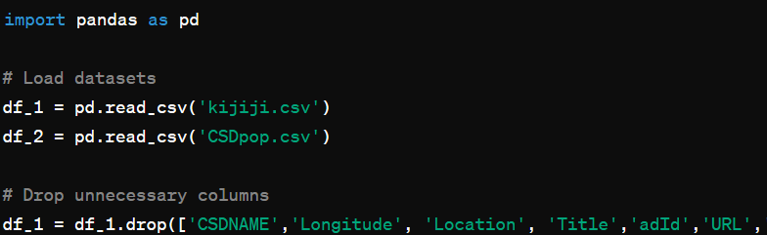
DATA preparation
In the process of preparing the dataset for accurate modeling in our project, we began by loading two crucial datasets: "kijiji.csv," which contains housing listings, and "CSDpop.csv," which provides population data. Subsequently, we filtered out unnecessary columns from the housing listings dataset and performed essential data type conversions to ensure compatibility with our analysis tools. This initial step sets the foundation for a streamlined and efficient data preparation process, laying the groundwork for subsequent modeling efforts.
4

Slide 5
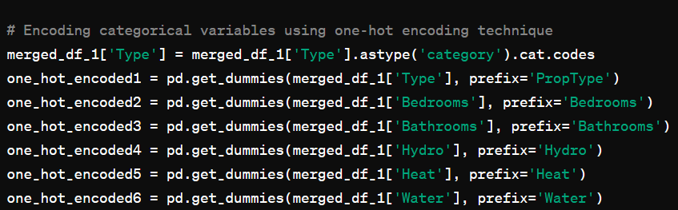
DATA preparation
20,585 samples (rows)
37 features (columns),
Handled missing values by replacing outliers and filling NaN values.
Formatted price data by removing special characters and converting to numeric format.
Merged datasets based on a common identifier and encoded categorical variables using a one-hot encoding technique.
Ensured the dataset was cleaned, formatted, and ready for machine learning model training.
5

Slide 6

ML MODELING
List of Models Used:
RandomForestRegressor
GradientBoostingRegressor
Linear Regression
DecisionTreeRegressor
KNeighborsRegressor.

Slide 7


Model Performance Overview
RandomForestRegressor achieved the highest mean R^2 score of 0.6823 and the lowest mean MSE of 186,565.40, indicating superior overall performance.
Linear Regression performed well but had a slightly lower mean R^2 score and higher mean MSE compared to RandomForestRegressor and GradientBoostingRegressor.
DecisionTreeRegressor showed lower performance compared to RandomForestRegressor and GradientBoostingRegressor, with a lower mean R^2 score and higher mean MSE.
KNeighborsRegressor performed the poorest among the models, exhibiting the lowest mean R^2 score and highest mean MSE.
GradientBoostingRegressor also demonstrated strong performance with a mean R^2 score of 0.6453 and a mean MSE of 208,269.18.

Slide 8
Among the models evaluated in the analysis, the Random Forest model emerged as the most effective for predicting rental prices in the Ontario market
Random Forest model achieved the lowest mean squared error (MSE) and highest R-squared value post cross-validation.
It consistently provided accurate predictions and explained a significant portion of rental price variance.
The model offered valuable insights into feature importances, aiding in understanding key factors influencing rental prices.
Known for its robustness, it effectively handled complex data relationships.
Overall, the Random Forest model emerged as the top performer for predicting rental prices in the Ontario market.

Slide 9
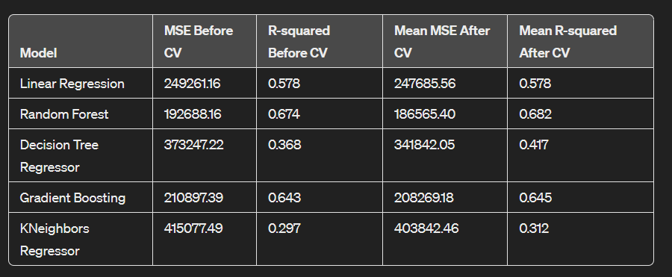
Model’s Report:
9

Slide 10
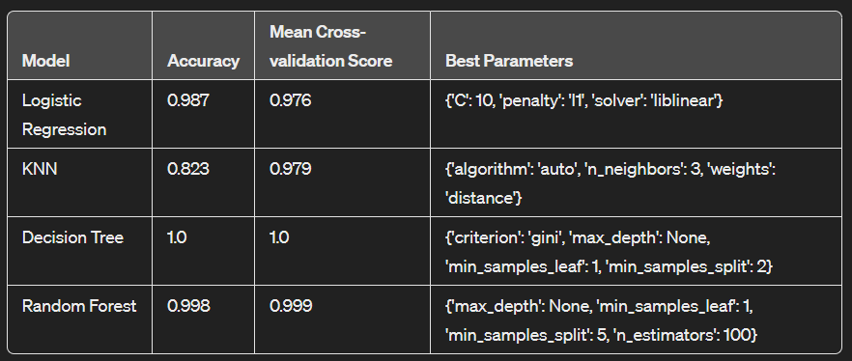
Classification REPORT:
The Decision Tree model achieved perfect accuracy and a perfect mean cross-validation score, making it the best model for this classification task. It doesn't just perform well on the training data but also generalizes effectively to unseen data, making it reliable for future predictions.

Slide 11

CONCLUSION:
Random Forest stood out as the top model for both predicting rental prices and classifying rental properties, even after parameter tuning, underscore its effectiveness in predicting rental prices and classifying properties. Its performance highlights its suitability for practical applications in the Ontario rental market.

Slide 12
Thank You
Kawaldeep Kaur
Khushi Khushi
Anureet Kaur

