Slide 1

Summer internship - I
PATEL KHUSH -20IT098
PATEL MITEN -20IT101
CYGNUX SOFTTECH

Slide 2
OUTLINES
REFRENCES
TOOLS AND TECHNOLOGY
MY ROLE
PROJECTS WORKED ON
SCREENSHORTS
TAKEAWAYS

Slide 3
Projects Worked on:
Live Projects Static websites:
The Kruncheez Cafe
Dynamic websites: (Angular)
Angrez: The Salon

Slide 4
MY Role as an intern:
For Static Websites: (Café )
In the static sites, we worked on designing UI/UX and learned the necessary skills for team work required to complete a live project.
For Angular Project: (Angrez)
As before this, we have worked on static sites to gain some experience as web developer, further in dynamic websites we worked on frontend and backend as well.
And in the websites, we worked on frontend and backend for the modules like customer-registration, forgot password, otp-box.

Slide 5






TOOLS AND TECHNOLOGY USED
Frontend Tools:
HTML
CSS
JavaScript
Backend Tools:
Express.js
Node.js
Frameworks:
Bootstrap
Angular

Slide 6
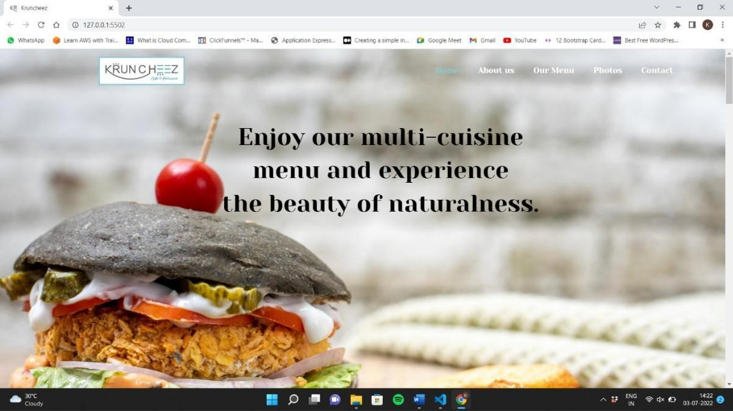
ScreenShots:

Slide 7
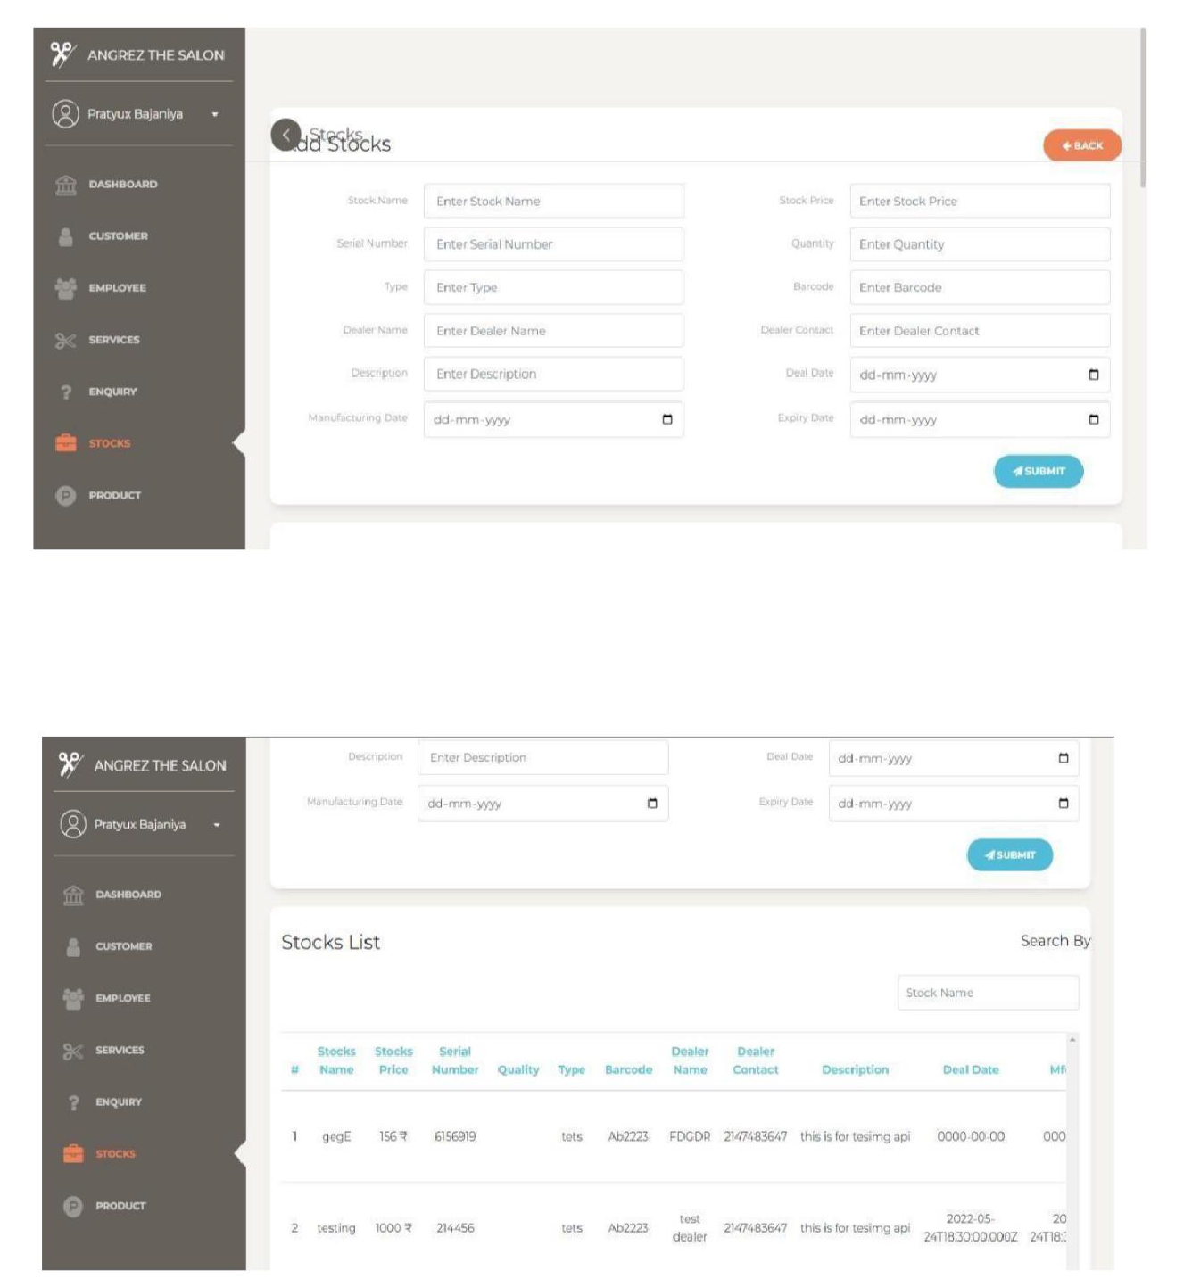

Slide 8
References:
https://stackoverflow.com/questions/50455347/how-to-do-a-timer-in-angular-5
https://www.geeksforgeeks.org/how-to-detect-click-event-outside-angular-component/
https://www.w3schools.com/
https://www.udemy.com/
https://angular.io/
https://nicepage.com/
https://dribbble.com/

Slide 9
Takeaways from Internship
Technical Skills:
More experience and understanding of HTML, CSS & Javascript
Necessary skills to enhance the user’s experience
Explored new technology and exposure to live projects
Soft Skills:
Critical Thinking
Problem Solving
Teamwork
Patience
Work ethics

Slide 10

THANK YOU

