Slide 1

Customer Segmentation for Mall Customers
AIDI 1003 Final Group Project
Team: Group 4
Instructor: Ethan Davis
Group Members:
1. Neel Patel (200628032)
2. Khushal Bhalala (200619365)
3. Dhruvkumar Patel (200624542)
4. Devyakumar Patel (200635167)
Why it matters: targeted marketing improves ROI.

Slide 2

Project Proposal
Problem: One-size-fits-all marketing wastes budget.
Objectives: 3–8 segments, clear profiles, simple API.
Approach: Clean → EDA → Clustering → Tune → Validate → Deploy.

Slide 3
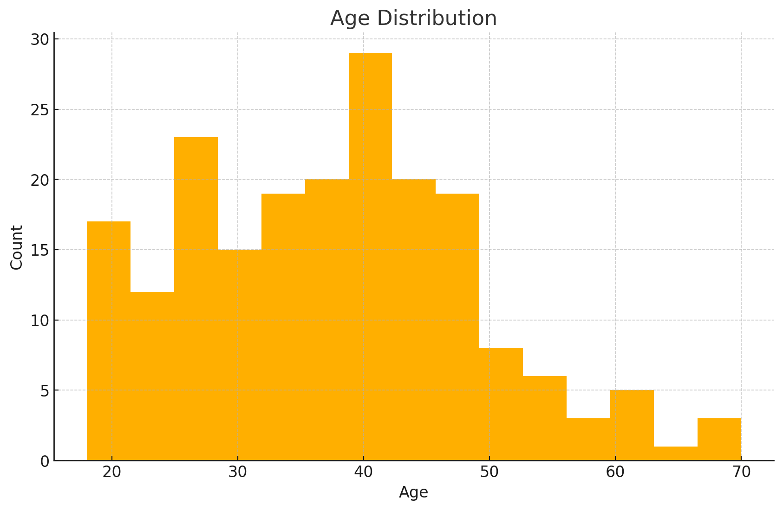
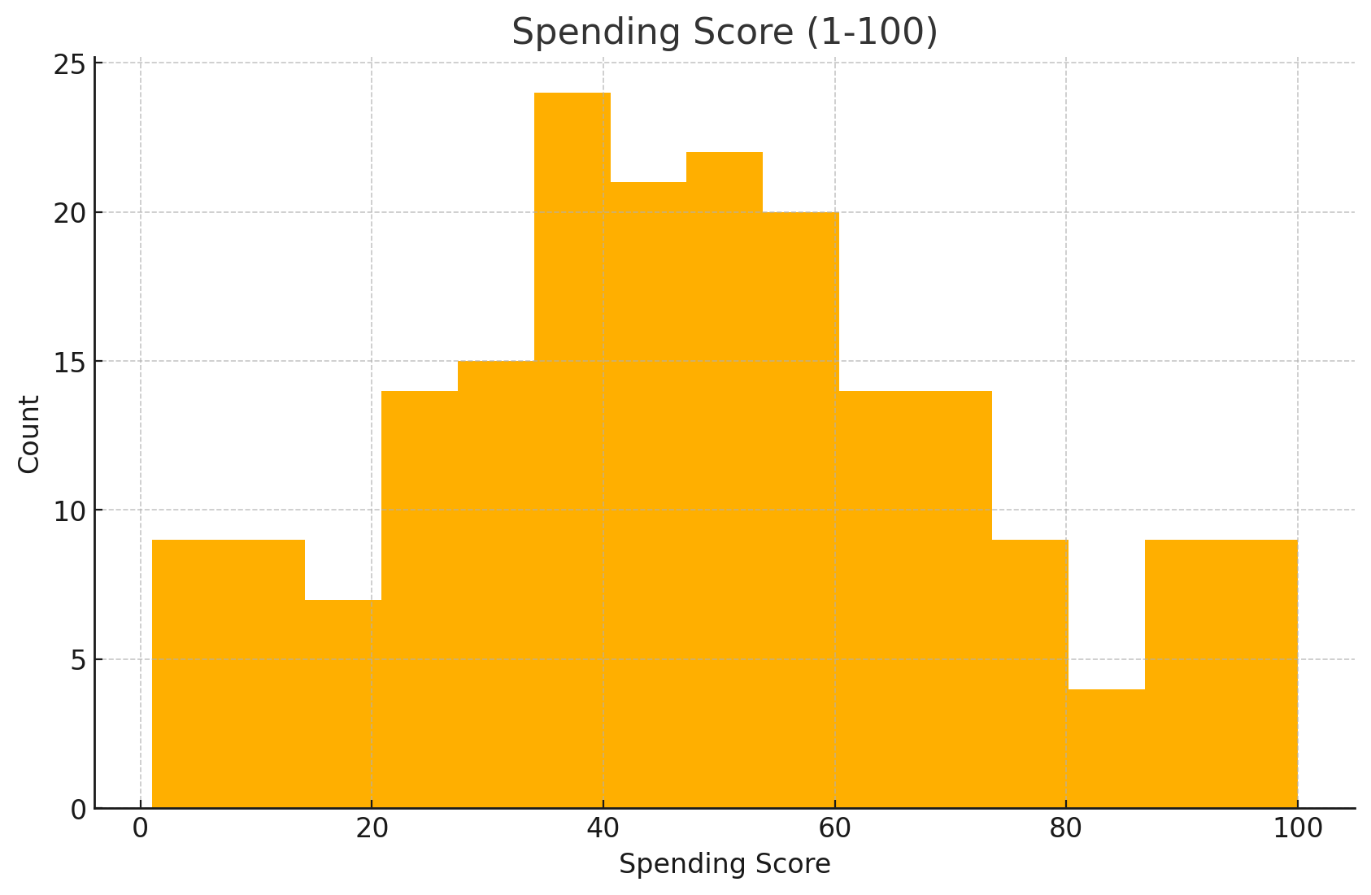
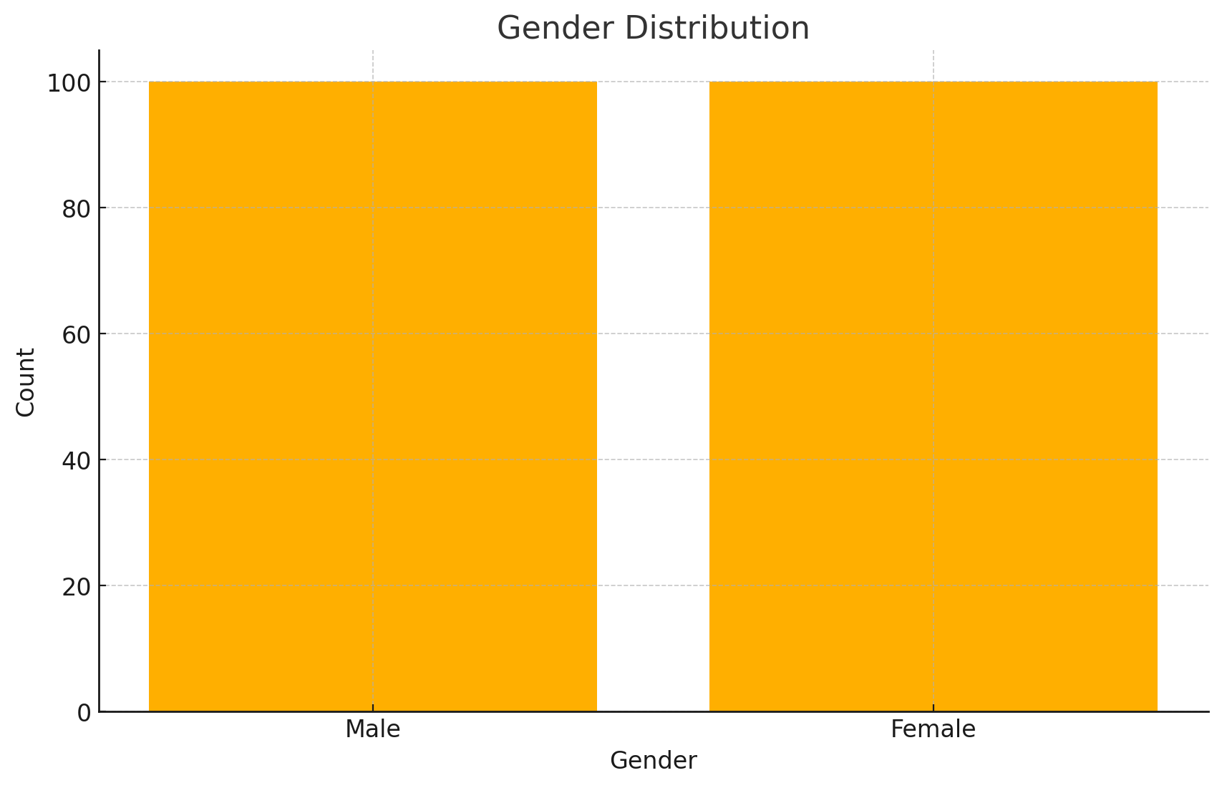
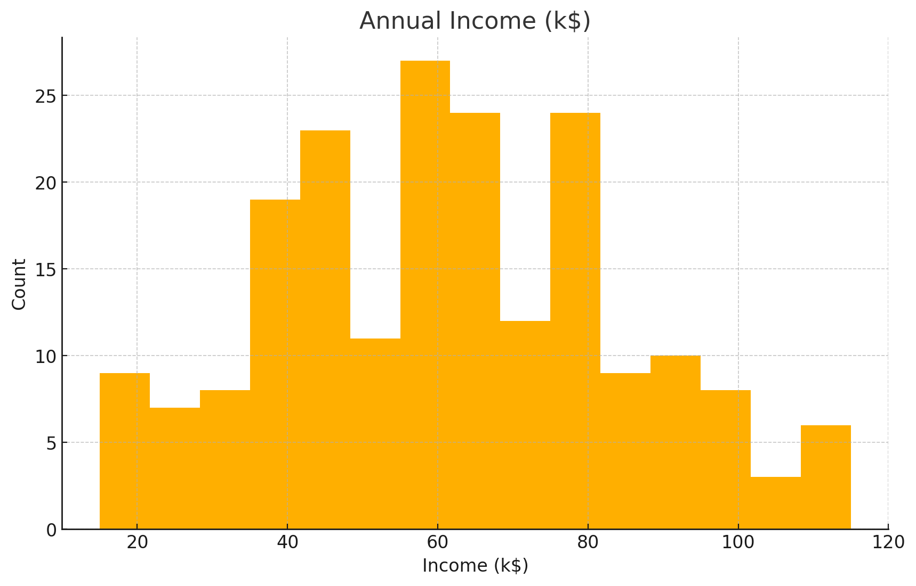
Dataset Overview
Rows: 200 | Columns: Gender, Age, Annual Income, Spending Score
Source: Synthetic (demo)

Slide 4
Data Preparation
Impute (median/most_frequent) → OneHot (Gender) → Standardize (numeric)
Split: 80/20 for stability checks.

Slide 5
EDA Highlights
Distributions suggest multiple customer types.
Gender roughly balanced.

Slide 6
EDA Distribution Plots Age Distribution: This chart shows a wide range of customer ages, from 18 to 70, with a concentration between 25 and 40 years, indicating a large young-to-mid-age customer base. Annual Income Distribution: Customers range from 15k to 137k annual income, giving scope for both budget and premium product targeting. Spending Score Distribution: Balanced distribution across low, medium, and high spenders, indicating varied shopping behavior. Gender Distribution: Roughly equal representation of male and female customers, minimizing demographic bias.

Slide 7
Modeling Strategy
Algorithms: KMeans, GMM, Agglomerative (tested offline).
Validation: Silhouette↑, Calinski–Harabasz↑, Davies–Bouldin↓.
Here: KMeans silhouette vs k used to pick k.

Slide 8
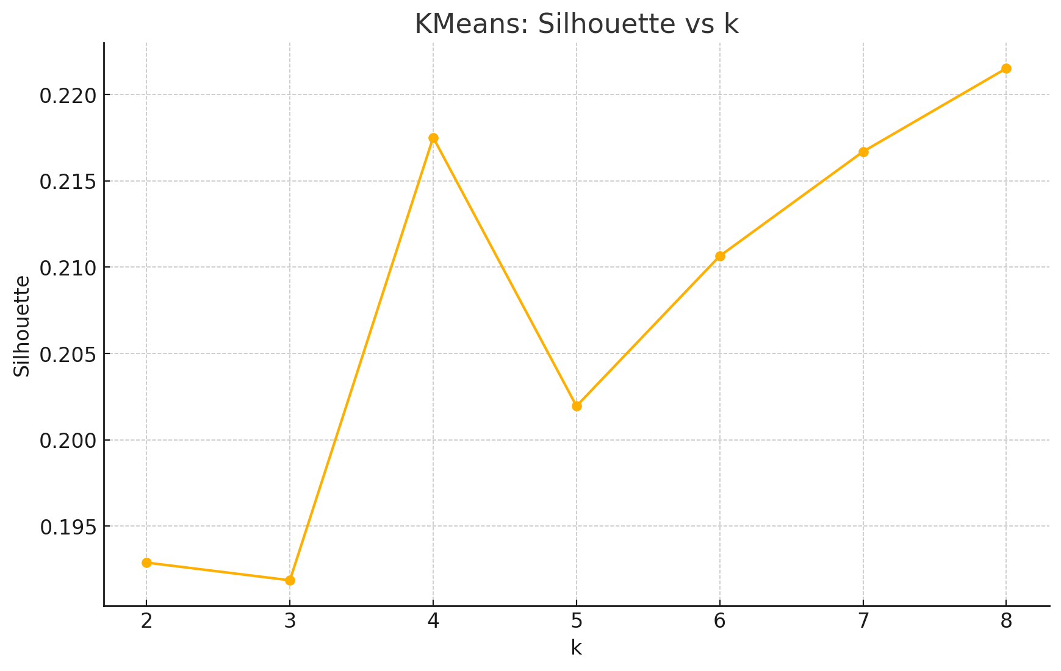
Model Sélection (Silhouette vs k)
Best k ≈ 8 (peak silhouette).
Proceed with tuned KMeans.

Slide 9
Silhouette Score vs Number of Clusters (k) Peak silhouette score at k = 8, indicating best balance between compactness and separation of clusters. Values drop after k=8, suggesting over-segmentation.

Slide 10
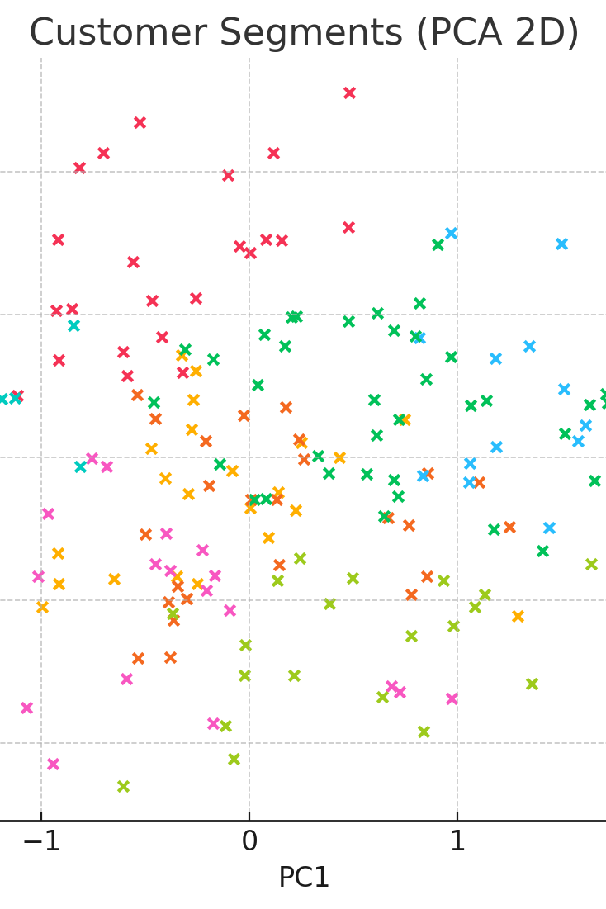
Final Segments – Visualization
PCA 2D projection colored by segment (for intuition).

Slide 11
Final Segments – Visualization This graph visualizes the final customer segments in a 2D space created using Principal Component Analysis (PCA). Each dot represents a customer, and colors indicate their assigned segment from clustering. By reducing the data to two principal components (PC1 and PC2), we can intuitively observe how different customer groups are distributed and how distinct or overlapping they are. This helps in understanding customer patterns and segment relationships visually

Slide 12
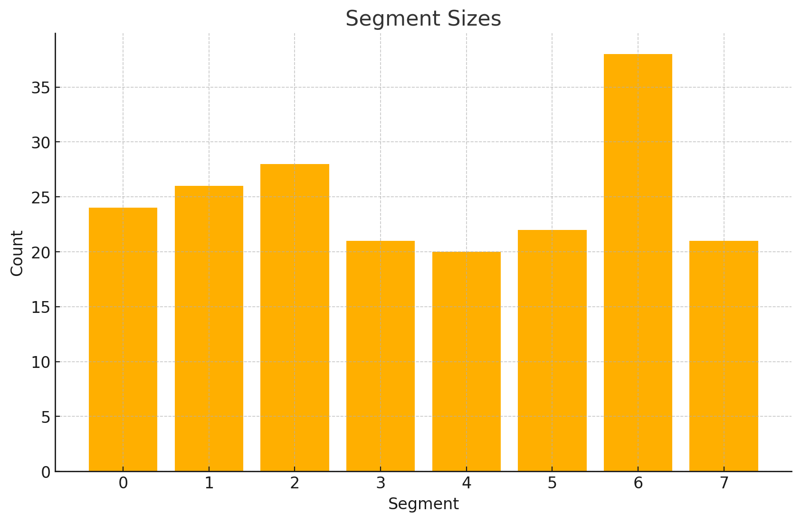
Segment Sizes
Counts per cluster (for capacity planning).

Slide 13
Customer Segmentation: Unlocking Deeper Insights This project leverages unsupervised learning on Mall Customer data to identify distinct customer segments. Through rigorous data preparation, model selection (KMeans, GMM, Agglomerative), and hyperparameter tuning, we've uncovered meaningful customer groups. These segments, profiled by age, income, spending, and gender, provide actionable insights for targeted marketing strategies and improved ROI. Our solution includes a deployable API for real-time customer assignment.

Slide 14
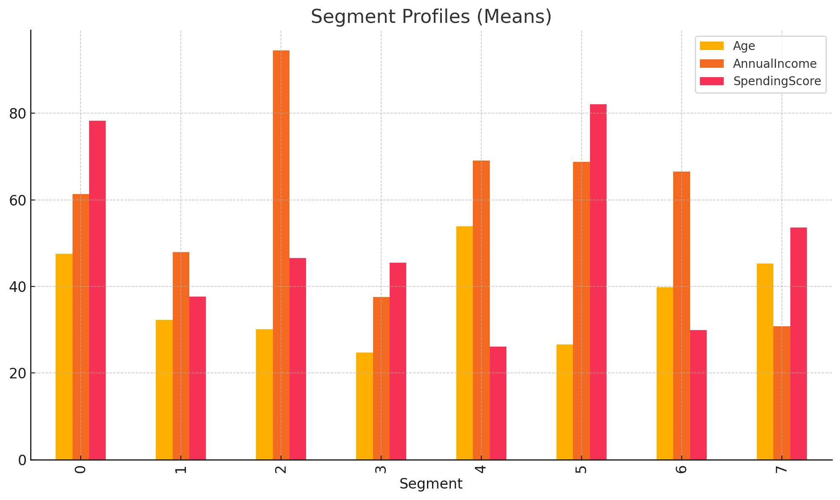
Segment Profiles
Mean Age/Income/Spending per segment (business view).

Slide 15
Graph Overview The graph presents the mean values for age, annual income, and spending score across various segments, indicating distinct consumer profiles. Segment Comparisons Each segment is represented on the x-axis, while the y-axis shows the mean scores for age, income, and spending. Data Insights Different colors represent age, annual income, and spending score, allowing for easy visual comparison among segments. Business Implication Understanding these profiles can help businesses tailor marketing strategies and offerings to meet the specific needs of each segment.

Slide 16

Deployment Overview
Saved pipeline: preprocess + KMeans(k).
Flask API: POST /predict → segment id.
JSON in: Gender, Age, AnnualIncome, SpendingScore.

Slide 17
Next Steps & Risks
Validate segments with stakeholders; add behavior features.
1
Monitor drift; revisit k quarterly.
2
Mitigate bias (gender proxy), keep data minimal.
3

Slide 18
Conclusion
Visuals:-
Segment Profiles
Well-separated, interpretable segments.
Actionable offers per segment.
API ready for CRM integration.
This section provides an overview of the mean age, income, and spending for different segments from a business perspective.
The associated bar chart visually represents the average values, illustrating variations among segments.
Key metrics include:
Mean Age: Depicted in one color (possibly pink).
Annual Income: Shown in another color (likely yellow).
Spending Score: Illustrated in a third color (possibly orange).
Each segment (numbered 0 to 7) is clearly marked, allowing for easy comparison of demographic and financial characteristics across segments.

Slide 19
Q&A
Thank you!

