Slide 1
QUICKFIX
Hyperlocal On-Demand Home Services Marketplace
PROJECT PRESENTATION BY:
• Khushal Rathod | Enrollment: 20230905040016
• Malav Makwana | Enrollment: 20230905040053
• Rohit Ambaliya | Enrollment: 20230905040044
• Krishn Dudhrejiya | Enrollment: 20230905040046

Slide 2
INTRODUCTION
Project Overview & Vision
What is QuickFix?
• Hyperlocal Marketplace:
Connects local skilled service providers (plumbers, electricians, appliance technicians) with customers instantly based on geolocation.
• On-Demand Services Model:
Features real-time request creation, radial job dispatching, instant swiping/acceptance, and interactive status tracking.
• Zero Communication Delay:
Eliminates middlemen and coordinates work directly via automatic distance calculations, system notifications, and real-time mapping.
Core Challenges Solved:
✔ Trust & Verification:
Service providers are verified through simulated Aadhaar KYC before they receive tasks.
✔ Hyperlocal Coordination:
Limits provider lists to coordinates within 1.0 km radius (expanding to 5.0 km) to optimize travel time.
✔ Workforce Autonomy:
Providers have total control over their availability, job categories, and accepting orders.
✔ Review Loop:
Customer feedback locks completed orders, updating rating aggregates automatically.

Slide 3
WHAT WE USED
Technology Stack & Tooling
FRONTEND & UI
• Next.js 15 (React 19) framework
• Tailwind CSS v4 utility layout styling
• Framer Motion for immersive 3D/hover states
• Radix UI for accessible interface widgets
• Lucide React for iconography
BACKEND & SECURE API
• Next.js Serverless Route Handlers
• BcryptJS for secure password encryption
• Jose library for secure JWT sessions
• Middleware routing for dashboard guard
• Node.js API environment
DATABASE & INTEGRATIONS
• MongoDB Core Database (User Profile, Orders)
• Supabase Real-time Database Client sync
• Brevo Email API (Transactional OTP sender)
• Leaflet.js & OpenStreetMap (Tile mapping)
• Vercel Cloud (Live hosting & CI/CD deployment)

Slide 4
HOW IT WORKS
End-to-End System Workflow
Step 1: Verification
Provider completes Aadhaar KYC. Authenticates account.
Step 2: Post Task
Customer posts job request with location, photos & budget.
Step 3: Dispatch
Request matches nearby providers (1km for 10s -> expands to 5km).
Step 4: Swipe Accept
Provider accepts request via swipe slider component.
Step 5: Selection
Customer selects provider. Order moves to IN_PROGRESS.
Step 6: Live Map
Provider GPS live-streams coordinates to Customer map.
Step 7: Completion
Provider completes work. Customer submits reviews & releases funds.

Slide 5
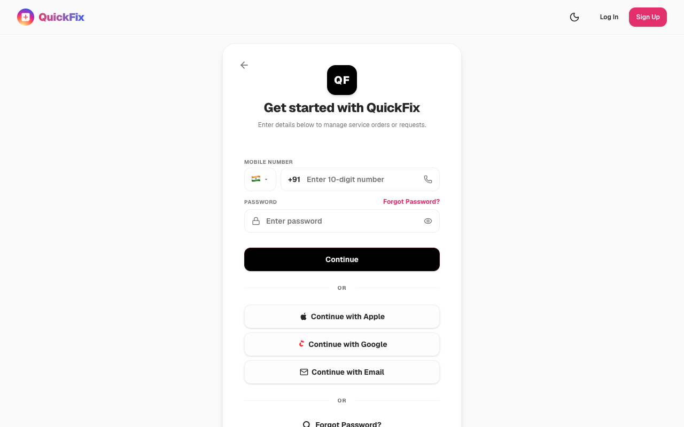
AUTH & LOGIN FLOW
User Registration & Secure Authentication
Email OTP & Login UI
✔ Login Options:
Seamless switching between email-based and mobile number login layouts.
✔ Simulated OAuth List:
Pre-linked sandbox accounts for quick testing of customer and provider profiles.
✔ Email OTP Delivery:
Brevo transactional API integration sends 4-digit codes directly to the user's email address.
✔ Interactive Design:
Soft shadows, clean form layouts, and responsive card containers.

Slide 6
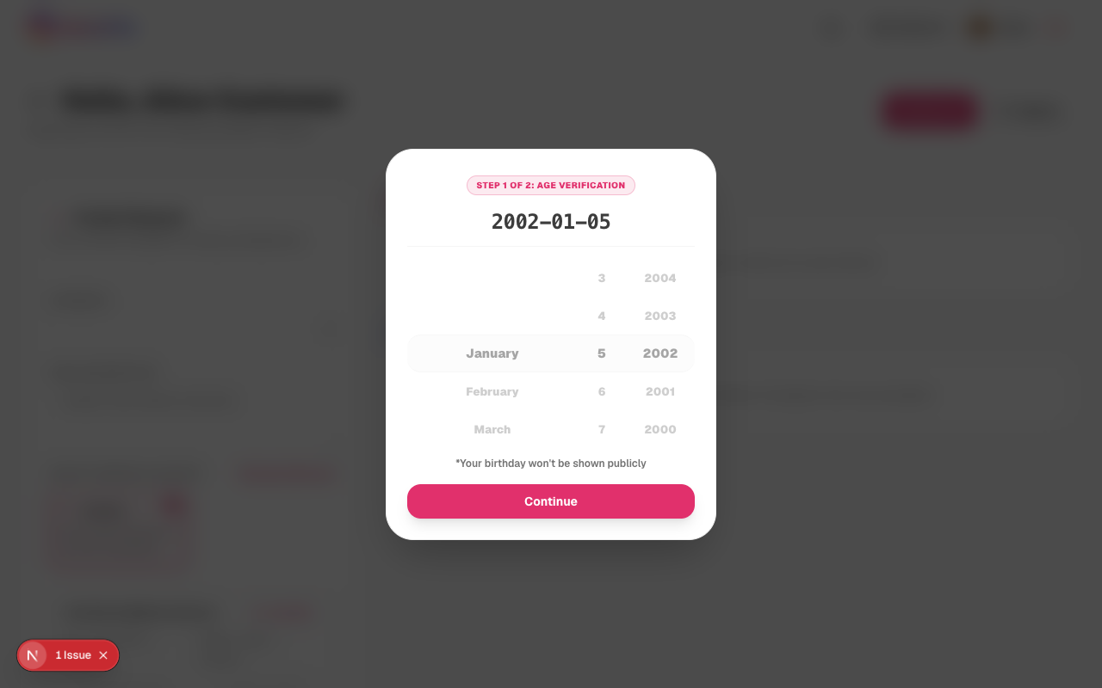
CUSTOMER PANEL
Client Dashboard & Request Posting
Job Dispatching & Address Selection
✔ Interactive Request Posting:
Clients specify description, category, and budget (automatically formatted to Rupees ₹).
✔ Reference Photo Uploads:
Compression pipeline scales files to 400x400 JPEGs before uploading to MongoDB.
✔ Hyperlocal Address Selection:
Map pin drag-and-drop retrieves exact street/area names, mapping coordinates.
✔ Active Job Stack:
Clean cards displaying ongoing tasks, provider details, and real-time status tracker.

Slide 7
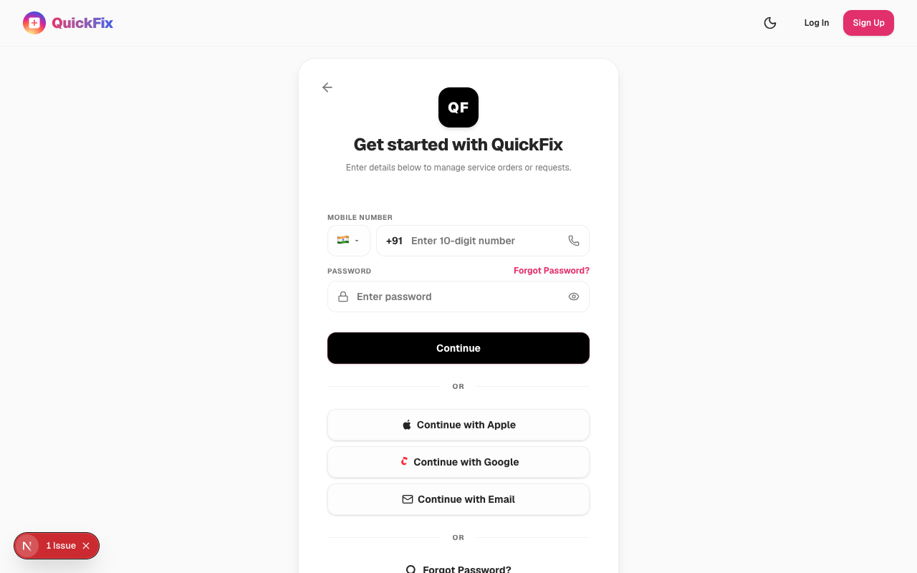
PROVIDER PANEL
Partner Hub & Order Acceptance
Job Acceptance & Radial Radius Dispatch
✔ Incoming Stack Dialog:
Large customer photos, payout breakdowns (with 10% commission deductions), and Point A to Point B distances.
✔ Swipe-to-Accept Slider:
Premium Framer Motion swipe slider to accept incoming requests.
✔ Active vs History Split:
Active dashboard only shows SELECTED/IN_PROGRESS orders. Completed and cancelled jobs collapse under Job History.
✔ Live GPS Tracking:
Device coordinates are sent silently via navigator.geolocation.watchPosition directly to the database.

Slide 8
SETTINGS & VERIFICATION
Aadhaar KYC & Account Management
Aadhaar Verification & Badges
✔ Aadhaar KYC Status:
Visual display of verified/unverified parameters. Links directly to a secure government verification portal simulation.
✔ Dynamic Badge Tiers:
Star ratings are replaced with dynamic tiers (Bronze, Silver, Gold, Platinum) computed from completed orders.
✔ Category Switching:
Providers can easily change their primary service category and age verification details in the hub.
✔ Inline Email Verification:
Triggers inline OTP verification when updating email inside the profile edit modal.

Slide 9
VISUAL WALKTHROUGH
Interface Showcase & Screenshots
Secure Login Page
Customer Booking Dashboard
Provider Swiggy-Style Hub

Slide 10
SYSTEM ARCHITECTURE
Performance Optimization & System Security
Database Parallelization (Promise.all)
Refactored user profiles, orders, and requests queries to load asynchronously in parallel instead of blocking sequentially. This improved dashboard load times by 3-4x.
MongoDB Connection Caching
Implemented global connection pooling status checks (`hasMigrated`). Database migrations execute in the background asynchronously, completely bypassing blocking operations on active queries.
Sequential User ID Mapping
Created a backend migration schema that automatically maps standard user records to sequential, secure User IDs (e.g. QF-1001, QF-1002) for searchability and disputes logging.
Image Compression & Upload Guards
Configured base64 document upload compression to scale user screenshots to 400x400 JPEGs at 0.7 quality before database insertion, completely eliminating 'Payload Too Large' network errors.

Slide 11
Conclusion & Future Roadmap
01. Project Summary:
Developed a functional, lightweight, secure, and ultra-premium hyperlocal marketplace dashboard using modern Next.js and MongoDB frameworks.
02. Integrated Wallet Mechanics:
Future integration of actual payments gateway models, adding platform commission logs and automatic credit payouts.
03. In-App Messaging:
Real-time chat system with integrated media attachments to secure provider-client communication.
04. Automated Dispute Resolution:
Smart contracts or admin moderation dashboards with complete history logs.

