Slide 1
Makefile
.phony, path variable & directive

Slide 2
Phony Targets:
.phony is a special target, use to specify a hypotetical target.
PHONY target is not actual file name.
Its just the name of command to be executed when explicitly requested.
Reasons to use:
Avoid conflicts with files with same name.
Improve performance.

Slide 3
Phony Targets:
Phony targets are used when target should not be file.
clean:
rm *.o
.PHONY: clean
clean:
rm *.o

Slide 4
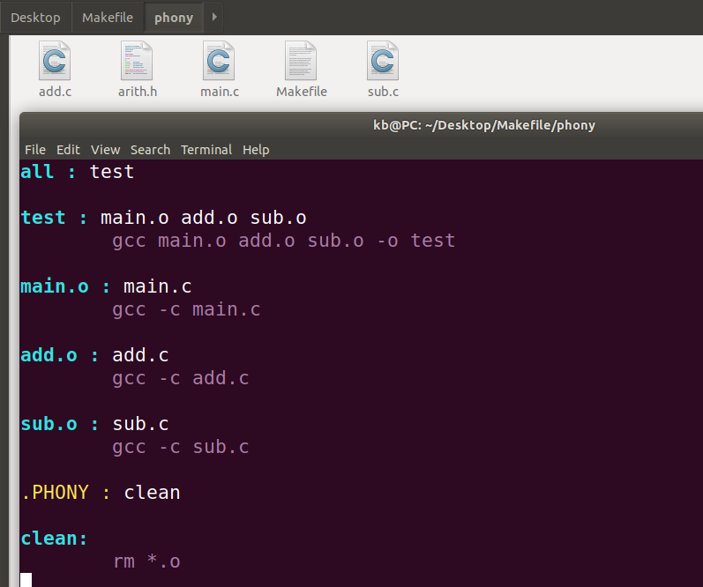
Makefile:

Slide 5
VPATH Variable
It specifies a list of directories that make should search for dependencies and target files.
Example:
VPATH = <path1>:<path2>...

Slide 6
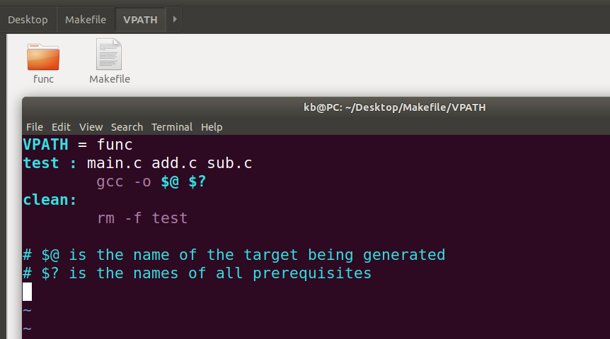
Makefile:

Slide 7
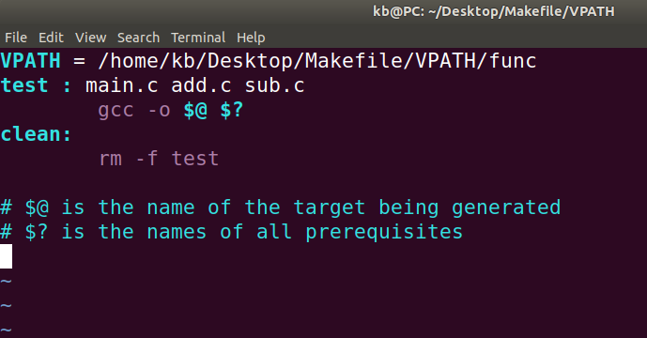
Makefile:

Slide 8
vpath Directive
Specify the search path directories for file name that match pattern.
List of directories to be searched, separated by colons or blanks.
Example:
vpath %.c func1 func2
vpath %.h func1:func2

Slide 9
vpath Directive
There are three forms of the vpath directive:
vpath pattern directories:
Specify the search path directories for file names that match pattern.
The search path, directories, is a list of directories to be searched, separated by colons or blanks, just like the search path used in the VPATH variable.
Example vpath %.c directory_name

Slide 10
vpath Directive
vpath pattern
Clear out the search path associated with pattern.
vpath
Clear all search paths previously specified with vpath directives.

Slide 11
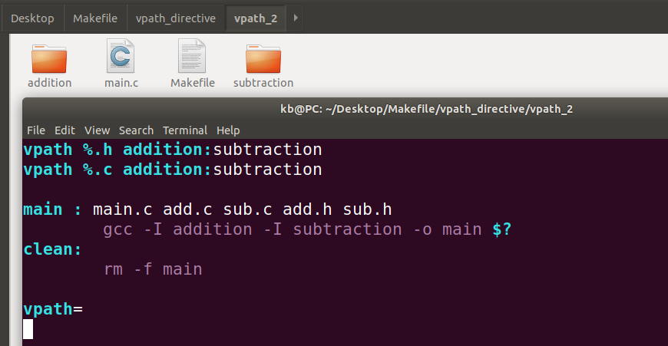
Makefile:

Slide 12
Thank You..

