Slide 1

Conducted by: Khushal Joshi
Case Study
Urban Company Customer Sentiment & Review Analysis

Slide 2
Business Problem Statement:
Urban Company receives thousands of customer reviews daily, but they remain underutilized.
High % of negative reviews could hurt brand reputation, customer trust, and future growth.
Lack of visibility into which services, subservices, cities, and time slots drive issues.

Slide 3
Our Objective:
Conduct review & sentiment analysis.
Identify patterns, pain points, and improvement areas.
Provide data-driven recommendations to improve customer satisfaction and revenue.

Slide 4




Technologies Used:
Python → Used for sentiment analysis and text preprocessing of customer reviews.
Excel → Helped in initial data exploration and cleaning before loading into SQL.
Power BI → Built interactive dashboards to visualize customer sentiments and trends.
PostgreSQL → Used to store, join, and query datasets for deeper insights.

Slide 5
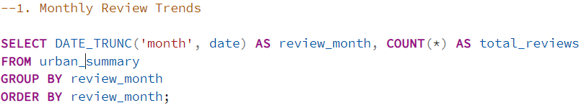
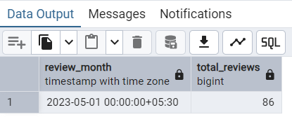
1. Monthly Review Trends
Reviews are clustered in specific months, showing demand seasonality.
May 2023 had 86 reviews, hinting at peak AC service season.
Seasonal spikes can guide staffing & marketing strategy.
Helps forecast demand & allocate resources effectively.

Slide 6
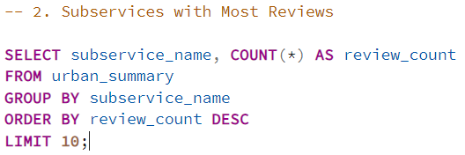
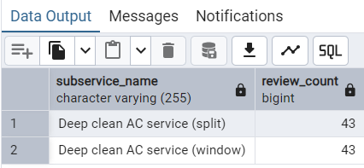
2. Subservices with Most Reviews
Indicates these subservices are most frequently booked.
They’re also highly discussed, meaning customers are vocal about them.
Focused improvements here → maximum impact on overall ratings.
"Deep Clean AC Service (Split/Window)" dominates reviews (43 each).

Slide 7
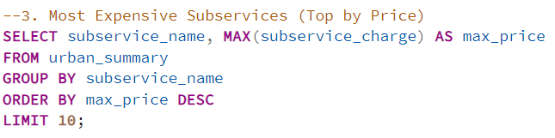
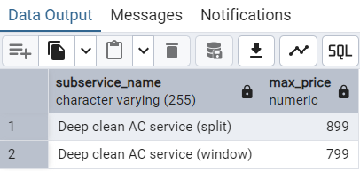
3. Most Expensive Subservices
Customers expect premium quality for high prices.
Price-sensitive customers may judge value-for-money harshly.
Enhancing service quality here could boost ratings & justify pricing.
Split AC Deep Cleaning: ₹899; Window AC Deep Cleaning: ₹799.

Slide 8
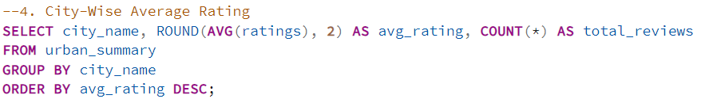
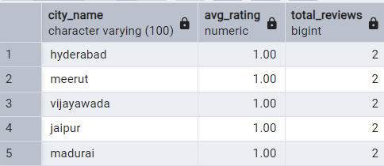
4. City-Wise Average Rating
Ratings across 40+ cities are consistently low (~1.0).
Indicates systemic service issues, not location-specific.
Urban Company has pan-India perception challenges.
Fixing service quality → nationwide brand uplift.

Slide 9
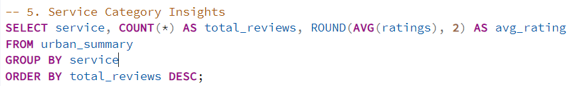
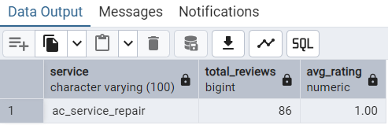
5. Service Category Insights
AC Service & Repair: 86 reviews, Avg. Rating 1.0.
Highlights a mismatch between service expectation vs. delivery.
Opportunity to retrain technicians & enhance service protocols.
Customers unhappy despite high demand.

Slide 10
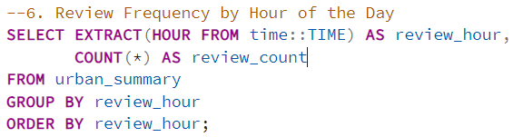
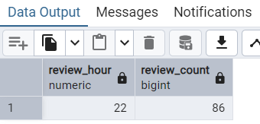
6. Review Frequency by Hour
Most reviews logged at 10 PM (86 reviews).
Indicates customers tend to review after service completion at night.
Insights into customer behavior → target follow-up notifications post-service.
Timely nudges could encourage more positive reviews.

Slide 11
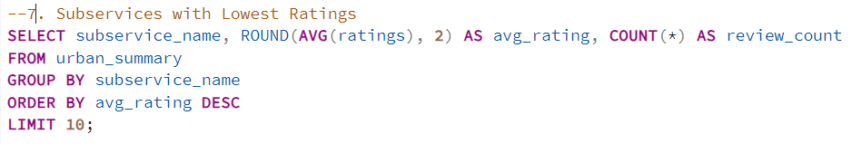
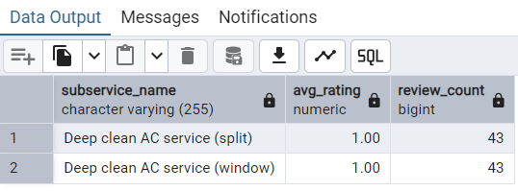
7.Subservices with Lowest Rating
Deep Clean AC services (Split/Window) avg. rating: 1.0.
Critical problem area — customers most dissatisfied.
Urgent need for process overhaul, technician retraining, quality audits.
Negative reviews here drag down brand-wide ratings.

Slide 12
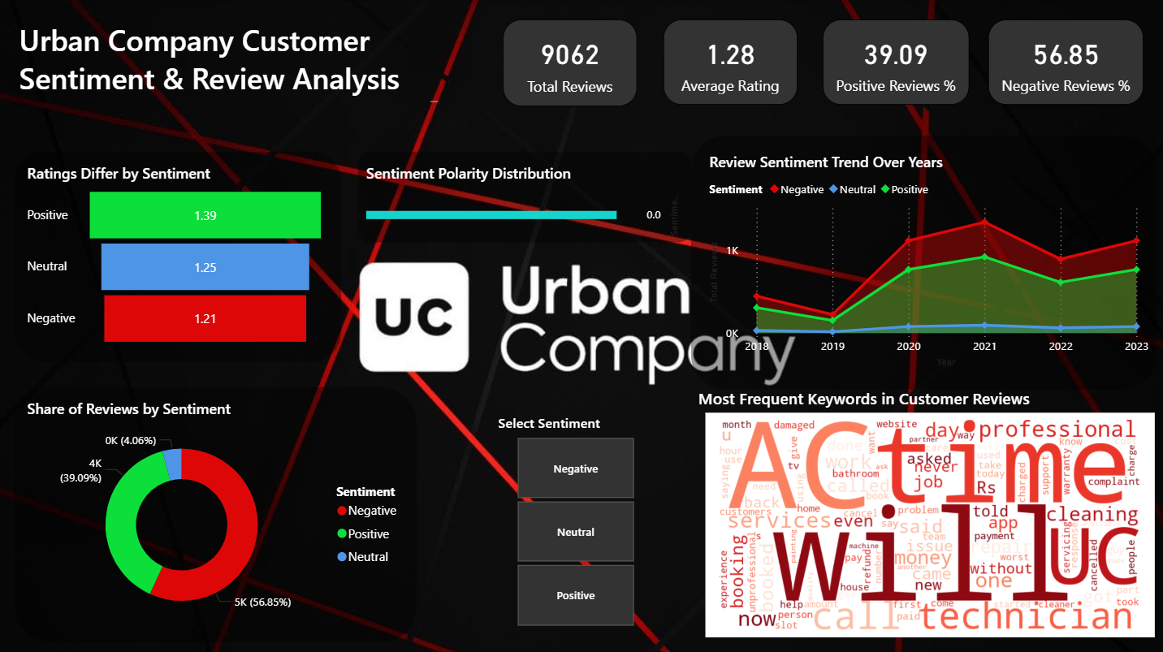

Slide 13
Recommendations:
Quality Uplift: Retrain technicians, stricter audits for AC services.
Seasonal Planning: Extra workforce during peak AC months.
Pricing Justification: Bundle premium services with warranties.
Customer Engagement: Encourage positive reviews via timely nudges.
Service Diversification: Learn from AC pain points & avoid replication across other categories.

