Slide 1
Indian Premiere League T-20

Slide 2
Designed & Created by 🡪
Under the Guidance of Mr.Rahul Tiwari

Slide 3
Team Leads and Members
Team Leader | Muzammil | Aastha | Khushal | Narayana | Rakshit
Team Members | Aarzoo | Ayushi | Vishal Lote | Mahima | Adil Sheikh
 | Piyush | Sneha | Paresh Pandharipande | Milind Doye | Shubham Puri
 | Harshal | Rashmi Raut | Mansi Ghadwale | Roshan | Suraksha
 | Rishabh | Ankush | Vaishnavi Satone | Abhilasha | Monali
 | Aishwarya | Manish | Rakesh | Mayur | Pratik
Project Manager: Priyanka Thakare

Slide 4
INTRODUCTION
The Indian Premier League or popularly known as (IPL) is a professional Twenty20 cricket league in India is the contested during March or April and May of every year by eight teams representing eight different cities in India largest league in the world.
The primary goal of the IPL is to encourage the player in the country and to give an international platform and exposure to the players to increase playing ability.

Slide 5
Logical Database Design

Slide 6
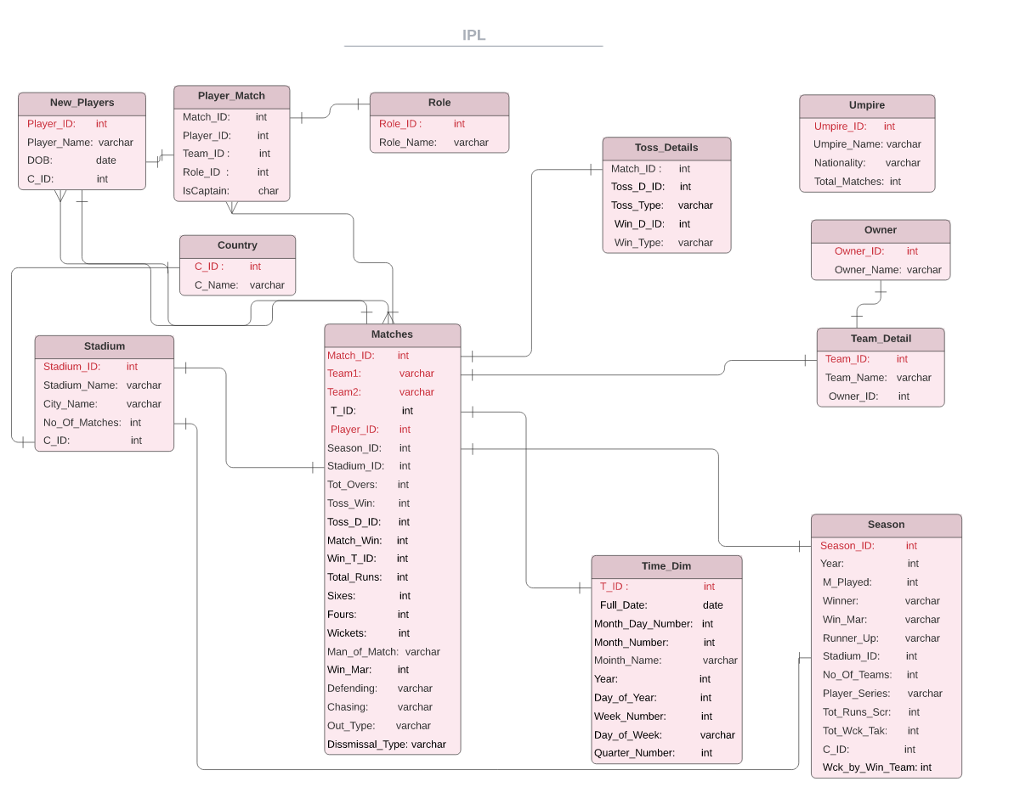

Slide 7
CREATE COMMANDS

Slide 8
Table Name: New_Players
CREATE TABLE New_Players ( PLAYER_ID NUMBER(38) NOT NULL,
PLAYER_NAME VARCHAR2(26) NOT NULL,
DOB DATE NOT NULL,
C_ID NUMBER(38),
CONSTRAINT PLAYER_ID_PK PRIMARY KEY (PLAYER_ID),
CONSTRAINT C_ID_FK FOREIGN KEY (C_ID) REFERENCES COUNTRY(C_ID)
);

Slide 9
Table Name: Matches
CREATE TABLE Matches(
MATCH_ID INTEGER NOT NULL PRIMARY KEY
,TEAM1 INTEGER NOT NULL
,TEAM2 INTEGER NOT NULL
,T_ID VARCHAR2(15)
,SEASON_ID INTEGER
,PLAYER_ID INTEGER NOT NULL
,STADIUM_ID INTEGER
,TOT_OVERS INTEGER
,TOSS_WIN INTEGER NOT NULL
,TOSS_D_ID INTEGER NOT NULL
,MATCH_WIN INTEGER NOT NULL
,WIN_T_ID INTEGER NOT NULL
,TOTAL_RUNS INTEGER NOT NULL
,SIXES INTEGER NOT NULL
,FOURS INTEGER NOT NULL
,WICKETS INTEGER NOT NULL
,MAN_OF_MATCH INTEGER NOT NULL
,WIN_MAR INTEGER NOT NULL
,DEFENDING INTEGER NOT NULL
,CHASING INTEGER NOT NULL
,OUT_TYPE VARCHAR(10) NOT NULL
,DISSMISAL_TYPE VARCHAR(9) NOT NULL
, CONSTRAINT M_PK PRIMARY KEY(MATCH_ID,TEAM1,TEAM2,PLAYER_ID)
,CONSTRAINT P_FK FOREIGN KEY(PLAYER_ID) REFERENCES Players (PLAYER_ID)
,CONSTRAINT S_FK FOREIGN KEY(SEASON_ID) REFERENCES Season (SEASON_ID)
,CONSTRAINT ST_FK FOREIGN KEY(STADIUM_ID) REFERENCES Stadium (STADIUM_ID)
);

Slide 10
Table Name: Player_Match
CREATE TABLE Player_Match (
MATCH_ID NUMBER(38) NOT NULL,
PLAYER_ID NUMBER(26) NOT NULL,
TEAM_ID NUMBER(38) NOT NULL,
ROLE_ID NUMBER(26) NOT NULL,
ISCAPTAIN VARCHAR2(26) NOT NULL,
CONSTRAINT MATCH_ID_FK FOREIGN KEY (MATCH_ID) REFERENCES MATCHES(MATCH_ID),
CONSTRAINT PLAYER_ID_FK FOREIGN KEY (PLAYER_ID) REFERENCES NEW_PLAYERS(PLAYER_ID),
CONSTRAINT ROLE_ID_FK FOREIGN KEY (ROLE_ID) REFERENCES ROLE(ROLE_ID),
CONSTRAINT TEAM_ID_FK FOREIGN KEY (TEAM_ID) REFERENCES TEAM_DETAIL(TEAM_ID));

Slide 11
Table Name: Team
CREATE TABLE Team(
TEAM_ID INTEGER NOT NULL PRIMARY KEY
,TEAM_NAME VARCHAR(27) NOT NULL
,FIELD3 VARCHAR(30)
,OWNER_ID INTEGER NOT NULL,
CONSTRAINT OWNER_ID_FK FOREIGN KEY (OWNER_ID) REFERENCES Owner(OWNER_ID));
);

Slide 12
Table Name: Stadium
CREATE TABLE STADIUM
( STADIUM_ID NUMBER NOT NULL PRIMARY KEY,
STADIUM_NAME VARCHAR2(30),
STADIUM_CITY VARCHAR2(30),
MATCHES_COUNTS NUMBER,
C_ID NUMBER,
CONSTRAINT C_ID_FK FOREIGN KEY (C_ID) REFERENCES Country(C_ID)
)

Slide 13
Table Name: Season
CREATE TABLE Season(
SEASON_ID INTEGER NOT NULL PRIMARY KEY
,YEAR INTEGER
,M_PLAYED INTEGER
,WINNER INTEGER
,WIN_MAR VARCHAR(16)
,RUNNER_UP INTEGER
,STADIUM_ID INTEGER
,NO_OF_TEAMS INTEGER
,PLAYER_SERIES INTEGER
,TOT_RUNS_SCR INTEGER
, TOT_WCK_TAK INTEGER
,C_ID INTEGER
,WCK_BY_WIN_TEAM INTEGER,
CONSTRAINT FK_COUNT FOREIGN KEY(C_ID) REFERENCES COUNTRY(C_ID),
CONSTRAINT FK_NPLY FOREIGN KEY(PLAYER_SERIES) REFERENCES NEW_PLAYERS(PLAYER_ID),
CONSTRAINT FK_TDET FOREIGN KEY(WINNER) REFERENCES TEAM_DETAIL(TEAM_ID),
CONSTRAINT FK_STD FOREIGN KEY(STADIUM_ID) REFERENCES STADIUM(STADIUM_ID) );

Slide 14
Table Name: Umpires
CREATE TABLE umpires(
Umpire_ID INTEGER NOT NULL PRIMARY KEY
,Umpire_Name VARCHAR(25) NOT NULL
,Nationality VARCHAR(12) NOT NULL
,Total_Matches INTEGER NOT NULL
);
INSERT INTO umpires(Umpire_ID,Umpire_Name,Nationality,Total_Matches) VALUES (1,'Sundaram Ravi','India',109);
INSERT INTO umpires(Umpire_ID,Umpire_Name,Nationality,Total_Matches) VALUES (2,'Kumar Dharmasena','South Africa',94);
INSERT INTO umpires(Umpire_ID,Umpire_Name,Nationality,Total_Matches) VALUES (3,'Anil Chaudhary','India',78);
INSERT INTO umpires(Umpire_ID,Umpire_Name,Nationality,Total_Matches) VALUES (4,'Chettithody shamshuddin','India',74);
INSERT INTO umpires(Umpire_ID,Umpire_Name,Nationality,Total_Matches) VALUES (5,'Marais Erasmus','South Africa',66);
INSERT INTO umpires(Umpire_ID,Umpire_Name,Nationality,Total_Matches) VALUES (6,'Simon Taufel','Australia',55);
INSERT INTO umpires(Umpire_ID,Umpire_Name,Nationality,Total_Matches) VALUES (7,'Asad rauf','Pakistan',51);
INSERT INTO umpires(Umpire_ID,Umpire_Name,Nationality,Total_Matches) VALUES (8,'C. K. Nandan','India',55);
INSERT INTO umpires(Umpire_ID,Umpire_Name,Nationality,Total_Matches) VALUES (9,'Billy Doctrove','West Indies',44);
INSERT INTO umpires(Umpire_ID,Umpire_Name,Nationality,Total_Matches) VALUES (10,'Vineet Kulkarni','India',48);
INSERT INTO umpires(Umpire_ID,Umpire_Name,Nationality,Total_Matches) VALUES (11,'Rudi Koertzen','South Africa',42);
INSERT INTO umpires(Umpire_ID,Umpire_Name,Nationality,Total_Matches) VALUES (12,'Rod Tucker','Australia',46);
INSERT INTO umpires(Umpire_ID,Umpire_Name,Nationality,Total_Matches) VALUES (13,'Billy Bowden','New Zealand',38);
INSERT INTO umpires(Umpire_ID,Umpire_Name,Nationality,Total_Matches) VALUES (14,'Aleem Dar','Pakistan',38);
INSERT INTO umpires(Umpire_ID,Umpire_Name,Nationality,Total_Matches) VALUES (15,'Bruce Oxenford','Australia',48);
INSERT INTO umpires(Umpire_ID,Umpire_Name,Nationality,Total_Matches) VALUES (16,'Nitin Menon','India',43);
INSERT INTO umpires(Umpire_ID,Umpire_Name,Nationality,Total_Matches) VALUES (17,'Sudhir Asnani','India',31);
INSERT INTO umpires(Umpire_ID,Umpire_Name,Nationality,Total_Matches) VALUES (18,'Shavir Tarapore','India',31);
INSERT INTO umpires(Umpire_ID,Umpire_Name,Nationality,Total_Matches) VALUES (19,'Nigel Llong','England',37);
INSERT INTO umpires(Umpire_ID,Umpire_Name,Nationality,Total_Matches) VALUES (20,'Russell Tiffin','Zimbabwe',30);
INSERT INTO umpires(Umpire_ID,Umpire_Name,Nationality,Total_Matches) VALUES (21,'Chris Gaffaney','New Zealand',33);
INSERT INTO umpires(Umpire_ID,Umpire_Name,Nationality,Total_Matches) VALUES (22,'Daryl Harper','Australia',28);
INSERT INTO umpires(Umpire_ID,Umpire_Name,Nationality,Total_Matches) VALUES (23,'Amiesh Saheba','India',27);
INSERT INTO umpires(Umpire_ID,Umpire_Name,Nationality,Total_Matches) VALUES (24,'Krishna Hariharan','India',21);
INSERT INTO umpires(Umpire_ID,Umpire_Name,Nationality,Total_Matches) VALUES (25,'Nand Kishor','India',21);
INSERT INTO umpires(Umpire_ID,Umpire_Name,Nationality,Total_Matches) VALUES (26,'Richard Illingworth','England',20);
INSERT INTO umpires(Umpire_ID,Umpire_Name,Nationality,Total_Matches) VALUES (27,'K. N.

Slide 15
Ananthapadmanabhan','India',18);
INSERT INTO umpires(Umpire_ID,Umpire_Name,Nationality,Total_Matches) VALUES (28,'Brian Jerling','South Africa',18);
INSERT INTO umpires(Umpire_ID,Umpire_Name,Nationality,Total_Matches) VALUES (29,'Johan Cloete','South Africa',17);
INSERT INTO umpires(Umpire_ID,Umpire_Name,Nationality,Total_Matches) VALUES (30,'Anil Dandekar','India',17);
INSERT INTO umpires(Umpire_ID,Umpire_Name,Nationality,Total_Matches) VALUES (31,'Sanjay Hazare','India',17);
INSERT INTO umpires(Umpire_ID,Umpire_Name,Nationality,Total_Matches) VALUES (32,'Virender Sharma','India',16);
INSERT INTO umpires(Umpire_ID,Umpire_Name,Nationality,Total_Matches) VALUES (33,'Subrat Das','India',15);
INSERT INTO umpires(Umpire_ID,Umpire_Name,Nationality,Total_Matches) VALUES (34,'Krishnaraj Srinath','India',15);
INSERT INTO umpires(Umpire_ID,Umpire_Name,Nationality,Total_Matches) VALUES (35,'Ian Howell','South Africa',14);
INSERT INTO umpires(Umpire_ID,Umpire_Name,Nationality,Total_Matches) VALUES (36,'Suresh Shastri','India',14);
INSERT INTO umpires(Umpire_ID,Umpire_Name,Nationality,Total_Matches) VALUES (37,'Mark Benson','England',13);
INSERT INTO umpires(Umpire_ID,Umpire_Name,Nationality,Total_Matches) VALUES (38,'Abhijit Deshmukh','India',12);
INSERT INTO umpires(Umpire_ID,Umpire_Name,Nationality,Total_Matches) VALUES (39,'Paul Reiffel','Australia',11);
INSERT INTO umpires(Umpire_ID,Umpire_Name,Nationality,Total_Matches) VALUES (40,'Yeshwant Barde','India',9);
INSERT INTO umpires(Umpire_ID,Umpire_Name,Nationality,Total_Matches) VALUES (41,'Rajesh Deshpande','India',8);
INSERT INTO umpires(Umpire_ID,Umpire_Name,Nationality,Total_Matches) VALUES (42,'Pashchim Pathak','India',8);
INSERT INTO umpires(Umpire_ID,Umpire_Name,Nationality,Total_Matches) VALUES (43,'Gary Baxter','New Zealand',7);
INSERT INTO umpires(Umpire_ID,Umpire_Name,Nationality,Total_Matches) VALUES (44,'Steve Davis','Australia',7);
INSERT INTO umpires(Umpire_ID,Umpire_Name,Nationality,Total_Matches) VALUES (45,'Arani Jayprakash','India',7);
INSERT INTO umpires(Umpire_ID,Umpire_Name,Nationality,Total_Matches) VALUES (46,'Simon Fry','Australia',6);
INSERT INTO umpires(Umpire_ID,Umpire_Name,Nationality,Total_Matches) VALUES (47,'Tony Hill','New Zealand',6);
INSERT INTO umpires(Umpire_ID,Umpire_Name,Nationality,Total_Matches) VALUES (48,'G. A. Pratapkumar','India',6);
INSERT INTO umpires(Umpire_ID,Umpire_Name,Nationality,Total_Matches) VALUES (49,'Ivaturi Shivram','India',6);
INSERT INTO umpires(Umpire_ID,Umpire_Name,Nationality,Total_Matches) VALUES (50,'Tyron Wijewardene','Sri Lanka',6);
INSERT INTO umpires(Umpire_ID,Umpire_Name,Nationality,Total_Matches) VALUES (51,'Krishnamachari Bharatan','India',3);
INSERT INTO umpires(Umpire_ID,Umpire_Name,Nationality,Total_Matches) VALUES (52,'Krishnamachari Srinivasan','India',3);
INSERT INTO umpires(Umpire_ID,Umpire_Name,Nationality,Total_Matches) VALUES (53,'Ulhas Gandhe','India',2);
INSERT INTO umpires(Umpire_ID,Umpire_Name,Nationality,Total_Matches) VALUES (54,'Shashank Ranade','India',2);
INSERT INTO umpires(Umpire_ID,Umpire_Name,Nationality,Total_Matches) VALUES (55,'Subroto Das','India',1);
INSERT INTO umpires(Umpire_ID,Umpire_Name,Nationality,Total_Matches) VALUES (56,'Ian Gould','England',1);

Slide 16
Table Name: Time_Dim
CREATE TABLE Time_Dim AS
SELECT
TO_DATE('22/03/2019','DD/MM/YYYY') + NUMTODSINTERVAL(n,'day') AS Full_Date,
TO_CHAR(TO_DATE('22/03/2019','DD/MM/YYYY') + NUMTODSINTERVAL(n,'day'),'DD') AS Month_day_number,
TO_CHAR(TO_DATE('22/03/2019','DD/MM/YYYY') + NUMTODSINTERVAL(n,'day'),'MM') AS Month_Number,
TO_CHAR(TO_DATE('22/03/2019','DD/MM/YYYY') + NUMTODSINTERVAL(n,'day'),'Month') AS Month_Name,
TO_CHAR(TO_DATE('22/03/2019','DD/MM/YYYY') + NUMTODSINTERVAL(n,'day'),'YYYY') AS Year,
TO_CHAR(TO_DATE('22/03/2019','DD/MM/YYYY') + NUMTODSINTERVAL(n,'day'),'DDD') AS Day_of_year,
TO_CHAR(TO_DATE('22/03/2019','DD/MM/YYYY') + NUMTODSINTERVAL(n,'day'),'W') AS Week_number,
TO_CHAR(TO_DATE('22/03/2019','DD/MM/YYYY') + NUMTODSINTERVAL(n,'day'),'Day') AS Day_of_week,
TO_CHAR(TO_DATE('22/03/2019','DD/MM/YYYY') + NUMTODSINTERVAL(n,'day'),'Q') AS Quarter_number
FROM (
select level n
from dual
connect by level <= 54
);

Slide 17
Table Name: Toss
CREATE TABLE Toss(
MATCH_ID INTEGER,
TOSS_D_ID INTEGER,
TOSS_TYPE VARCHAR(20),
WIN_T_ID INTEGER,
WIN_TYPE VARCHAR(20)
CONSTRAINT Match_id_pk PRIMARY KEY(Match_ID));

Slide 18
Table Name: Country
CREATE TABLE Country (
C_ID NUMBER(38),
C_NAME VARCHAR2(128) NOT NULL,
CONSTRAINT C_ID_PK PRIMARY KEY (C_ID) );

Slide 19
Table Name: Role
CREATE TABLE Role ( ROLE_ID NUMBER(38) NOT NULL,
ROLE_NAME VARCHAR2(26) NOT NULL,
CONSTRAINT ROLE_ID_PK PRIMARY KEY (ROLE_ID));

Slide 20
Table Name: Owners
CREATE TABLE Owners(
OWNER_ID NUMBER NOT NULL,
OWNER_NAME VARCHAR2(30) NOT NULL,
CONSTRAINT PRIMARY KEY (OWNER_ID);

Slide 21
IPL DB Queries
Managing the System

Slide 22
Queries with Solutions

Slide 23
1. What percentage of matches are won by toss winners?
Solution 🡪🡪🡪

Slide 24

select (count(case when toss_win = match_win then 1 end)/44) *100
/(select count(*)/44 from Matches) as Percentage
from Matches;

Slide 25
What percentages of matches are won after fielding first?
Solution 🡪🡪🡪

Slide 26
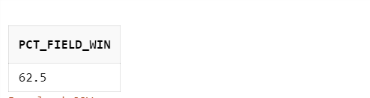
WITH ABC AS (
SELECT MATCH_ID MM FROM MATCHES WHERE
CHASING =MATCH_WIN GROUP BY MATCH_ID)
SELECT COUNT(DISTINCT (ABC.MM ))/COUNT(DISTINCT( MATCH_ID))*100 AS
PCT_FIELD_WIN
FROM MATCHES A
LEFT OUTER JOIN ABC
ON A.MATCH_ID= ABC.MM;

Slide 27
Match won by the maximum margin of runs?
Solution 🡪🡪🡪

Slide 28
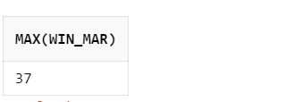
SELECT MAX(WIN_MAR)
FROM MATCHES M
INNER JOIN TOSS_DETAILS T
ON M.WIN_T_ID = T.WIN_T_ID
WHERE M.WIN_T_ID=102;

Slide 29
How lucky are the toss winning teams?
Solution 🡪🡪🡪

Slide 30
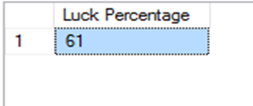
SELECT (COUNT(CASE WHEN TOSS_WIN = MATCH_WIN THEN 1 END)/44) *100
/(SELECT COUNT(*)/44 FROM MATCHES) AS "LUCK PERCENTAGE"
FROM MATCHES;

Slide 31
Does winning the toss means winning the match?
Solution 🡪🡪🡪

Slide 32
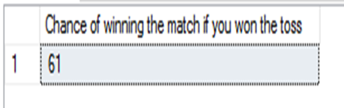
SELECT (COUNT(CASE WHEN TOSS_WIN = MATCH_WIN THEN 1 END)/44) *100
/(SELECT COUNT(*)/44 FROM MATCHES) AS
"CHANCE OF WINNING THE MATCH IF YOU WON THE TOSS "
FROM MATCHES;

Slide 33
Match won by maximum wickets?
Solution 🡪🡪🡪

Slide 34
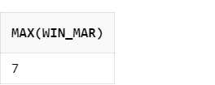
SELECT MAX(WIN_MAR)
FROM MATCHES M
INNER JOIN TOSS_DETAILS T
ON M.WIN_T_ID = T.WIN_T_ID
WHERE M.WIN_T_ID=101;

Slide 35
Match won by the minimum margin of runs.
Solution 🡪🡪🡪

Slide 36
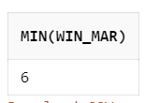
SELECT MAX(WIN_MAR)
FROM MATCHES M
INNER JOIN TOSS_DETAILS T
ON M.WIN_T_ID = T.WIN_T_ID
WHERE M.WIN_T_ID=102;

Slide 37
Match won by minimum wickets.
Solution 🡪🡪🡪

Slide 38
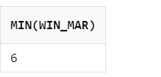
SELECT MIN(WIN_MAR)
FROM MATCHES M
INNER JOIN TOSS_DETAILS T
ON M.WIN_T_ID = T.WIN_T_ID
WHERE M.WIN_T_ID=101;

Slide 39
How many matches used Duckworth Lewis method?
Solution 🡪🡪🡪

Slide 40
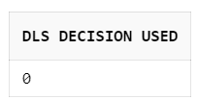
SELECT COUNT(MATCH_ID)
FROM MATCHES M
INNER JOIN TOSS_DETAILS T
ON M.WIN_T_ID = T.WIN_T_ID
WHERE M.WIN_T_ID = 103;

Slide 41
Top players of the match
Solution 🡪🡪🡪

Slide 42
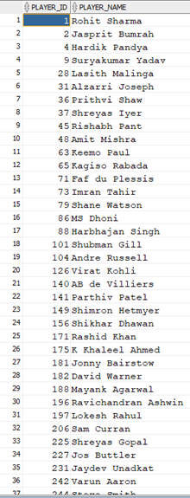
SELECT DISTINCT M.PLAYER_ID,P.PLAYER_NAME
FROM MATCHES M
INNER JOIN NEW_PLAYERS P
ON M.PLAYER_ID=P.PLAYER_ID
WHERE
M.MAN_OF_MATCH = P.PLAYER_ID
ORDER BY M.PLAYER_ID;

Slide 43
SELECT
DISTINCT M.PLAYER_ID, P.PLAYER_NAME
FROM MATCHES M
INNER JOIN NEW_PLAYERS P
ON M.PLAYER_ID=P.PLAYER_ID
WHERE M.MAN_OF_MATCH = P.PLAYER_ID
ORDER BY M.PLAYER_ID;

Slide 44
Matches where D/L method was and wasn't applied.
Solution 🡪🡪🡪

Slide 45
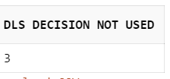
MATCHES WHERE DLS METHOD IS USED:
SELECT COUNT(DISTINCT MATCH_ID) FROM MATCHES M
INNER JOIN DECISSION T
ON M.WIN_T_ID = T.WIN_T_ID
WHERE M.WIN_T_ID = 103;
MATCHES WERE DLS NOT USED:
SELECT COUNT(DISTINCT MATCH_ID) "DLS DECISION NOT USED"
FROM MATCHES M
INNER JOIN DECISSION T
ON M.WIN_T_ID = T.WIN_T_ID
WHERE M.WIN_T_ID <> 103;

Slide 46
Matches where D/L method was applied
Solution 🡪🡪🡪

Slide 47
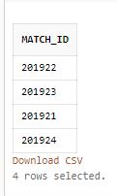
SELECT DISTINCT MATCH_ID
FROM MATCHES
WHERE WIN_T_ID =103 ;

Slide 48
Number of matches won by each team
Solution 🡪🡪🡪

Slide 49
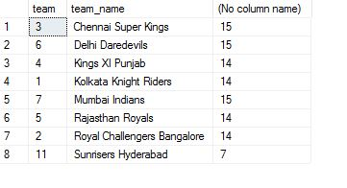
select team, t.team_name ,sum(nop) as "number of matches played" from (
select team1 as team, count(team1)/44 as nop from matches group by team1
union
select team2 as team , count(team2)/44 as nop from matches group by Team2) sub
inner join
Team_Details t
on
team=t.Team_ID
group by team,t.Team_Name

Slide 50
Top 10 players based on no of man of the match awards won
Solution 🡪🡪🡪

Slide 51
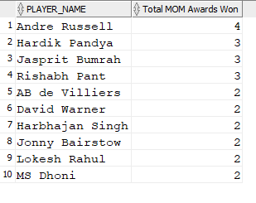
SELECT * FROM(
SELECT DISTINCT P.PLAYER_NAME, COUNT(M.MAN_OF_MATCH)
"TOTAL MOM AWARDS WON"
FROM MATCHES M
INNER JOIN NEW_PLAYERS P
ON M.PLAYER_ID = P.PLAYER_ID
WHERE M.MAN_OF_MATCH = P.PLAYER_ID
GROUP BY P.PLAYER_NAME, M.MAN_OF_MATCH
ORDER BY COUNT(M.MAN_OF_MATCH) DESC)
WHERE ROWNUM <= 10;

Slide 52
Number of matches played by each team
Solution 🡪🡪🡪

Slide 53

SELECT TEAM, T.TEAM_NAME ,SUM(NOP) AS "NUMBER OF MATCHES PLAYED" FROM (
SELECT TEAM1 AS TEAM, COUNT(TEAM1)/44 AS NOP
FROM MATCHES
GROUP BY TEAM1
UNION
SELECT TEAM2 AS TEAM , COUNT(TEAM2)/44 AS NOP
FROM MATCHES GROUP BY TEAM2) SUB
INNER JOIN TEAM_DETAILS T
ON TEAM=T.TEAM_ID
GROUP BY TEAM,T.TEAM_NAME;

Slide 54
Number of wins per team
Solution 🡪🡪🡪

Slide 55
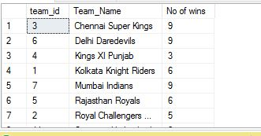
SELECT TEAM AS TEAM_ID, T.TEAM_NAME , SUM(NOW) AS "NO OF WINS" FROM (
SELECT TEAM1 AS TEAM, COUNT(CASE WHEN MATCH_WIN =TEAM1 THEN 1 END)/44 AS NOW
FROM MATCHES GROUP BY TEAM1
UNION
SELECT TEAM2 AS TEAM, COUNT(CASE WHEN MATCH_WIN =TEAM2 THEN 1 END)/44 AS NOW FROM MATCHES GROUP BY TEAM2
) SUB
INNER JOIN TEAM_DETAILS T
ON TEAM=T.TEAM_ID
GROUP BY TEAM,T.TEAM_NAME;

Slide 56
Best defending and chasing team
Solution 🡪🡪🡪

Slide 57
SELECT COUNT(DISTINCT MATCH_ID ) " COUNT OF WIN ", MATCH_WIN , TEAM_NAME
FROM MATCHES M
INNER JOIN TEAMTABLE T
ON T.TEAM_ID = M.MATCH_WIN
WHERE MATCH_WIN = CHASING
GROUP BY MATCH_WIN,TEAM_NAME
ORDER BY COUNT(DISTINCT MATCH_ID) DESC;
SELECT COUNT(DISTINCT MATCH_ID ) AS " COUNT_OF_WIN ", MATCH_WIN , TEAM_NAME
FROM MATCHES M
INNER JOIN TEAMTABLE T
ON T.TEAM_ID = M.MATCH_WIN
WHERE MATCH_WIN = DEFENDING
GROUP BY MATCH_WIN,TEAM_NAME
ORDER BY COUNT(DISTINCT MATCH_ID) DESC;

Slide 58
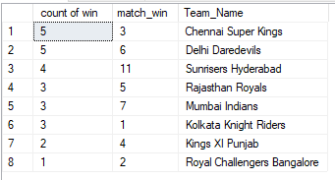
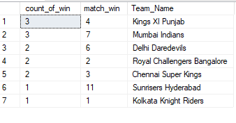

Slide 59
Most common dismissal type
Solution 🡪🡪🡪

Slide 60
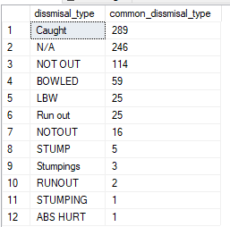
SELECT DISSMISAL_TYPE , COUNT(DISSMISAL_TYPE) AS COMMON_DISSMISAL_TYPE
FROM MATCHES
GROUP BY DISSMISAL_TYPE
ORDER BY COMMON_DISSMISAL_TYPE DESC;

Slide 61
Number of matches played in 2017 IPL edition
Solution 🡪🡪🡪

Slide 62
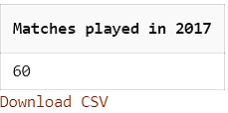
SELECT M_PLAYED AS "MATCHES PLAYED IN 2017“
FROM SEASON
WHERE YEAR = 2017;

Slide 63
Who won the final match?
Solution 🡪🡪🡪

Slide 64
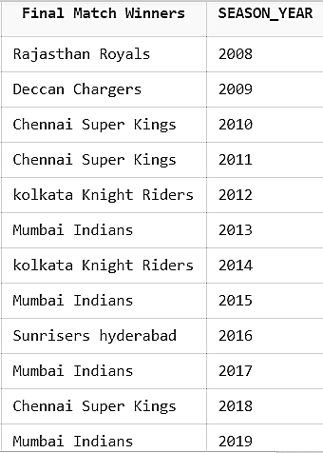
SELECT TEAM_DETAIL.TEAM_NAME AS FINAL_MATCH_WINNER,
YEAR AS SEASON_YEAR
FROM SEASON
INNER JOIN TEAM_DETAIL
ON WINNER = TEAM_ID
ORDER BY YEAR ASC;

Slide 65
Number of matches each season
Solution 🡪🡪🡪

Slide 66
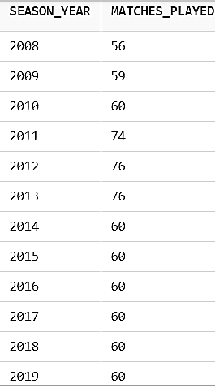
SELECT YEAR, M_PLAYED) AS “MATCHES_PLAYED”
FROM SEASON ORDER BY YEAR ASC;

Slide 67
Champions each season
Solution 🡪🡪🡪

Slide 68
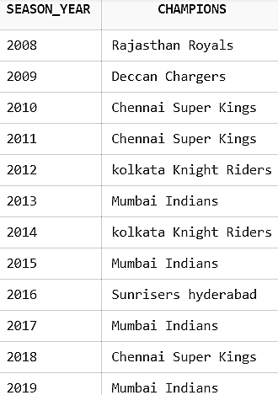
SELECT YEAR ,TEAM_NAME AS CHAMPIONS
FROM SEASON
INNER JOIN TEAM_DETAIL
ON WINNER = TEAM_ID
ORDER BY YEAR ASC;

Slide 69
Which two teams reached the finals?
Solution 🡪🡪🡪

Slide 70
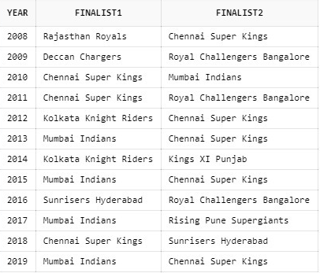
SELECT S.YEAR, T1.TEAM_NAME AS FINALIST1 , T2.TEAM_NAME AS FINALIST2
FROM SEASON S
JOIN TEAM_DETAIL T1
ON S.WINNER= T1.TEAM_ID
JOIN TEAM_DETAIL T2
ON S.RUNNER_UP = T2.TEAM_ID
ORDER BY YEAR ASC;

Slide 71
Top Umpires
Solution 🡪🡪🡪

Slide 72
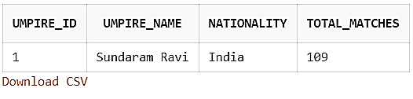
SELECT UMPIRE_ID, UMPIRE_NAME, TOTAL_MATCHES
FROM Umpires
ORDER BY TOTAL_MATCHES DESC;

Slide 73
No. of matches held in each city.
Solution 🡪🡪🡪

Slide 74
SELECT STADIUM_CITY,SUM(MATCHES_COUNTS)
FROM STADIUM
GROUP BY STADIUM_CITY;

Slide 75
Best venue for defending and chasing the team
Solution 🡪🡪🡪

Slide 76
SELECT STADIUM_ID,MATCH_ID,TEAM1,TEAM2,TOSS_WIN,TOSS_D_ID,DEFENDING
FROM IPL.MATCHES
WHERE TOSS_D_ID=20 AND DEFENDING=MATCH_WIN
GROUP BY MATCH_ID;
UNION
SELECT STADIUM_ID,MATCH_ID,TEAM1,TEAM2,TOSS_WIN,TOSS_D_ID,CHASING FROM IPL.MATCHES
WHERE TOSS_D_ID=10 AND CHASING=MATCH_WIN
GROUP BY MATCH_ID;

Slide 77
Number of matches played by each team.
Solution 🡪🡪🡪

Slide 78
SELECT TEAM, T.TEAM_NAME ,SUM(NOP) AS "NUMBER OF MATCHES PLAYED“
FROM (
SELECT TEAM1 AS TEAM, COUNT(TEAM1)/44 AS NOP FROM MATCHES GROUP BY TEAM1
UNION
SELECT TEAM2 AS TEAM , COUNT(TEAM2)/44 AS NOP FROM MATCHES GROUP BY TEAM2) SUB
INNER JOIN TEAM_DETAILS T
ON TEAM=T.TEAM_ID
GROUP BY TEAM,T.TEAM_NAME;

Slide 79
Does winning the toss means winning the match?
Solution 🡪🡪🡪

Slide 80

SELECT (COUNT(CASE WHEN TOSS_WIN = MATCH_WIN THEN 1 END)/44) *100
/(SELECT COUNT(*)/44 FROM MATCHES) AS "CHANCE OF WINNING THE MATCH IF YOU WON THE TOSS "
FROM MATCHES;

Slide 81
Number of Sixes
Solution 🡪🡪🡪

Slide 82
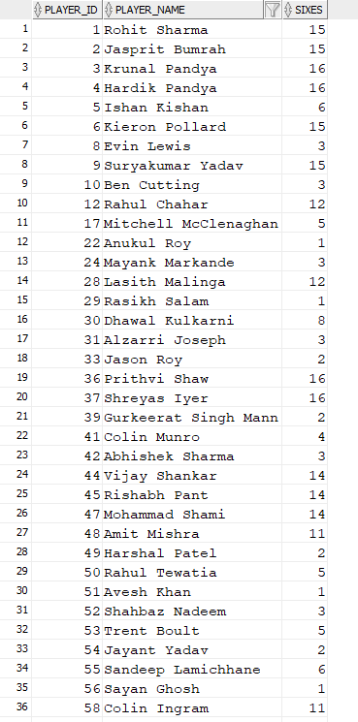
SELECT M.PLAYER_ID ,N.PLAYER_NAME ,
COUNT(M.SIXES) AS SIXES
FROM MATCHES M
INNER JOIN NEW_PLAYERS N
ON M.PLAYER_ID = N.PLAYER_ID
WHERE M.PLAYER_ID = N.PLAYER_ID
GROUP BY M.PLAYER_ID, N.PLAYER_NAME
ORDER BY M.PLAYER_ID;

Slide 83
What was the decision taken by the captains when they won the match?
Solution 🡪🡪🡪

Slide 84
SELECT DISTINCT M.MATCH_ID, M.MATCH_WIN ,
CASE
WHEN M.DEFENDING = M.MATCH_WIN THEN 'WINNING TEAM CHOSE TO DEFEND.'
ELSE 'WINNING TEAM CHOSE TO CHASE.'
END AS DECISION,
N.PLAYER_NAME
FROM MATCH M
INNER JOIN NEW_PLAYERS N
ON N.PLAYER_ID = M.PLAYER_ID
INNER JOIN PLAYER_MATCH P ON N.PLAYER_ID = P.PLAYER_ID
WHERE P.PLAYER_ID = N.PLAYER_ID AND P.ISCAPTAIN = 'Y' AND P.TEAM_ID = M.MATCH_WIN;

Slide 85


Slide 86
Batsman analysis like runs, half centuries, centuries, sixes etc.
Solution 🡪🡪🡪

Slide 87
SELECT M.PLAYER_ID , P.PLAYER_NAME , M.TOTAL_RUNS , M.SIXES , M.FOURS , CASE WHEN M.TOTAL_RUNS BETWEEN 50 AND 99 THEN 1 END
AS HALFCENTURIES ,
CASE WHEN M.TOTAL_RUNS >=100 THEN 1 END
AS CENTURIES
FROM MATCHES M
INNER JOIN NEW_PLAYERS P
ON M.PLAYER_ID = P.PLAYER_ID
WHERE M.TOTAL_RUNS IS NOT NULL;

Slide 88
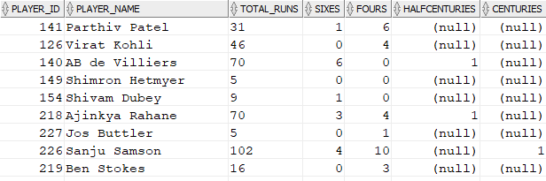

Slide 89
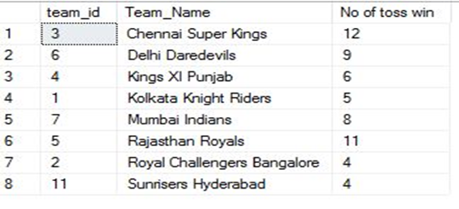
31. How many times did the team win the toss?
select team as team_id, t.Team_Name , sum(now) as "No of toss win" from (
select match_id, team1 as team, count(distinct case when team1=toss_win then 1 end)
as Now from matches group by match_id , Team1
union
select Match_ID, team2 as team, count(distinct case when team2=toss_win then 1 end) as
Now from matches group by match_id,team2) sub
inner join
Team_Details t
on team = t.Team_ID
group by team , Team_Name

Slide 90
THANK YOU

