Slide 1


SMART INDIA HACKATHON 2026
TITLE PAGE
Problem Statement ID – SIH26036
Problem Statement Title- Online verification system of weighing and measuring instruments.
Theme- Miscellaneous
PS Category- Software
Team Name - KHUSHAL

Slide 2
MAANAK : Online system for measuring instruments
KHUSHAL
Proposed Solution
Single national platform for state wise access for legal metrology departments
Enabling online registration, application, fee payment, scheduling, verification and certification.
Agentic AI for doc verification, fraud detection and compliance enquiries
Generate digitally signed certificate with QR codes for instant verification
Provision of dashboards, alerts, search in the app.
Addressal of Problem
Replaces manual and fragmented process to one easier app solution.
Reduces verification delays through automated scheduling
Increases accuracy through the use of AI assisted doc verification
Helps in fraud prevention and anomaly detection
Innovation and Uniqueness
AI powered multi-agent system
Multi-lingual voice-chat assistance
AI instrument recognition and tamper seal detection using photographs

Slide 3
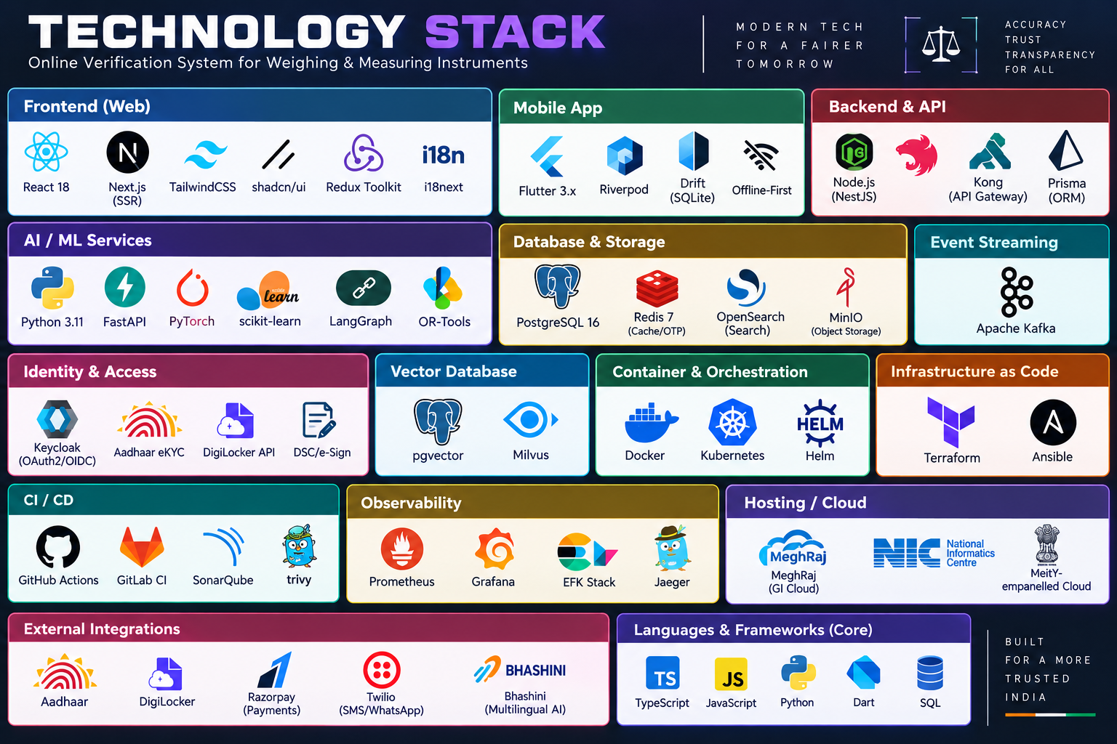
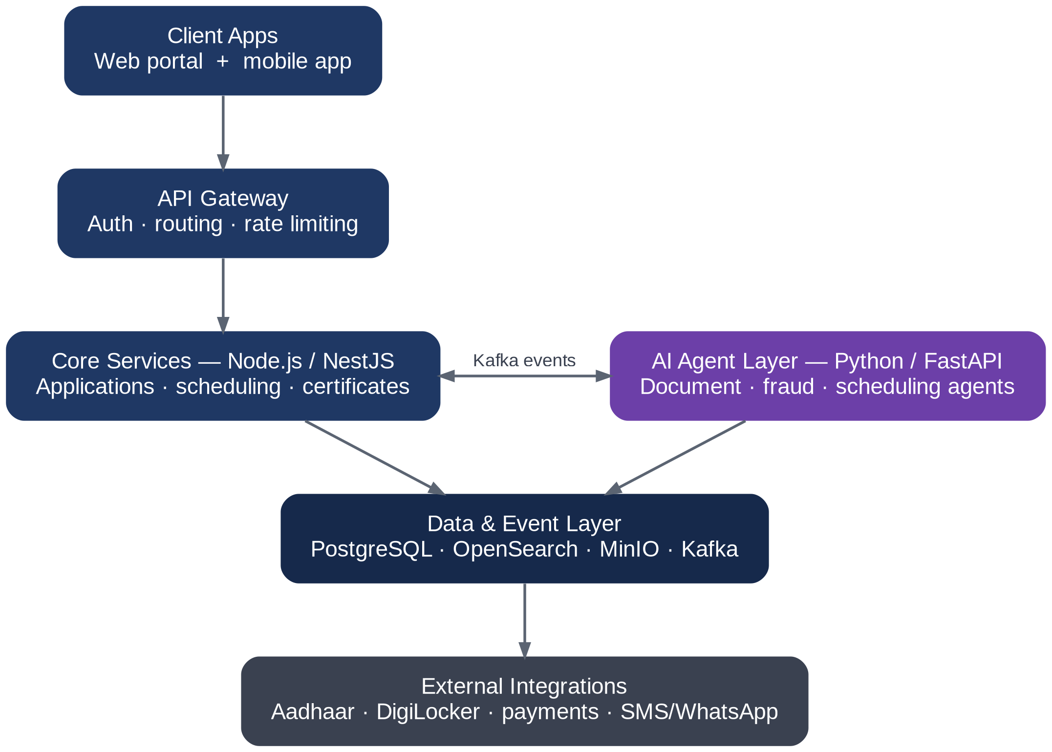
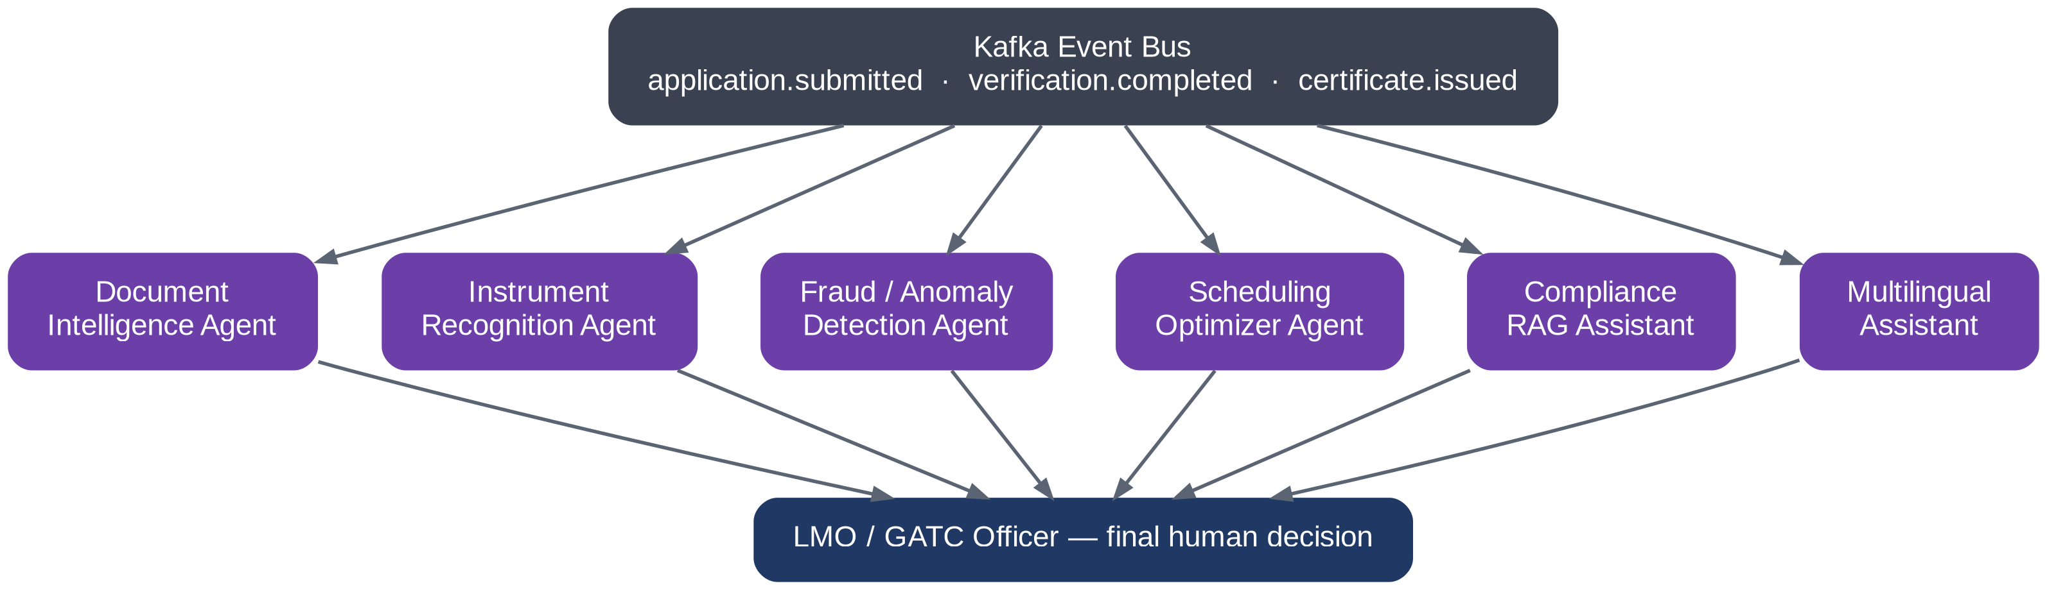
TECHNICAL APPROACH
KHUSHAL
Technologies Used
High Level Architecture
AI Agent Architecture

Slide 4
FEASIBILITY AND VIABILITY
KHUSHAL
FEASIBILITY
Scalable architecture supports 1,00,00 users and 99.9% uptime
Offline first mobile design practical in rural and low mobility areas
Government ready deployment through Meghraj/NIC backed cloud infrastructure
Existing integrations such Aadhar, DigiLocker, GST allow easier integration.
POTENTIAL CHALLENGES
Integration complexity with state legacy systems and infrastructure
Poor connectivity relaying issues like data synchronization in rural areas
Data security risks due to integration with KYC’s like Aadhar like systems
Resistance to adoption due to widespread accustomed usage of manual systems
Legal and regulatory compliance issues with digital signatures and audit records
AI model drift could reduce accuracy as real-world data shifts
SOLUTIONS
Phased rollout with MVP to state to nationwide deployment
Apply AI advisory for legal compliance
Use kafka decoupling for failure handling

Slide 5
IMPACT AND BENEFITS
KHUSHAL
IMPACTS
Consumers : instant verification, easier handling and remote access with app
Retail owners : faster access to certifications, verifications and renewal process without manual effort
Metrology Officers : reduced manual workload through the AI assisted platform
GATCs : better allocation with streamlined workflows
Rural Users : more accessibility through the app with solving the poor connectivity problem to an extent.
BENEFITS
SOCIAL
Improved consumer trust and transparency
Multilingual support
ECONOMIC
Faster schedule, low runtime.
Better fraud detection reducing losses
ENVIRONMENTAL
Reduce paper usage
Minimize unnecessary physical visits
GOVERNANCE
Centralized, auditable and transparent system
Cross state monitoring with national oversight

Slide 6
RESEARCH AND REFERENCES
KHUSHAL
DigiLocker Issuer API Specification
Legal Metrology (General) Rules, 2011
BHASHINI – Reference for multilingual AI
Technical research: Study of AI/ML-based document processing, computer vision, anomaly detection, route optimization, RAG systems, offline-first applications and secure digital certification

