Slide 1
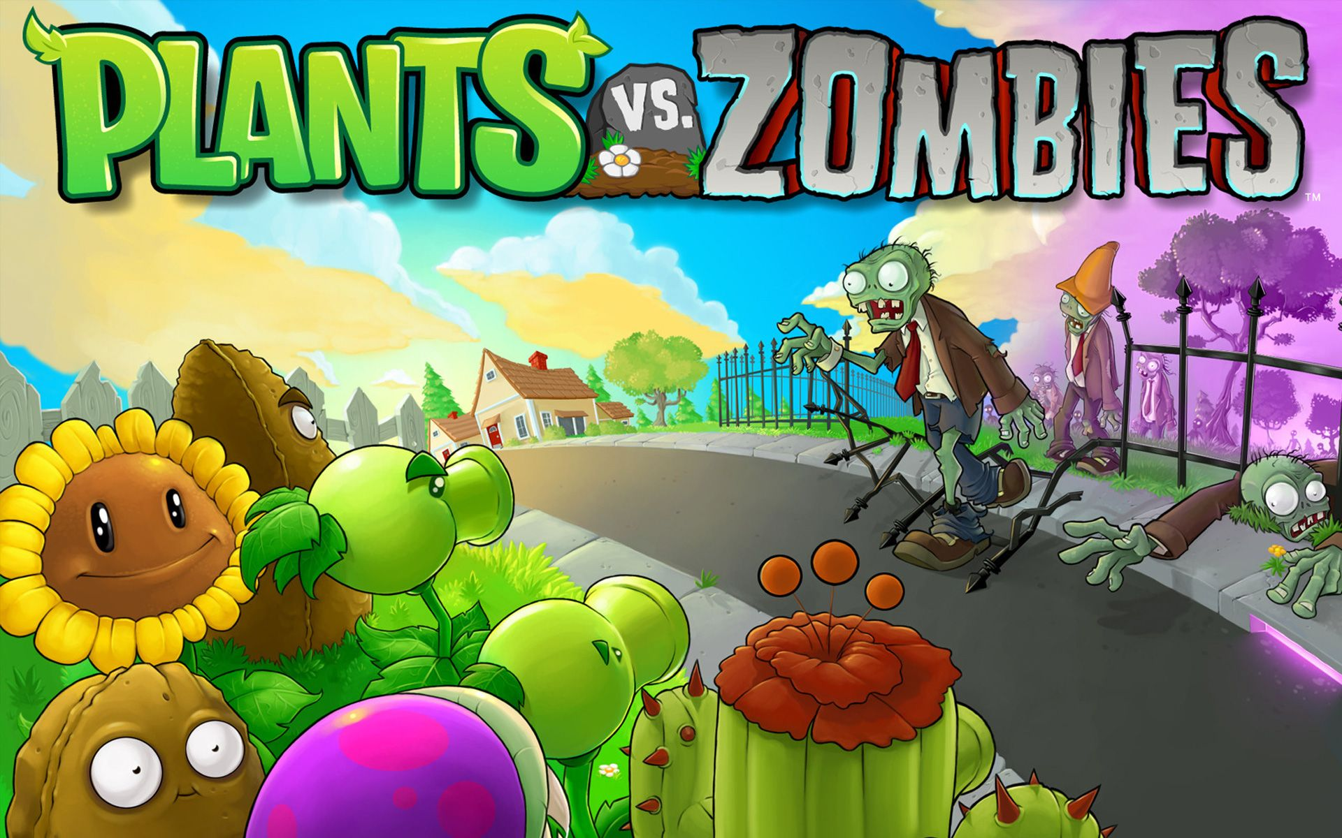
Snigdha Gupta | 2018316
Khushali Verma| 2018290

Slide 2
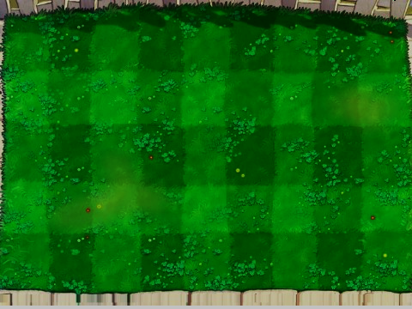
IMPLEMENTATION
CLASSES USED
Driver class - GamePlay
Game, which contains objects of
User Class
Lawn Class
Tile Class
Sun Class
LawnMover Class
1 class for each level
Utility classes like
Almanac Class
Pea class
Coin class
CLASSES USED
Character Class
Zombie class
6 classes for each zombie
Plant class
4 classes for each type of plant
1 class each for each plant, extending one type each
Other classes to introduce various GUI components.
INTERFACES
Serializable - To serialize all components of the Game Class
Cloneable - For cloning the dancing zombie
Runnable - To simultaneously implement various tasks at each level

Slide 3
IMPLEMENTATION
EXCEPTIONS
NotEnoughSunException
Thrown when there are not enough suns to purchase a plant during the game.
GameWinnerException
Thrown when a player Wins a Level
GameLostException
Thrown when the zombies cross your lawn and eat your brain
DESIGN PATTERNS
Factory Design Pattern
While Producing Zombies at each level
Singleton Design Pattern
Strictly a single instance of the game class can be generated
Decorator
Used in Serializing and Deserializing
FlyWeight

Slide 4
CONTRIBUTION
SNIGDHA
GUI Functionalities like
Drag and Drop
Timeline
Transitions
Scene Building
Event Handling
Back End
Basic class Implementation and Exception Handling
Design Patterns
KHUSHALI
GUI Functionalities like
Event Handling
Design of Game Flow
FXML Linking and Loading
Sun tokens binding
Back End
Basic Class Implementation and Exception Handling
Serialization and Deserialization

Slide 5
BONUS
ALMANAC
Not everyone knows how dangerous these zombies can be and a user must be equipped with a User Manual which guides them through their Evil powers and their flaws.
This is a guide for user about Various Plants and Zombies showing their strengths and weaknesses.
SUPER POWER
It’s rough for plants to exist at times when it’s cold, suns are a rare occurrence and zombies are on the edge to eat your brain.
The Special Power is a Life Saviour Button provided on Screen which when clicked forces all the zombies to Retreat for few seconds.

