Slide 1
Chat server using socket programming
1-Vaibhav Kokate_9016
2-Yash Shah_9020
3-Khushal Malu_9021
4-Shrish Dollin_9022
5-Yash Sant_9023

Slide 2
SERVER SIDE

Slide 3
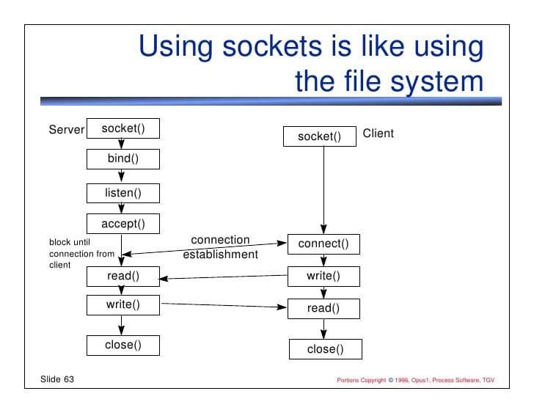
Flowchart for server connection:

Slide 4
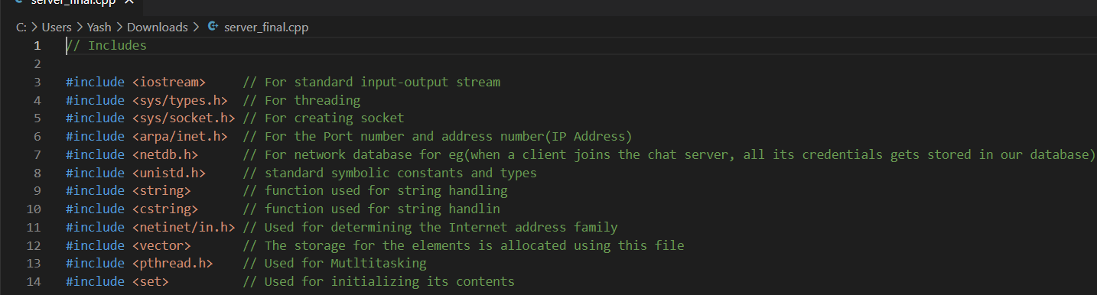
CODE INSIGHTS

Slide 5
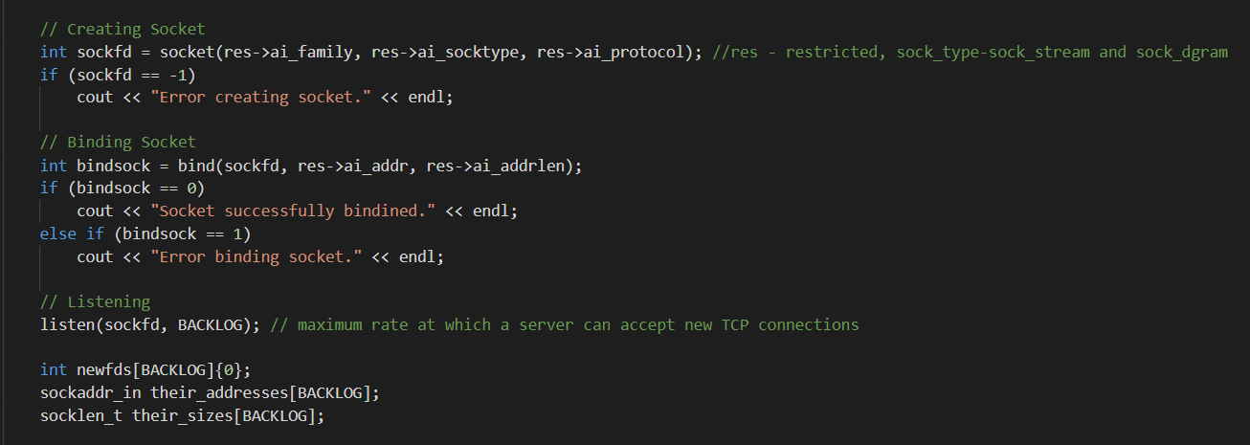
Three main important steps:

Slide 6
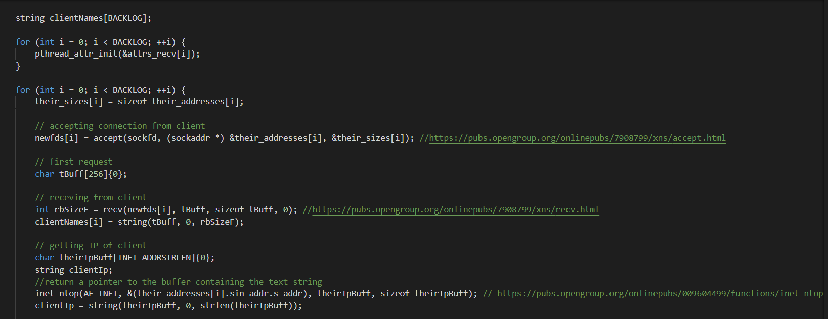
Accepting the connection request:

Slide 7

IP ADDRESSES
IP Addresses
Public
Private
Static
Dynamic

Slide 8
FIREWALL
What is a Firewall ?
Types of firewall
Firewall
Packet-filtering firewalls
Proxy firewalls
NAT firewalls
Web application firewalls
Next-gen firewalls (NGFW)

Slide 9
Client Side
I 14

Slide 10
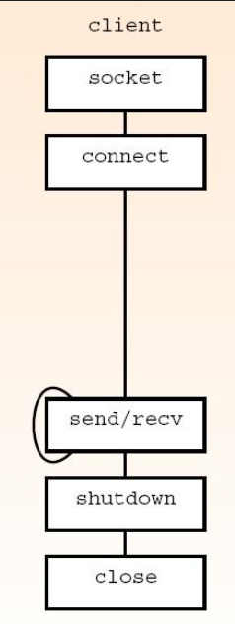
ALGORITHM
FLOW-CHART
STEP 1:START
STEP 2:SOCKET CONNECTION
STEP 3:CONNECT THE SOCKET
STEP 4:SEND & RECEIVE MESSAGES
STEP 5:SHUTDOWN THE SOCKET
STEP 6:STOP

Slide 11
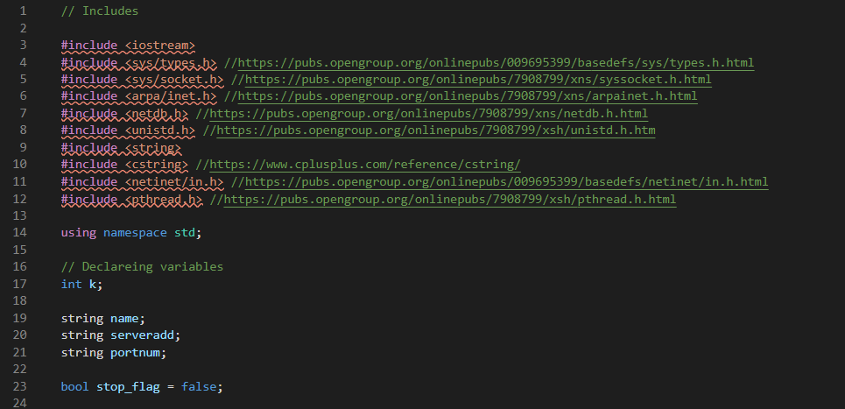
CODE INSIGHTS

Slide 12
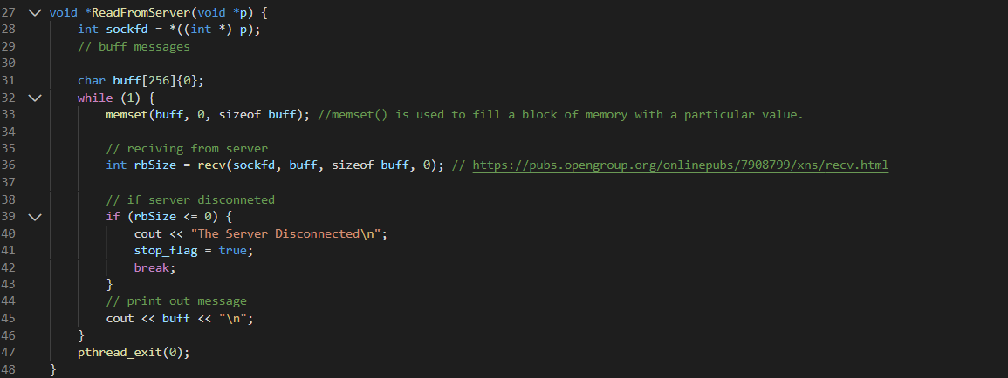
TO READ FROM SERVER

Slide 13
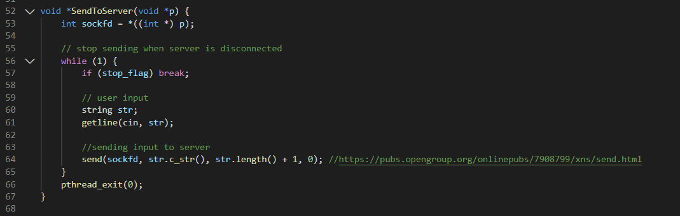
TO SEND TO SERVER

Slide 14
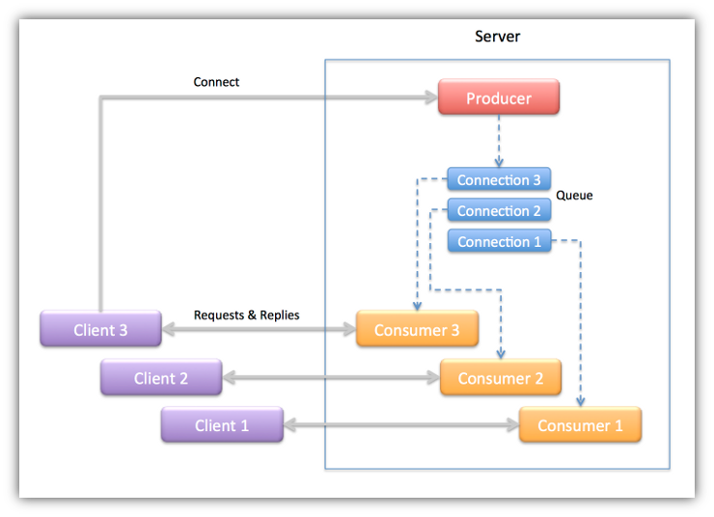
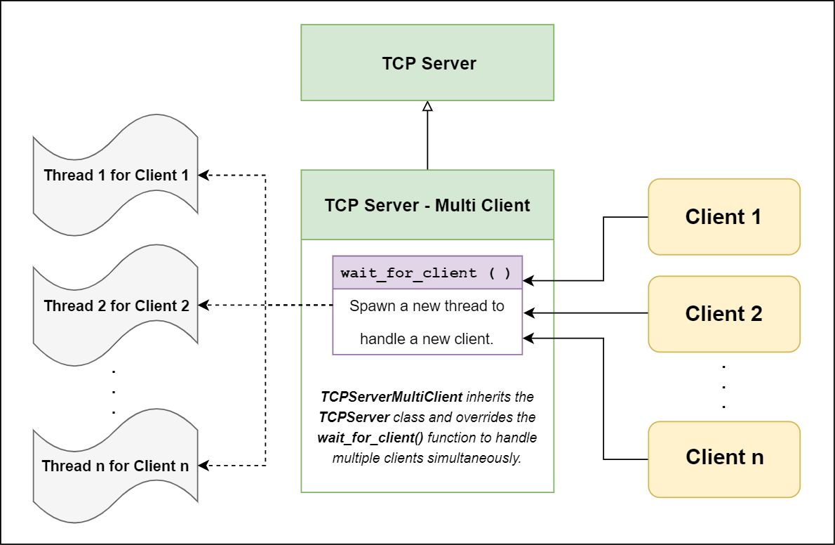
THREADING
A thread of execution is a sequence of instructions that can be executed concurrently with other such sequences in multithreading environments, while sharing a same address space. An initialized thread object represents an active thread of execution; Such a thread object is joinable and has a unique thread id.
To start a thread, we simply need to create a new thread object and pass the executing code to be called (i.e, a callable object) into the constructor of the object. Once the object is created a new thread is launched which will execute the code specified in callable. After defining callable, pass it to the constructor.

Slide 15
HOW THREADING WORKS?
Creating threads
First, you have to include thread header in your program
When you want to create a thread, you have to create an object of a thread class.
Initializing thread with a function
When you create a thread, you can pass a pointer of a function to its constructor. Once thread is created, this function starts its work in a separate thread.
The pthread_create() function is used to create a new thread, with attributes specified by attr, within a process. If attr is NULL, the default attributes are used. If the attributes specified by attr are modified later, the thread's attributes are not affected. Upon successful completion, pthread_create() stores the ID of the created thread in the location referenced by thread.
Join threads
Thread joining is done by using join() member function of a thread class
Joinable and not Joinable threads
After join() returns, thread becomes not joinable. A joinable thread is a thread that represents a thread of execution which has not yet been joined.
A thread is not joinable when it is default constructed or is moved/assigned to another thread or join() or detach() member function is called.
Not joinable thread can be destroyed safely.
You can check if a thread is joinable by using joinable() member function

Slide 16
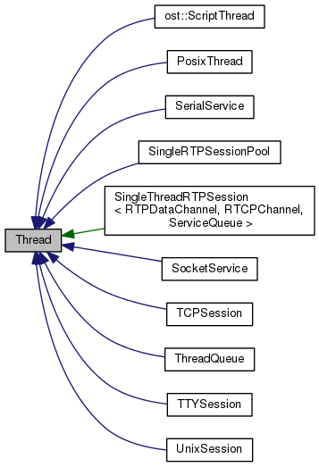
For Threading there are basically two needs Creating the Thread & Joining the Thread.As shown in the Program for Server.cpp we use #include <pthread.h> header file and for clientwin.cpp we use #include <thread>
SERVER CLIENT
// CREATING THREADS // CREATING THREADS
pthread_t tids_recv[BACKLOG];
pthread_attr_t attrs_recv[BACKLOG];
string clientNames[BACKLOG];
for (int i = 0; i < BACKLOG; ++i) {
pthread_attr_init(&attrs_recv[i]);
thread thread1(ReadFromServer, &sockfd);
thread thread2(SendToServer, &sockfd);
// JOINING THREADS
thread1.join();
thread2.join();
// JOINING THREADS
for (int i = 0; i < k; ++i) {
pthread_join(tids_recv[i], NULL);

Slide 17
THANK YOU!

