Slide 1
ATTENDENCE MANAGEMENT
INT 213

Slide 2
WHY THIS TOPIC?
TO GET HANDS ON UNDERSTANDING:-
TKINTER
DATABASE MANAGEMENT.
NEED OF THE HOUR.

Slide 3
TECHNOLOGY USED
PYTHON
TKINTER FOR GUI.
MYSQL FOR DATABASE MANAGEMENT.

Slide 4
ATTENDENCE MANAGEMENT
DIVIDED INTO 3 MODULES:-
STUDENT MODULE.
TEACHERS MODULE.
ADMIN MODULE.

Slide 5
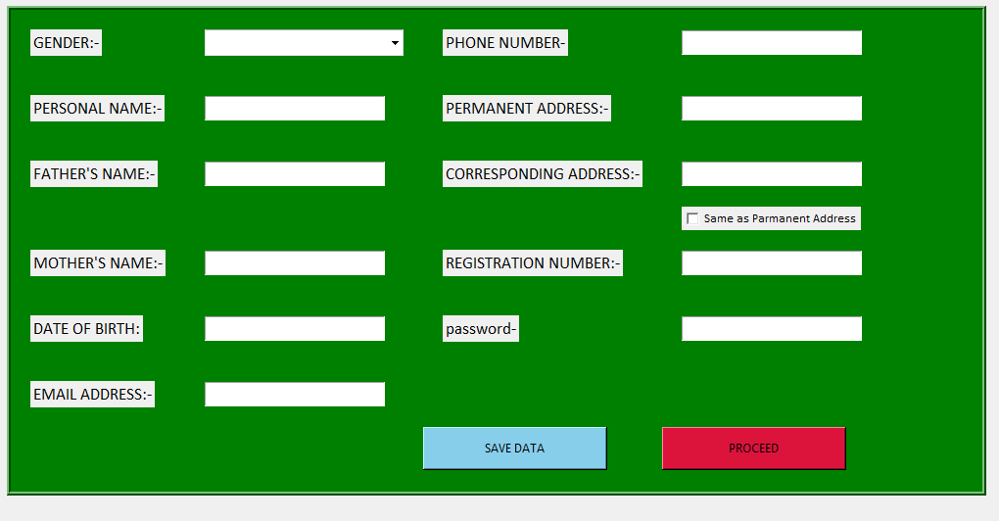
SIGN-IN
ONLY FOR NEW USER.
ENTER ALL REQUIRED INFORMATION.
CLICK ON SAVE DATA(mandatory)
CLICK ON PROCEED
LOGIN AGAIN

Slide 6
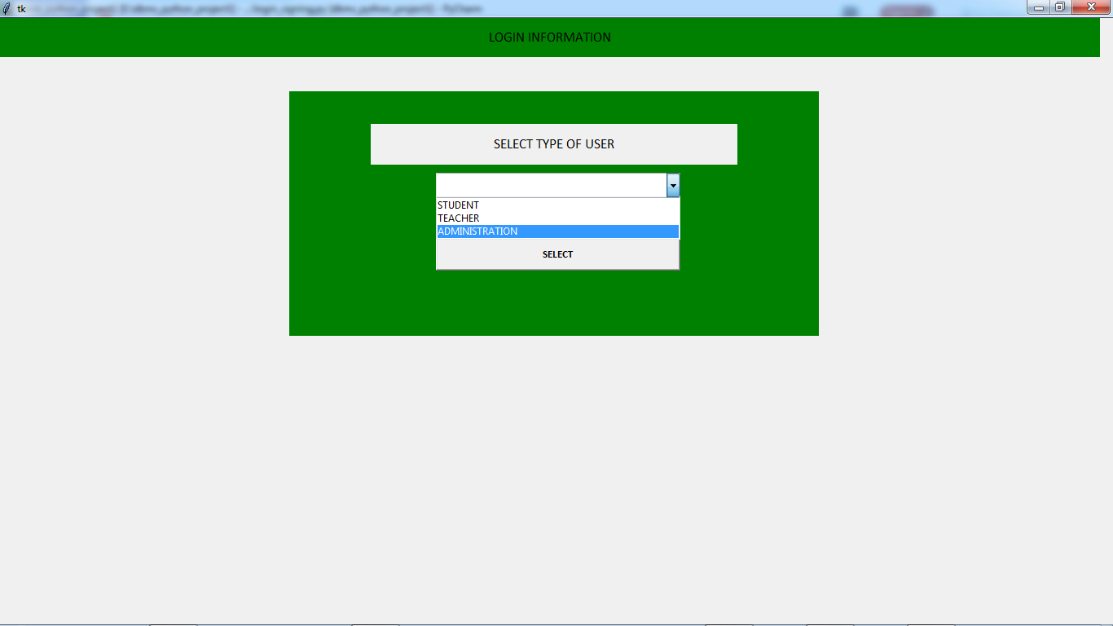
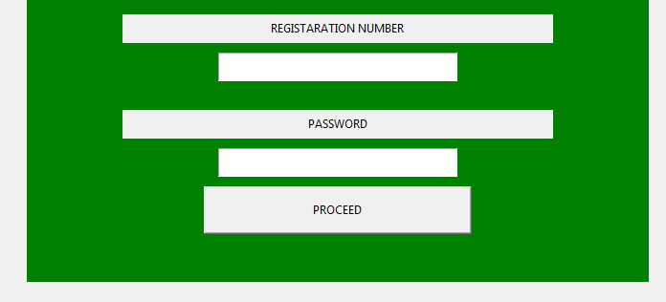
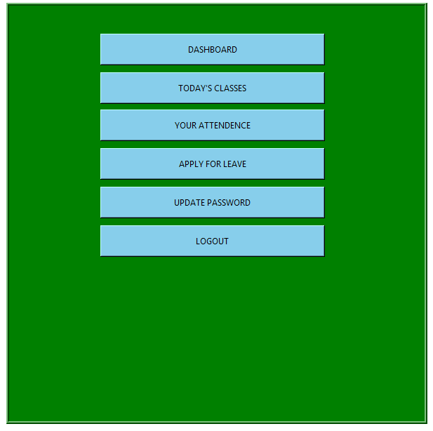
LOGIN
SELECT TYPE OF USER
ENTER REGISTRATION NUMBER:
ENTER PASSWORD
IF MATCHED ->

Slide 7

STUDENT MODULE
DASHBOARD.
GO THROUGH CLASSES.
MARK ATTENDENCE.
CAN UPDATE SECONDARY CREDENTIALS
INFORMATION.

Slide 8
DASHBOARD
CONTAIN ALL REQUIRED INFROMATION. E.G-> NAME, COURSES, SESSION,etc.
CAN CHECK TODAY'S CLASSES.
CAN CHECK ANY ANNOUNCEMENT OR NEWS.
CAN CHECK ANY MESSAGE.

Slide 9
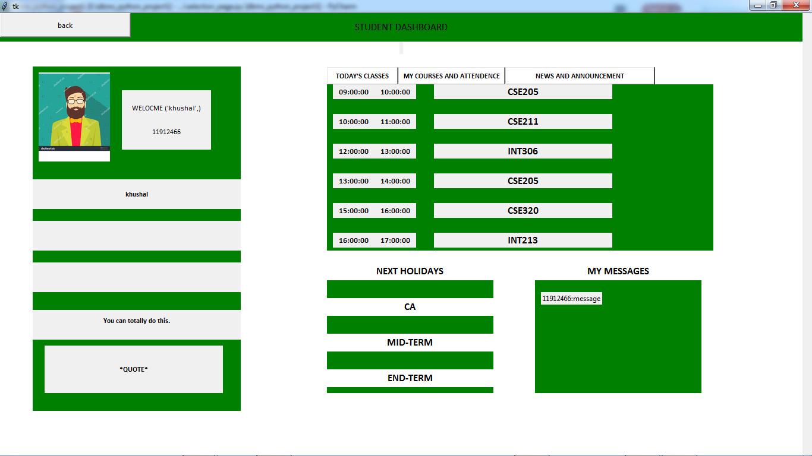

Slide 10
TODAY'S CLASSES
STUDENT WILL KNOW ABOUT:-
ENDED CLASSES.
UPCOMING CLASSES.
ONGOINING CLASSS.
COLOR FRAMES FOR EASY UNDERSTADING.
BUTTONS AVAILABLE FOR SMOOTH TRANSMISIONS.

Slide 11
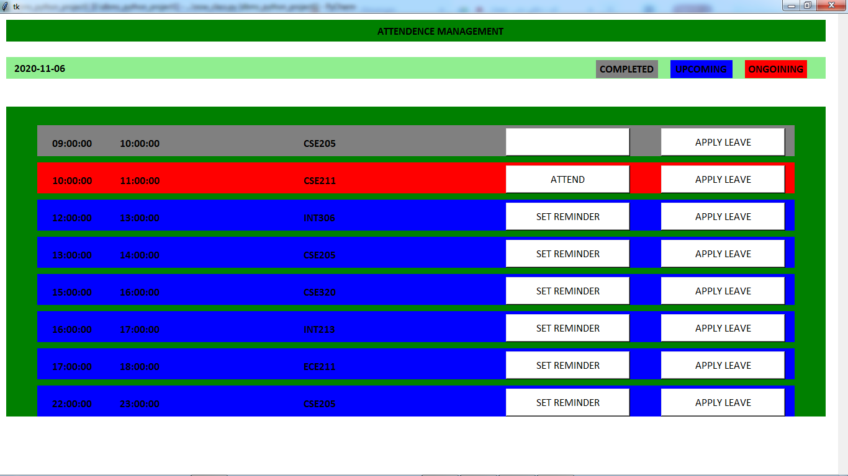
ATTEND CLASS

Slide 12
ATTEND CLASS
THROUGH ONGOINING CLASS.
STUDENT WILL DIRECTLY DIRECTED TO ATTEND CLASS.
ATTEND CLASS POLICY-> SPENT TIME GET ATTENDENCE.

Slide 13
ATTENDENCE CALCULATION FORMULA
POINT BASED ATTENDENCE.
STATUS POLL BASED ATTENDENCE.
TOTAL 4 POLLS PRESENTED.
RUNNING COUNTER ->SHOWS TOTAL TIME SPENT.
1 MIN IN COUNTER=1 POINT
1 STATUS POLL MARKED 'YES'= 5 POINT.
TOTAL POINT=80.
POINT REQUIRED TO MARK 'PRESENT'=50

Slide 14
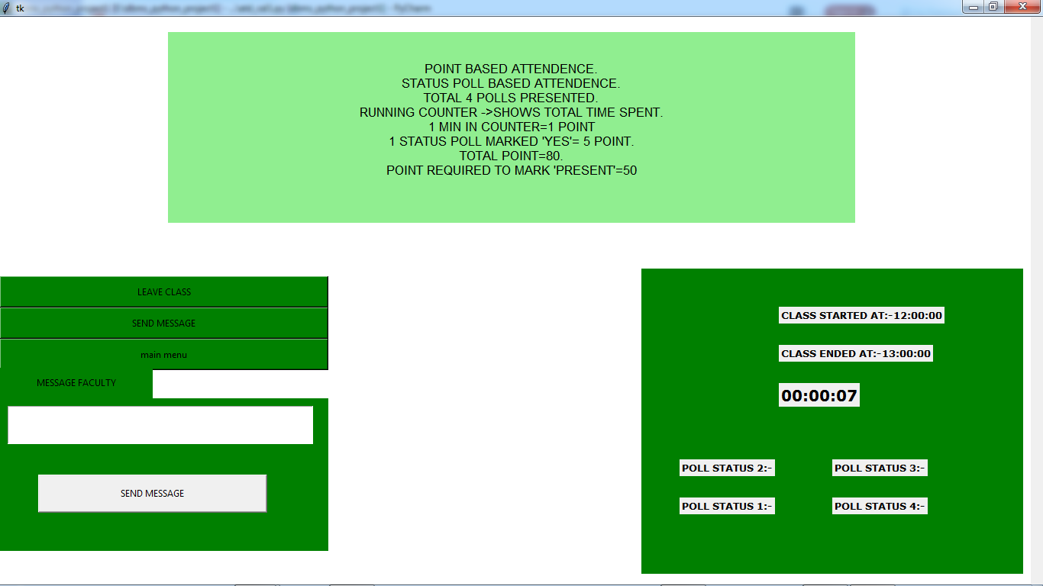

Slide 15
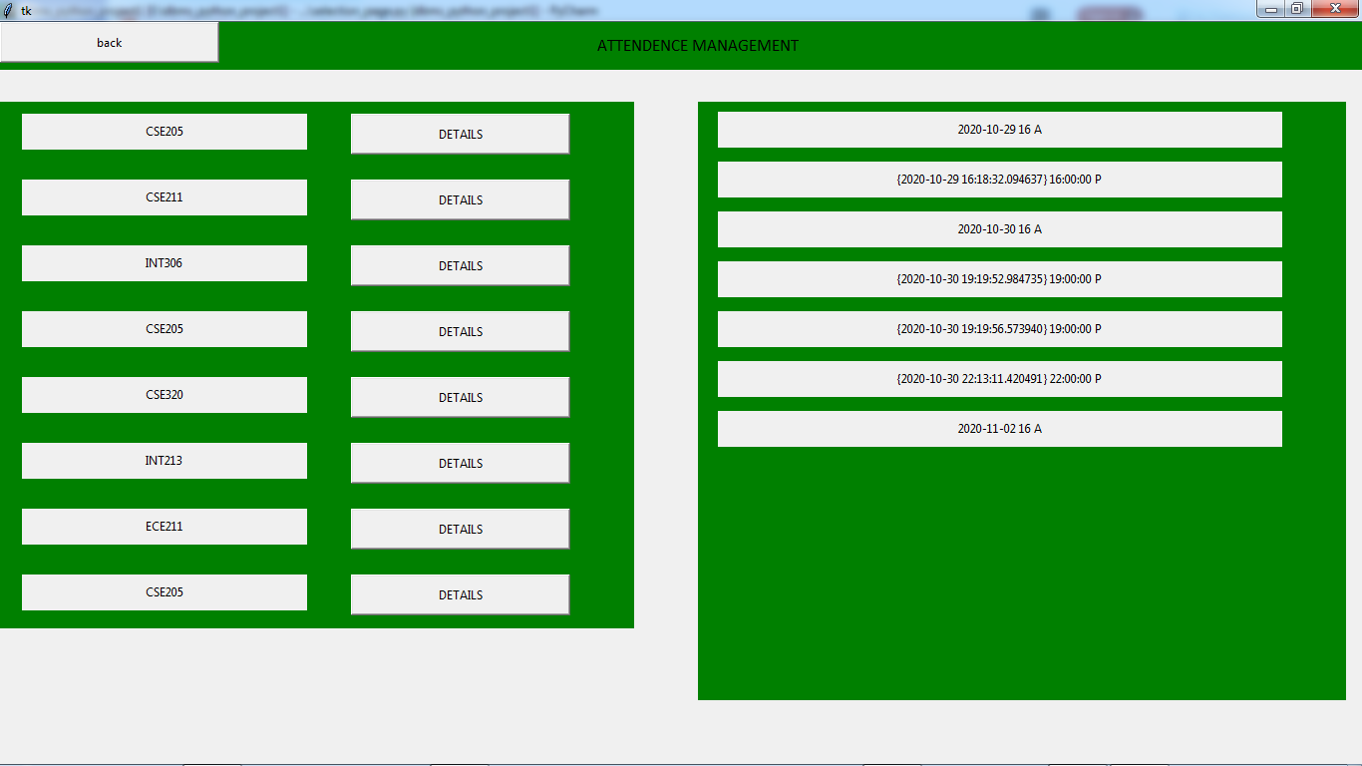
YOUR ATTENDENCE
STUDENT CAN CHECK THEIR ATTENDENCE HERE.
CLICK ON SUBJECT -> GET YOUR RECORD.

Slide 16
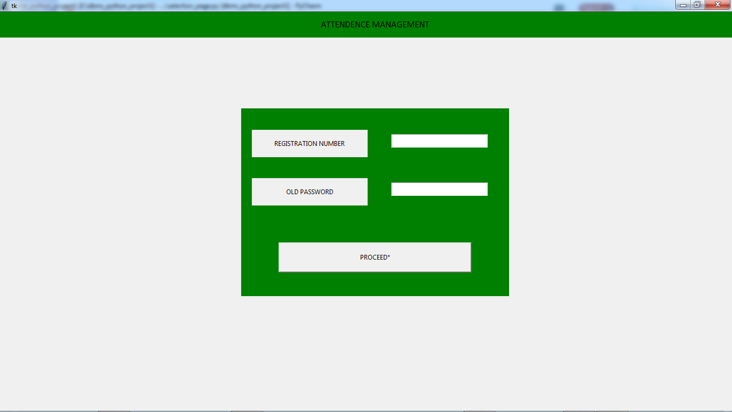
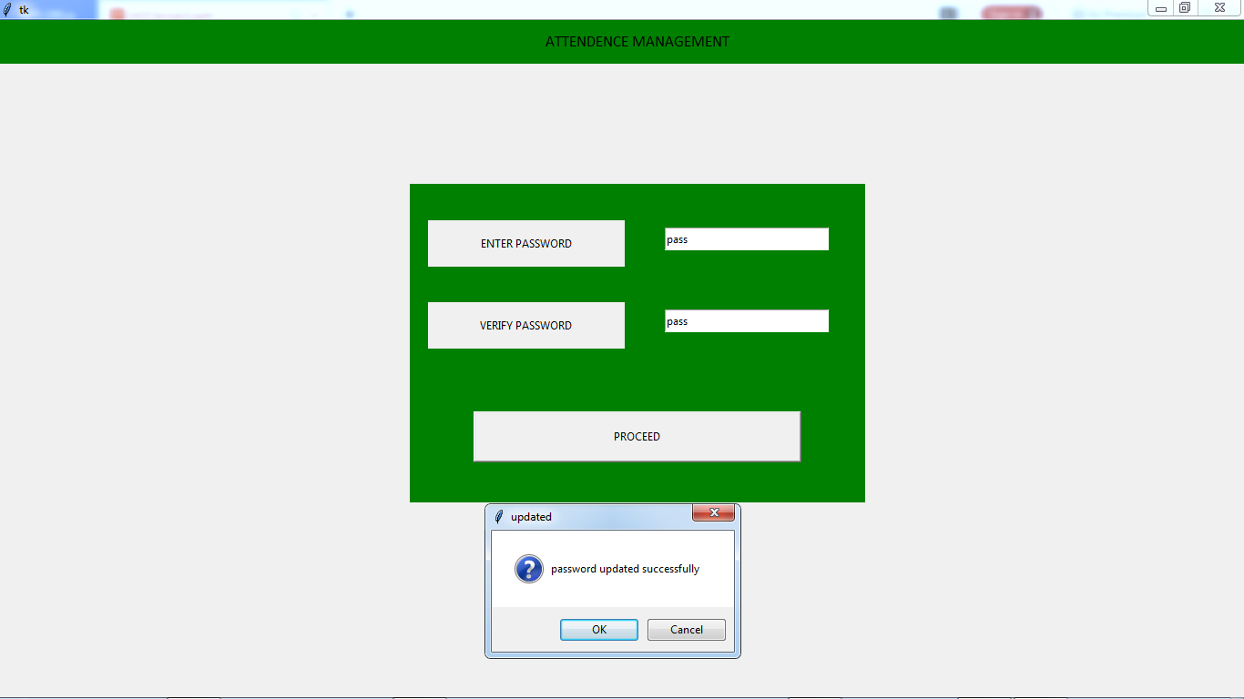
UPDATE PASSWORD

Slide 17

TEACHER MODULES
DASHBOARD.
SCHEDULLING.
UPDATE CLASS.
CHECK STUDENT STATUS.
APPLY FOR LEAVE.

Slide 18
DASHBOARD
CONTAIN REQUIRED INFORMATION ABOUT TEACHER.
CONTAIN SCHEDULING OF THE CLASS.
CONTAIN MESSAGE AND ANNOUNCEMENT GIVEN BY ADMIN.

Slide 19
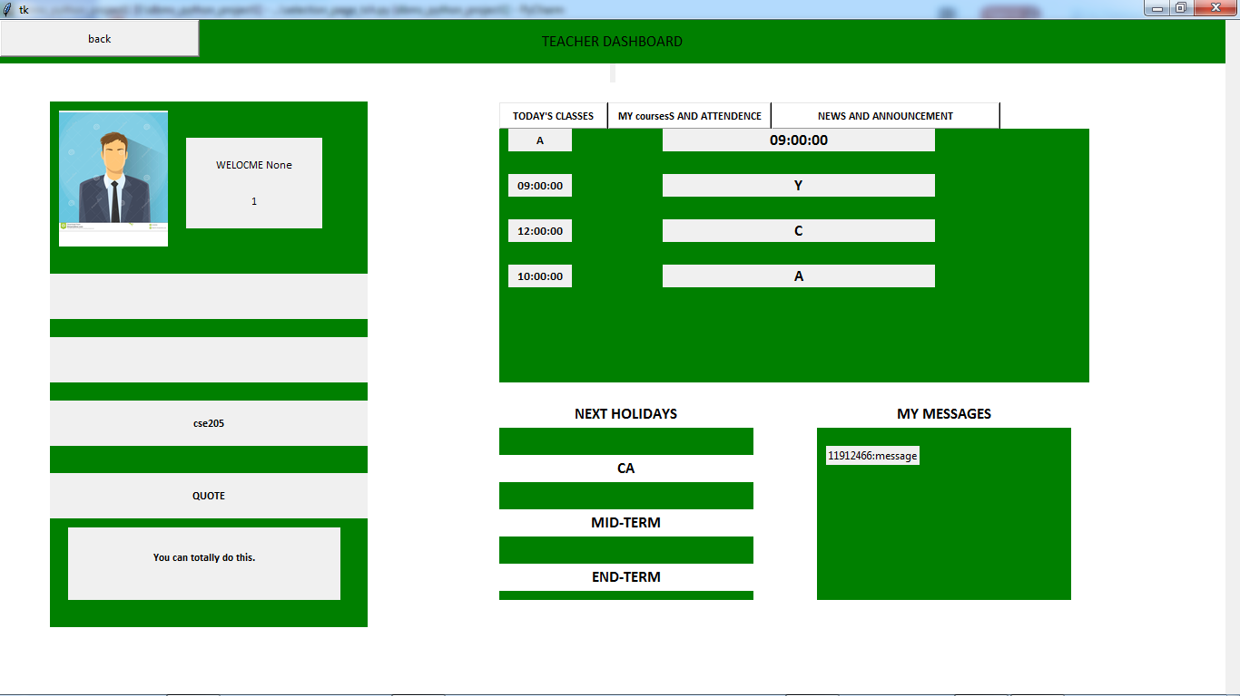

Slide 20
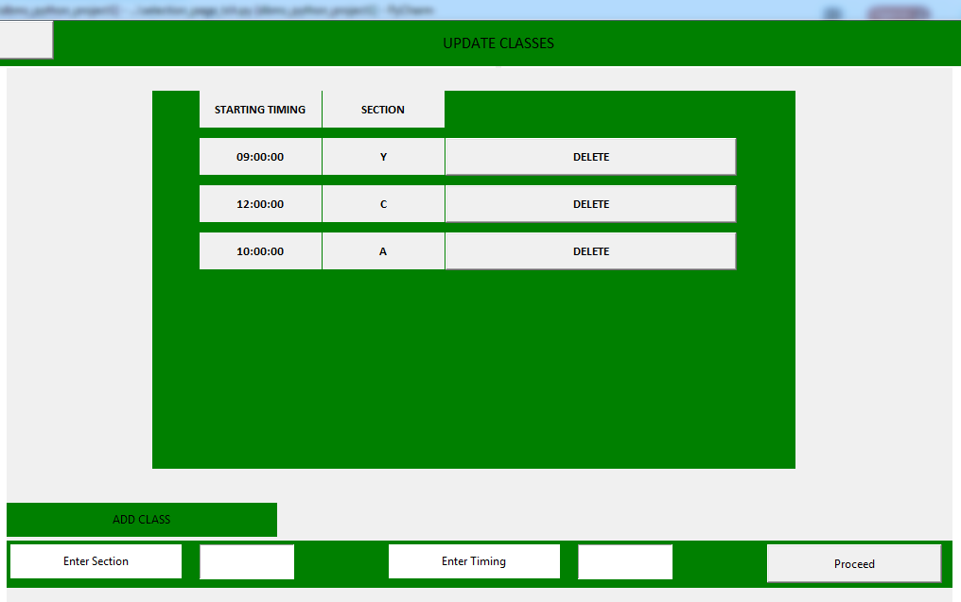
UPDATE SCHEDULES
CAN ADD A NEW SECTION AND TIME FOR NEW CLASS.
CAN DELETE ANY OLD SECTION CLASS

Slide 21
STUDENT STATUS
CAN CHECK ALL STUDENT OF THE CLASS
CAN CHECK ALL STUDENT 'PRESENT'
CAN CHECK ALL STUDENT ABSENT'

Slide 22
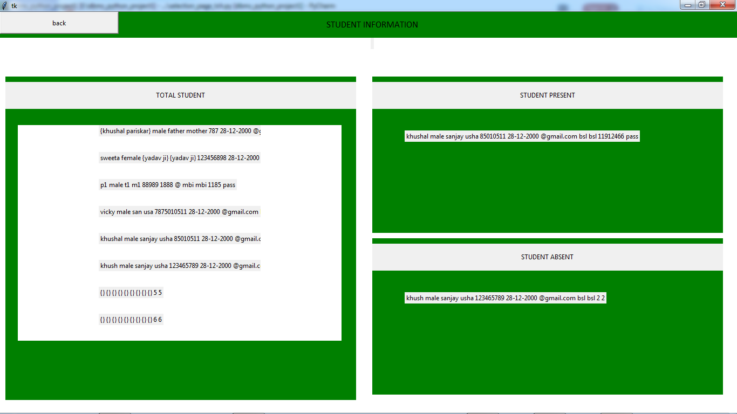

Slide 23
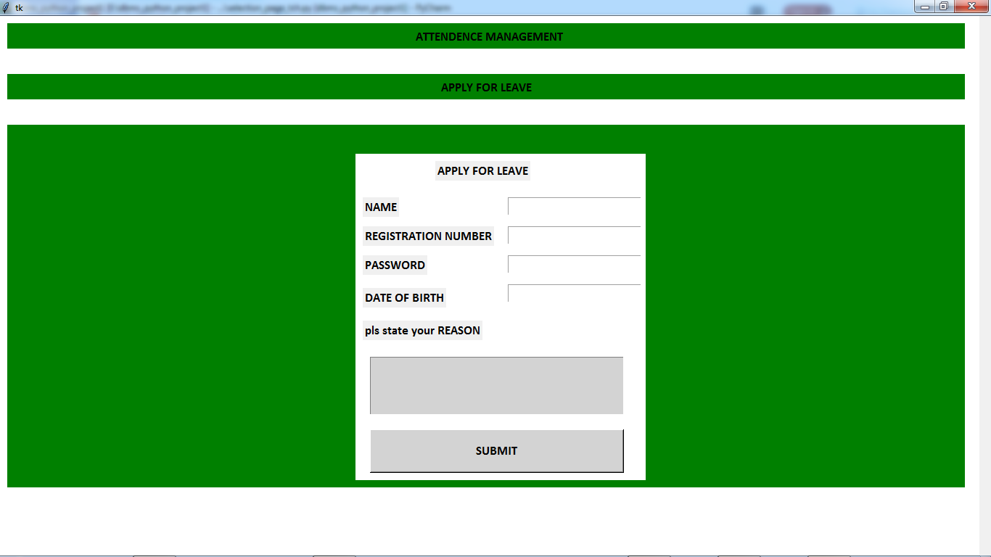
APPLY FOR LEAVE

Slide 24
ADMIN MODULE
DASHBOARD.
UPDATE/DELETE STUDENT.
UPDATE/DELETE TEACHERS.
ADD NEW USER.

Slide 25
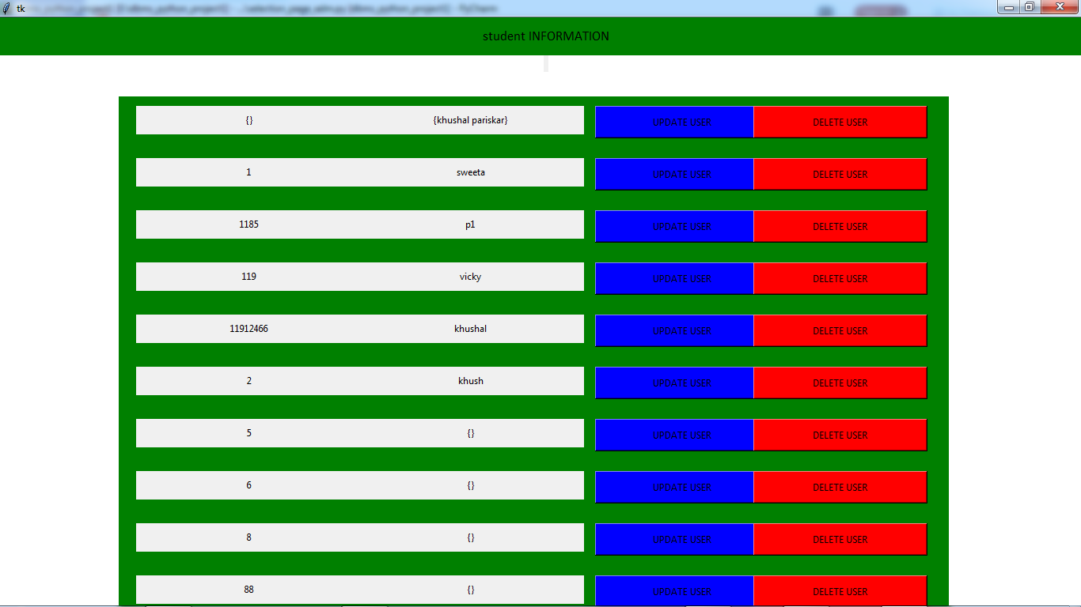
UPDATE/DELETE USER

Slide 26
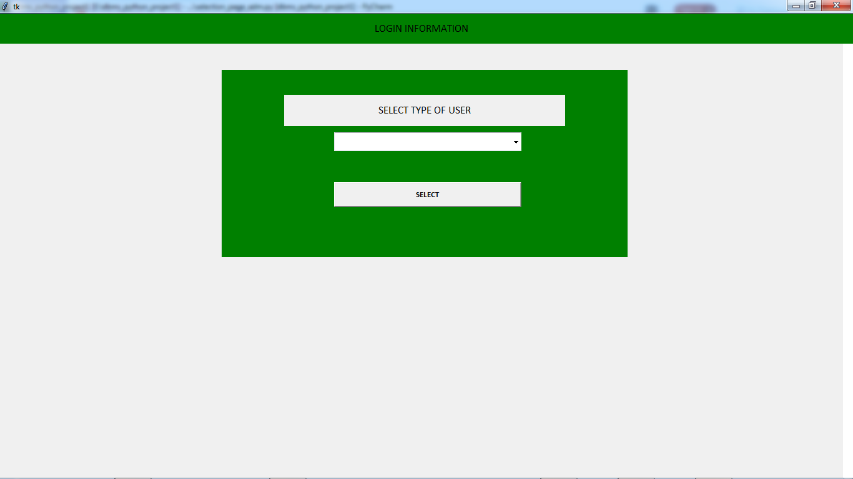
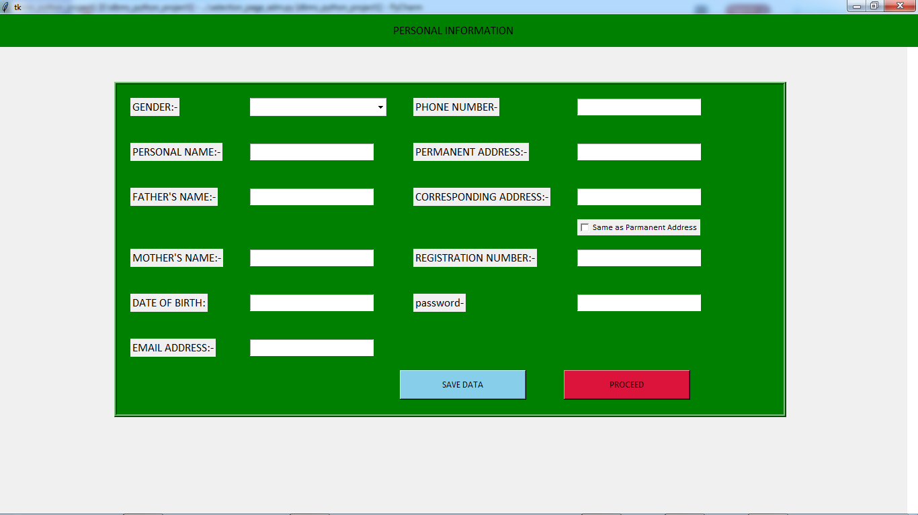
ADD USER
SELECT TYPE OF USER.
ADD NEW USER.

