Slide 1
Container Congestion Predictor &
Port Operations Optimiser
PortOptimizer — AI-Powered Port Congestion Prediction & Operations Management
Objective: Predict congestion, optimize port resources, recommend alternate routing, and generate a 72-hour operational plan.
PROJECT PARTICIPANTS:
Khushal Vadher • Darshan Raval • Parth Patoliya • Jay Rohit
01

Slide 2
Technology Stack & Team Contribution
• Machine Learning / AI
Python, scikit-learn, Random Forest Classifier, pandas, NumPy, joblib
• Backend
Python, FastAPI, Uvicorn, PyMongo
• Database
MongoDB Atlas, MongoDB
• Frontend
React, Vite, JavaScript, Axios, React Router, Recharts
• Khushal Vadher
Machine Learning / AI — Congestion prediction model, feature engineering, ML preprocessing, model training/prediction, risk estimation, and operational flow integration.
• Darshan Raval
Backend — FastAPI backend APIs, MongoDB integration, vessel/port data handling, and congestion API integration.
• Parth Patoliya
Backend & Optimization — Routing recommendation backend, berth optimization, crane optimization, 72-hour operations planner, and operational decision logic.
• Jay Rohit
Frontend — React/Vite frontend development, command-centre dashboard, vessel management, congestion visualization, routing/operations/alerts UI, and API integration.
02

Slide 3
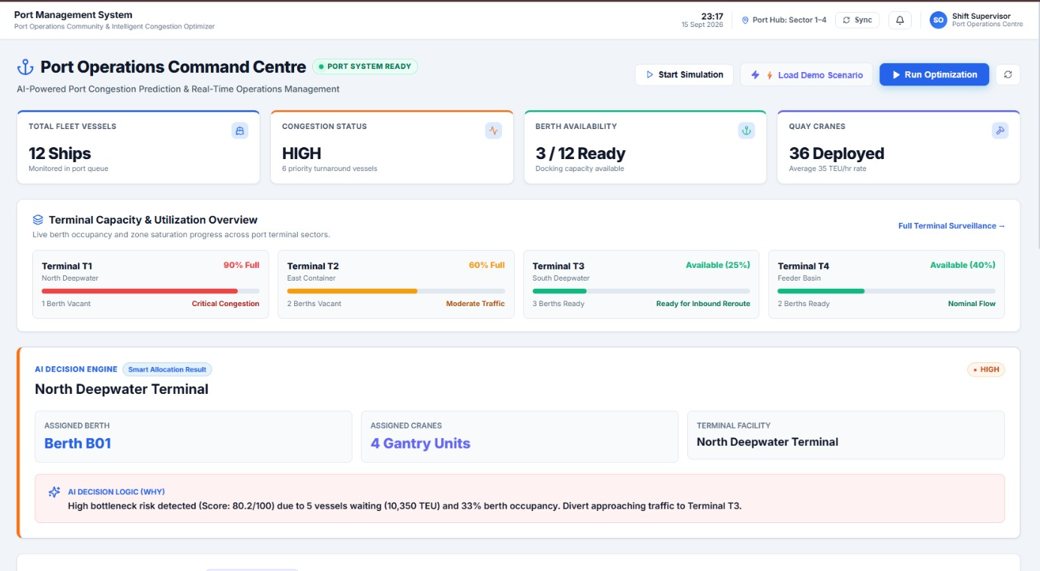
Port Operations Command Centre Dashboard Overview
[Insert Screenshot 1 Here:
Port Operations Command Centre]
• Centralized high-level port operations monitoring for shift supervisors.
• Real-time tracking of KPIs: Total Fleet Vessels (12 Ships), Congestion Status (HIGH), Berth Availability (3/12 Ready), and Quay Cranes Deployed (36 Deployed).
• Terminal Capacity & Utilization Overview covering deepwater and container terminals (e.g., Terminal T1 at 90% Full with Critical Congestion).
• AI Decision Engine integration displaying live optimization results and clear explainable AI logic (e.g., why a specific route or terminal bypass is suggested).
03

Slide 4
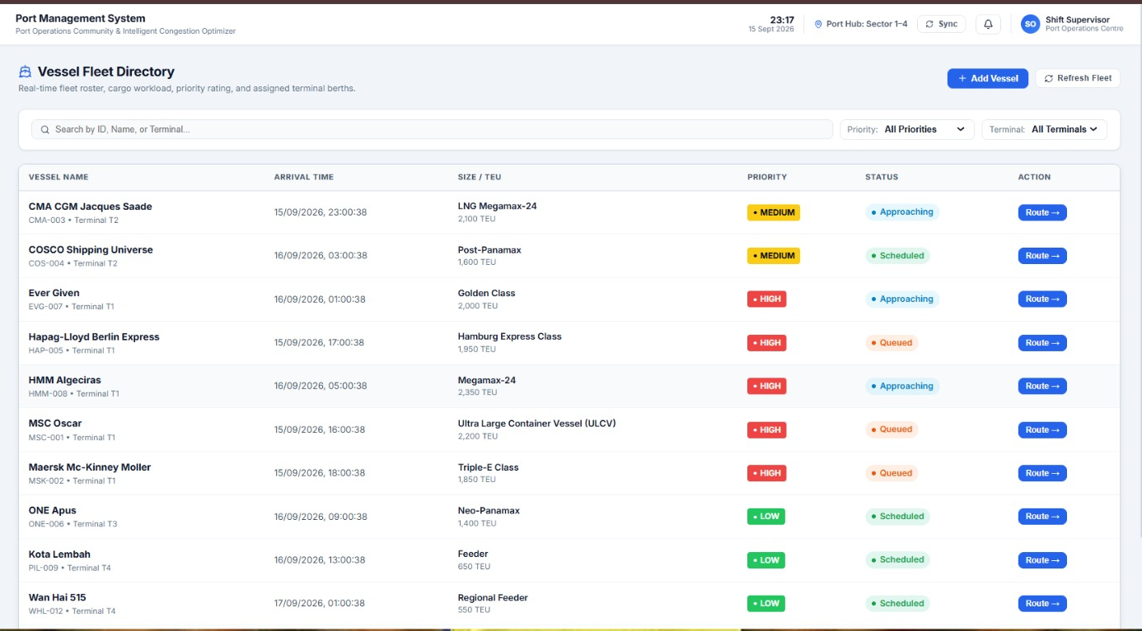
Vessel Fleet & Congestion Monitoring
[Insert Screenshot 2 Here:
Vessel Fleet Directory]
• Comprehensive real-time fleet roster capturing precise vessel name, terminal association, and identification codes.
• Granular vessel telemetry tracking ETA/Arrival Time, exact cargo metrics (Size/TEU), and operational status (Approaching, Scheduled, Queued).
• Intelligent congestion-driven priority indexing flagging vessels as HIGH, MEDIUM, or LOW priority based on port congestion conditions.
• Direct actionable UI controls providing rapid navigation hooks to the Alternate Routing engine per vessel.
04

Slide 5
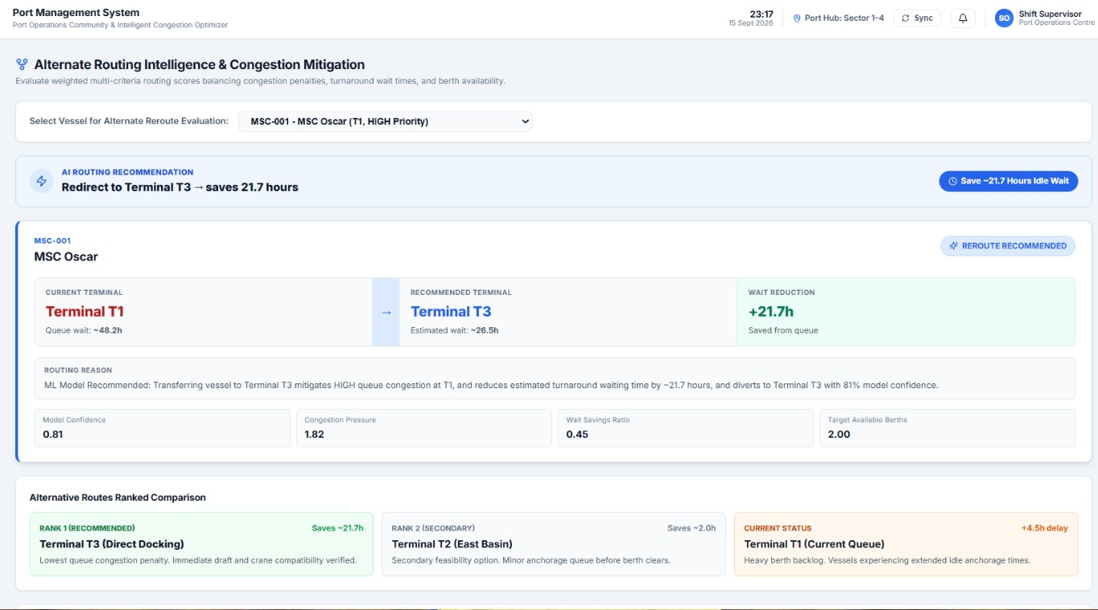
Alternate Routing Intelligence & Congestion Mitigation
[Insert Screenshot 3 Here:
Alternate Routing Intelligence]
• Data-driven multi-criteria reroute engine evaluating model confidence, congestion pressure, wait savings ratio, and available target berths.
• Quantified operational efficiency gains tracking exact turnaround improvements (e.g., 'Redirect to Terminal T3 saves 21.7 hours idle wait').
• Explainable AI framework detailing the math and logic behind recommendations (e.g., mitigating HIGH queue congestion at T1, 81% model confidence).
• Ranked alternative comparison matrix presenting primary direct docking options alongside secondary feasibility pathways and current queue delays.
05

Slide 6
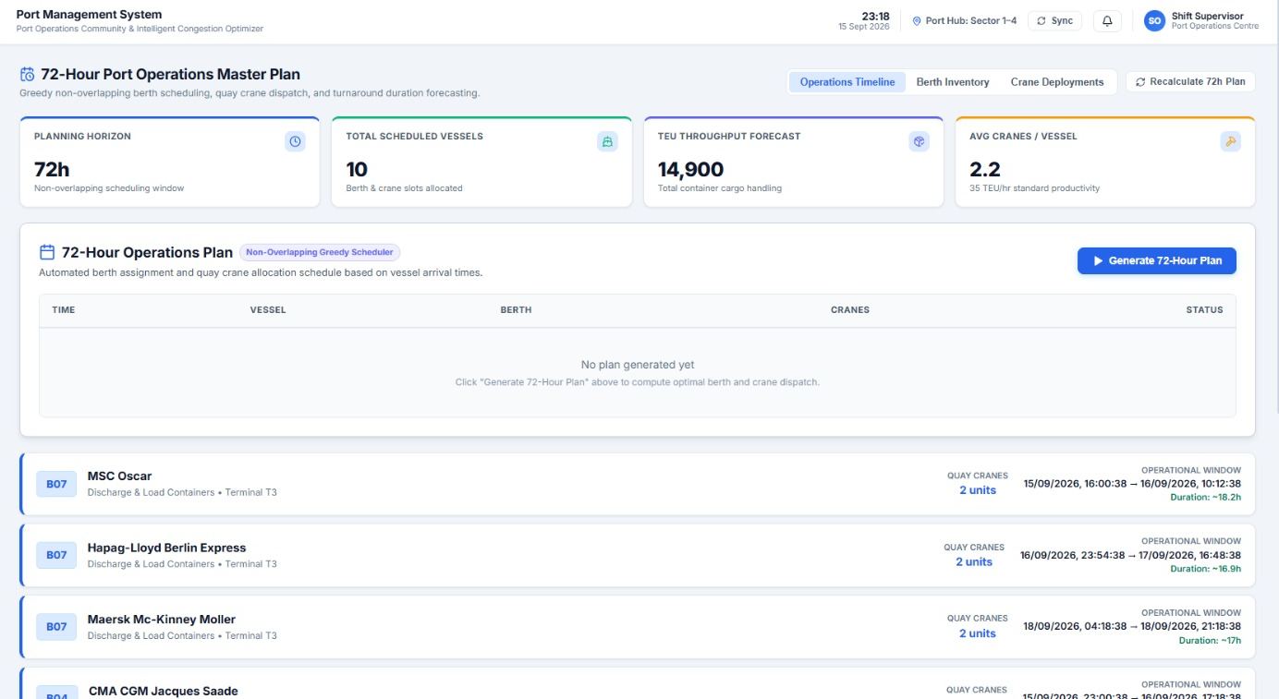
72-Hour Port Operations Master Plan
[Insert Screenshot 4 Here:
72-Hour Port Operations Master Plan]
• Predictive scheduling window implementing a non-overlapping greedy scheduler across a 72-hour planning horizon.
• Integrated resources dashboard coordinating 10 scheduled vessels, 14,900 TEU throughput forecast, and an average of 2.2 cranes per vessel.
• Algorithmic timeline synchronization generating optimal berth numbers, precise crane unit requirements, and structured time slots.
• Dynamic re-evaluation tools enabling one-click recalculation of the master plan to absorb unexpected real-time operational shifts.
06

Slide 7
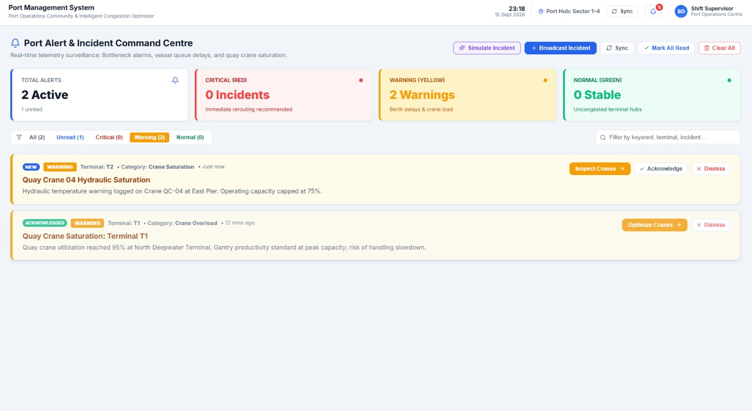
Port Alert & Incident Command Centre
[Insert Screenshot 5 Here:
Port Alert & Incident Command Centre]
• Real-time telemetry surveillance isolating critical bottlenecks, extensive vessel queue delays, and equipment anomalies.
• Categorized severity tiering distributing system telemetry into Critical (Red), Warning (Yellow), and Normal (Green) diagnostic feeds.
• Actionable incident resolution offering direct shortcuts like 'Inspect Cranes' or 'Optimize Cranes' to solve terminal bottlenecks instantly.
• Live simulator controls supporting simulated incident broadcasts to pressure-test port resilience and backup optimization pathways.
07

Slide 8
Hybrid Architecture & Intelligent Operational Flow
PortOptimizer utilizes a high-performance Hybrid Architecture combining Predictive Machine Learning with Explainable Optimization Logic, rather than relying on independent black-box models for scheduling operations.
CORE DATA & OPERATIONAL LIFECYCLE FLOW:
1. Data Ingestion & Storage: Real-time Vessel / Port Operational Data extracted and managed inside MongoDB Atlas.
2. AI Predictive Analytics: Feature Engineering & Machine Learning (Random Forest) to output the Congestion Risk Score.
3. Explainable Optimization Logic: The generated risk indices feed directly into mathematical decision frameworks for Routing Recommendations, Berth Allocation, and Crane Optimization.
4. Master Plan Compilation: Integration of all optimal vectors into a non-overlapping greedy 72-Hour Operations Plan.
5. Application Interface: Delivered via an enterprise FastAPI backend connected directly to a high-fidelity React frontend dashboard.
08

