Slide 1
ATM SYSTEM
OOPD PROJECT 2
PROJECT MEMBERS:-
RAHUL GUPTA (MT20065)
KHUSHBOO BAJAJ (MT20060)

Slide 2
PROJECT DEFINITION
This project allows customers having a Bank Account and linked ATM card to login via card into their account and perform Transactions of withdraw, deposit or Transfer money to other account holders. Also, customers can check Last transaction, mini statement, balance enquiry and linked cards to the account. It also provides customers to change setting of the card which includes Block card, change pin and set card limit.

Slide 3
EXISTING SYSTEM
Many Transactions related tasks where customers have to go to the bank to perform that, often is time consuming. When Banks are closed in holidays such tasks cannot be performed and these emergencies become difficult to be handled.The facility of transferring money to other account holders is not provided at these ATMs. Customers having multiple type of card linked to account is not accessible in the current existing system. Also, there is no option to set a limit on the minimum balance that should always be there in the account. Nowadays banks draw a penalty if the condition of minimum account balance is not sufficed. This feature will help customers in saving the penalties. This limit can be checked by the user as well.

Slide 4
PROPOSED SYSTEM
Our proposed system implements some features that are not there in the current system. In the system that we have ATM system provides customers to login to their account via card. To perform Withdrawal, Deposit, or Transfer of amount, to check the Balance, to check about the last Transaction, Linked cards and Mini statement. In this case the change pin would be useful. The user can set a pin which is easy for the user to remember. The feature of setting limit to the account ensures that no transaction that can decrease the account balance below a limit should be carried out. The user can even view the limit and the balance before performing a transaction.All the cards that are linked to the current account can be viewed.This is a feature that is different from the current existing system. In case if a user wants to block a card, whether it is credit card or any card, he can do so with the current system. He only requires to select the card which he wishes to block for any particular reason. After that no transaction can be allowed from that card.

Slide 5
CLASSES IMPLEMENTED IN OUR OBJECT ORIENTED DESIGN
ATM CardPin
Account AccountDetails
Validation Transaction_details
Display
ATMdisplay
Feature
Transactions
withdraw
Deposit
Transfer_money
Settings
Card_Limit
BlockedCards

Slide 6
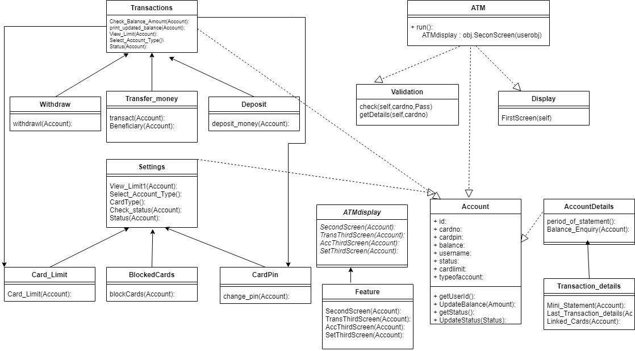
CLASS DIAGRAM

Slide 7
DESCRIPTION OF CLASSES IMPLEMENTED

Slide 8
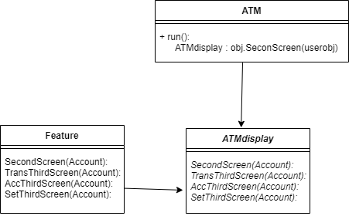
ATM CLASS
CONSISTS OF:-
Constructor
run() method
The object of the ATM class is created in main.The program flow goes to the execution of the run() method of this class from main.with three main functionalities.The constructor of this class accepts as parameter the objects of the classes Display,Validation and Feature.The run() method displays the initial display screen and transfers checks if the credentials entered by the user is correct or not.

Slide 9
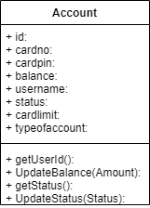
Account class
CONSISTS OF:-
Constructor
getUserId(self)
getStatus(self):
updateBalance(self, amount)
updateStatus(self, status):
The Account class initialises id,cardno,cardpin,balance,username,status,cardlimit,typeofaccount.
getUserId(self) returns the id of the user.
getStatus(self) returns the status of the card i.e whether card is active or block.
updateBalance(self,amount) sets the balance field to the amount
updateStatus(self,status) sets the status of the card.

Slide 10
Display class
CONSISTS OF:-
FirstScreen(self)
The Display class encompasses the function FirstScreen() that display the initial screen.

Slide 11

Validation class
CONSISTS OF:-
Check(self,cardno,Pass)
getDetails(self,cardno)
The Validation class validates the cardno and password entered by the user with the help of function
check(self,cardno,Pass).The details corresponding to the corresponding userid are retrieved through function
getDetails(self,cardno)

Slide 12
ATMdisplay class
CONSISTS OF:-
SecondScreen(self,userobj)
TransThirdScreen(self,userobj)
AccThirdScreen(self,userobj)
SetThirdScreen(self,userobj)
Abstract class which Feature class extends this follow OCP principle as when changes is to be done new class will extend the Abstract class and no new changes has to be in the Atm class.

Slide 13
Feature class
The Feature class extends ATMdisplay class and contains implementation of functions for display of user choice screen.
CONSISTS OF:-
SecondScreen(self,userobj)
TransThirdScreen(self,userobj)
AccThirdScreen(self,userobj)
SetThirdScreen(self,userobj)

Slide 14
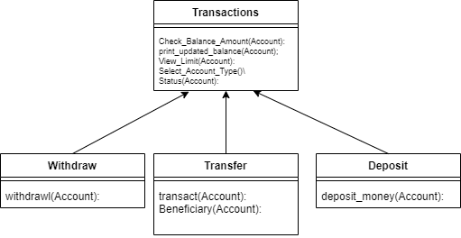
Transaction class
CONSISTS OF:-
Check_Balance_Amount(self,userobj,Account_type)
print_updated_balance(self,userobj)
View_Limit(self,userobj,Account_type)
Select_Account_Type(self)
Status(self,userobj)
The Transaction class contains functions related to transactions.The classes withdraw ,deposit, Transfer_money extend from the Transaction class and contains functionalities which can be extended by all these three classes.

Slide 15
withdraw class
CONSISTS OF:-
withdrawl(self,userobj)
The withdraw class extends from Transaction class and hence the functions in the transaction class are actually inherited.It implements a function withdrawl(self,userobj) which contains code for withdrawing money from a card.

Slide 16
Deposit class
CONSISTS OF:-
deposit_money(self,userobj)
The Deposit class extends from Transactions class and hence every its function but apart from that it has a specialized function deposit_money(self,userobj).

Slide 17
Transfer_money class
CONSISTS OF:-
Beneficiary(self,userobj)
transact(self,userobj)
The Transfer_money is the child class of Transactions class and implements the functions Beneficiary(self,userobj) and transact(self,userobj) of its own.The class deals with functionalities related to transferring money to a different account.

Slide 18
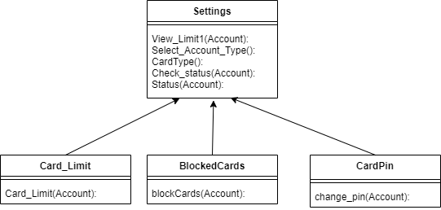
Settings class
CONSISTS OF:-
View_Limit1(self,userobj)
Select_Account_Type(self)
CardType(self)
Check_status(self,userobj)
Status(self,userobj)
The Settings class deals with functions related to changing the setings of the card,This acts as the base class for classes CardLimit,BlockedCards,CardPin.

Slide 19
CardLimit class
CONSISTS OF:-
set_card_limit(self,userobj)
The CardLimit class extends from the Settings class.It has a function set_card_limit(self,userobj) to set a limit on the card

Slide 20
BlockedCards class
CONSISTS OF:-
blockCards(self,userobj)
The BlockedCards class extends from Settings class and implements a specialized function blockCards() which implements the functionality of blocking the cards specified.

Slide 21
CardPin class
CONSISTS OF:-
changepin(self,userobj)
The CardPin class extends from the Settings class and has access to all the functions of the Settings class.The changepin(self,userobj) function of the CardPin class has implementation to change the pin

Slide 22
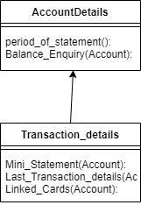
AccountDetails class
CONSISTS OF:-
period_of_statement(self)
Balance(self,userobj)
The AccountDetails class is the base class for Transaction_details class.It implements functions period_of_statement(self) and Balance(self,userobj)

Slide 23
Transaction_details class
CONSISTS OF:-
Mini_Statement(self,userobj)
Last_transaction_detail(self,userobj)
Linked_Cards(self,userobj)
The Transaction_details class extends from Account_details class and has specialised functionality Mini_Statement(self,userobj) which prints the mini statement for given dates.The function Last_transaction_detail(self,userobj)
Displays the details of the last transaction.

Slide 24
WHAT ROLE DOES SOLID PRINCIPLES HAVE TO PLAY??
SOLID is a mnemonic abbreviation for a set of design principles created for software development in object-oriented languages.When implemented properly it makes your code more extendable, logical and easier to read.The principles are:-
Single Responsibility Principle
Open Closed Principle
Liskov's Substitutability Principle
Interface Segregation Principle
Dependency Inversion Principle

Slide 25
WHAT ROLE DOES SOLID PRINCIPLES HAVE TO PLAY??
1.SINGLE RESPONSIBILITY PRINCIPLE:-The Single Responsibility Principle requires that a class should have only one job. So if a class has more than one responsibility, it becomes coupled.In our implementation we have made sure to incorporate the principle.
The classes that we have implemented have only one job to perform.We have used simple building blocks..To achieve SRP,we have used composition i.e compose different functions together so each of them just do one thing but their composition would do all the things we want.Single responsibility principle does not necessarily mean that the class should have only one function.
For example:-In our implementation the class withdraw() has only one responsibility i.e implementing the task of withdrawing money from the account.Hence this has only one reason to change and adheres to single responsibility principle.

Slide 26
WHAT ROLE DOES SOLID PRINCIPLES HAVE TO PLAY??
2.OPEN CLOSED PRINCIPLE:-The Open Close Principle states that the design and writing of the code should be done in a way that new functionality should be added with minimum changes in the existing code. The design should be done in a way to allow the adding of new functionality as new classes, keeping as much as possible existing code unchanged.Software entities should be open for extension and closed for modification.We have made sure to incorporate OCP principle because the classes that we have extended in our code makes no changes to the original functionality of the base class.OCP can be applied by using parameters and inheritance.We have used both approaches.There are no changes that needs to be done in the parent class.For example while extending Feature class from ATMdisplay class,we made no changes to the ATMdisplay class.

Slide 27
WHAT ROLE DOES SOLID PRINCIPLES HAVE TO PLAY??
3.LSP PRINCIPLE:-This principle suggests that “parent classes should be easily substituted with their child classes without blowing up the application”. If any module is using a Base class then the reference to that Base class can be replaced with a Derived class without affecting the functionality of the module.In order to implement an interface or inherit from a base class, we have to make sure that we fully implement it.Here we have made sure that there are no child classes which when substituted for child class would lead to crashing of the base class.While inheriting the child class is implemented fully.

Slide 28
WHAT ROLE DOES SOLID PRINCIPLES HAVE TO PLAY??
4.DEPENDENCY INVERSION PRINCIPLE:-This principle states that High-level modules should not depend on low-level modules. Both should depend on abstractions.Abstractions should not depend on details. Details (concrete implementations) should depend on abstractions.
In Python we have Abstract Base classes(ABC classes) in order to implement dependency inversion principle to the core.We have ATMdisplay as our abstract base class for Feature class.Here we can observe that abstarction does not depend upon the detail.

Slide 29
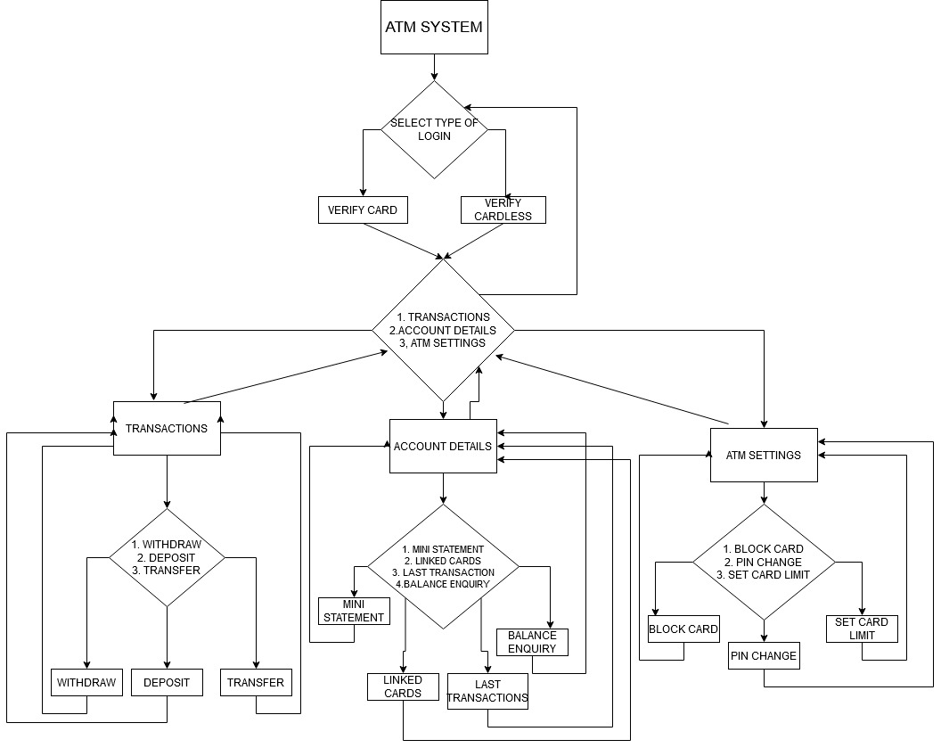
Code Flow:-

Slide 30
CONTRIBUTIONS:-
RAHUL GUPTA (MT20065)
FEATURES IMPLEMENTED:-
LOGIN via CARD
VALIDATION
WITHDRAW
DEPOSIT
TRANSFER
BLOCK CARD
KHUSHBOO BAJAJ (MT20060)
FEATURES IMPLEMENTED:-
MINI STATEMENT
BALANCE ENQUIRY
LAST TRANSACTION
LINKED CARDS
PIN CHANGE
CARD LIMIT
TESTING BY:-
KHUSHBOO BAJAJ (MT20060)
RAHUL GUPTA (MT20065)

