Slide 1
Sauce Demo Automation Framework
Selenium | Java | Maven | GitHub & Jira Integration|TestNG | Jenkins
Presented By: Khushboo Yadav
Email: ky7619429@gmail.com
Batch-3 (Java Selenium)
Superset ID: 3707628

Slide 2
Agenda
Project Overview
Tools & Technologies Used
Project Structure
Key Test Scenarios
Maven Setup
Selenium + TestNG Integration
Jira Integration
Jenkins CI/CD Pipeline
Demo & Output
Challenges & Solutions
Conclusion
Future Scope & Enhancements

Slide 3
Project Overview
Website Under Test: https://www.saucedemo.com
Objective: Automate end-to-end login and purchase flow
Why SauceDemo?
Simple & UI-driven test cases
Good for demonstrating automation framework design
Benefits:
Faster feedback through automation
CI/CD ready
Reusable and scalable codebase

Slide 4
Tools & Technologies
Tool / Technology | Version / Platform | Purpose / Usage in Project
Java | JDK 17 | Programming language for Selenium scripts
Selenium WebDriver | Latest | Web automation testing framework
TestNG | Latest | Testing framework with annotations and reports
Maven | Latest | Build, dependency management, and reporting
GitHub | Online platform | Version control and collaboration
Jenkins | Latest | CI/CD pipeline for automated build and test execution
JIRA (Zephyr Scale) | Cloud-based | Test management, test case creation, and execution tracking
Extent Reports | Latest | HTML report generation for test results
ChromeDriver | Latest | Browser driver for Chrome automation
API Token Authentication | Jira Cloud | Secure access to JIRA for automation

Slide 5
Project Structure
selenium-capstone-project/
│
├── pom.xml | testng.xml | config.properties
├── src/
│ ├── main/java/
│ │ ├── utils/ → DriverFactory.java
│ │ ├── pages/ → Page Objects
│ │ └── jira/ → JiraIntegration.java
│ └── test/java/
│ ├── steps/ → Step Definitions
│ └── tests/ → Test Cases
│ └── resources/features/ → Cucumber files
├── reports/ → Test outputs
├── jenkins/ → Build pipeline files
├── scripts/ → Automation helpers
├── zephyr/ → Jira configs
├── .gitignore
└── README.md

Slide 6
Test Cases Summary
• Login Tests (8) – Valid/invalid login, errors, navigation • Inventory Tests (6) – Product display, sorting, filters • Cart Tests (5) – Add/remove items, cart navigation • Checkout Tests (10) – Form validation, order process • Menu Tests (5) – Logout, reset, navigation links • UI Tests (6) – Page elements, footer, responsiveness

Slide 7
Test Execution
✔ Tests automated using Selenium WebDriver ✔ Structured using TestNG for better management ✔ Executed locally and through Jenkins pipeline ✔ Parallel and sequential execution supported ✔ Detailed logs and reports generated after each run ✔ HTML reports with pass/fail details and screenshots ✔ Jira/Zephyr integration for tracking test results ✔ Environment-specific configurations handled via properties file ✔ Easy debugging with error messages and screenshots ✔ Execution triggered on code push, scheduled builds, or manually ✔ Supports CI/CD process for faster delivery and feedback ✔ Enhances test reliability and reduces human error

Slide 8
GitHub Integration
🔗 Feature | 📋 Description | 📸 Image/Visual Suggestion
✅ Version Control | Central repository, tracks all changes and branches | GitHub logo with arrows showing commit history
✅ Collaboration | Teams can work from different locations seamlessly | People icons connected via cloud
✅ Automated Builds | Jenkins triggers build on code push to GitHub | Jenkins logo connecting to GitHub
✅ Secure Access | SSH keys or tokens for authentication | Lock icon with GitHub logo
✅ Issue Tracking | Link test reports to Jira or Zephyr | Jira/Zephyr logo with arrows linking to GitHub
✅ Continuous Integration | Fast feedback and test execution after push | Cloud with pipeline arrows connecting GitHub → Jenkins → Jira

Slide 9
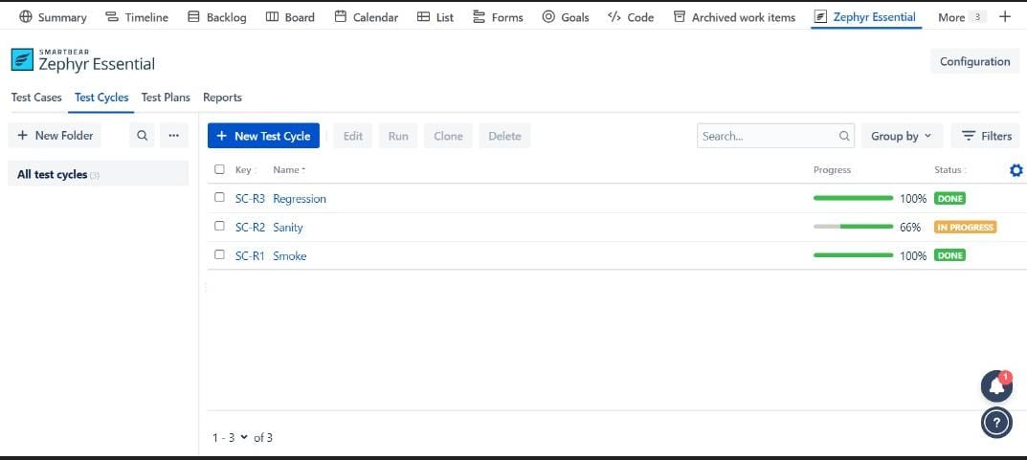
Jira Integration
Jira Dashboard: Project View
Use Story Creation Form
Linking Test to User Stories
Reporting a Bug with screenshot

Slide 10
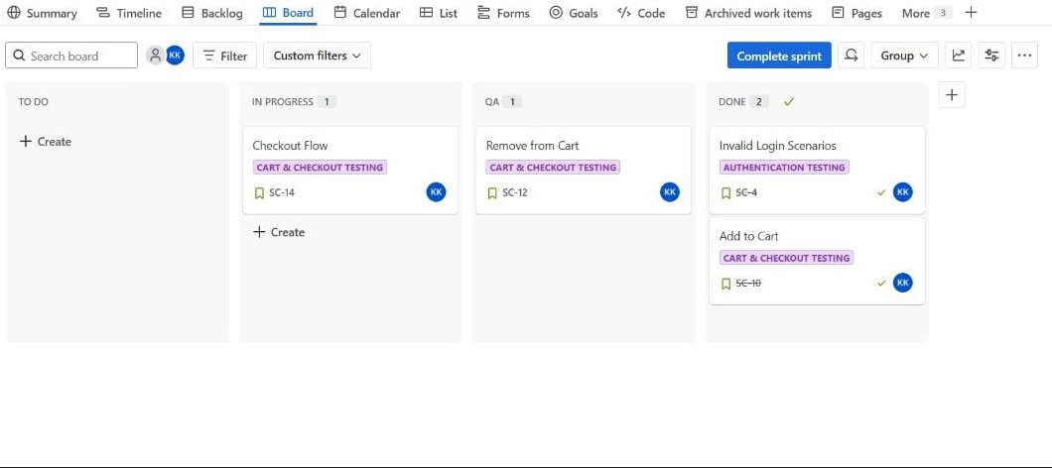
JIRA Board – Sprint Backlog & Task Tracking

Slide 11
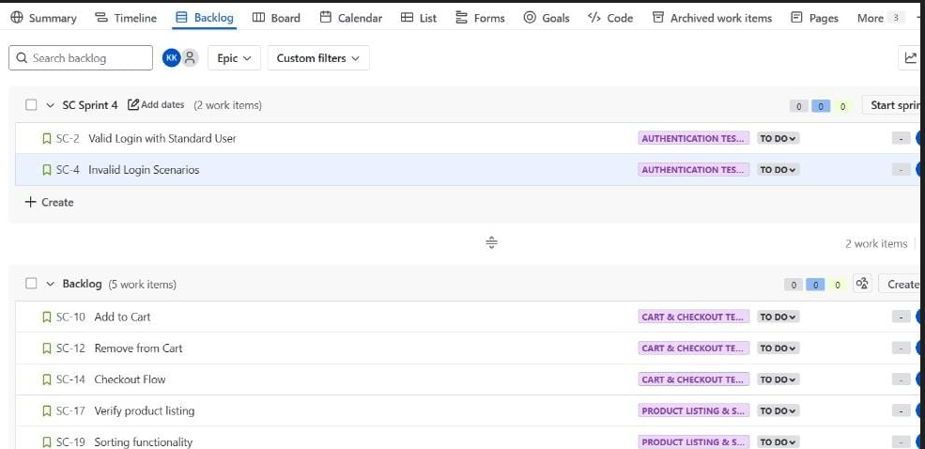
JIRA Integration – Backlog, Test Cases & Defects

Slide 12
Jenkins Setup
🔧 Step | 📋 Description | 📸 Image/Visual Suggestion
✅ Install Jenkins | Download and setup on server or local machine | Jenkins logo with download arrow
✅ Configure Plugins | Install Git, Maven, TestNG, etc. plugins | Plugin icon or gear symbol
✅ Add Credentials | Add GitHub, Jira API tokens securely | Lock icon with key and user avatar
✅ Create Job | Configure pipeline to pull from GitHub repo | Job icon with settings symbol
✅ Build Triggers | Set on push, schedule, or manually | Clock or push arrow icon
✅ Test Execution | Run Selenium tests via Maven or shell | Test icon with play button
✅ Reports & Logs | Generate HTML reports, view console logs | Report sheet icon with magnifier
✅ Integration | Link with Jira/Zephyr for test tracking | Jira logo connected with Jenkins

Slide 13
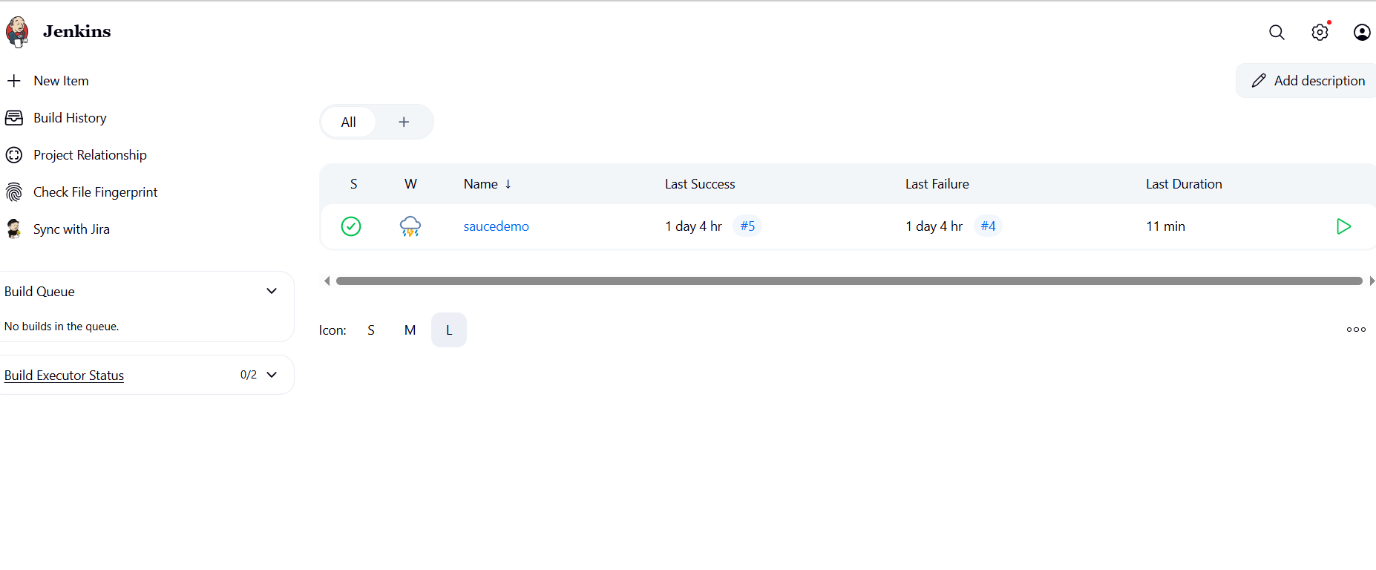
Output

Slide 14
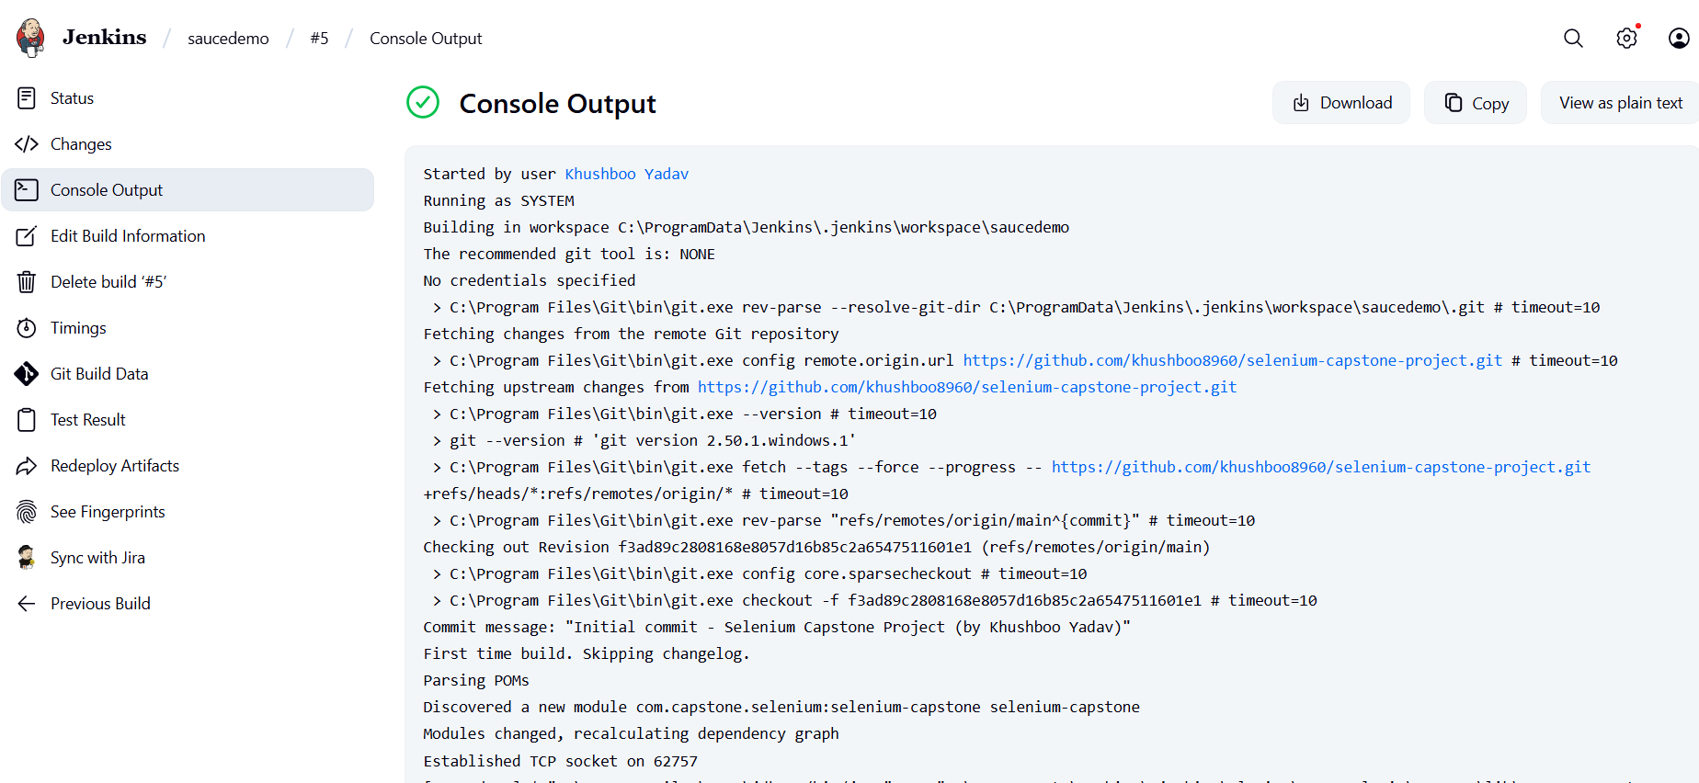
Jenkins Console Output

Slide 15
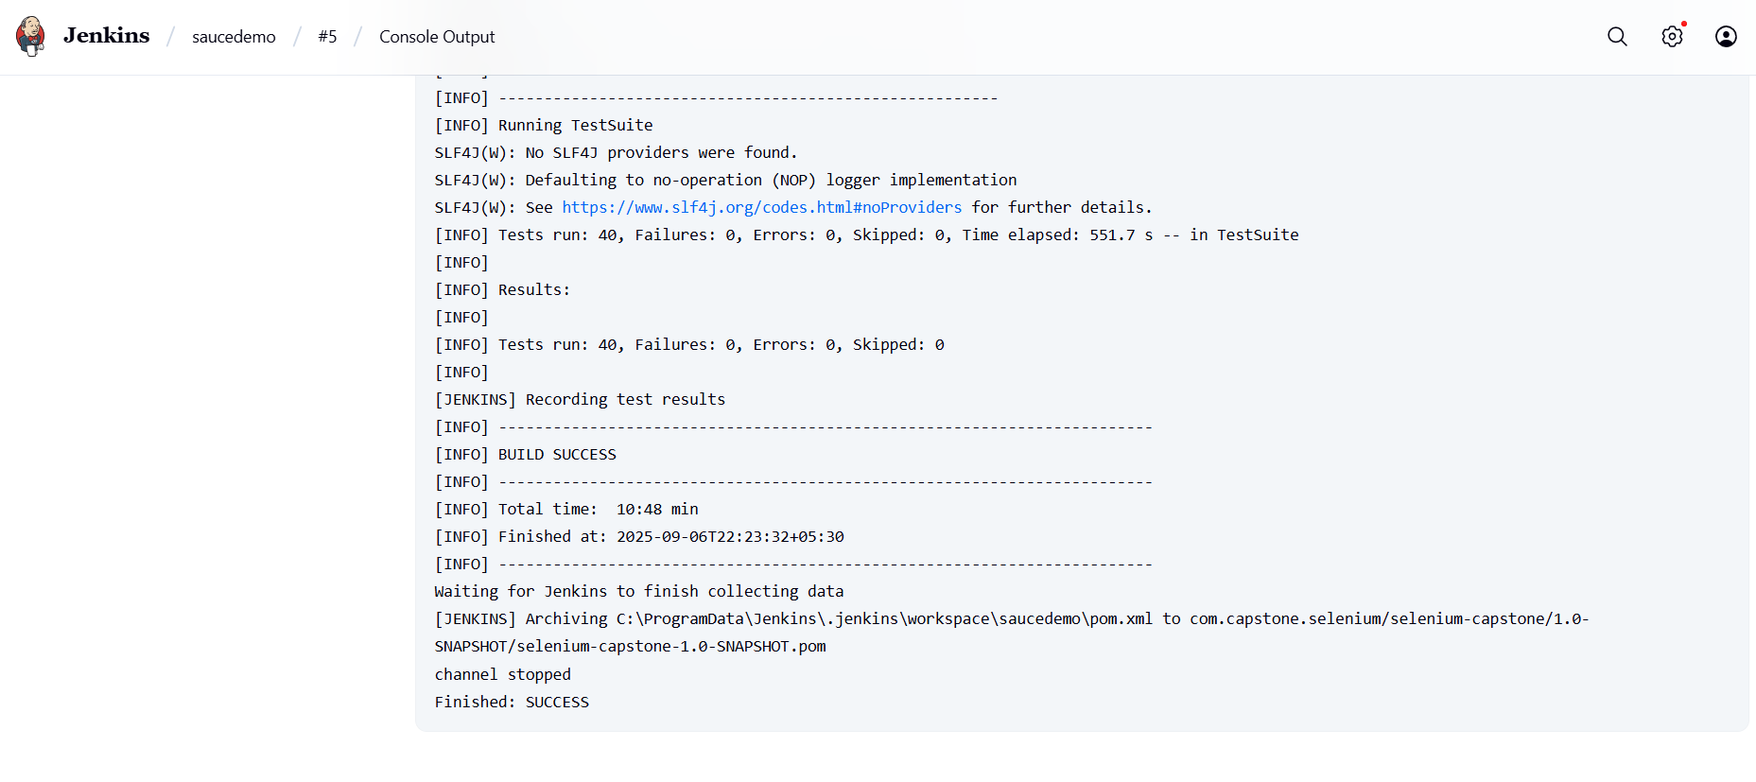
Jenkins Build History

Slide 16
Key Test Scenarios
1. Login:
Valid login, invalid credentials, locked-out user, blank fields, error message handling.
2. Inventory / Products:
Verify product display, sorting (name/price), add/remove items, cart badge updates.
3. Cart:
Navigate to cart, verify product details, continue shopping, empty cart.
4. Checkout:
Checkout with valid/invalid details, cancel button, overview verification, complete order, success message.
5. User Menu & Navigation:
Logout, About link, reset app state, menu options visibility.
6. UI & Pages:
Login page elements, footer links, back button after logout, title/logo consistency.

Slide 17
Maven Setup(pom.xml)
Selenium WebDriver: Browser automation
TestNG: Test framework
Cucumber: BDD scenarios
ExtentReports: HTML test reports
Apache POI: Excel data handling
WebDriverManager: Automatic driver setup
SLF4J: Logging support
Maven Surefire Plugin: Runs TestNG suite (testng.xml)

Slide 18
Jenkins CI/CD Pipeline
1. Code pushed to GitHub repository
2. Jenkins polls for changes or triggers on commit
3. Builds project using Maven goals: clean test
4. Executes Selenium + TestNG automation scripts
5. Generates reports (ExtentReports, logs, screenshots)
6. Publishes test results and sends notifications

Slide 19
Challenges & Solutions
🔥 Challenge | ✅ Solution
Dynamic web elements | Use explicit waits with conditions
Handling test data | Use Excel / Properties file inputs
Cross-browser compatibility | Configure drivers for Chrome & Firefox
Integration with Jira | Use API tokens and secure credentials
Generating reports | Integrate ExtentReports with TestNG
Automation failures | Capture screenshots for debugging
CI/CD interruptions | Setup proper pipeline triggers and error handling

Slide 20
Conclusion
✔ Successfully automated web application testing using Selenium and TestNG ✔ Integrated GitHub for version control and Jenkins for CI/CD pipelines ✔ Implemented BDD with Cucumber for better collaboration and readability ✔ Tracked requirements and bugs with Jira/Zephyr integration ✔ Generated detailed reports with screenshots using ExtentReports ✔ Framework is scalable, maintainable, and suitable for real-time projects

Slide 21
Future Enhancements
Planned Improvements:
Cross-browser & cross-platform testing with Selenium Grid
Integration with Docker & Kubernetes for scalable test execution
Implementing advanced reporting with Allure/Extent Reports
Adding API testing with RestAssured for backend validation
Expanding automation coverage for regression and performance testing

