Slide 1


Web App vapt
Report By: Khushboo Danidhariya (PRN No.:*********)
MSc. Information Technology
Semester-II
under the guidance of
Prof. Lavanya Sharma
Department of Computer Applications,
Faculty of Science,
The Maharaja Sayajirao University of Baroda,

Slide 2
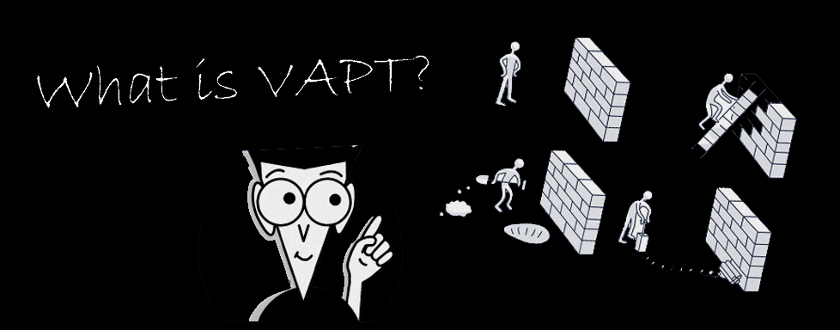
VA : Vulnerability assessment
Vulnerability assessments search for potential weak points in your security
PT : Penetration Testing
while Penetration testing identifies weaknesses and then attempts to exploit them.

Slide 3
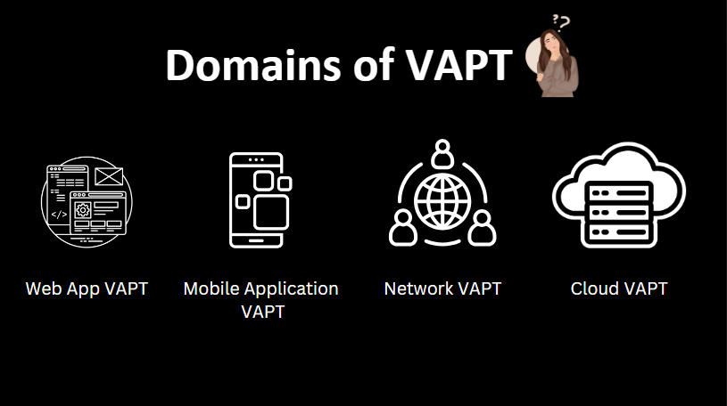

Slide 4
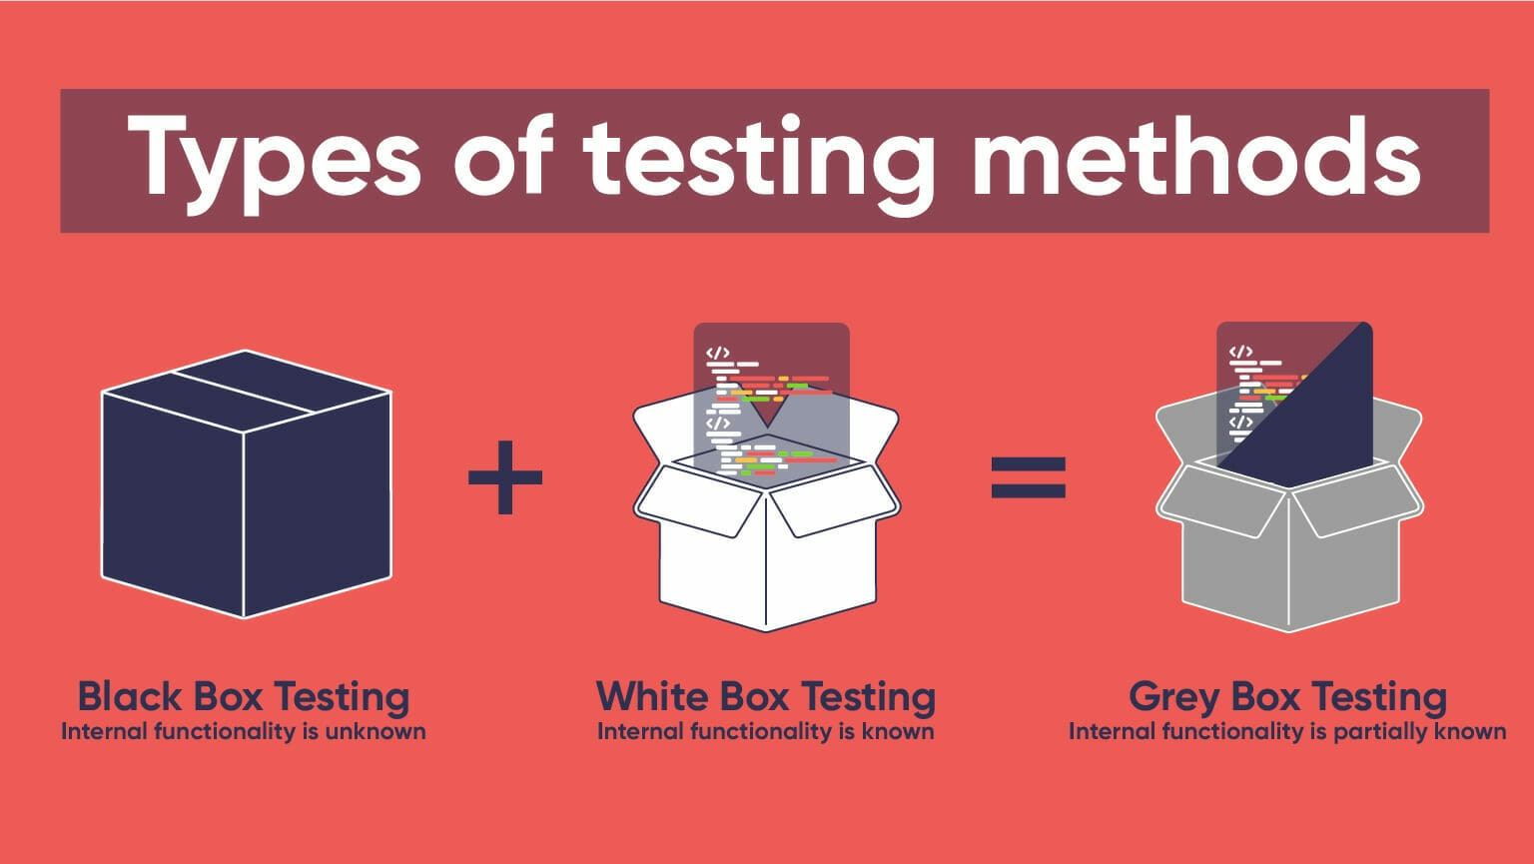
Type of testing
Black Box Testing : Testers have no prior knowledge of the target system. They attempt to simulate an external attack without inside information.
White Box Testing : Testers have complete knowledge of the target system, including source code and architecture. This type of test is often used for in-depth assessments.
Gray Box Testing : Testers have limited knowledge of the target system, simulating an attacker with partial information.

Slide 5
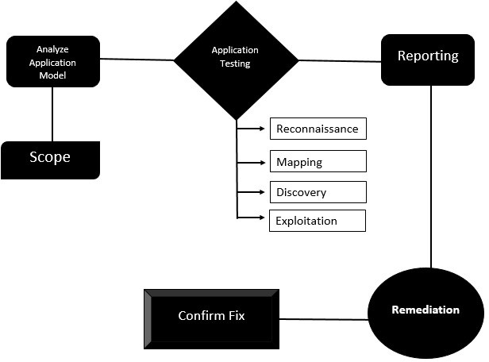
Life cycle of vapt
Sr. No. | Type of Asset | Host Name | IP Address
1 | Website | https://testfire.net | 65.61.137.117
2 | Website | https://www.mlsa.gov.mv/ | 172.67.174.237

Slide 6
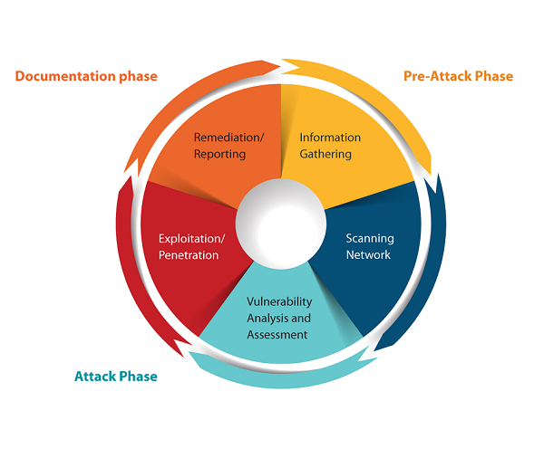
Steps of testing

Slide 7


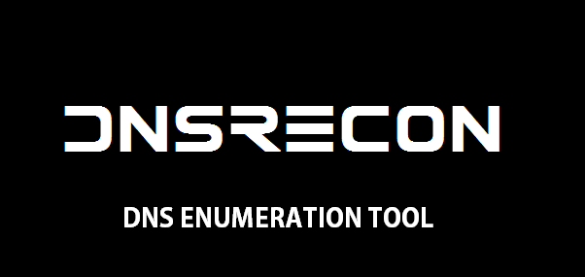



Tools used during testing
Wappalyzer : We have performed Wappalyzer scan on target to detect Backend Technologies.
ffuf : ffuf will give information about some open directory with some status code like 200,301,302,403.
Dnsrecon : Enumerate General DNS Records for a given Domain (MX, SOA, NS, A, AAAA, SPF and TXT).
Burp suit :Burp Suite is a software security application used for penetration testing of web applications. Both a free and a paid version of the software are available.
Nmap : Nmap Give information about Open Port And their server version also we got operating system and traceroute
Nessus : Nessus is one of the most widely used vulnerability assessment tools in the cybersecurity industry. It is developed and maintained by Tenable

Slide 8
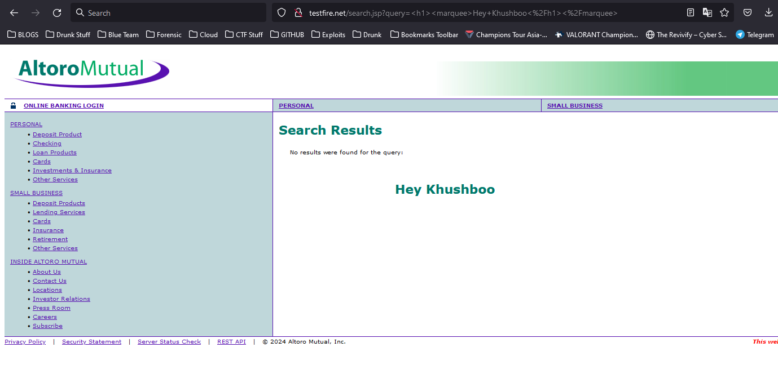
List of vulnerabilities for https://testfire.net
Vulnerability Name:
HTML Injection
Description
HTML Injection also known as Cross Site Scripting. It is a security vulnerability that allows an attacker to inject HTML code into web pages that are viewed by other users.

Slide 9
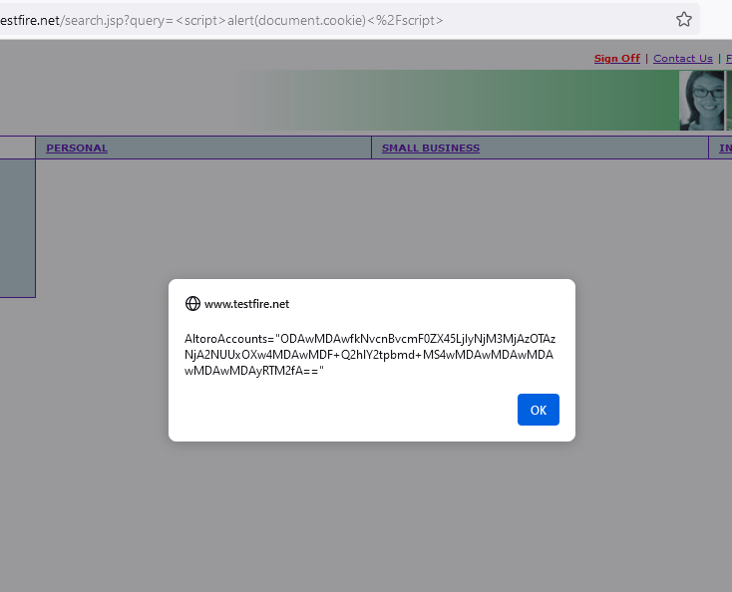
Vulnerability Name:
Cross site scripting
Description
Reflected cross-site scripting vulnerabilities arise when data is copied from a request and echoed into the application's immediate response in an unsafe way. An attacker can use the vulnerability to construct a request that, if issued by another application user, will cause JavaScript code supplied by the attacker to execute within the user's browser in the context of that user's session with the application.

Slide 10
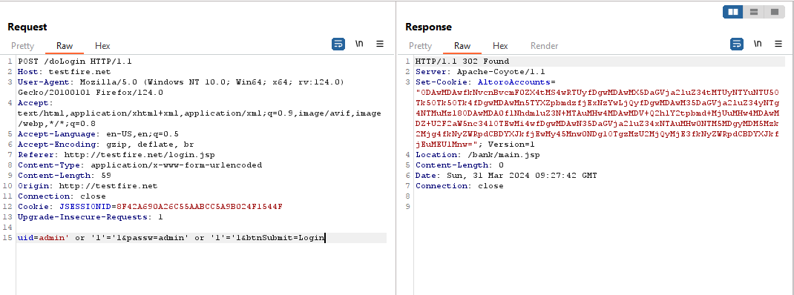
Vulnerability Name:
Sqli Authentication Bypass
Description
In SQLi authentication bypass attacks, attackers manipulate input fields such as username and password in login forms or authentication parameters in HTTP requests to inject SQL code. By carefully crafting malicious input, attackers can manipulate the SQL queries executed by the application to bypass authentication checks or alter their behavior.

Slide 11
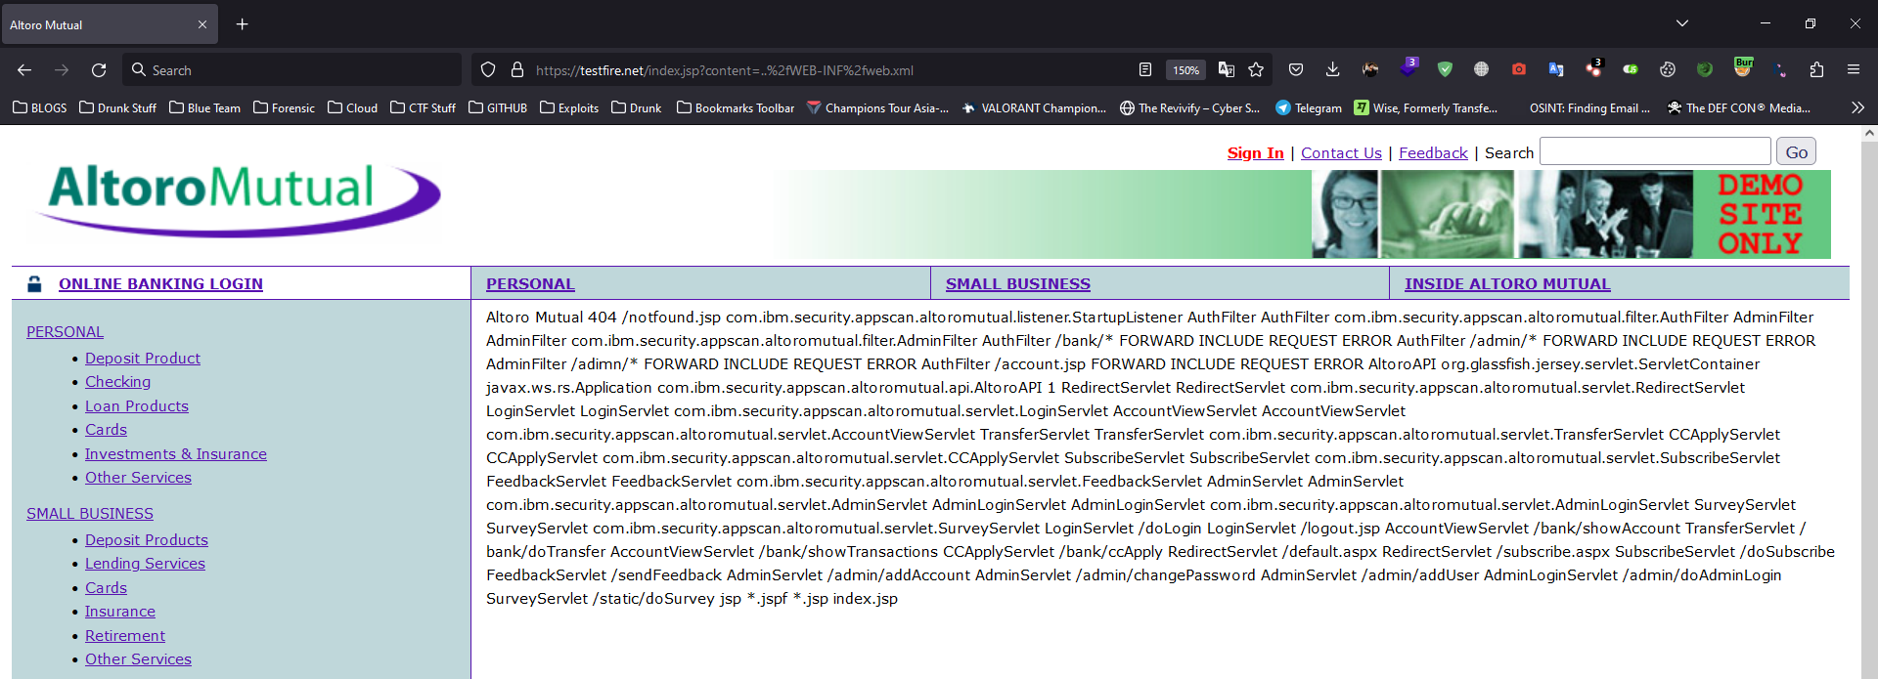
Vulnerability Name:
File Path Manipulation
Description
File path manipulation vulnerabilities arise when user-controllable data is placed into a file or URL path that is used on the server to access local resources, which may be within or outside the web root.

Slide 12
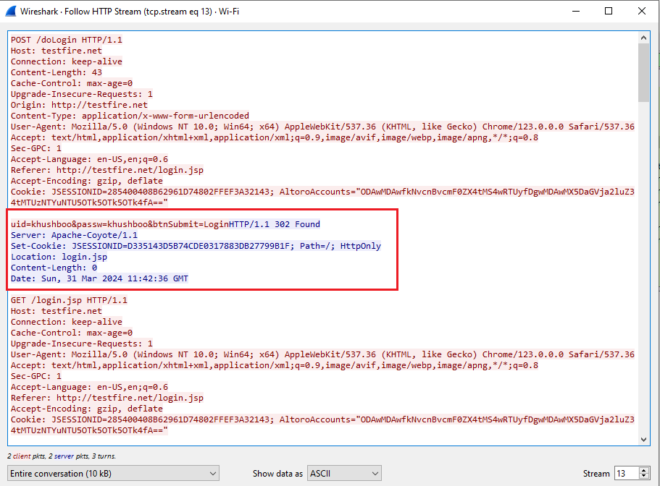
Vulnerability Name:
Security logging and monitoring
Description
Security logging and monitoring failures are security vulnerabilities that can occur when a system or application fails to log or monitor security events properly. This can allow attackers to gain unauthorized access to systems and data without detection transmits or stores confidential information.

Slide 13
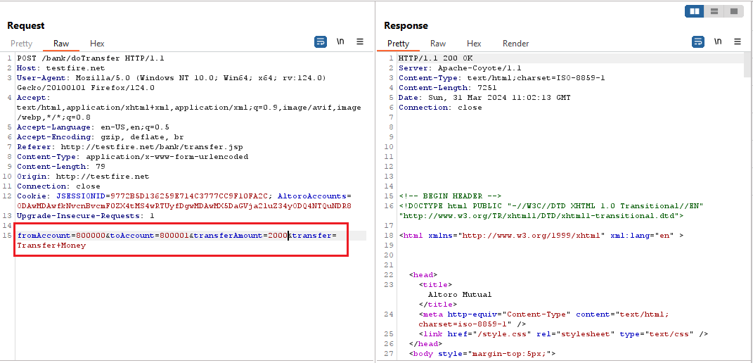
Vulnerability Name:
Insecure Direct Object Reference
Description
Insecure Direct Object Reference, a type of web application security vulnerability. IDOR occurs when an application uses user-supplied identifiers to access objects directly, such as database keys or file paths, without proper access controls. This can allow attackers to manipulate these identifiers and gain unauthorized access to sensitive data or perform unauthorized actions on the system.

Slide 14
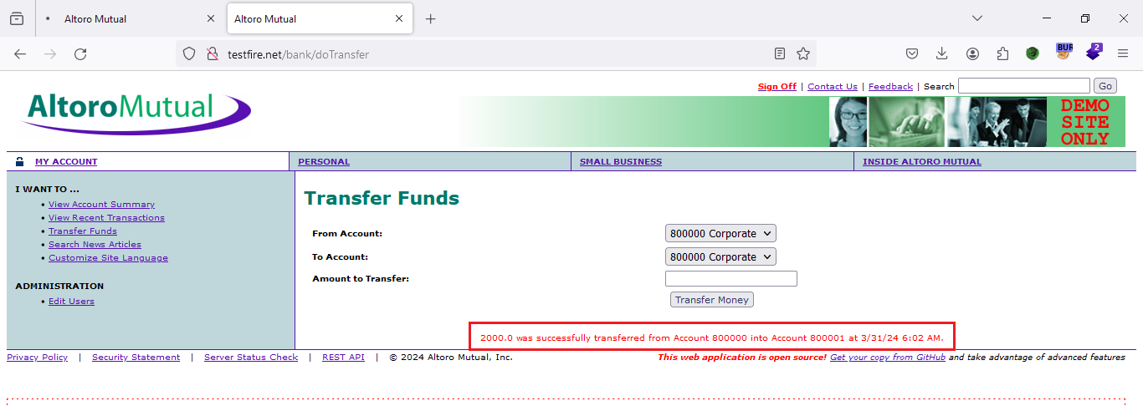
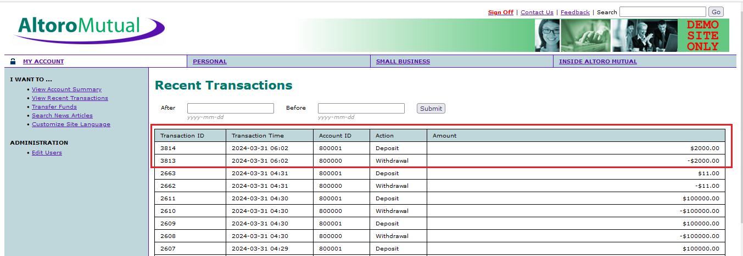

Slide 15
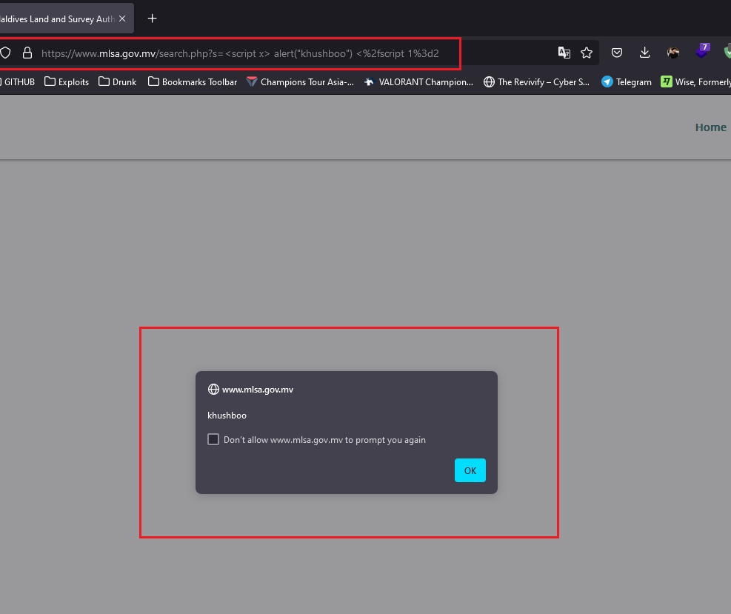
List of vulnerabilities for https://mlsa.gov.mv
Vulnerability Name:
Cross-site scripting (reflected)
Vulnerable URL
https://www.mlsa.gov.mv/search.php?s=%3Cscript%20x%3E%20alert(%22khushboo%22)%20%3C%2fscript%201%3d2
Description
Reflected cross-site scripting vulnerabilities arise when data is copied from a request and echoed into the application's immediate response in an unsafe way. An attacker can use the vulnerability to construct a request that, if issued by another application user, will cause JavaScript code supplied by the attacker to execute within the user's browser in the context of that user's session with the application.

Slide 16
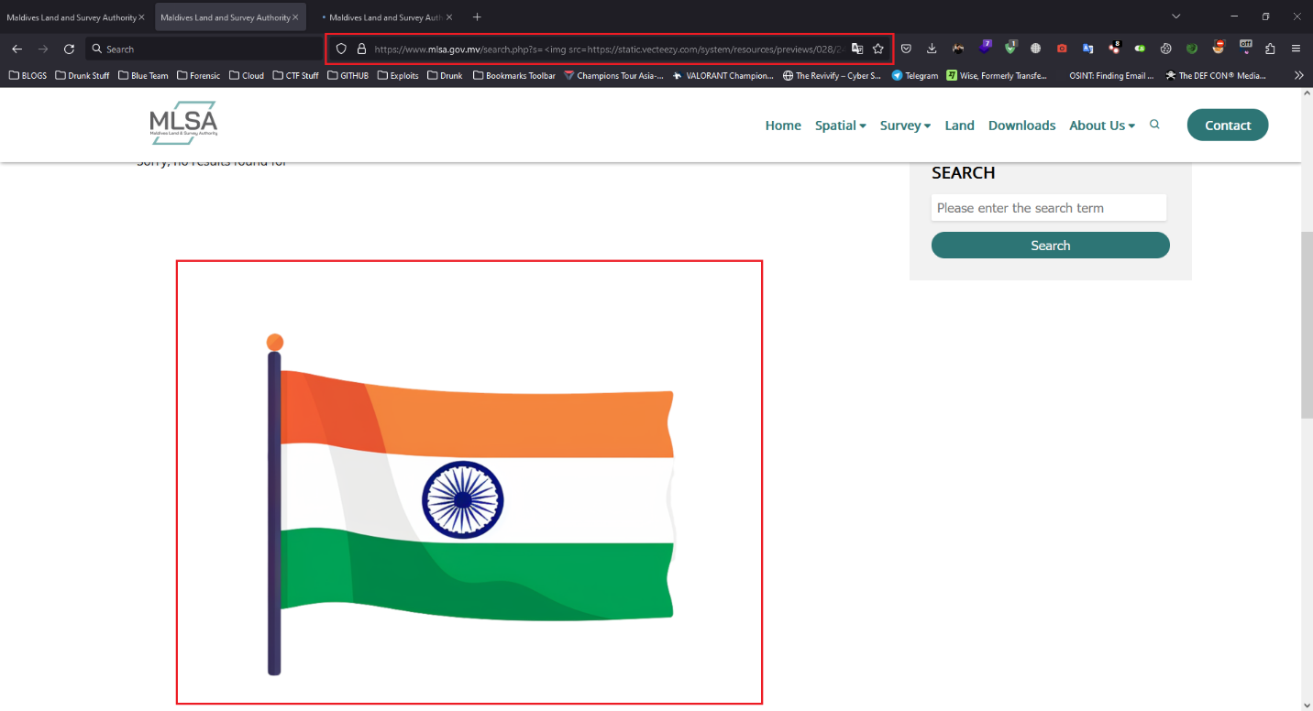
Vulnerability Name:
Cross-site scripting (reflected)
Vulnerable URL :
https://www.mlsa.gov.mv/search.php?s=%3Cimg%20src=https://static.vecteezy.com/system/resources/previews/028/245/503/non_2x/india-flag-logo-vector-free-ai-generated-free-png.png%3E

Slide 17
conclusion
The above-mentioned vulnerabilities were being tested and exploited by automated and manual methods for the verification of its severity by the approach of and Greybox testing.
All vulnerabilities mentioned above should be patched as soon as possible; suitable patches are provided with every vulnerability.

Slide 18
THANK YOU

