Slide 1
Tutorial Enhanced Control Dashboard

Slide 2
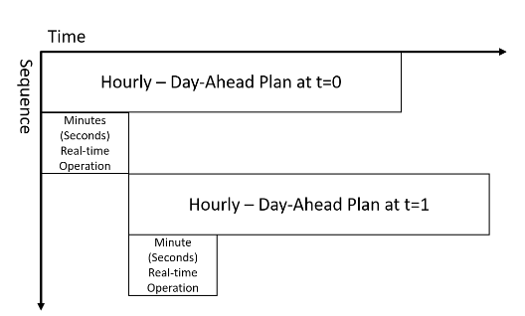
Ultimate Operation
t=hour 0
t=hour 1
t=hour 2

Slide 3
Complete Configuration Tab layout
System Configuration
Data
Use-cases
select
priority
_{Load Profile}
Start Time / End Time
Demand Charge Reduction
x
1
_{Energy Price}
Start Time / End Time
Power Factor Correction
v
2
_{ESS Data}
Arbitrage
3
Reserves Placement
4

Slide 4
User Inputting Data – Load Profile/Price
User tells start-time/end-time, number of days/months. (1 month)
User Uploads file with a specified data
Values (MW/($/MWh)), Timestamps (hourly)
We will check length → invalid if not equal to month, valid if it is
We will interpolate to 5 minutes data.
Values, Timestamp (5 minutes resolution)
We will check length → invalid if not equal to month, valid if it is
Implement a function which displays this every 5 minute rolling window of one hour

Slide 5
Complete Configuration Tab layout
ESS Data
Capacity (kWh)
Value
Power (kW)
Value
Inverter Rating
Value

Slide 6
Complete Configuration Tab layout
Demand Charge Reduction
Peak Charge
Value
Threshold
Value
x
x
Control Type
Optimization
Rule-based
Uncertainty Budget
Value

Slide 7
Complete Configuration Tab layout
Power Factor Correction
Load Power Factor
Value
Power Factor Limit
Value
x
x
Control Type
Optimization
Rule-based

Slide 8

Control Dashboard
Use Cases
Active Power
Active Power
Arbitrage
Reactive Power
Reactive Power
Demand Charge Reduction
Demand Shaping
ESS Power
Net Power
System Capacity
Frequency Regulation
Time (24 hour) Res
Spinning/Non-spinning Reserve
Power factor
Power Factor Correction
SoC
Revenue
Day Ahead Estimate
Update Load Forecast
Actual, Not Adjusted
Update Price Forecast
Time
Actual, Real Time Adjusted
8

Slide 9
Plotting
00:00 12:00 24:00
Update Price Forecast

