Slide 1
Tutorial Enhanced Control Dashboard

Slide 2
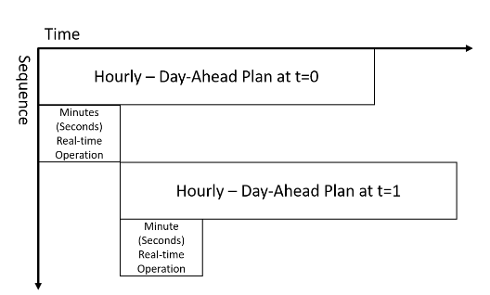
Ultimate Operation
t=hour 0
t=hour 1
t=hour 2

Slide 3
User Inputting Data
User tells start-time/end-time, number of days/months. (1 month)
User Uploads file with a specified data
Values, Timestamps (hourly)
We will check length → invalid if not equal to month, valid if it is
We will interpolate to 5 minutes data.
Values, Timestamp (5 minutes resolution)
We will check length → invalid if not equal to month, valid if it is
Implement a function which displays this every 5 minute rolling window of one hour

