Slide 1

Main Tab
Storage Enabled Flexibility: Submarine Cables
Life Model
Cable Loading
Temperature Rise Model
Load Cycle
Power
SoC
Energy Storage
ESS Power
Co-located Renewables
Time
Time
Life Extension Benefit
Manual ESS Profile
Life Without ESS
Optimize
Life With ESS
Investment Deferred
Run
Notes:
Notes:
Life Model: fit life model to reflect rated model temperature. Can also draw life model curve
Temperature Rise Model: fit equation and show rise in temperature vs cable life ??
Load Cycle: Input loading cycle
Energy Storage: efficiency input, efficiency output, solar profile
Co-Located Renewable: input solar Profile

Slide 2
Complete Configuration Tab layout
System Configuration
Cable Parameters
Include ESS
True
_{e0}
5
_{Cable Temperature}
Ideal
_{Ambient temperature}
20
Load Cable Data
File in the repo
t0
293
_{Load ESS Data}
File in the repo
_{alpha0}
5e15
_{Save Results}
Yes/No
beta
2
_{n0}
18.8

Slide 3
Configuration Tab – First Implementation
These values are specified in the system case config
System Configuration
{ "caseType": { "includeESS": true, "idealCableTemp": true }, "StartTime": "7/18/2017 00:00:00", "EndTime": "7/19/2017 00:00:00", "cable_power_path": "../../data/cable_loading_data.xlsx", "ess_data_path": "../../data/ess_power.xlsx", "save_results": true, "metadata": { "CaseType": "Defaults", "includeESS": "true=use ess power to offset cable power, false=don't use it", "idealCableTemp": "true=use ideal battery temperature, false=calculate based on current loadings", "cable_power_path": "path to the cable data", "ess_data_path": "path to the ess power data", "StartTime": "Start time for the simulation run in the form of YYYY-MM-DD HH:MM:SS", "EndTime": "End time for the simulation run in the form of YYYY-MM-DD HH:MM:SS"
Include ESS
True
_{Cable Temperature}
Ideal
Existing File
Load Cable Data
_{Load ESS Data}
Existing
_{Save Results}
Yes
All entries are fixed, i.e. they are taken from default values once the tab is loaded up

Slide 4
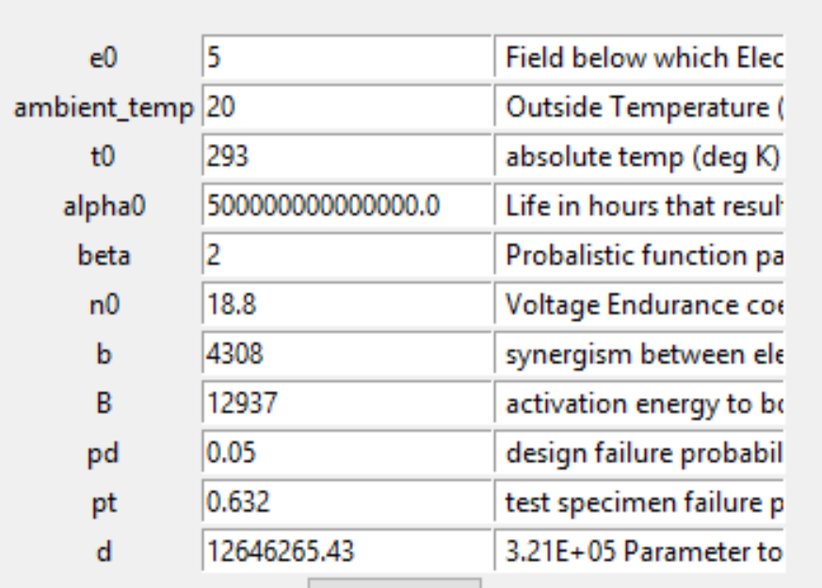
Configuration Tab – First Implementation
Cable Model Inputs
_{e0}
5
_{Ambient temperature}
20
Something like this
t0
293
_{alpha0}
5e15
beta
2
_{n0}
18.8
These values are defined in __init__
In cable_estimation_class

Slide 5
Configuration Tab – Ultimate Implementation
System Configuration
User select Cable data
User select ESS file
Include ESS
False
ESS Data File
_{Cable Temperature}
Ideal
Load Cable Data
Any file
_{Save Results}
Yes
Display Cable data loaded and report error if there is any issue
Include ESS changes to True
Else it’s false
Include ESS becomes automatically true once load ESS Data file is loaded
Cable load data value change once it is loaded
Save results can be turned on/off
Cable temperature can be ideal or not ideal

Slide 6
Configuration Tab – Ultimate Implementation
Cable Model Inputs
_{e0}
5
_{Ambient temperature}
20
t0
293
_{alpha0}
5e15
beta
2
_{n0}
18.8
Range of values for “certain” parameters which users can input like a dropdown list
I will check with Jan to ask which inputs can be changed

Slide 7
Cable Life estimation Procedure
Configuration (ESS Power or not)
Configuration (ideal/non ideal temperature)
get_cable_loading_data(args)
Calculate cable current
get_cable_temperature(args)
Calculate cable temperature
Cable current
Cable temperature
Remaining Life
get_cable_coefficients(args)
calculate life coefficients

Slide 8
Life Model Button
Range of temperature, keeping ideal temperature flag e.g. [Ideal temperature – 70K, ideal temperature + 70K]
Remaining Life = f(Temperature)
get_cable_coefficients(args)
calculate life coefficients

