Slide 1

Evidently AI
Machine Learning Model Monitoring
12th Aug 2022
1

Slide 2
AGENDA
What is Evidently AI ?
Evidently Capabilities
Evidently Features
Implementation & Demo
Integration
Observation & Conclusion
Evidently vs Competitors

Slide 3
What is Evidently AI ?
Evidently is an open-source Python library for data scientists and ML engineers. It helps evaluate, test and monitor the performance of ML models from validation to production.
Evidently AI - Open-Source Machine Learning Monitoring

Slide 4
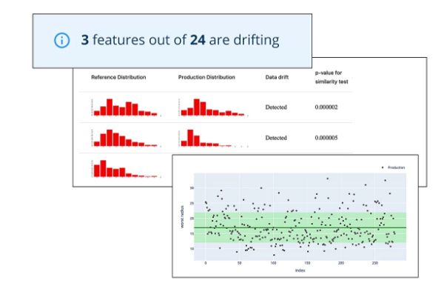
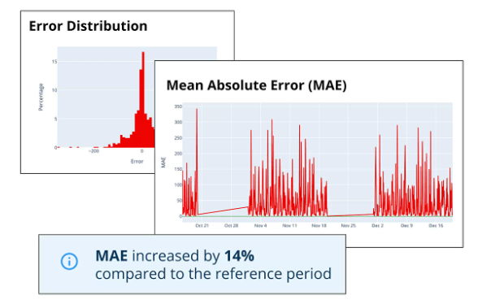
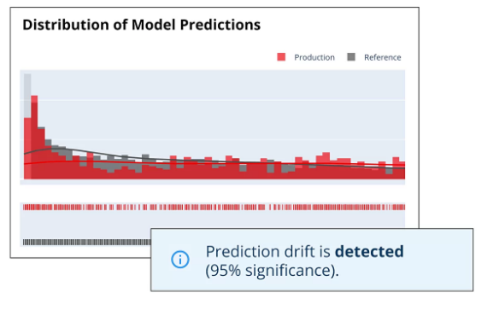
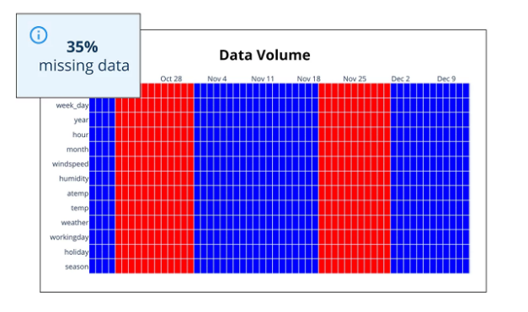
Evidently Capabilities
Model Quality​
Data Drift​
Target Drift​
Data Quality

Slide 5
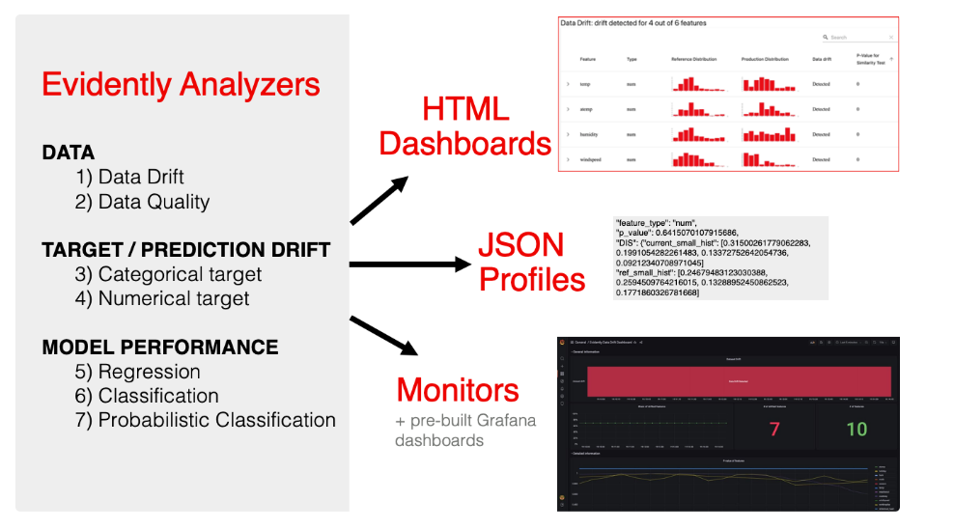

Slide 6
Demo

Slide 7
ML Pipeline Tools Integration

Slide 8
ML Pipeline Tools Integration
Evidently comes with pre-built reports for Data drift, Target drift and Model Performance
Evidently can be integrated with other tools to fit to existing workflows
MLflow Integration to track Model performance
Airflow Integration to generate JSON profiles or HTML reports
Grafana for real-time ML Monitoring

Slide 9
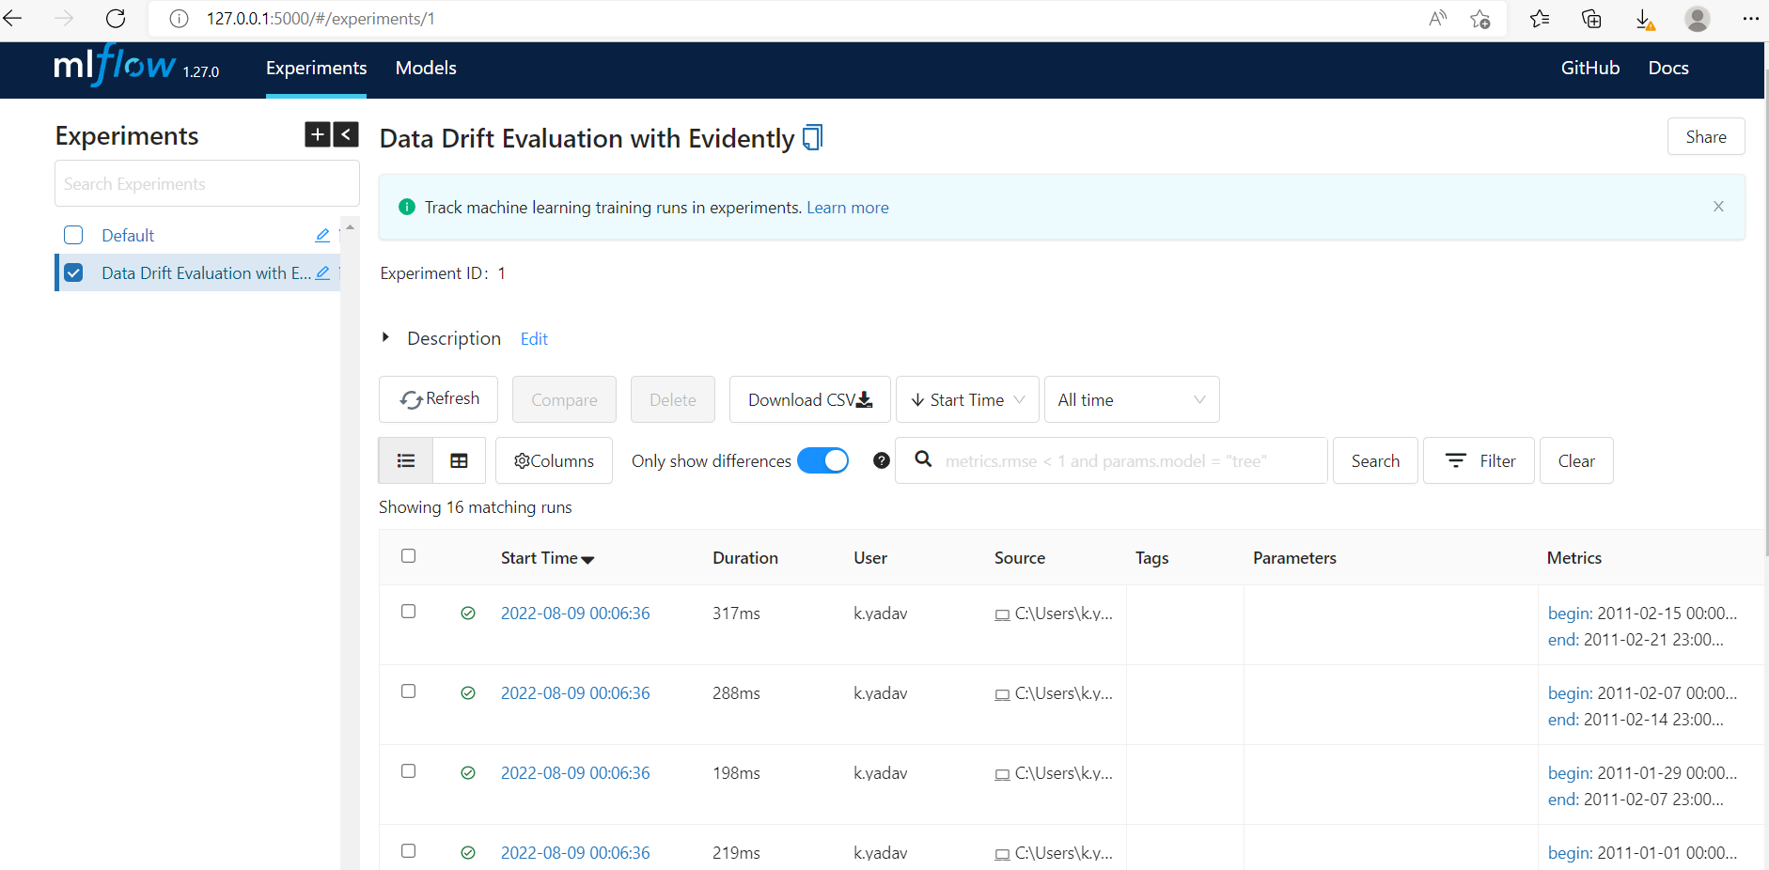
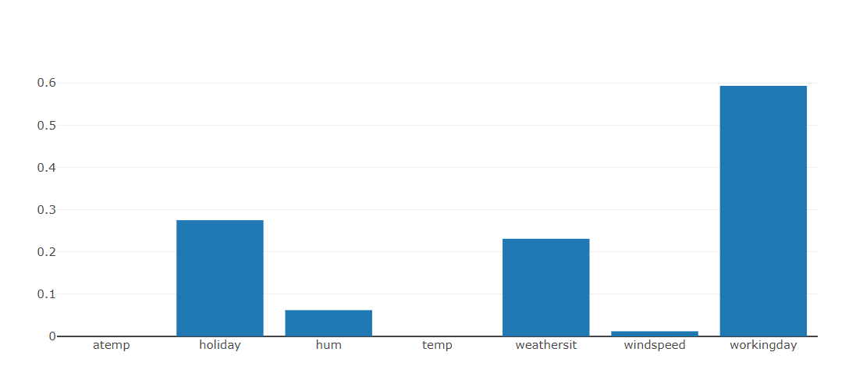
MLflow Integration
MLflow with Evidently to track the performance of models.
In this case, Evidently is used to calculate the metrics and MLflow to log the results.
These Metrics can be accessed from MLflow interface.
Evidently calculates a rich set of metrics and statistical tests.
You can choose any of the pre-built reports to define the metrics you’d want to get
Data Drift Evaluation with EvidentlyRun

Slide 10
Airflow Integration
Airflow integration to generate JSON profiles or HTML reports and as a step in the Airflow DAG.
Common batch monitoring needs as DAGs.
Generate model performance reports as a batch job
Run a report every time new data arrives and store in File System
Generate visual performance reports on defined conditions
Run a data drift check
If the drift is not detected, log the output
If the drift is detected, generate and store a visual HTML report

Slide 11
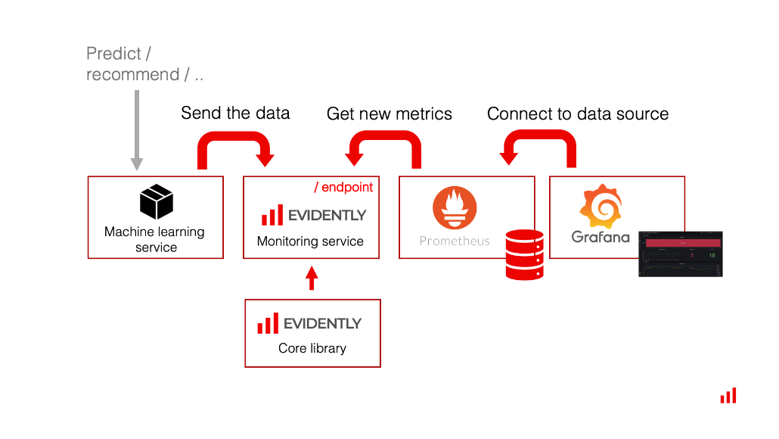
Real-time ML Monitoring using Grafana
Grafana is an open-source data visualization platform and is paired frequently with Prometheus (Time Series DB) to monitor software system performance.
In this case, Evidently provides a metrics calculation layer,
Prometheus is used to store the metrics, and Grafana is used to display the dashboards and manage alerts.

Slide 12
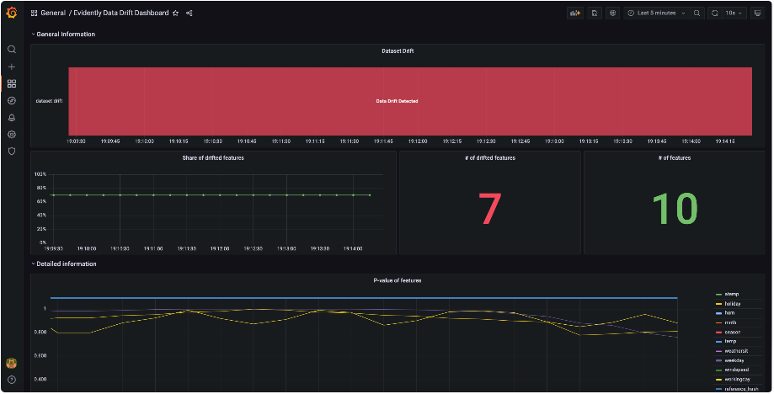
Data Drift Dashboard using Grafana

Slide 13
Evidently vs Competitors
CRITERIA​ | EVIDENTLY AI​ | SELDON CORE​
Open Source​ | Yes​ | Yes, the product is free​ but they launched consulting services and an enterprise edition.
Monitoring functionalities/Capabilities​ | Input data drift,​ Model output ( target drift), ​Model and data quality​ | Alibi comes with pre -made detectors:- ​ Outlier detectors, ​ Drift detectors,​ Adversarial detectors​
Data Types​ | Tabular Data (Numerical & Categorical)​ | Tabular, Images, Time Series, Graphs.​
Compatibility​ | Yes , Its Platform -agnostic (no framework dependency) , Evidently aims to work anywhere​ | It's not platform-agnostic; Alibi is designed to be used together with Seldon Core​

Slide 14
Conclusion
Evidently aims to provide a solid approach to monitoring that works on any platform, and that's a more ambitious goal.
Although it lacks some features, it has some fundamental capabilities, and we think it will swiftly catch up in terms of features.
Evidently works well with numerical and categorical data tabular data.
Evidently is a terrific all-around option because it is a versatile general-purpose solution that operates anywhere. It doesn’t get into the way !!

Slide 15
Thank You

