Slide 1

Care4U
INFO 5100 | Course - AED | Dr. (Prof.) Kal Bugrara | Northeastern University | Spring 2021
Team : Care4u
Khushbu Thakur,
Kunal Upadhyay,
Vivekkumar Singh

Slide 2

Problem Statement
The COVID-19 ('Coronavirus') pandemic led several countries to take lockdown measures
Stuck at home?
Looking for medical help without the risk of going to the hospital?
How about bringing the hospital to you?

Slide 3
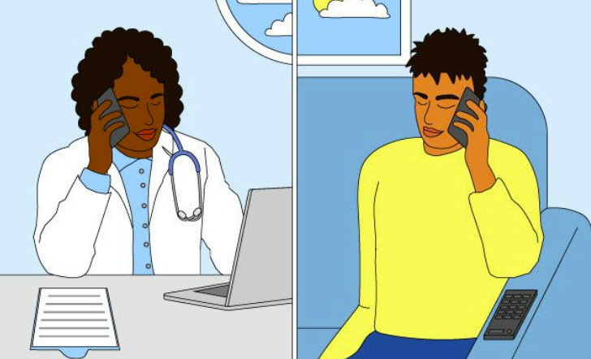
Objective
Our aim is to create a software that can provide access to the medical services without the risk of going to a hospital
User can seek medical help from their home
keeping the medical personnel and patients safe in the pandemic

Slide 4
Care4U:
order medicines
book fitness sessions for a healthy lifestyle
book an emergency ambulance service from our list of services.
consult a doctor

Slide 5
Implementation:
used the Advance java feature jcalendar
used the Advance java feature javax.mail to send email alerts
used java swing panels to build the UI

Slide 6
Work Requests: Customer
A customer can place order from a shop for medicines
Customer can directly reach out to doctor for consultation
Customer can directly book a session at fitness centers
Can request an ambulance service

Slide 7
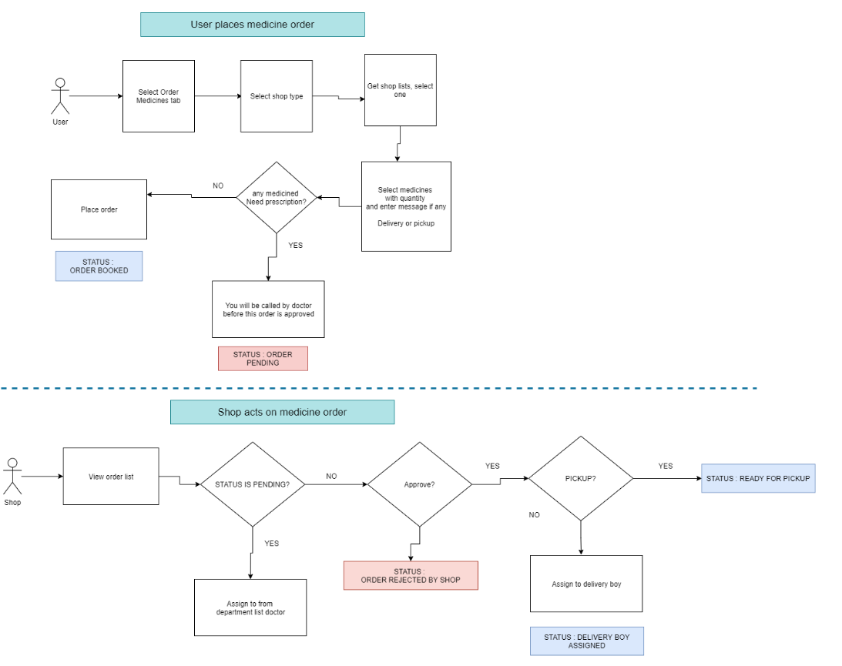
Order Medicine:

Slide 8
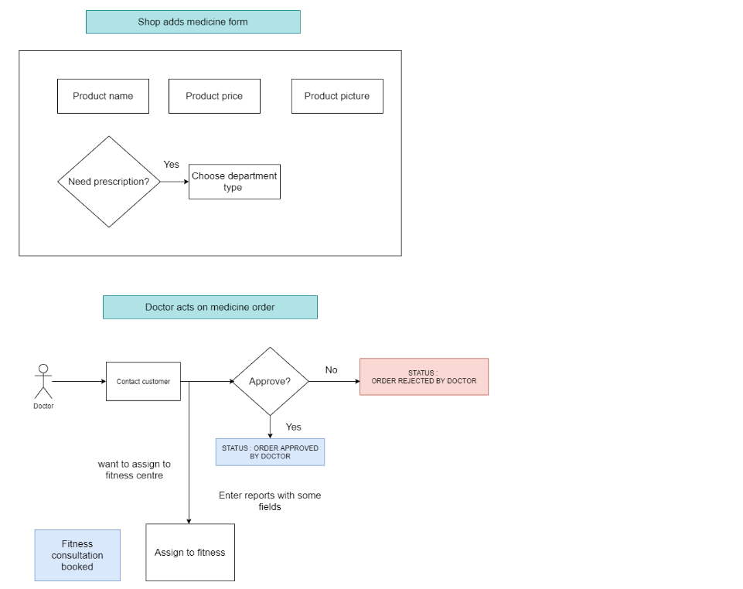
Order Medicine:

Slide 9
Work Requests: Shop
A shop can process or remove the request
Shop can rout the order to doctor for prescription
Shop can assign orders to delivery man

Slide 10
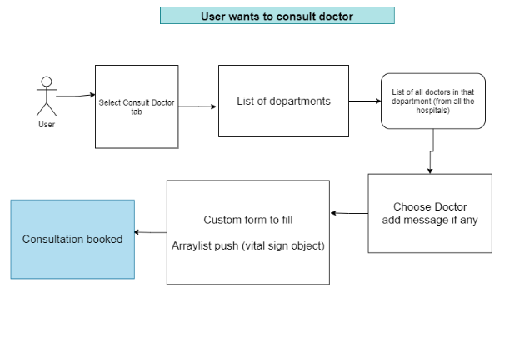
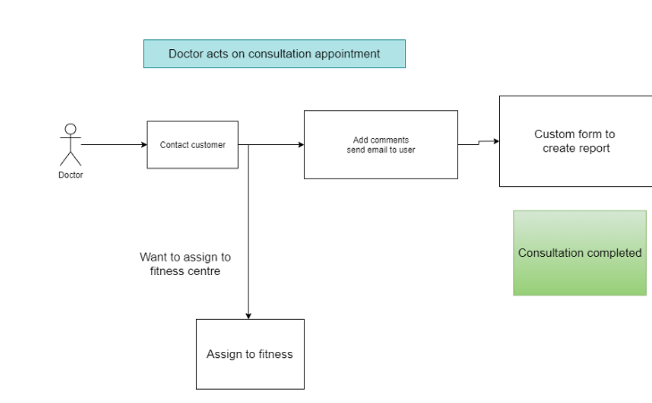
Doctor:

Slide 11
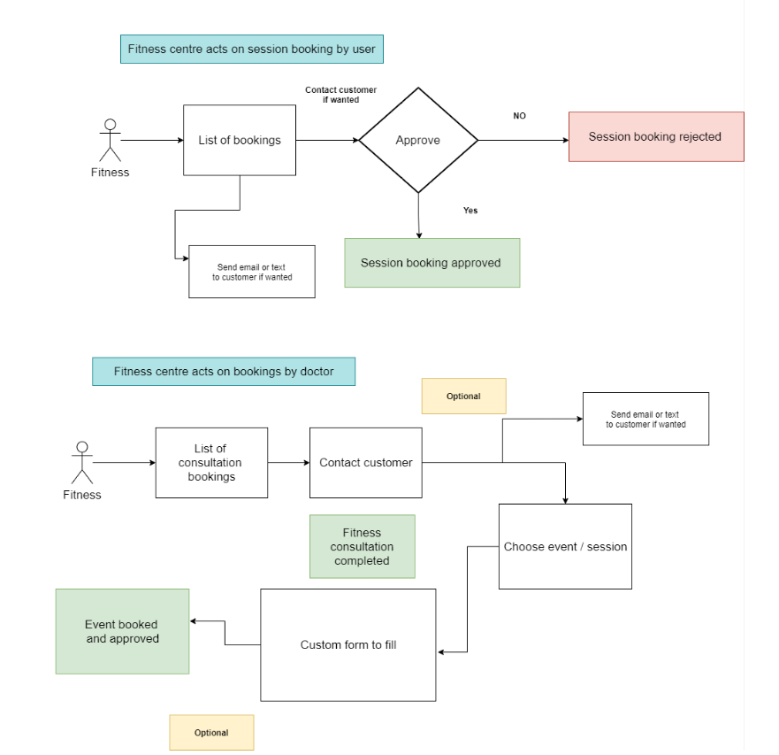
Fitness Center:

Slide 12
Thank You!

