Slide 1
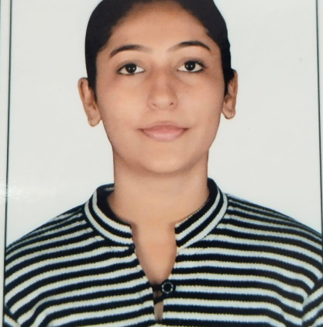
KHUSHBU JETHWANI
Bachelor of Technology (ECE) : 2018 to 2022
Senior Analyst/Software Engineer
Skills
Java 8 /J2EE | Basics, OOPS, Exception Handling ,Arrays ,Collection and Generics, lambda exp, Stream API, Junit, Mockito
Spring core | IOC & Dependency Injection, Autowire
Spring REST/Spring Cloud/Spring Boot Microservices C/C++/DSA Machine Learning | REST controllers, Implementation of GET, POST, PUT & DELETE, Exception Handling, Testing Services, Controller & Repository layer. Certification on C,C++,Data Structure and Algorithms. Certification on Machine Learning with various Projects.
Database | MongoDB No SqlBasics My SQL RDS Basics
Tools | GIT, Postman
UI Technology | HTML5 ,CSS
Add On Skills | Communication Skill, Team management, Peer learning
Bangalore
khushbu.jethwani@capgemini.com
+91 8949466076
A5
A motivated, adaptable, organized and self-driven learner and always ready to contribute while gaining new skills and learning new tools.
A team player with good communication skills.
Intermediate level knowledge of JAVA and upskilling day by day
Java Microservice Development knowledge using Spring boot and spring cloud framework on a beginner level.
Communication Skill, Team management, Peer learning
Aws Cloud practitioner certificate
Learned implementation of microservice architecture using Java and Spring Cloud
Did RND on various Frameworks and libraries of spring to find better solutions for building microservices.
Experience in creating projects with the Machine Learning Technology using various Libraries of Python.

