Slide 1
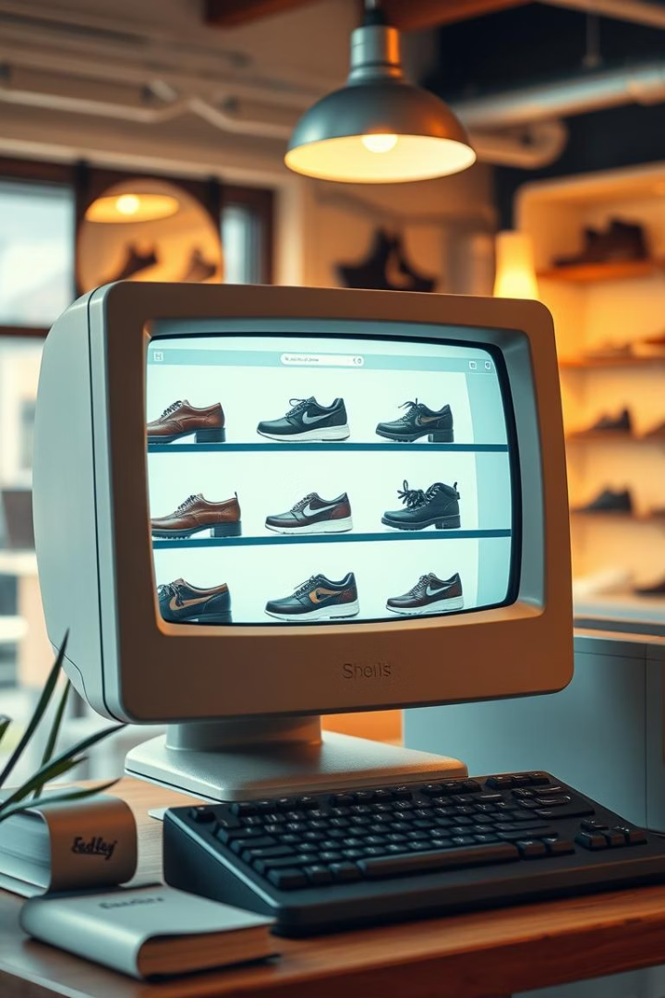
How Zappos Started: A Customer-First Revolution
Two friends, Nick Swinmurn and Tony Hsieh, founded Zappos in 1999.
Initially named ShoeSite.com, they aimed to make shoe buying easy online.
Started with $300K investment, focusing on wide selection and convenience.

Slide 2

Overcoming Early Challenges
Low Sales
Brand Partnerships
Struggled with minimal revenue in initial years
Difficult to convince major shoe brands to collaborate
Customer Focus
Committed to user experience despite obstacles

Slide 3
The Turning Point: Customer Obsession
Free Shipping
365-Day Returns
Friendly Support
Rapid Growth
Removed cost barriers to buying shoes
Generous return policy boosted buyer confidence
Exceptional service created strong loyalty
Hit $1B sales by 2009

Slide 4

Zappos' Legacy: Customer Service as a Competitive Advantage
Amazon Acquisition
Unique Culture
Bought for $1.2 billion in 2009
Maintained strong customer-centric values
Ongoing Success
Thank You!
Known for outstanding service and employee happiness
Appreciate your attention and interest

