Slide 1
StockSense: LSTM-Based Stock Prediction Platform
Project Presentation | Flask + Deep Learning + Financial Analytics

Slide 2
Problem Statement
Retail traders often lack simple, integrated tools for stock analysis.
Most solutions separate technical charts, prediction, and sentiment.
Goal: build one web app that gives trend insight, next-day estimate, and market mood.

Slide 3
Project Overview
Backend: Flask application with route-based modules for dashboard, live price, prediction, and sentiment.
Model: pre-trained deep LSTM network loaded from stock_dl_model.h5.
Data sources: Yahoo Finance (historical + live), GNews/YFinance headlines for sentiment.
Output: charts, next-day signal (BUY/SELL/HOLD), downloadable datasets, and live metrics.

Slide 4
System Architecture
Application Layer
User authentication (register/login/logout)
Dashboard route (/) for model visualization
Live price API and page
Next-day prediction page
Sentiment analysis page
CSV dataset download endpoint
ML + Data Layer
MySQL + SQLAlchemy for user records
Keras model inference for close-price trend
MinMaxScaler for normalization/inverse transform
Matplotlib chart generation
TextBlob polarity scoring
Session-based protected routes

Slide 5
Model Training Pipeline (Notebook)
Example ticker used: POWERGRID.NS with 4,555 rows of historical OHLCV data.
Data split: 70% training, 30% testing on Close price.
Sequence setup: 100-day lookback window for each sample.
Scaling: MinMaxScaler (0 to 1) for stable LSTM learning.
Training: 50 epochs, Adam optimizer, MSE loss.

Slide 6
LSTM Network Configuration
Input shape: (100, 1)
Stacked layers: LSTM(50) -> LSTM(60) -> LSTM(80) -> LSTM(120)
Dropout: 0.2, 0.3, 0.4, 0.5 to reduce overfitting
Output layer: Dense(1) for next value regression
Approximate trainable parameters: 178,761

Slide 7
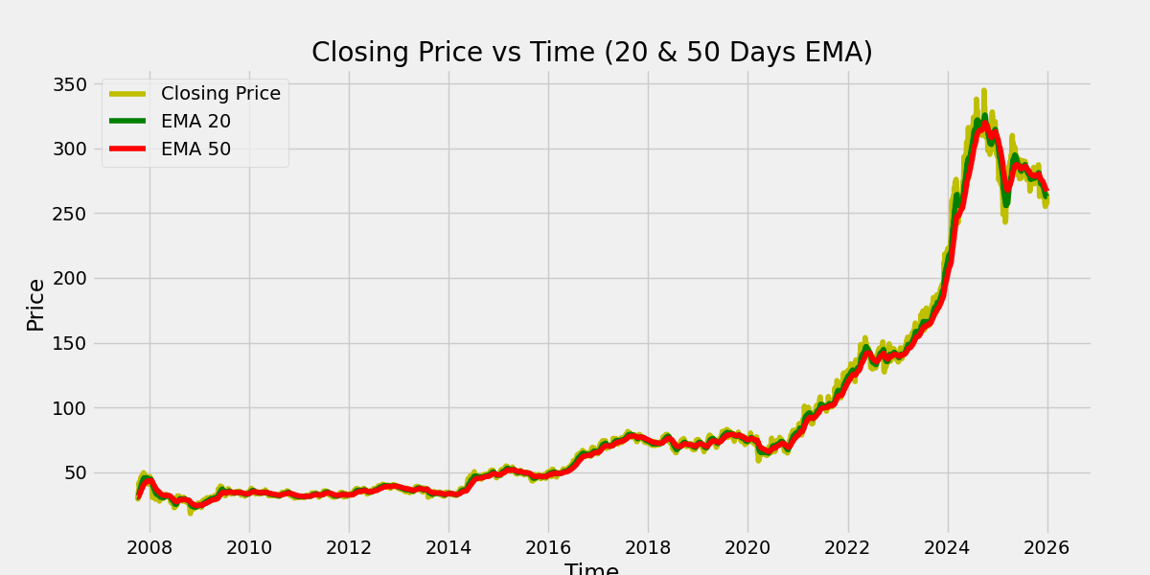
Technical Indicator View
Closing price with EMA-20 and EMA-50 overlays generated by the Flask dashboard.

Slide 8
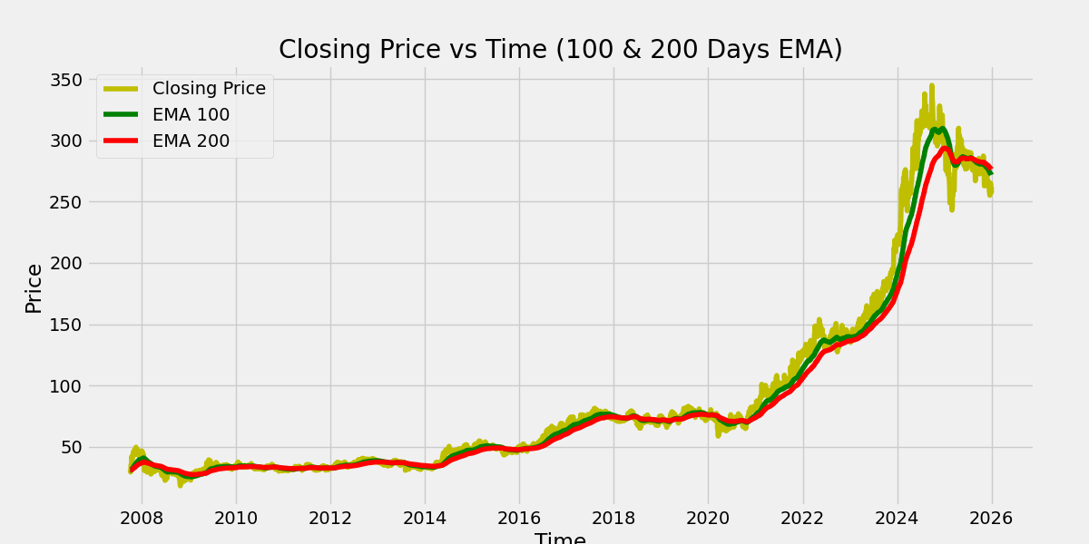
Long-Term Trend View
Closing price with EMA-100 and EMA-200 to capture long-range movement.

Slide 9
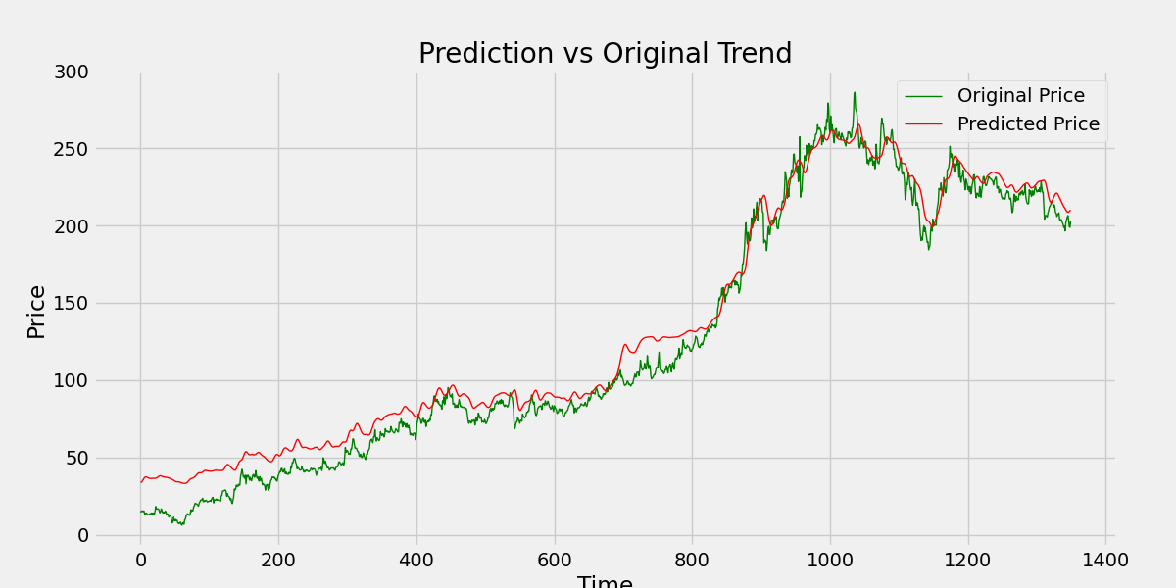
Prediction vs Actual
Model output compared with actual test-series movement.

Slide 10
Key Features Delivered
Product Features
Secure user login and registration
Interactive dashboard for selected ticker
Auto-generated analytics charts
Downloadable historical CSV datasets
Decision Support
Next-day price estimate with direction
Trading signal logic: BUY / HOLD / SELL
Real-time price snapshot and intraday series
Headline sentiment summary with polarity labels

Slide 11
Current Limitations & Future Scope
Predictions are based primarily on historical close prices (single-feature focus).
Sentiment uses lexical polarity; finance-specific NLP can improve reliability.
Backtesting and risk metrics can be added for stronger validation.
Future work: multi-feature modeling, transformer-based forecasting, portfolio-level recommendations.

Slide 12
Conclusion
This project demonstrates an end-to-end stock analytics platform with deployed ML inference.
It combines data engineering, deep learning, and web product development in one workflow.
The architecture is ready for iterative upgrades toward production-grade quant intelligence.

