Slide 1





Product Optimization & Revenue
Contribution Analysis for Afficionado Coffee
Roasters
Presented By:
Khushbu Sahu
Tools:
Excel | Power Query | Power BI | DAX

Slide 2

Business Overview
Afficionado Coffee Roasters is a specialty coffee retailer offering a wide range of beverages, coffee beans, bakery items, and complementary products across multiple store locations. As sales volume and product variety continue to grow, understanding which products, categories, stores, and time slots contribute the most to overall revenue becomes essential for effective business decision-making.
This project provides product-centric intelligence to support menu optimization and merchandising strategy.
Problem Statement
Although transaction-level product data is available, Afficionado Coffee Roasters lacks:
• Clear visibility into product popularity vs profitability
• Category-level revenue dependency insights
• Identification of low-impact or underperforming menu items

Slide 3
Objectives
Primary Objectives
Identify top-selling and least-selling products
Quantify revenue contribution by product and category
Measure revenue concentration across the menu
Secondary Objectives
Support menu simplification and optimization
Identify high-impact “hero” products
Highlight low-performing products for review or redesign

Slide 4
Methodology
This project leverages Power BI to analyze transactional sales data and uncover actionable insights into revenue distribution, product performance, category contribution, store performance, and customer purchasing patterns.
The analysis helps identify high-performing products, evaluate revenue concentration using Pareto (80/20) Analysis.
Highlight opportunities to optimize inventory, marketing strategies, and operational planning.
Data Collection
↓
Data Preparation
↓
Data Modelling
↓
DAX Development
↓
Exploratory Analysis
↓
Revenue Contribution
↓
Product Analysis
↓
Pareto Analysis
↓
Business Recommendations
↓
Interactive Dashboard
Analytical flow

Slide 5
Dataset overview
Column | Description
transaction_id | Unique identifier per transaction
year | Transaction year (2025)
transaction_time | Time of transaction (HH:MM:SS)
transaction_qty | Quantity purchased
unit_price | Price per unit
store_id | Store identifier
store_location | Physical store location
Balance | Account balance
product_id | Unique identifier for each product
product_category | Broad product group
product_type | Product variant within the category
product_detail | Detailed attributes such as flavor or blend

Slide 6
Data Cleaning & Transformation
Verified transaction, product, and store data for completeness.
Converted date, time, quantity, price, and revenue columns to appropriate data types.
Ensured numeric fields were correctly formatted for calculations.
Created a Revenue column by multiplying Unit Price × Quantity.
Used the calculated revenue for all business KPIs and performance analysis.
Created a Time Slot column from the transaction time.
Classified transactions into:
Morning
Afternoon
Evening
Enabled time-based sales and revenue analysis.
Removed unnecessary columns.
Applied transformations in Power Query before loading data.
Optimized the model to improve dashboard performance.

Slide 7
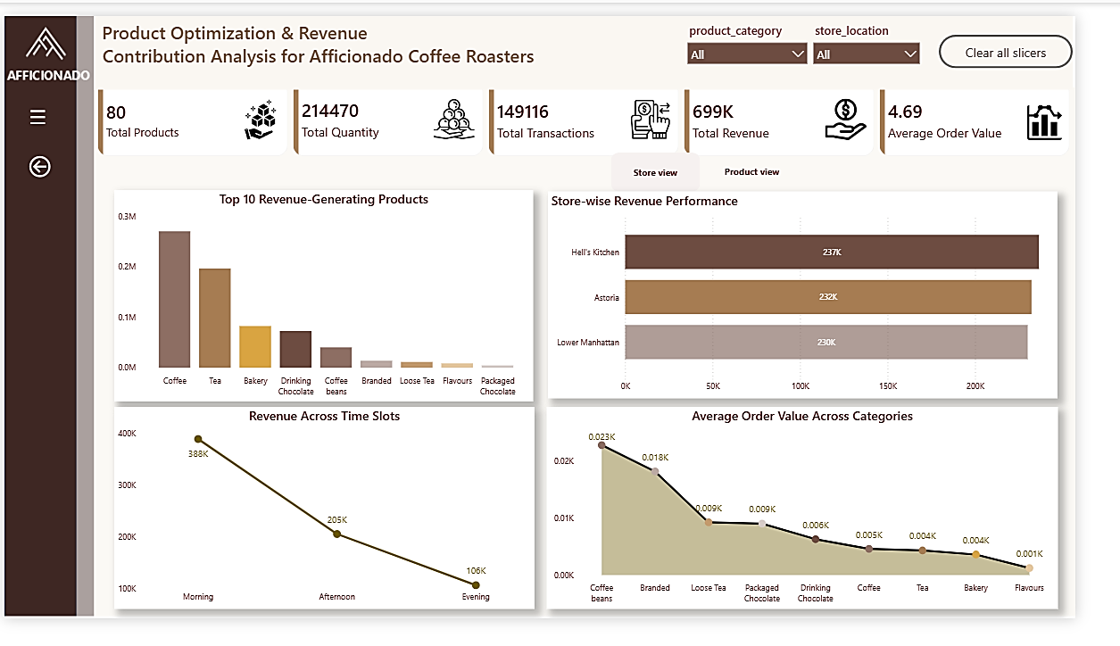
Dashboard Overview
Executive Overview
💡 Key Findings
Coffee category generates the highest overall revenue.
Morning time slot contributes the maximum sales.
Hell's Kitchen is the top-performing store.
Revenue is concentrated in a few major product categories.

Slide 8
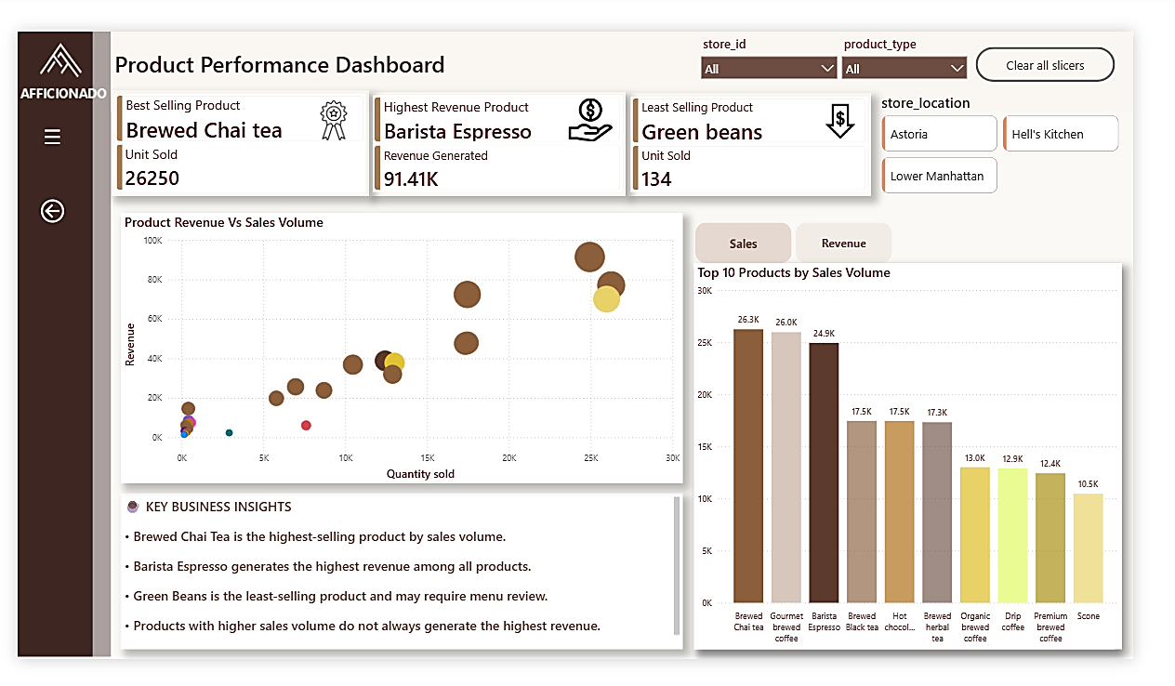
Product Performance
Dashboard
Objective
Identify the highest and lowest performing products based on revenue and sales quantity.
💡 Key Findings
Brewed Chai Tea is the highest-selling product by quantity.
Barista Espresso generates the highest revenue.
Green Beans is the least-selling product.
High sales volume does not always translate into the highest revenue.

Slide 9
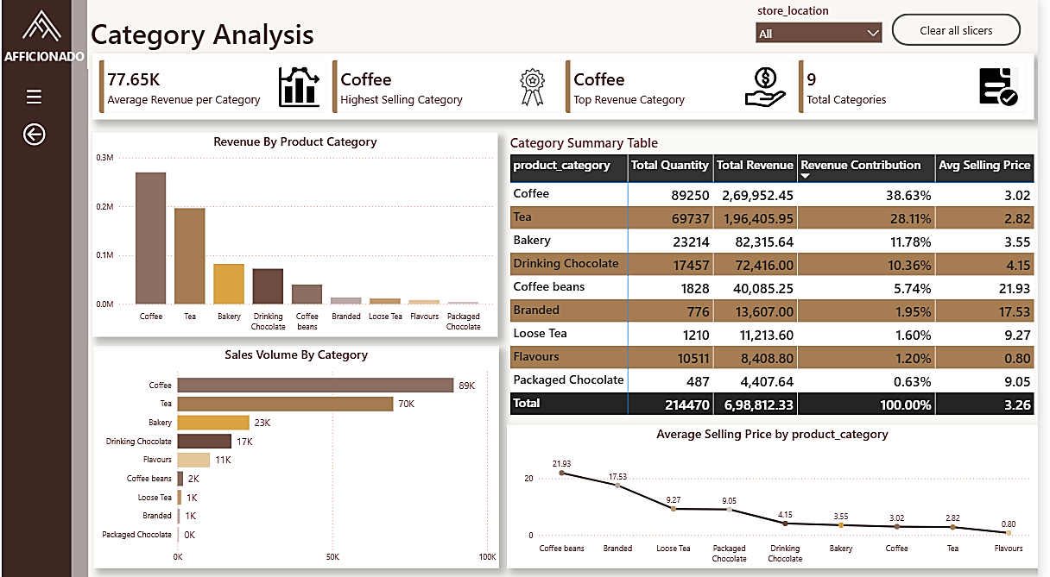
Category Analysis
Objective
Analyze category-wise sales and revenue performance to identify key business growth opportunities.
💡 Key Findings
Coffee is both the highest-selling and highest-revenue category.
Tea is the second-largest revenue contributor.
Coffee Beans have the highest average selling price but lower sales volume.
Flavours and Packaged Chocolate contribute minimally to total revenue.

Slide 10
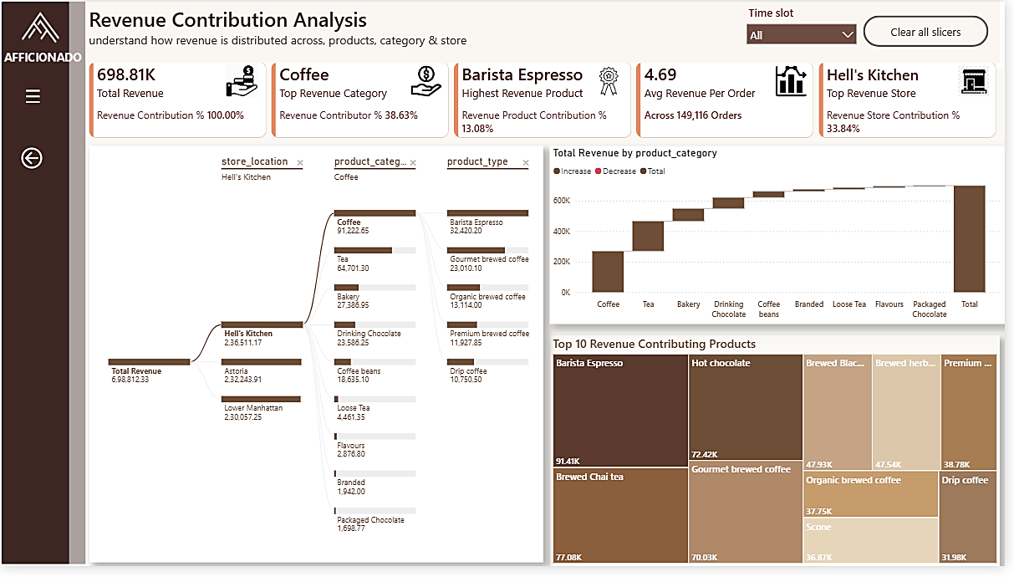
Revenue Contribution Analysis
Objective
Measure revenue concentration across the menu
💡 Key Findings
Coffee contributes the largest share of total revenue (38.63%).
Barista Espresso is the highest revenue-generating product.
Hell's Kitchen contributes the highest store revenue.
A small number of categories and products drive most business revenue.
.

Slide 11
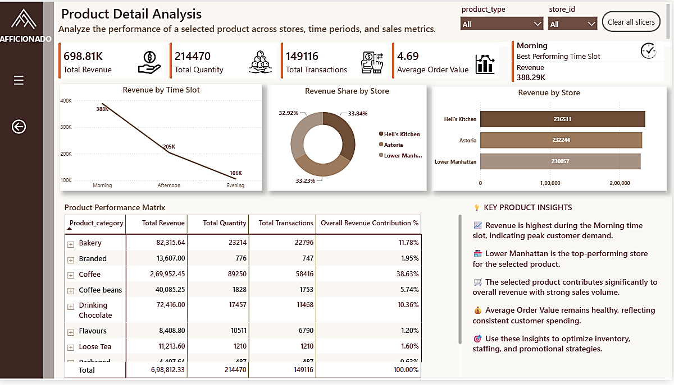
Product Details
Objective
Analyze the detailed performance of individual products across different business dimensions.
💡 Key Findings
Morning is the best-performing time slot for the selected product.
Lower Manhattan performs strongly for the selected product.
Coffee category contributes the highest revenue within product details.
Average Order Value remains healthy across transactions.

Slide 12
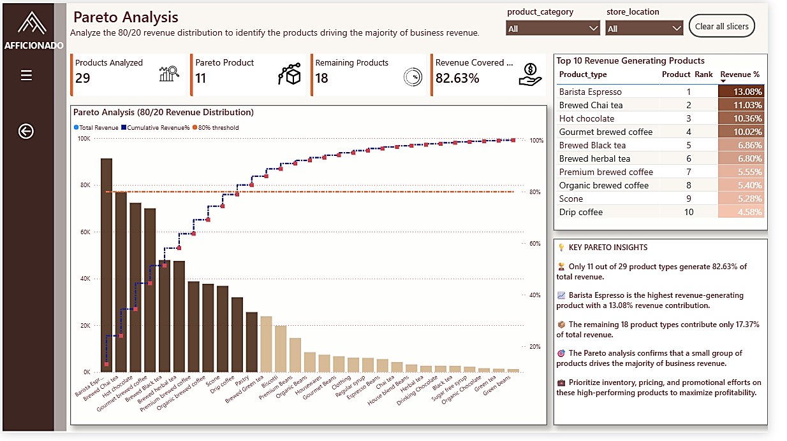
Pareto Analysis
Objective
Analyze the 80/20 revenue distribution to identify the products driving the majority of business revenue.
💡 Key Findings
Only 11 out of 29 product types generate 82.63% of total revenue.
The remaining 18 products contribute only 17.37%.
Barista Espresso is the largest individual revenue contributor.
Revenue is highly concentrated among a limited number of products.

Slide 13
Recommendations
Overall Business Recommendations
Focus investment on high-revenue products and categories.
Optimize staffing and inventory based on time-slot demand.
Expand best-performing product strategies across all store locations.
Use Pareto Analysis to prioritize marketing and inventory decisions.
Continuously monitor product performance to improve profitability and customer satisfaction.

Slide 14
Conclusion
Project Successfully:
✔ Find the hero product i.e. Barista Espresso generate highest revenue
✔ Identified Long-tail Products with Minimal Impact i.e. 18 out of 29 product types contribute
only 17.37% of total revenue.
The business is highly dependent on 11 Hero Products for the majority of its revenue. This creates a menu diversification risk, as any decline in these products could significantly affect overall revenue.

Slide 15


