Slide 1




Student Segmentation and Personalized
Course Recommendation System for EduPro
Presented By:
Khushbu Sahu
Tools:
Excel | Power Query | Power BI | DAX

Slide 2
Business Overview
Online learning platforms have rapidly expanded over the past decade, offering flexible education opportunities to learners across different geographic .
These platforms provide access to courses spanning diverse subject areas and skill levels, enabling learners to pursue professional development, academic enrichment, and personal interests.
EduPro, an online learning platform, collects substantial data related to learners, courses, and enrollments. However, without systematic analysis, this data remains underutilized.
EduPro currently faces:
Learners struggle to discover relevant content
Engagement and retention opportunities are lost. Limited understanding of learner behavior patterns
No structured learner segmentation framework
Problem Statement

Slide 3
Objectives
This study aims to analyze learner demographics and enrollment patterns on EduPro. The main objectives include:
To examine the demographic distribution of learners across the platform.
To analyze course enrollment trends across different age groups.
To identify gender-based differences in course selection behavior.
To determine the most popular course categories and levels.
To visualize these insights through an interactive analytical dashboard

Slide 4
Methodology and Dataset Overview
The analysis utilizes four primary datasets provided by the EduPro platform:
Table | Purpose
Users | Demographics
Courses | Course Details
Teachers | Instructor Info
Transactions | Enrolment History
Learner Profile User level analytical layer
Learner Profile table was created as a user-level analytical layer to support segmentation and personalized recommendations.

Slide 5
Data Cleaning
Data Preparation Process
✔ Removed inconsistencies and validated records
✔ Standardized data types and formats
✔ Checked for duplicates and missing values
✔ Created relationships between tables
✔ Developed learner-level features for segmentation
✔ Optimized dataset using Power Query and DAX
Data Transformation
Used Power Query for preprocessing.
Optimized data model for reporting and analysis.

Slide 6
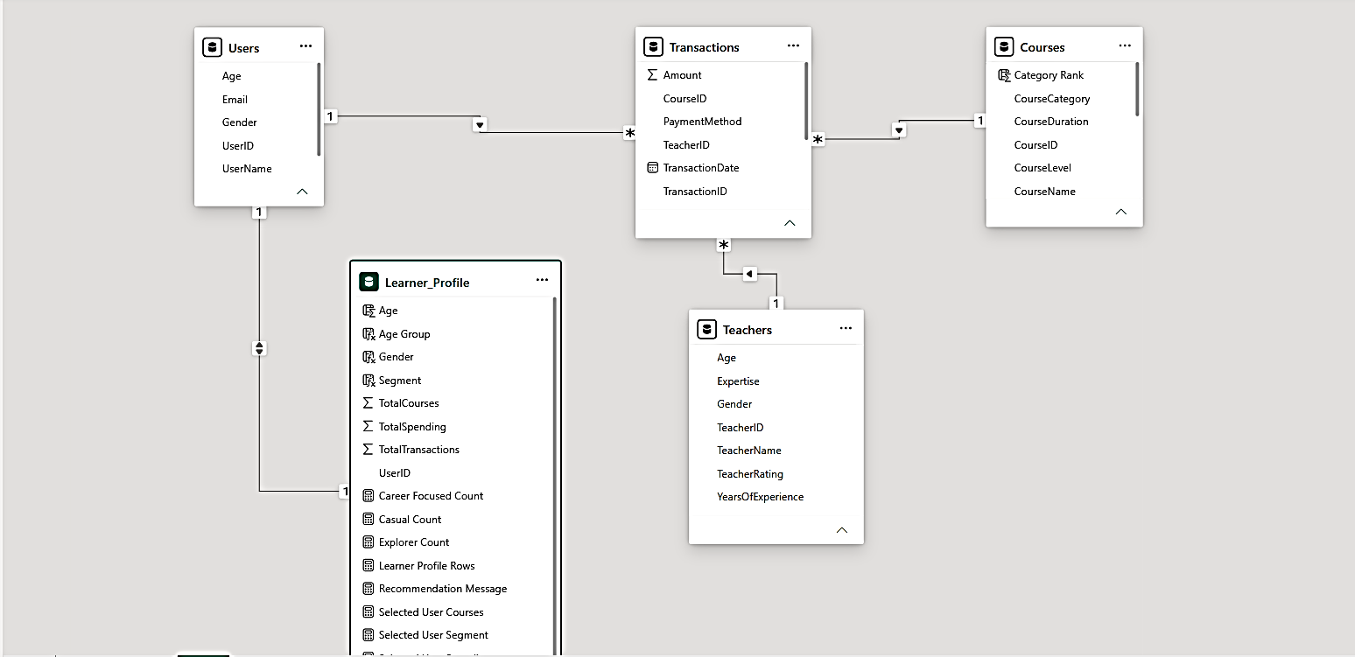
Data Model
Users → Transactions via user ID
Courses → Transactions via course ID
Teachers → Transactions via teachers ID
Users → Learner Profile via user ID

Slide 7
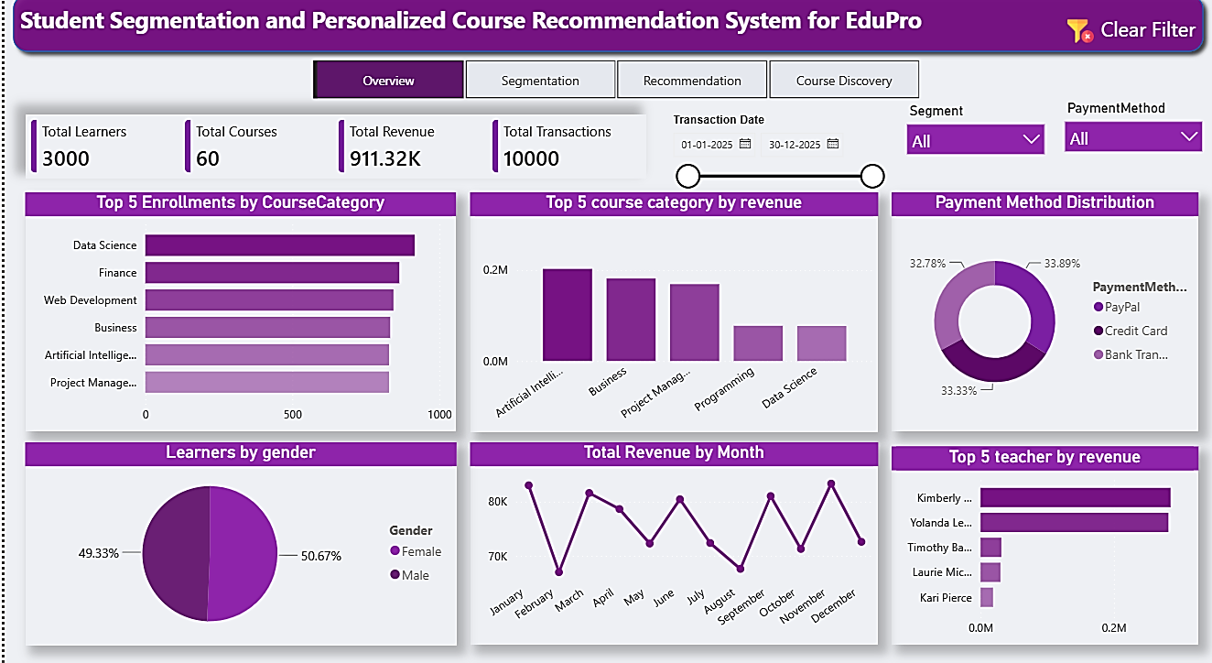
Dashboard Overview
Key Insight
3,000 learners generated 911.32K revenue through 10,000 transactions.
Data Science is the most enrolled course category.
Revenue trends remain stable across months.
Gender participation is nearly balanced.
Payment methods are evenly distributed among learners.
A small group of instructors contributes the majority of revenue.

Slide 8
Learner segments
A learner profile table was created by aggregating user-level enrollment and spending data, enabling behavior analysis and segmentation for personalized course recommendations.
Process Followed
Transactions Data (aggregate transaction data on the basis of user ID to calculate Total course enrolled,
total spending , total transaction per learner)
↓
Learner Profile Creation
↓
Feature Engineering
(Total Courses, Spending, Preferences)
↓
DAX-Based Segmentation ( Rules Learner Profile[TotalCourses] >= 8, "Explorer",
Learner_Profile[TotalSpending] >= 500, "Career Focused",
Learner_Profile[TotalCourses] >= 3, "Specialist",
"Casual Learner“)
↓
Casual | Explorer | Specialist | Career Focused

Slide 9
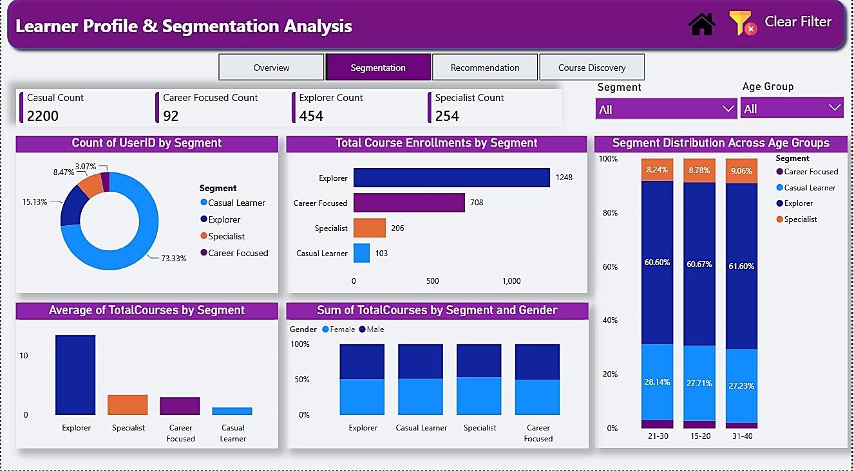
Learner profile dashboard
Key Insight
Learner Distribution
Casual Learners represent 73.33% of the
learner base (2200 users).
Explorers account for 15.13% of learners
(454 users).
Specialists represent 8.47% of learners
(254users).
Career Focused learners form only 3.07% of
the population (92 users).
Explorers show the highest average courses per learner, making them the most engaged segment.
Gender distribution remains relatively balanced across all learner segments.
The 21–30 age group contains the largest proportion of learners.
Business Recommendations
Use personalized recommendations to increase engagement.
For specialist Offer advanced and certification-based courses.

Slide 10
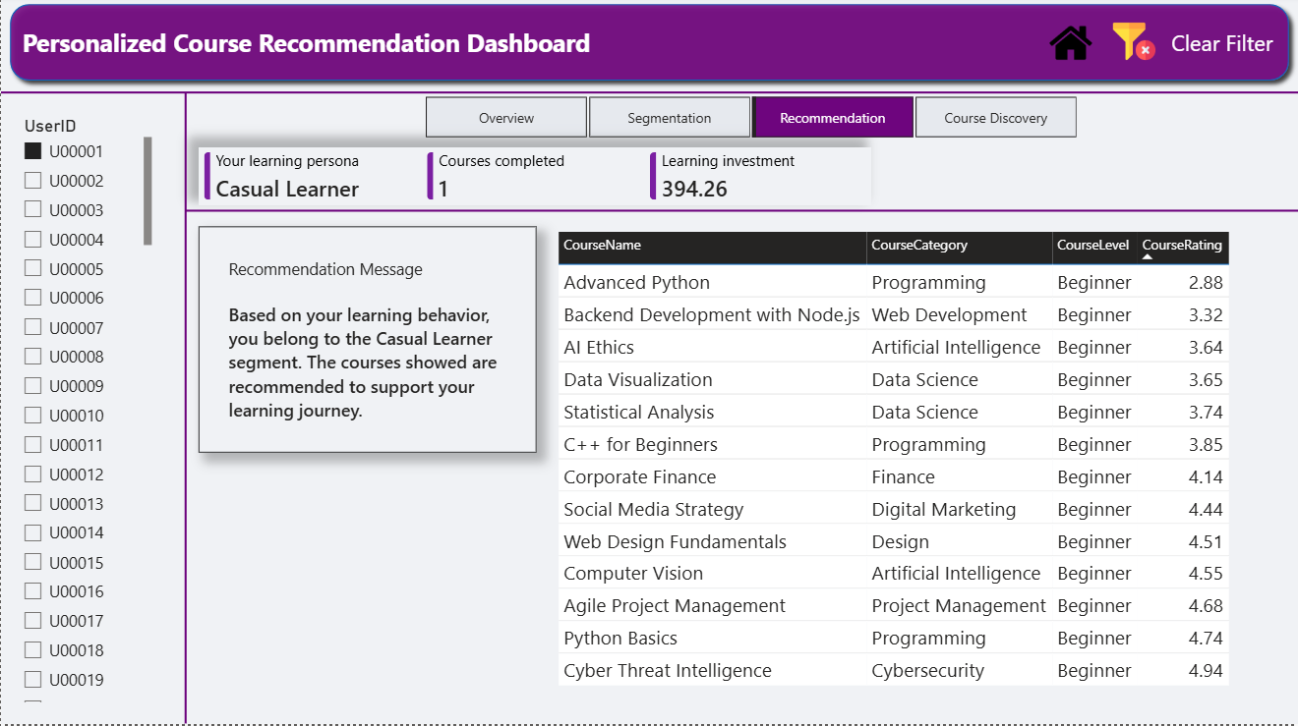
Personalized Course Recommendation Dashboard
Overview
The Personalized Recommendation Dashboard is designed for existing learners. It analyzes a learner's historical learning behavior and segment membership to recommend courses aligned with their interests and learning goals.
How It Works
Step 1: User Selection
A learner is selected using the UserID slicer.
Step 2: Learner Profile Analysis
The system evaluates:
Total Courses Completed
Learning Investment
Learner Segment
Step 3: Recommendation Generation
Based on the learner's segment, suitable courses are recommended to support future learning and engagement.

Slide 11
Key Metrics
Learning Persona
Displays the learner's segment:
Casual Learner
Explorer
Specialist
Career Focused
Courses Completed
Shows learner engagement level.
Learning Investment
Represents the total amount spent on learning activities.
Business Value
Improves learner engagement
Supports personalized learning paths
Increases course discovery
Enhances learner retention

Slide 12
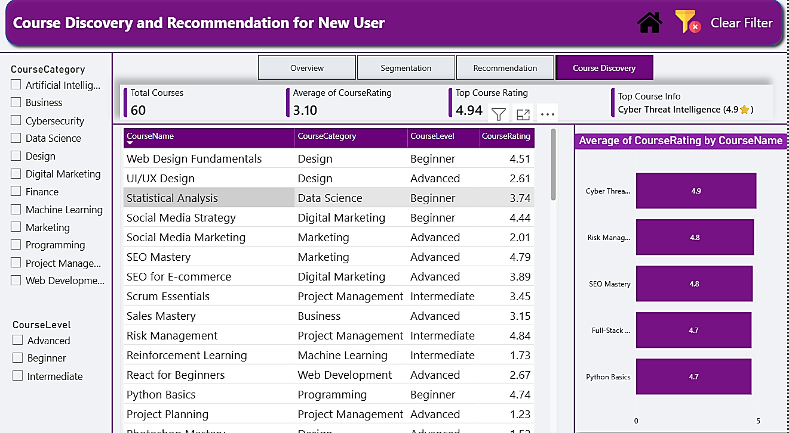
Course Discovery and Recommendation for New Users
Overview
This dashboard is designed for new learners who do not yet have enrollment history.
Instead of using past behavior, recommendations are generated based on learner-selected preferences.
How It Works
Step 1: Select Course Category
Learners choose their area of interest.
Examples:
Data Science
Artificial Intelligence
Business
Marketing
Step 2: Select Course Level
Learners choose:
Beginner
Intermediate
Advanced
Step 3: View Recommended Courses
The dashboard dynamically displays courses matching the selected preferences.

Slide 13
Business Recommendation and Future Enhancements
Recommendation 1: Increase Casual Learner Engagement
Casual Learners represent the largest learner segment (73%+).
Introduce beginner-friendly learning paths.
Send personalized course recommendations.
Use email campaigns and learning reminders.
Expected Outcome: Higher course enrollments and improved retention.
Recommendation 2: Expand High-Demand Categories
Data Science, Finance, and Web Development show strong enrollment demand.
Launch additional courses in these categories.
Develop structured learning pathways.
Expected Outcome: Increased learner satisfaction and revenue growth.
Future Enhancements
✔ Machine Learning-Based Recommendation Engine
✔ Real-Time Learner Behaviour Tracking
✔ Web Application Deployment (Power BI Service / Streamlit)

Slide 14
Conclusion
Project Successfully:
✔ Segmented Learners
✔ Identified Behaviour Patterns
✔ Built Recommendation Framework
✔ Improved Personalization Strategy
Why Power BI Was Used for This Project?
Power BI was chosen because it provides powerful data modeling, DAX-based analytics, interactive dashboards, and dynamic recommendation capabilities, making it an ideal tool for learner segmentation and educational analytics.
Thank You
Khushbu Sahu

