Slide 1

Customer Behavior
Analysis
3,900 purchases — 18 features — goal: spending patterns, segments, product & subscription insights

Slide 2
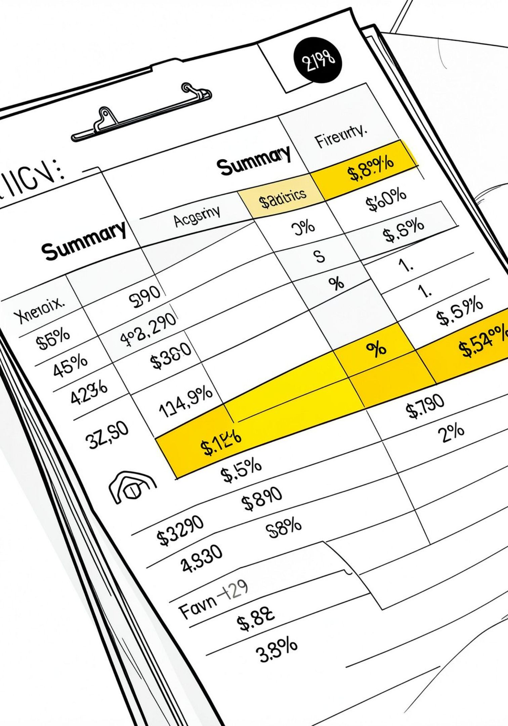
Dataset Snapshot
Rows / Columns
Key Features
Missing Data
Demographics, purchase details, behavior, shipping, discounts
37 values in Review Rating
3,900 rows · 18 columns

Slide 3

Data Preparation (Python)
- Engineered age_group & purchase_frequency_days
- Dropped promo_code_used (redundant)
- Loaded cleaned DataFrame to PostgreSQL
- Loaded with pandas
- df.info() & describe()
- Imputed review ratings by category median
- Renamed to snake_case

Slide 4
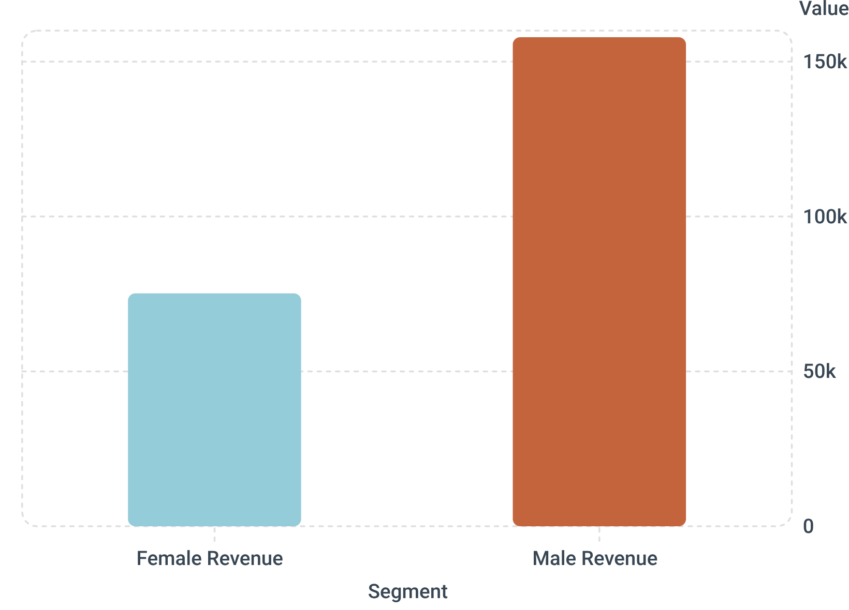
SQL Analysis — Revenue & Segments
- Revenue by gender: Male > Female
- Customer segments: Loyal 3,116 · Returning 701 · New 83

Slide 5

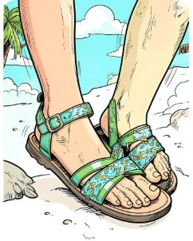
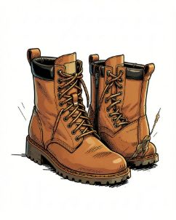
Top Products & Ratings
Gloves
Sandals
Boots
Avg rating 3.86 — top-rated
Avg rating 3.84
Avg rating 3.82
Top-5 also: Hat 3.80 · Skirt 3.78

Slide 6
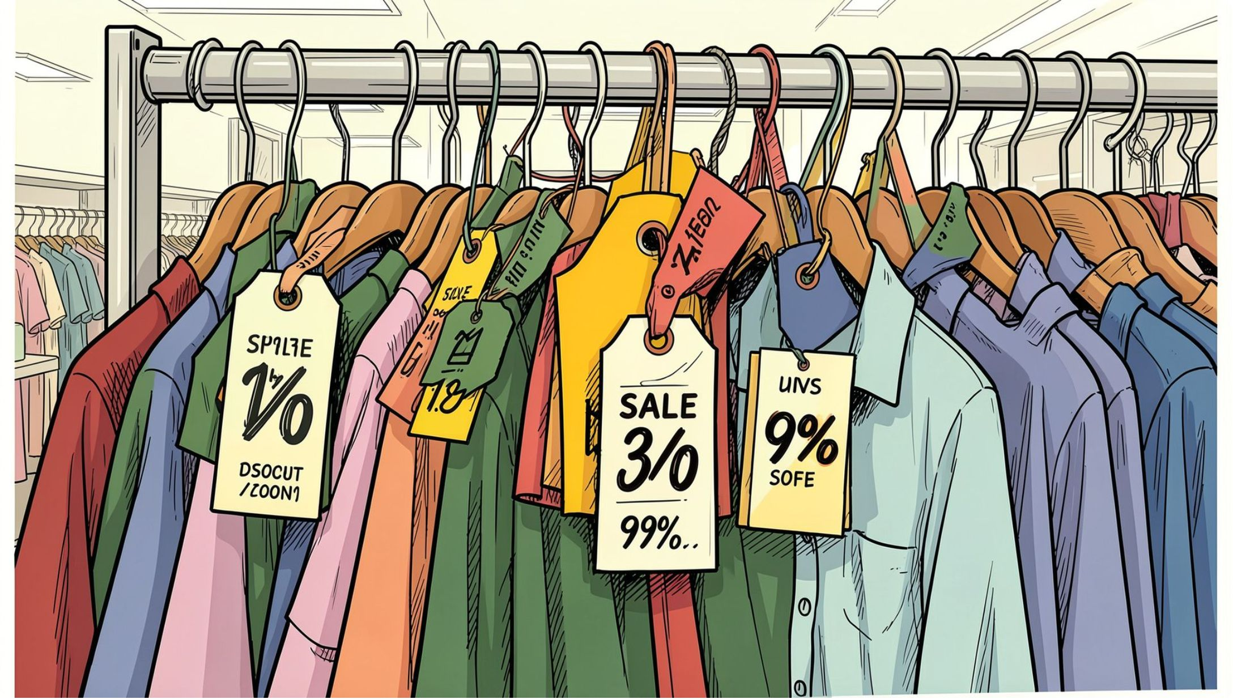
Discounts & Price Sensitivity
- Identified 839 discount-using customers who spent above average
- Top discount-dependent items: Hat 50% · Sneakers 49.66% · Coat 49.07% · Sweater 48.17% · Pants 47.37%

Slide 7
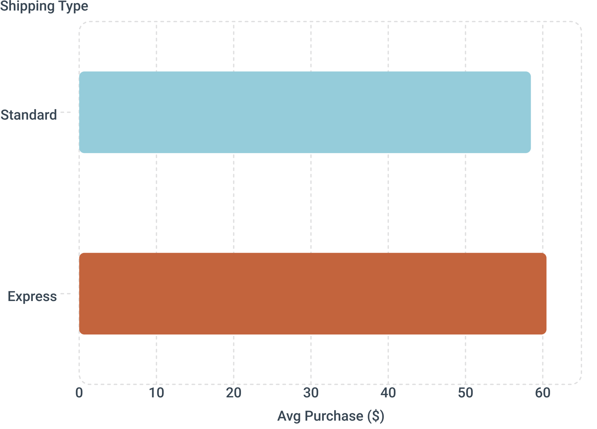
Shipping & Purchase Behavior
- Express slightly higher avg spend
- Payment method top: PayPal
- Frequency top: Every 3 Months

Slide 8
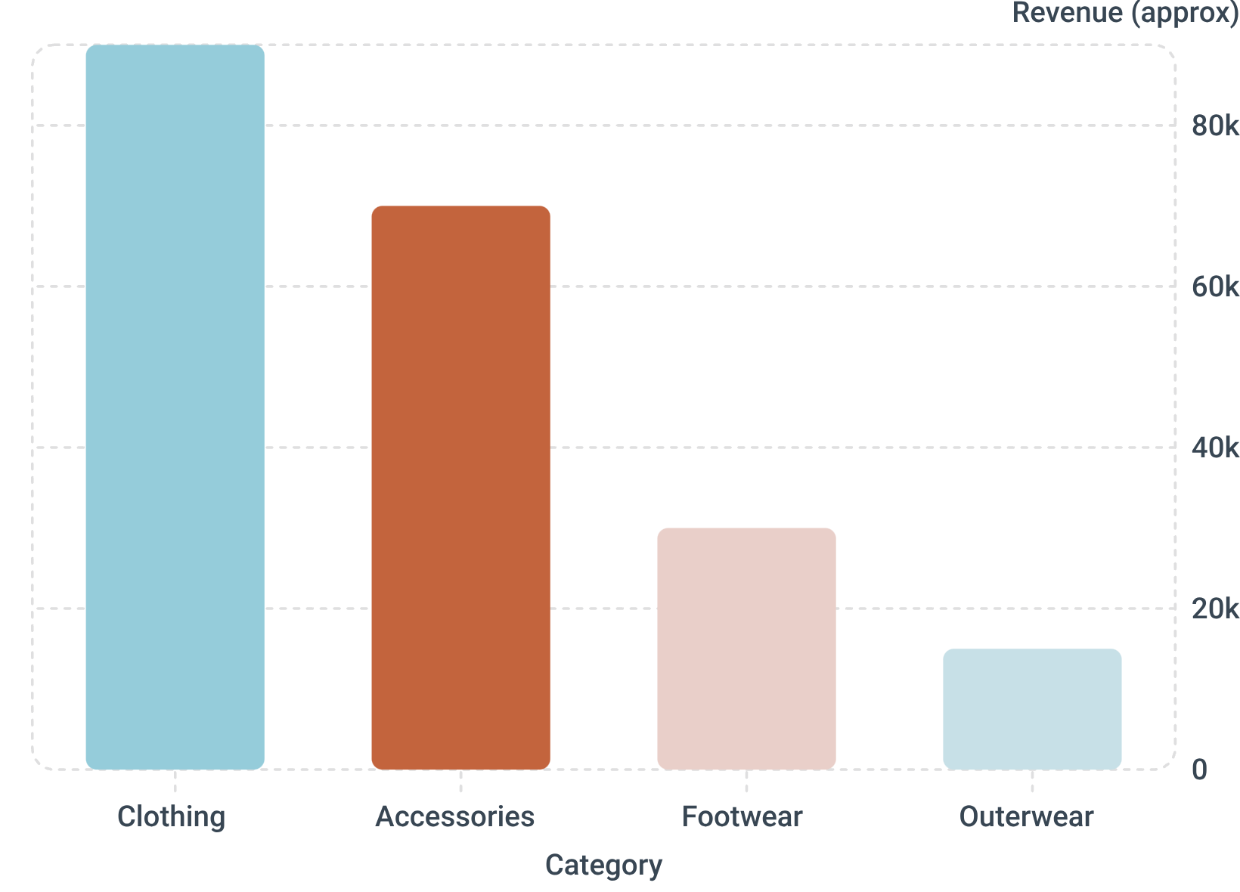
Revenue & Sales by Category
- Sales volume:
Clothing ~1,800
Accessories ~1,200
Footwear ~600
Outerwear ~300
- Top items by category: Jewelry, Sunglasses, Belt; Blouse, Pants, Shirt; Sandals, Shoes, Sneakers; Jacket, Coat

Slide 9
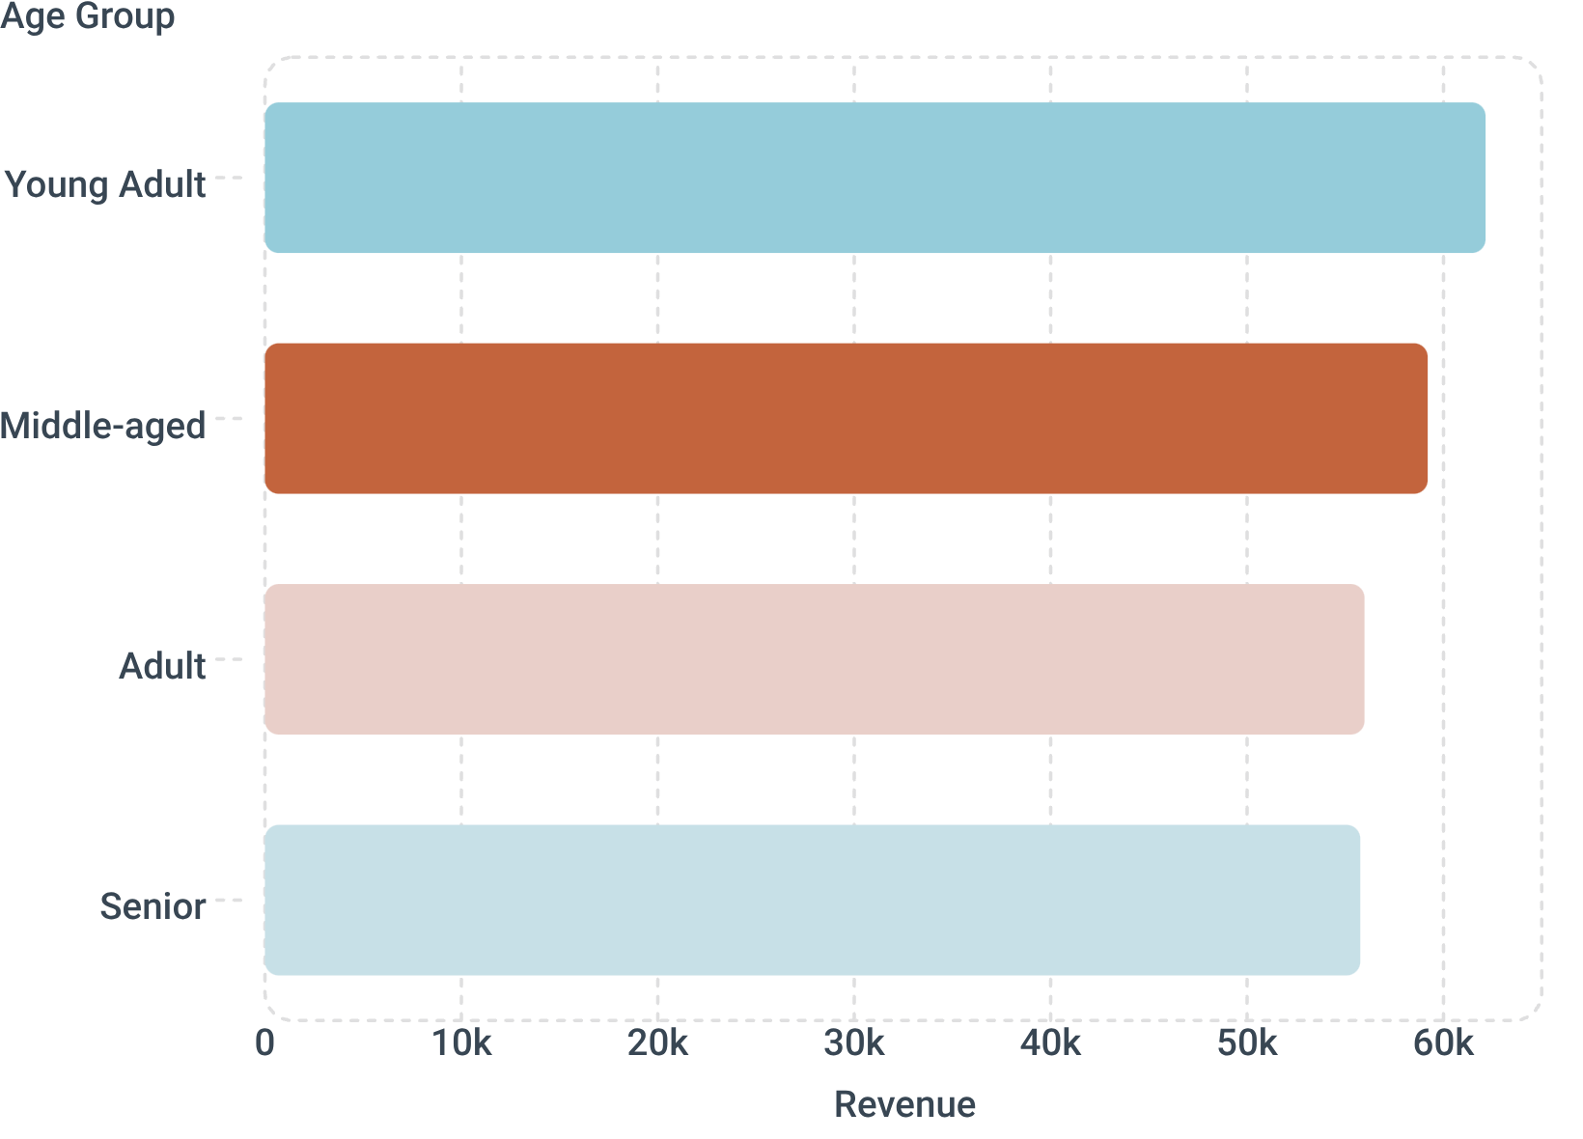
Demographics & Revenue by Age
- Highest revenue: Young Adults · focus marketing here
- Subscribers: 1,053 (avg spend 59.49, revenue 62,645) ·
- Non-subscribers: 2,847 (avg 59.87, revenue 170,436)

Slide 10
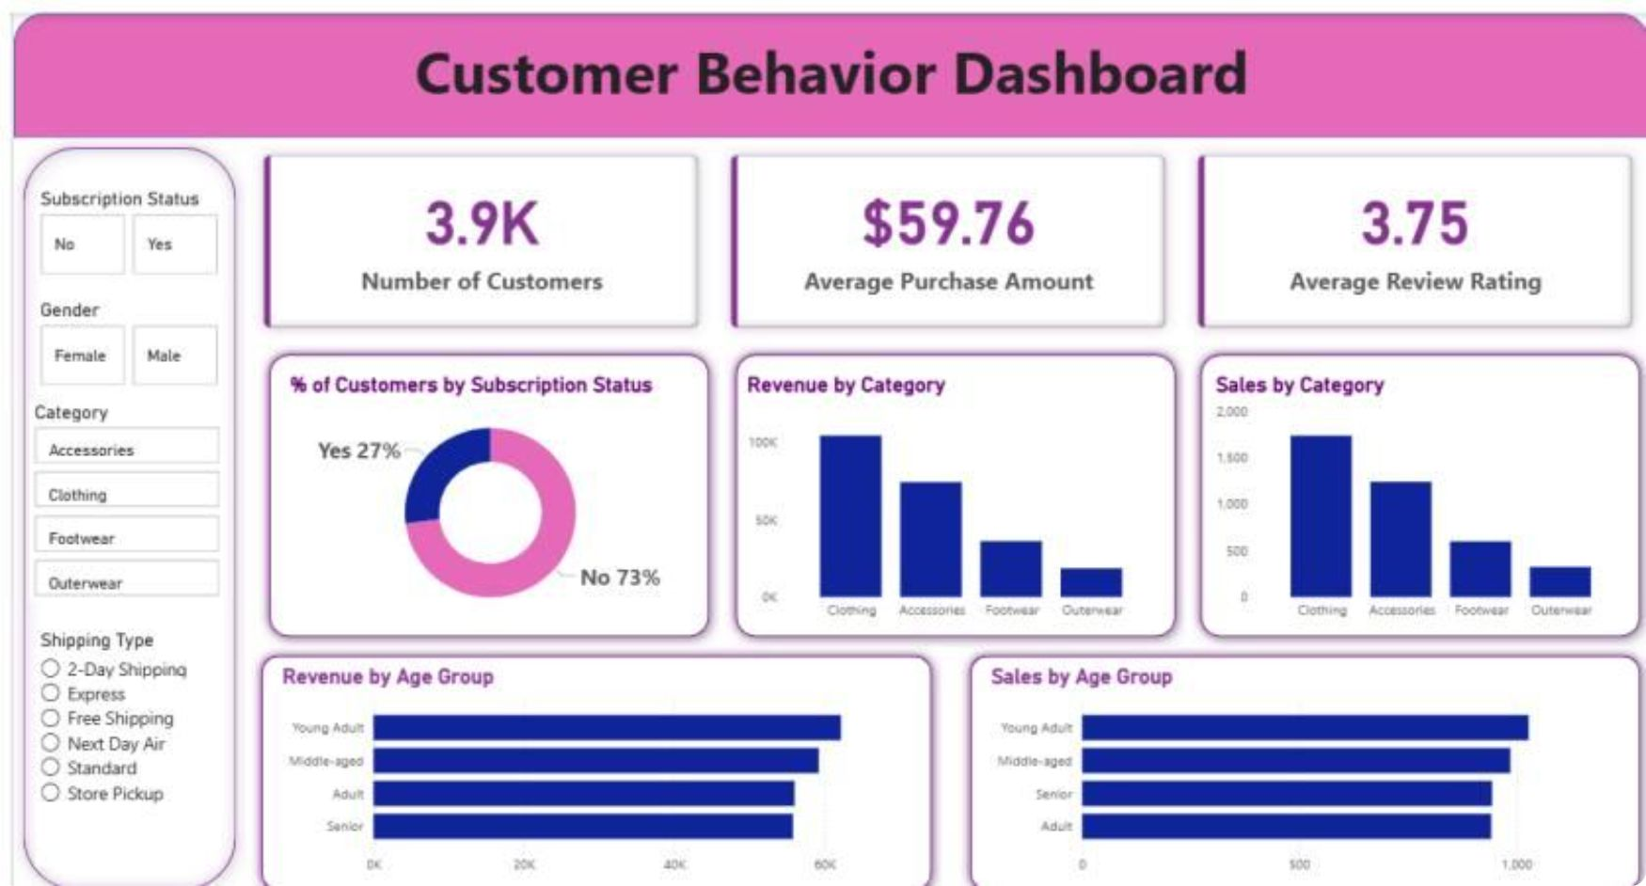
Recommendations & Dashboard
Boost Subscriptions
Promote exclusive benefits
Interactive Power BI dashboard built to visualize these metrics.
Loyalty Programs
Reward repeat buyers
Discount Policy
Balance conversion & margins
Product Positioning
Highlight top-rated & best-sellers
Targeted Marketing
Focus on high-revenue age groups & express users

