Slide 1
CSE-2208 Design and Analysis of Algorithm
Tanvir Ahammad
Lecturer
Dept. of CSE
Jagannath University, Bangladesh
Courtesy: Md. Manuarul Islam, Assoc. Prof.
Notes:
‹#›

Slide 2

Algorithm

Slide 3
What is algorithm?
Refers to the logic of a program and a step-by-step description of how to arrive at the solution of a given problem
In order to qualify as an algorithm, a sequence of instructions must have following characteristics:
Each and every instruction should be precise and unambiguous.
Each instruction should be such that it can be performed in a finite time
One or more instruction should not be repeated, this ensures that the algorithm will ultimately terminate
After performing the instructions, that is after the algorithm terminates, the desired results must be obtained.

Slide 4
Algorithm
A procedure for solving a problem in terms of
the actions to be executed, and
the order in which these actions are to be executed
is called an algorithm.
Correctly specifying the order in which the actions are to be executed is important.

Slide 5
Algorithm
Consider the “rise-and-shine algorithm” followed by one junior executive for getting out of bed and going to work
Consider the “rise-and-shine algorithm”
(1) Get out of bed,
(2) take off pajamas,
(3) take a shower,
(4) get dressed,
(5) eat breakfast,
(6) carpool to work.
This routine gets the executive to work well prepared to make critical decisions.

Slide 6
Algorithm
Suppose that the same steps are performed in a slightly different order:
(1) Get out of bed,
(2) take off pajamas,
(3) get dressed,
(4) take a shower,
(5) eat breakfast,
(6) carpool to work.
In this case, our junior executive shows up for work soaking wet.
Specifying the order in which statements are to be executed in a computer program is called program control.

Slide 7
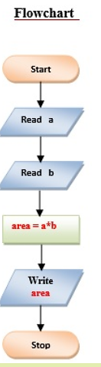
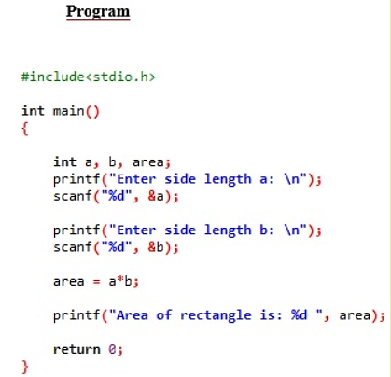
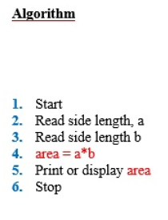
Example
Problem- Find the area of a rectangle

Slide 8
General Concepts
Algorithm strategy
Approach to solving a problem
May combine several approaches
Algorithm structure
Iterative ⇒ execute action in loop
Recursive ⇒ reapply action to subproblem(s)
Problem type
Satisfying ⇒ find any satisfactory solution
Optimization ⇒ find best solutions

Slide 9
Some Algorithm Strategies
Divide and conquer algorithms
Dynamic programming algorithms
Greedy algorithms
Backtracking algorithms
Branch and bound algorithms
Heuristic algorithms

Slide 10
Divide and Conquer
Based on dividing problem into subproblems
Approach
Divide problem into smaller subproblems
Subproblems must be of same type
Subproblems do not need to overlap
Solve each subproblem recursively
Combine solutions to solve original problem
Usually contains two or more recursive calls
Notes:
‹#›
2

Slide 11
Divide and Conquer – Examples
Binary Search
Quicksort
Partition array into two parts around pivot
Recursively quicksort each part of array
Concatenate solutions
Mergesort
Partition array into two parts
Recursively mergesort each half
Merge two sorted arrays into single sorted array
Notes:
‹#›
3

Slide 12
Mergesort
Array A = 5, 2, 4, 7, 1, 3, 2, 6.
5 | 2 | 4 | 1 | 7 | 3 | 2 | 6
5 | 2 | 4 | 1
7 | 3 | 2 | 6
5 | 2
4 | 1
7 | 3
2 | 6
3
7
2
5
1
6
2
4
2 | 5
1 | 4
3 | 7
2 | 6
1 | 2 | 4 | 5
2 | 3 | 6 | 7
1 | 2 | 2 | 3 | 4 | 5 | 6 | 7
Notes:
‹#›

Slide 13
Dynamic Programming Algorithm
Based on remembering past results
Approach
Divide problem into smaller subproblems
Subproblems must be of same type
Subproblems must overlap
Solve each subproblem recursively
May simply look up solution
Combine solutions into to solve original problem
Store solution to problem
Generally applied to optimization problems

Slide 14
Fibonacci Algorithm
Fibonacci numbers
fibonacci(0) = 1
fibonacci(1) = 1
fibonacci(n) = fibonacci(n-1) + fibonacci(n-2)
Recursive algorithm to calculate fibonacci(n)
If n is 0 or 1, return 1
Else compute fibonacci(n-1) and fibonacci(n-2)
Return their sum

Slide 15
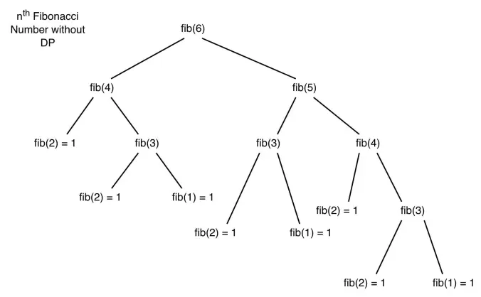
Exponential complexity!!

Slide 16
Dynamic Programming – Example
Dynamic programming version of fibonacci(n)
If n is 0 or 1, return 1
Else solve fibonacci(n-1) and fibonacci(n-2)
Look up value if previously computed
Else recursively compute
Find their sum and store
Return result

Slide 17
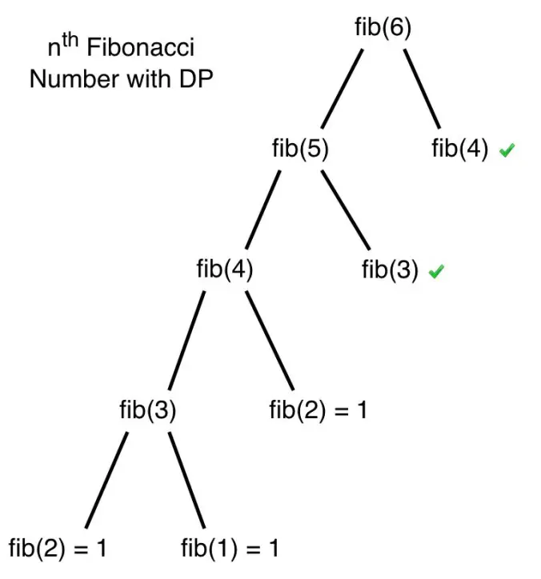
O(N)!

Slide 18
Dynamic Programming
Dynamic Programming is a general algorithm design technique
for solving problems defined by or formulated as recurrences with overlapping subinstances
Invented by American mathematician Richard Bellman in the 1950s to solve optimization problems and later assimilated by CS
“Programming” here means “planning”
Notes:
‹#›

Slide 19
Dynamic Programming
Main idea:
set up a recurrence relating a solution to a larger instance to solutions of some smaller instances
- solve smaller instances once
record solutions in a table
extract solution to the initial instance from that table
Notes:
‹#›

Slide 20
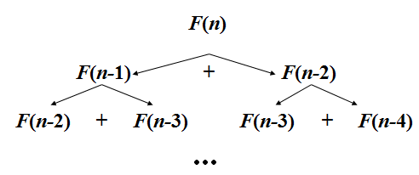
Example: Fibonacci numbers
Recall definition of Fibonacci numbers:
F(n) = F(n-1) + F(n-2)
F(0) = 0
F(1) = 1
Computing the nth Fibonacci number recursively (top-down):
Notes:
‹#›

Slide 21

Example: Fibonacci numbers
Recall definition of Fibonacci numbers:
F(n) = F(n-1) + F(n-2)
F(0) = 0
F(1) = 1
Notes:
‹#›

Slide 22
Dynamic Programming - Example
0-1 Knapsack
Longest Common Subsequence
Longest Increasing Sequence
Sum of Subset
Warshall’s All pairs shortest path
Bellman Ford’s Single Source Shortest Path
Matrix Chain Multiplication

Slide 23
Greedy Algorithm
Based on trying best current (local) choice
Approach
At each step of algorithm choose best local solution
Hope local optimum lead to global optimum
Notes:
‹#›
2

Slide 24
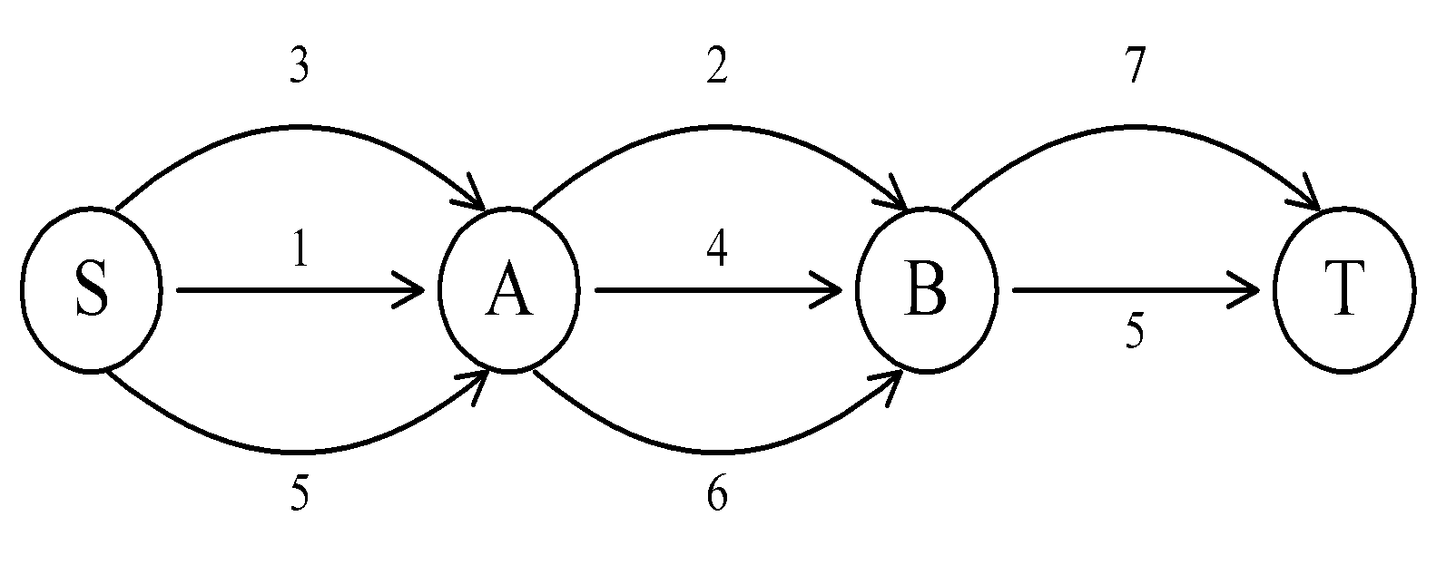
The shortest path
To find a shortest path in a multi-stage graph
Apply the greedy method : the shortest path from S to T :
1 + 2 + 5 = 8
Notes:
‹#›

Slide 25
Greedy Algorithm – Example
Kruskal’s Minimal Spanning Tree Algorithm
sort edges by weight (from least to most)
tree = ∅
for each edge (X,Y) in order
if it does not create a cycle
add (X,Y) to tree
stop when tree has N–1 edges
Picks best local solution at each step

Slide 26
Greedy Algorithm - Example
Dijkstra’s Single Source Shortest Path
Minimum Spanning Tree – Prim & Kruskal
Fractional Knapsack Problem
Huffman Coding

Slide 27
The shortest path
To find a shortest path in a multi-stage graph
Apply the greedy method :
the shortest path from S to T :
1 + 2 + 5 = 8
Notes:
‹#›

Slide 28
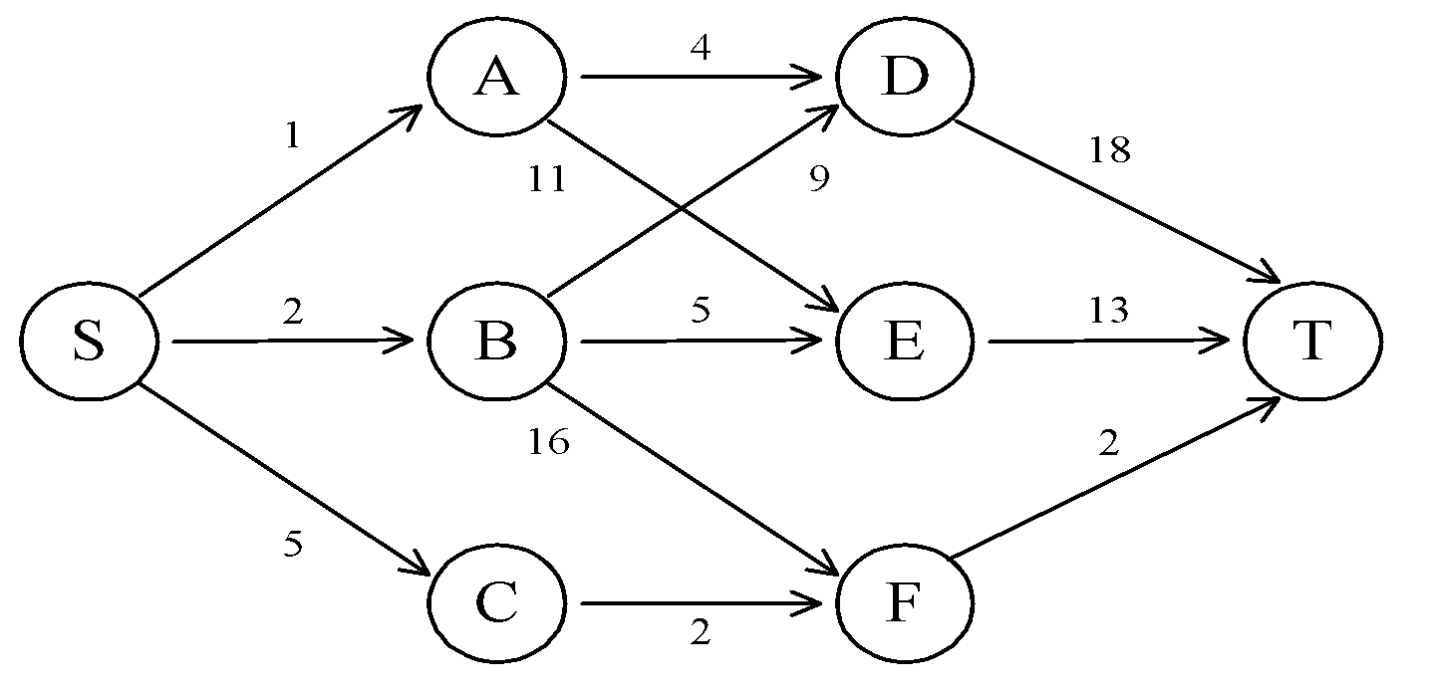
The shortest path in multistage graphs
e.g.
The greedy method can not be applied to this case: (S, A, D, T) 1+4+18 = 23.
The real shortest path is:
(S, C, F, T) 5+2+2 = 9.
Notes:
‹#›

Slide 29
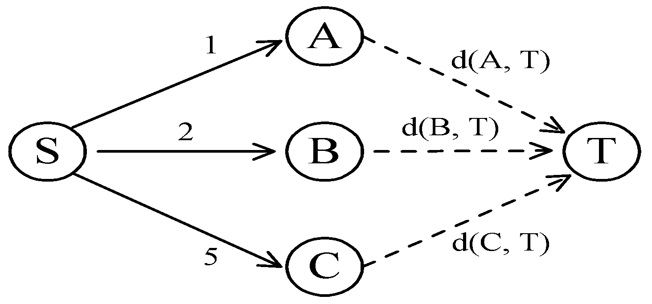
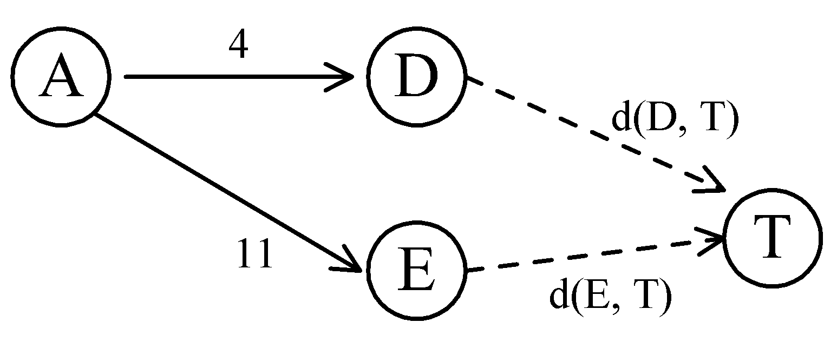
Dynamic programming
Dynamic programming approach (forward approach):
d(S, T) = min{1+d(A, T), 2+d(B, T), 5+d(C, T)}
d(A,T) = min{4+d(D,T), 11+d(E,T)}
= min{4+18, 11+13} = 22.
Notes:
‹#›

Slide 30
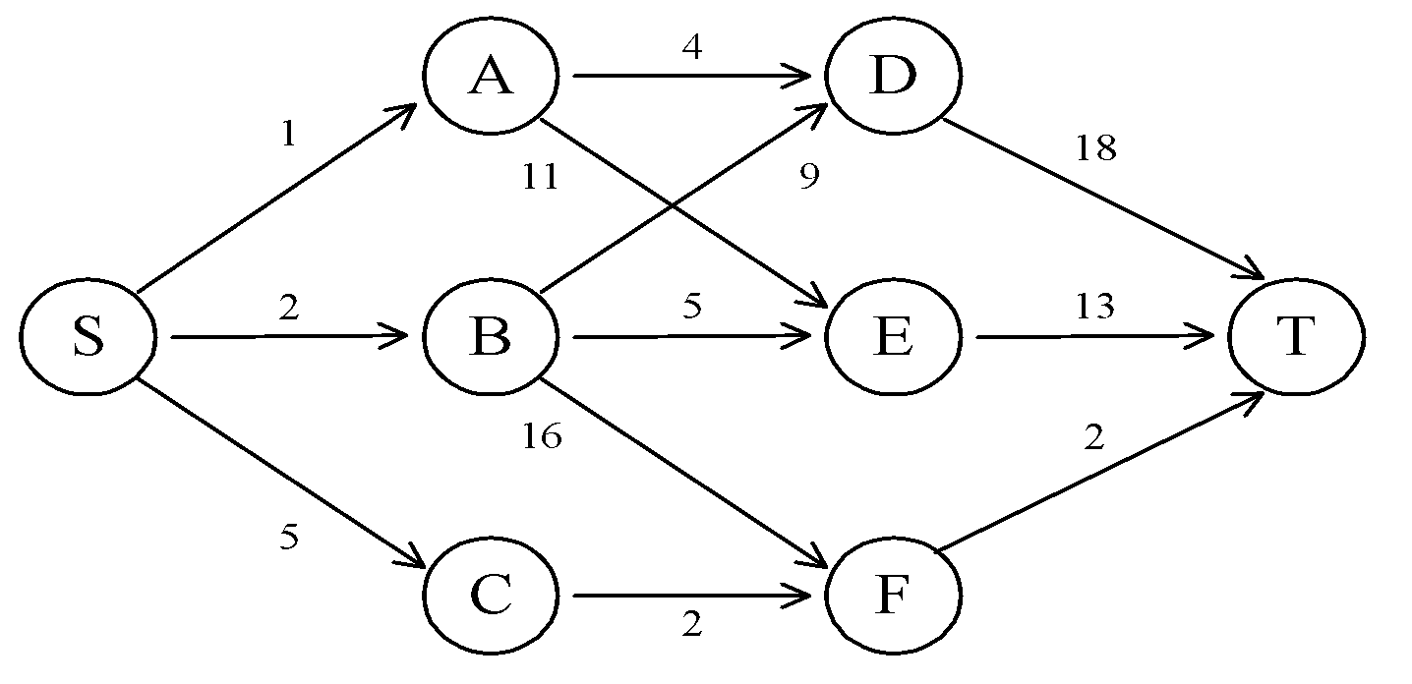
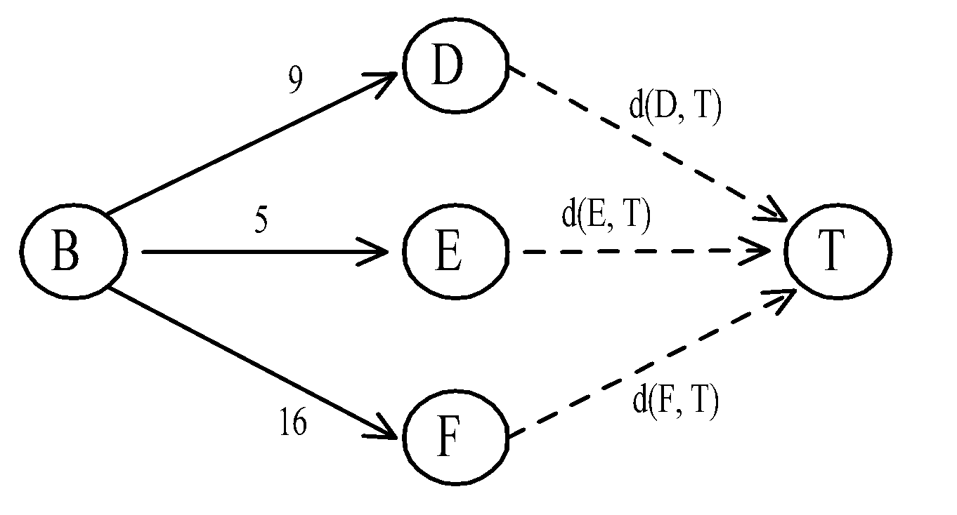
d(B, T) = min{9+d(D, T), 5+d(E, T), 16+d(F, T)}
= min{9+18, 5+13, 16+2} = 18.
d(C, T) = min{ 2+d(F, T) } = 2+2 = 4
d(S, T) = min{1+d(A, T), 2+d(B, T), 5+d(C, T)}
= min{1+22, 2+18, 5+4} = 9.
The above way of reasoning is called
backward reasoning.
Notes:
‹#›

Slide 31
Backtracking algorithms
Backtracking is an algorithmic technique for solving problems recursively by trying to build a solution incrementally, one piece at a time, removing those solutions that fail to satisfy the constraints of the problem at any point of time (by time, here, is referred to the time elapsed till reaching any level of the search tree).

Slide 32
Backtracking algorithms
For example, consider the SudoKo solving Problem, we try filling digits one by one. Whenever we find that current digit cannot lead to a solution, we remove it (backtrack) and try next digit. This is better than naive approach (generating all possible combinations of digits and then trying every combination one by one) as it drops a set of permutations whenever it backtracks.

Slide 33
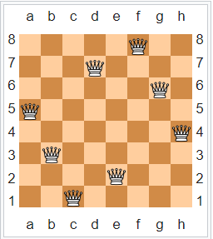
Backtracking algorithms
For example, classic 8-queen puzzle

Slide 34
References
https://www.hackerrank.com/domains/algorithms
Introduction to Algorithms, 3rd Edition (The MIT Press) 3rd Edition

