Slide 1
What Is An SDK?

Slide 2
Intro
Developer

Slide 3
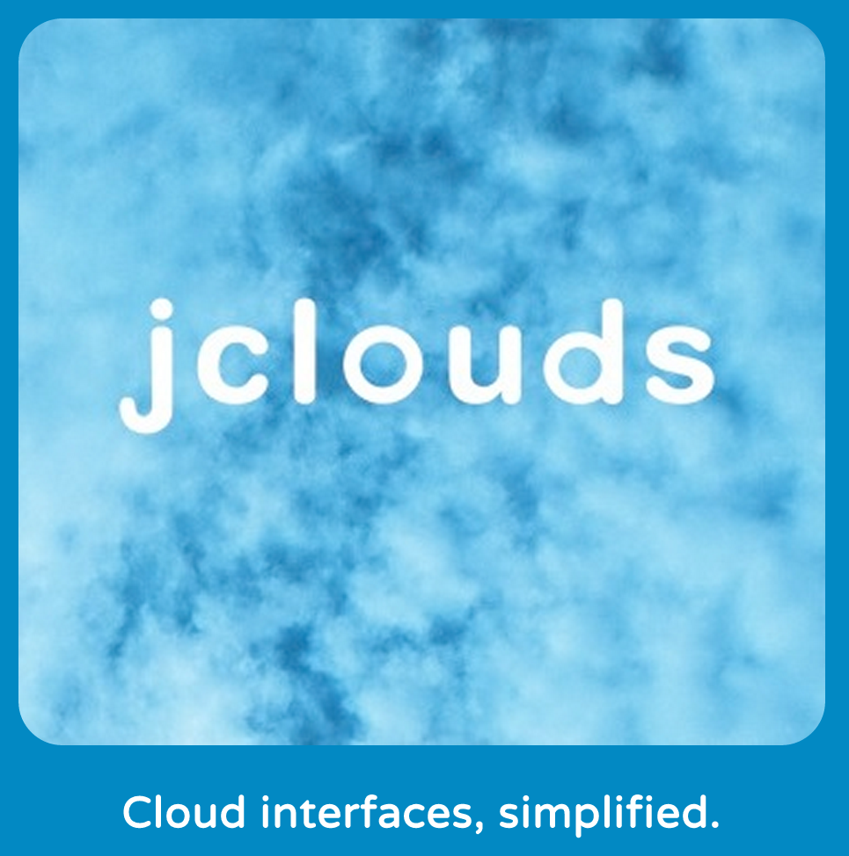
PMC and Committer on Apache jclouds

Slide 4
Intro
Advocate

Slide 5

Me

Slide 6
Intro
Operations

Slide 7
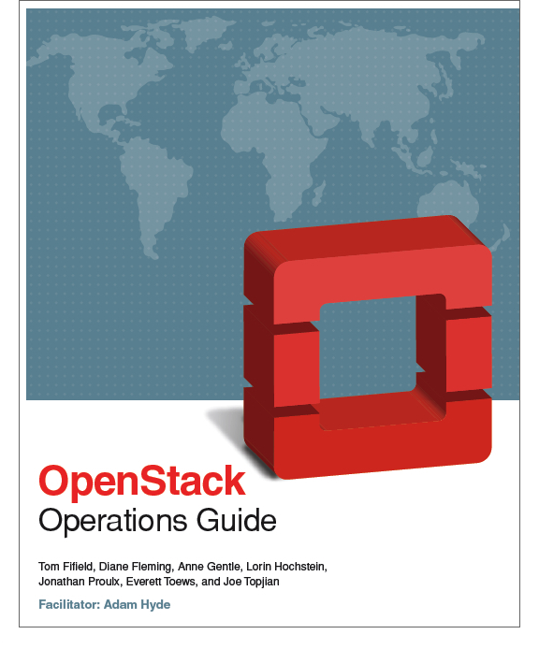
Co-author of The OpenStack Operations Guide
docs.openstack.org/ops

Slide 8
What
Software
Development
Kit

Slide 9
What
Language
Binding

Slide 10
What
Wrapper

Slide 11
Where Do SDKs Live?

Slide 12
Where
Infrastructure
with an API

Slide 13
Where
OpenStack
Your
System
AP I
User
System

Slide 14
Where
OpenStack
Your
System
AP I
User
System

Slide 15
Where
OpenStack
Your
System
AP I
SDK
User
System

Slide 16
Where
OpenStack
VM
VM
A
P
I
VM
VM
Your
System
SDK
User
System

Slide 17
Why Use an SDK?

Slide 18
Benefits
Deployed OpenStack

Slide 19
Benefits
Now What?

Slide 20
Benefits
Application
Development

Slide 21
Benefits
Request/Response

Slide 22
Benefits
(Re)Authentication

Slide 23
Benefits
Pagination

Slide 24
Benefits
State Polling

Slide 25
Benefits
Rate Limiting

Slide 26
Benefits
Retry

Slide 27
Benefits
Smoothing
Rough Edges

Slide 28
Benefits
Packaged

Slide 29
Benefits
Open Source

Slide 30
Benefits
Community

Slide 31
Benefits
All-in-One

Slide 32
Benefits
No lock-in

Slide 33
Benefits
Production Code

Slide 34
Benefits
Example Code

Slide 35
Benefits
Documentation

Slide 36
OpenStack SDK Criteria

Slide 37
Criteria
Language
Binding

Slide 38
Criteria
Getting Started
Guide

Slide 39
Criteria
Reference Doc

Slide 40
Criteria
Example Code

Slide 41
Criteria
Apache License v2
Compatible?

Slide 42
Criteria
wiki.openstack.org/wiki/SDKs

Slide 43
The OpenStack SDKs

Slide 44

OpenStack SDKs
jclouds

Slide 45

OpenStack SDKs
pkgcloud

Slide 46

OpenStack SDKs
php-opencloud

Slide 47

OpenStack SDKs
python-*client
pystack

Slide 48

OpenStack SDKs
fog

Slide 49

OpenStack SDKs
openstack.net

Slide 50

OpenStack SDKs
Upcoming: Gophercloud

Slide 51
OpenStack SDKs
developer.openstack.org

Slide 52
Tools

Slide 53
Tools
Chef

Slide 54
Tools
Puppet

Slide 55
Tools
Ansible

Slide 56
Tools
Vagrant

Slide 57
Tools
Jenkins

Slide 58
Tools
Whirr

Slide 59
Tools
BackWPup

Slide 60
Tools
Many More

Slide 61
Contribute

Slide 62
Contribute
Application
Developer
Expectations

Slide 63
Contribute
AWS
Java
Node.js
iOS
Android
PHP
Python
Ruby
.NET

Slide 64
Contribute
Microsoft
Java
Node.js
iOS
Android
PHP
Python
Ruby
.NET

Slide 65
Contribute
Google
Go
Java
Node.js
iOS/Android
PHP
Python
Ruby
.NET

Slide 66
Contribute
github.com/openstack

Slide 67
Contribute
github.com/openstack

Slide 68
Contribute
OpenStack Ecosystem

Slide 69
Contribute
Application
Developers

Slide 70
Contribute
Rackspace

Slide 71
Contribute
HP

Slide 72
Contribute
DreamHost

Slide 73
Contribute
IBM

Slide 74
Contribute
Canonical

Slide 75
Contribute
Red Hat

Slide 76
Contribute
Suse

Slide 77
Contribute
Application
Developers

