Slide 1
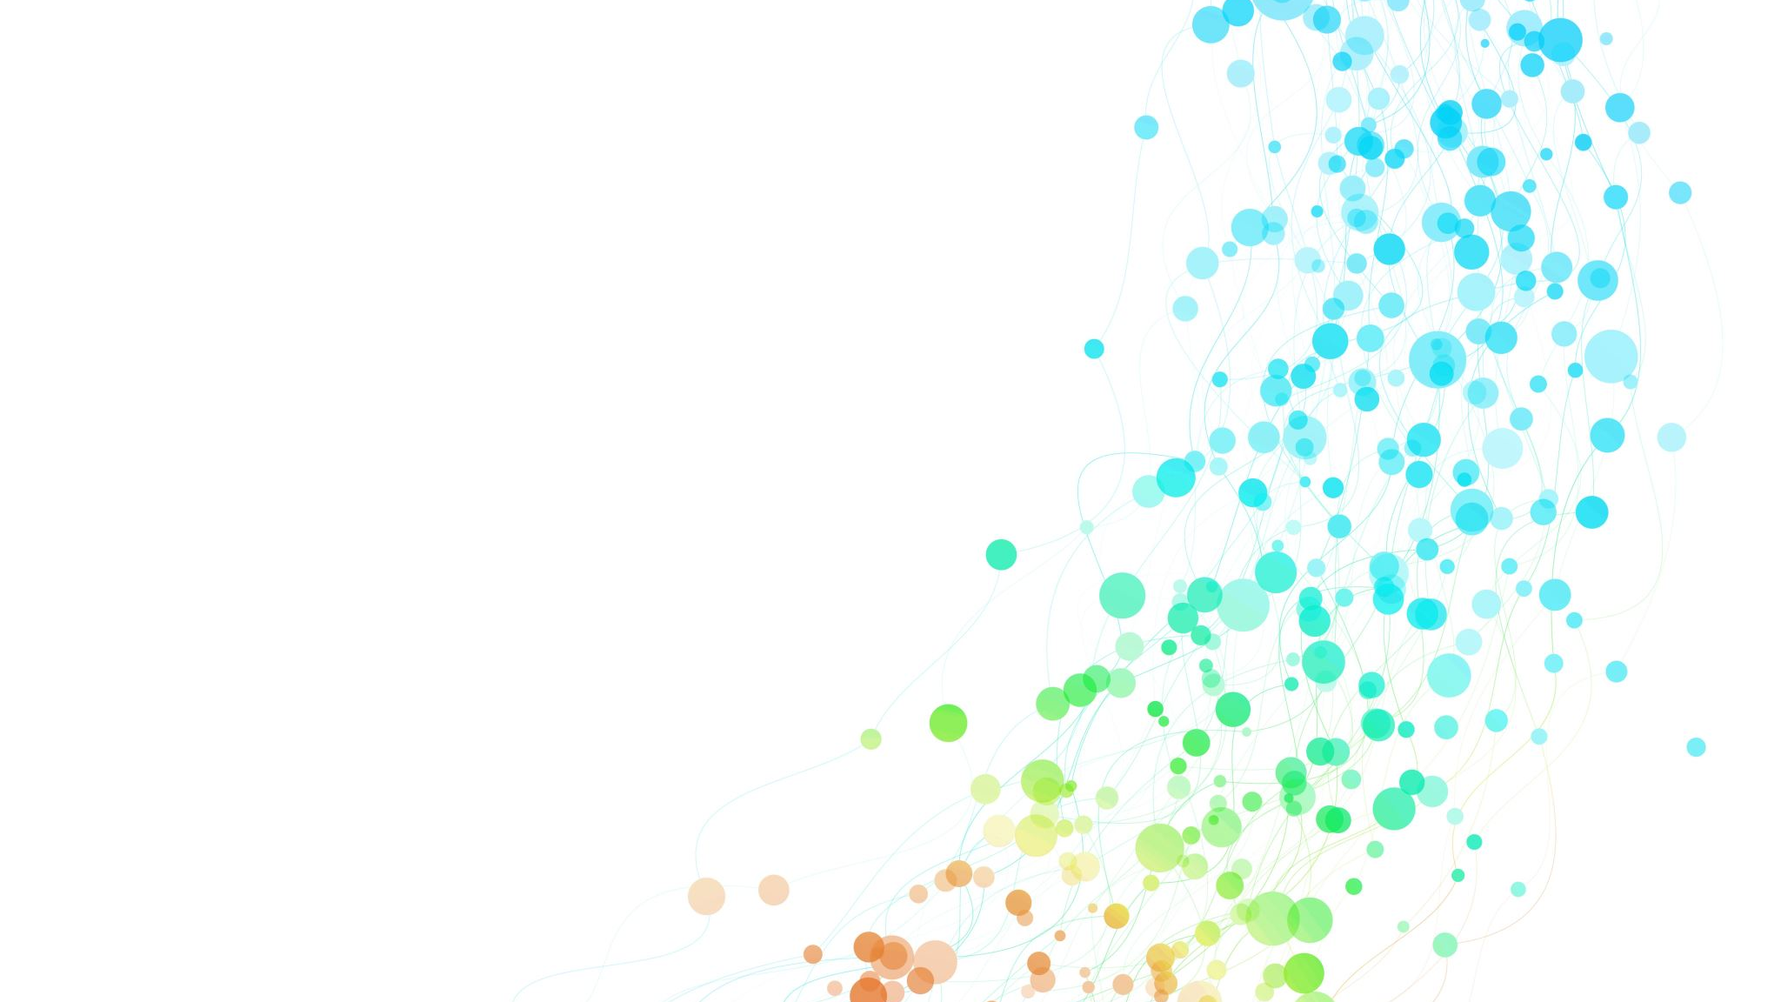
INFO 6105 Project Presentation
Group 17 :
L.K.Monisha Pulavarthy
Khushbu Singh

Slide 2

Zomato bangalore
Preprocessing, Data Cleaning, EDA & ML Models

Slide 3
Contents
Introduction
Dataset
Data Cleaning
EDA
Feature Engineering
ML Models
Conclusion

Slide 4
Introduction
We have chosen a dataset from Kaggle that contains information about multiple restaurants listed on Zomato in Bengaluru.
Zomato is a popular online food ordering platform in India.
Dataset link :
Zomato Bangalore Dataset

Slide 5
DATAset
51717
This dataset has 17 features(columns) and 51717 entries(rows)
Some of the columns that are important and analyzing the data are : ‘Name’,‘Online_Order’, ‘Ratings’, ‘Book_Table’, ‘Cuisines’, ‘Cost_for_two’, ‘Reviews_List’, ‘Votes’, ‘Listed_in(city)’, ‘Restaurant_Type’

Slide 6
Some rows from the dataset

Slide 7
Data cleaning
Cleaning 'online_order' and 'book_table' columns
These columns have ‘Yes’ and ‘No’ in their values.
Defined a function to replace Yes with ‘Y’ , No with ‘N’ and others with NaN, and applied the function to both the columns.
2. Cleaning the ‘rate’ column
Removed ‘/5’ from the Rate column. For example, if a rate is 4.1/5 the new cleaned value will be 4.1.
Also, converted this column to numeric.

Slide 8
DATA cleaning
3. Cleaning 'approx_cost(for two people)’ column
Removed commas ‘,’ from the column. As this column is a string, used a str.replace() function to achieve this.
Once the commas are removed from the whole column, then converted this to numeric datatype.

Slide 9
Data Cleaning
4. Cleaning 'location', 'rest_type', 'cuisines', and 'listed_in(type)’ columns
Grouped the top 10 values for each of these columns.
Defined a function to replace the missing values with NaN and applied the function to all the three columns.
5. Imputed missing values in 'online_order' and 'book_table' with the mode; and missing values in 'rate' and 'votes' with the median

Slide 10
DATA CLEANING
6. Dropped the unnecessary columns like 'phone’, 'dish_liked’, ‘url’, ‘address’.
7. Replaced the missing values in 'approx_cost(for two people)' with the median.
8. Renamed a few columns for better understanding. For example, ‘rate’ to ‘Ratings’; ‘listed_in(city)’ to ‘Area’ etc.

Slide 11
EDA
Using visualization and statistical techniques to explore the dataset, and identified:
Impact of location on success
Customer preferences
Trends in restaurant’s popularity etc.
Impact of having online ordering, and booking a table on the reviews

Slide 12
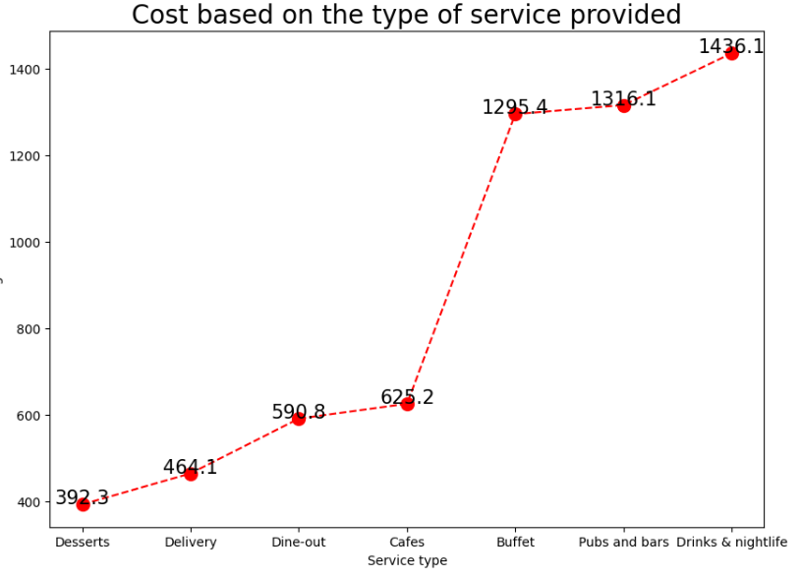
EDA
Average price for two people based on the type of restaurant.

Slide 13
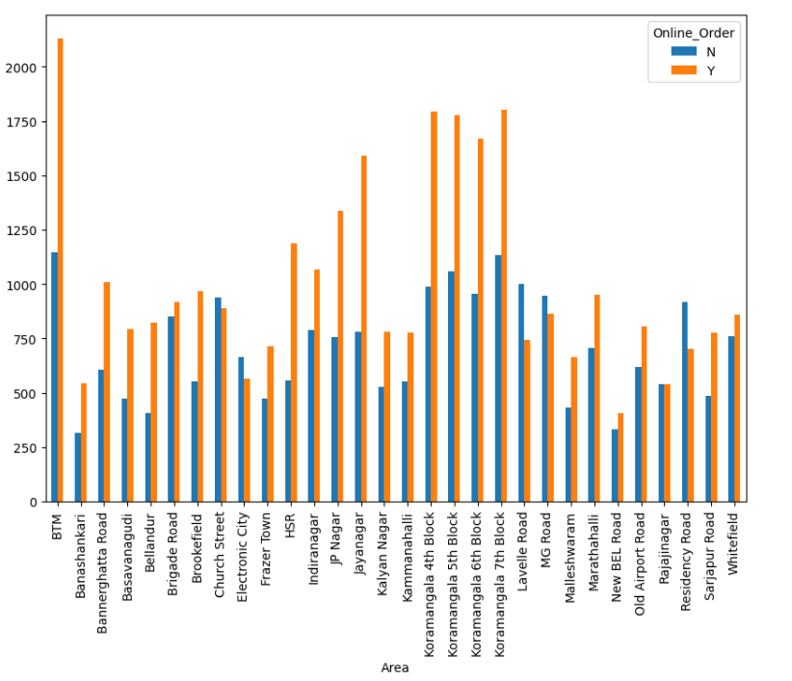
eda
Areas Vs Count of restaurants that accept online order.
We can see that BTM has the most number of restaurants that accept online ordering and Banashankari has least number of restaurants not taking online orders.

Slide 14
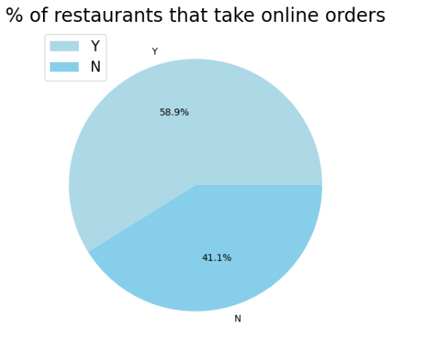
eda
Restaurants that accept online order Vs that do not

Slide 15
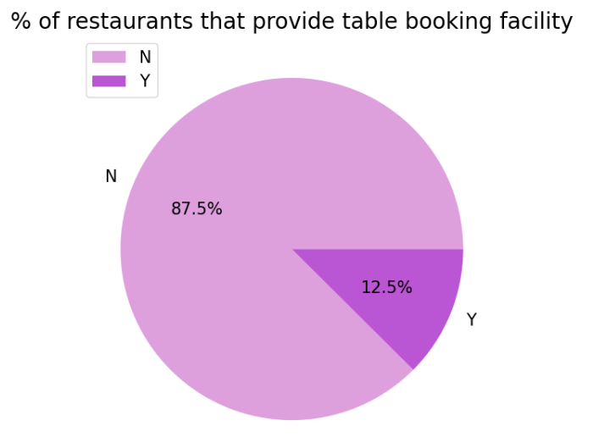
eda
Restaurant that accept booking a table Vs that do not.

Slide 16
Feature engineering
Created a new feature(column) called ‘expensive’ that indicates whether a given restaurant is considered expensive or not.
This is based on the ‘Cost_for_two’ column.
If a specific restaurant’s ‘cost_for_two’ is higher than the median of that whole column, then it is considered as expensive.

Slide 17
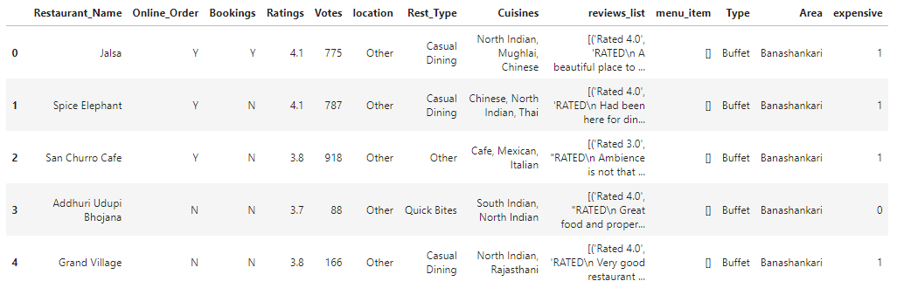
Feature engineering- expensive column

Slide 18
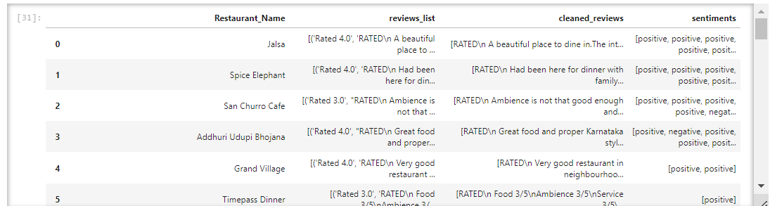
Sentiment analysis
Analyzed the column ‘reviews_list’ and based upon the each of the reviews of each restaurant, categorized them into ‘positive’ and ‘negative’.

Slide 19
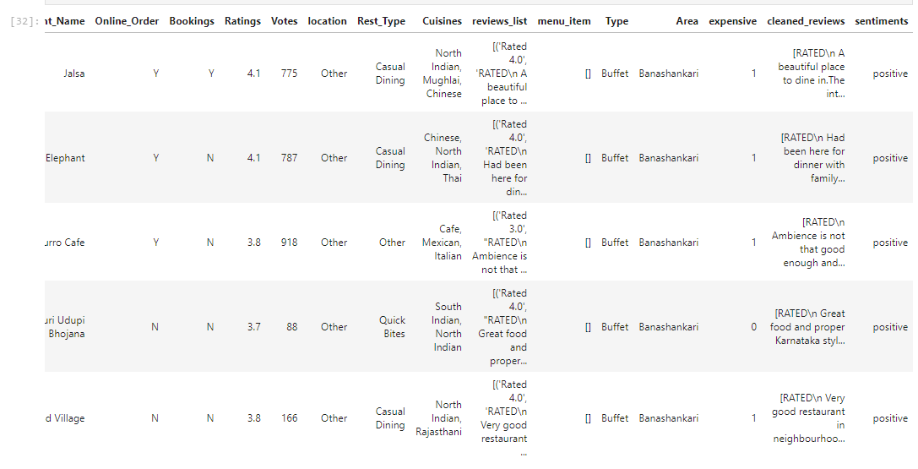
Sentiment analysis
Then, based upon the total number of ‘positive’s and ‘negative’s for each restaurant, handled the sentiments by calculating the average.

Slide 20
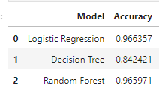
ML Models
Classification Model – If a restaurant is expensive or not
- Used Logistic Regression, Decision Tree Classifer and Random Forest models for this.

Slide 21
Ml models
After hyper-tuning the decision tree classifier parameters, the accuracy has drastically changed from 84% to 95%.

Slide 22
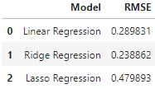
Ml models
Regression Analysis for Ratings Prediction
Used Linear, Ridge and Lasso regression for this.
Calculated RMSE from the cross_val_scores that returns the negative scores for error metrics.

Slide 23
Ml models
After tuning the hyper-parameters of Lasso Regression, it gave better RMSE score.
The RMSE has decreased from 0.479 to 0.296.

Slide 24
conclusion
Classification Models: Logistic regression performed the best in determining if a restaurant is expensive. Despite initially poor performance, tuning the decision tree classifier greatly improved its accuracy from 84% to 95%.
Regression Models: Ridge regression was the most effective for predicting restaurant ratings, as indicated by its lowest RMSE. The Lasso regression model initially had the highest RMSE, but after hyper-parameter tuning, its performance improved significantly, reducing the RMSE from 0.479 to 0.296.
These findings suggest that both model choice and hyper-parameter tuning are crucial in optimizing model performance for specific tasks in the dataset.

