Slide 1
Exploratory Data Analysis (ProductA)
Khushbu Patel

Slide 2

Steps involved in EDA
ANALYSE
VISUALIZE
DISCUSS
CONCLUDE
Know your data and analyse it using descriptive statistics
Visualize the data to obtain insights or interesting patterns
Discuss various trends and insights obtained from the visualization
Provide conclusion based on the EDA performed

Slide 3
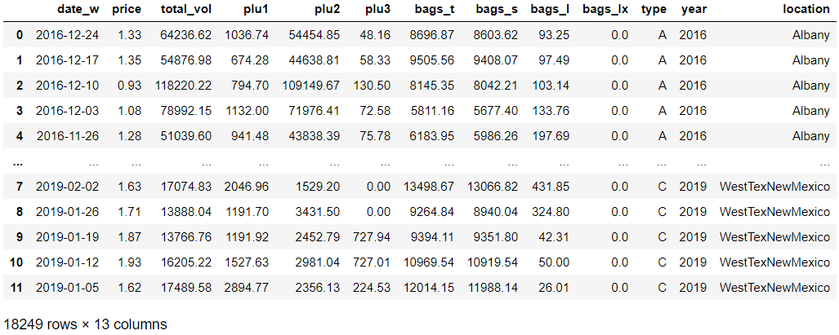
Know your data

Slide 4
Analysis
Product_a.csv contains sales data for 2 types of product (A and C) for 51 different locations of the United States over a time span of 4 years i.e. 2016-2019
It contains yearly data for years 2016 - 2018, whereas for year 2019 contains only first quarter sales data
Each location contains nearly ~340 observations where each observation represents weekly sales information
The data is highly right-skewed as for all the numeric fields the mean is greater than the median

Slide 5
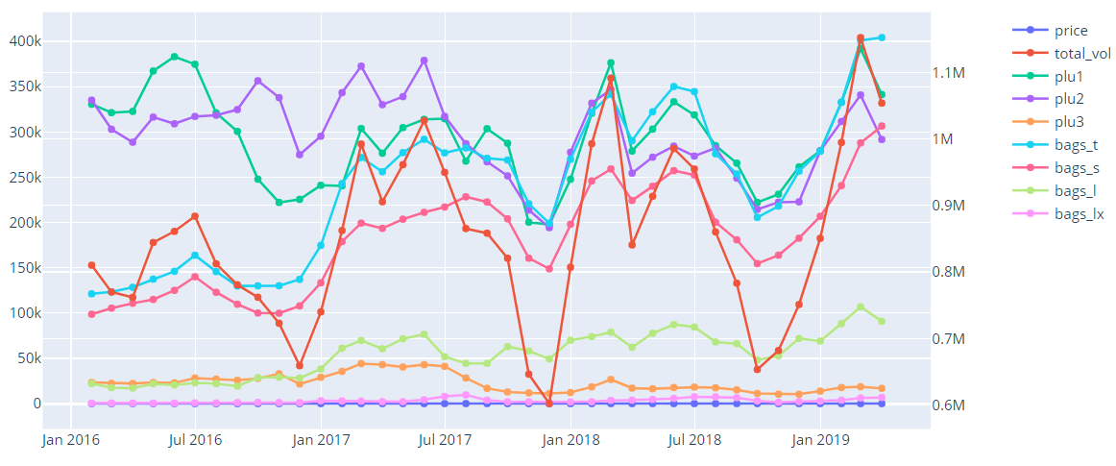
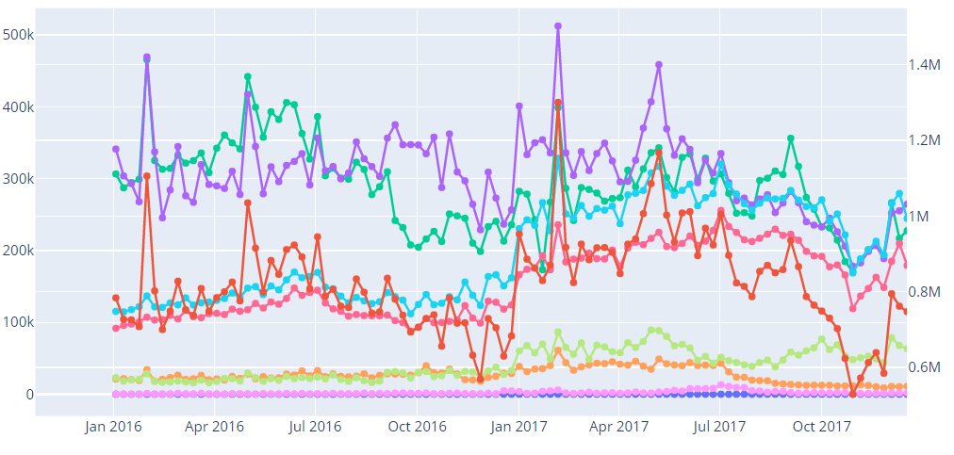
Monthly & Weekly Data
Monthly
From the monthly data we can see that the price and bags_lx values ranges in few hundreds, where as the remaining attributes have values ranging between 20k – 400k
Looking closely as weekly plot we can observer, total_vol column follows similar trend as that of plu2
total_vol can be obtained from plu1, plu2, plu3 and bags_t
Weekly

Slide 6
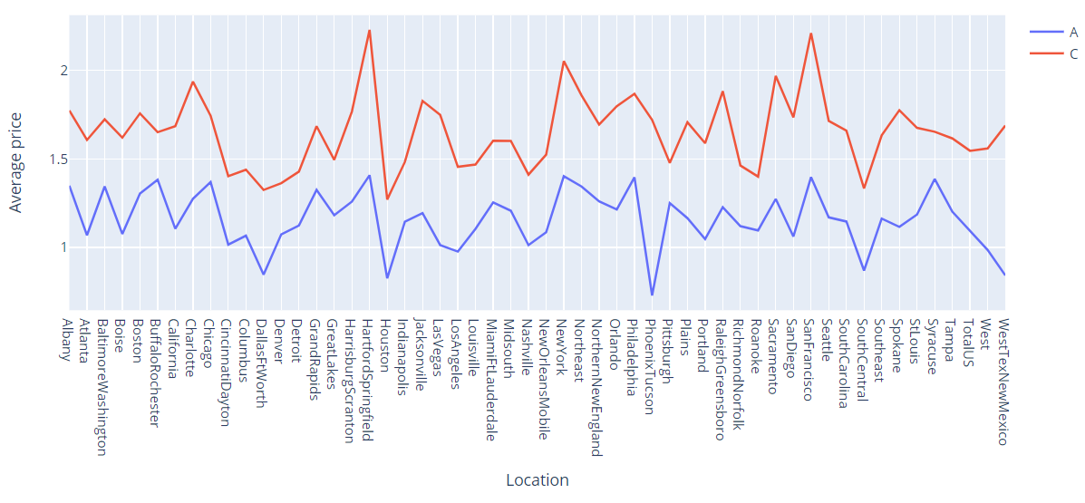
Price distribution
Average price of product A is higher as compared to that of product B
Major cities like Hartford Springfield, New York and San Francisco have the highest average price for both the products.
On contrary, Dallas Ft Worth, Houston and South central have the lowest average price

Slide 7
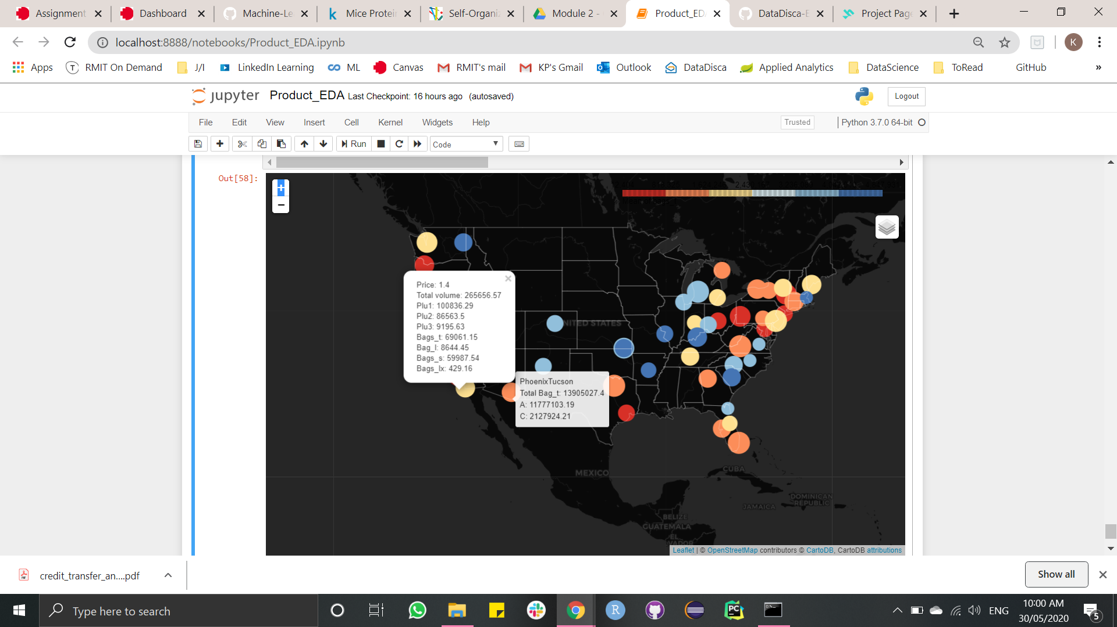
Map Visualization
Color range of markers display the mean values of bags_t
Tool tips show the total bags_t count grouped by product type
Pop up displays the average values for all the attributes
Highest sales are from the east regions
Central regions account for least no of sales

Slide 8
Thank You

